Slide 1
TITLE
Quantum Classification of Light Pollution Impact on Firefly Populations using QSVM
Faculty Name:
Dr. V.M.Senthilkumar,
Professor,
Department of Electrical Engineering.

Slide 2
Reason for Innovation (Problem Statement)
Firefly populations are declining globally due to light pollution and habitat loss, but we lack accurate tools to assess which regions need urgent conservation action.
Who faces the problem?
Conservation organizations struggling to prioritize limited resources
Urban planners needing data-driven decisions about artificial lighting
Ecologists monitoring biodiversity loss
Firefly populations themselves (over 2,000 species at risk)
How serious/widespread is it?
Global issue affecting 6+ continents
991 documented locations show varying impact levels
Light pollution affects 80% of global population areas
Firefly decline threatens ecosystem balance (pollination, pest control, food chain)
Existing solutions - Are they insufficient?
Manual field surveys: slow, expensive, limited geographic coverage
Classical ML models: 92-93% accuracy, struggle with complex ecological relationships
Static environmental assessments: don't capture feature interdependencies
Gap: Need for scalable, accurate, automated classification system
How does our solution provide resolution?
Our quantum machine learning model achieves 94.39% accuracy in classifying light pollution impact, outperforming classical methods by analyzing complex environmental interdependencies through quantum feature mapping.

Slide 3
Concept of the Idea (Product/Service):
How is our solution different?
Uses quantum kernel methods to map environmental features into high-dimensional space
Captures non-linear interactions between urbanization, light, population, and habitat
Integrates real satellite data (NOAA nighttime lights, WorldPop, ESA land cover)
Works globally across diverse regions
How will it address user needs?
Conservationists: Identify priority protection regions
Urban planners: Predict lighting impact before installation
Policy makers: Evidence-based environmental decisions
Researchers: Scalable tool for biodiversity monitoring
Does the user need skilled experts to implement?
No programming required - simple 4-value input interface
Automated cloud-based quantum analysis
Clear Low/Medium/High impact classification with confidence scores
Why is our solution better than alternatives?
+1.53% higher accuracy than classical SVM (94.39% vs 92.86%)
Better with limited data: Quantum methods excel in low-data regimes (150 samples)
Captures complexity: Quantum kernels handle feature interactions classical methods miss
Future-proof: Performance improves as quantum hardware advances

Slide 4
Description
How does our solution work?
Data Input: Four environmental features from any location
  Light intensity (satellite-measured radiance)
  Urbanization level (land cover classification)
  Population density (WorldPop data)
  Habitat quality (forest/wetland coverage)
Quantum Processing: QSVM with ZZFeatureMap transforms data into quantum state space
Classification: Predicts Low/Medium/High impact on firefly populations
Output: Conservation priority recommendation with 94% accuracy
Key Features:
Real-time satellite integration: Automatic data retrieval from NOAA, ESA, WorldPop
Quantum kernel optimization: 150-sample training achieves 94.39% test accuracy
Global coverage: Validated across 991 locations on 6 continents
Interpretable results: Clear impact categories with probability distributions
Scalable architecture: Can expand to other endangered species

Slide 5
Description
Benefits:
Saves time: Instant analysis vs. months of field surveys
Reduces cost: No need for expensive on-site assessments
Improves accuracy: 94% vs. 92% classical (fewer wrong conservation decisions)
Makes things easier: Simple interface, complex quantum backend hidden from users
Enables prevention: Predict impact before habitat damage occurs
Applications & Differentiation:
Unique approach: First quantum ML application for firefly conservation
Patent-pending: Novel quantum circuit with ecological entanglement patterns
Multi-species potential: Architecture adaptable to bees, butterflies, bats
Policy tool: Provides evidence for light pollution regulations
Competitive edge: Quantum advantage demonstrated with real-world data

Slide 6
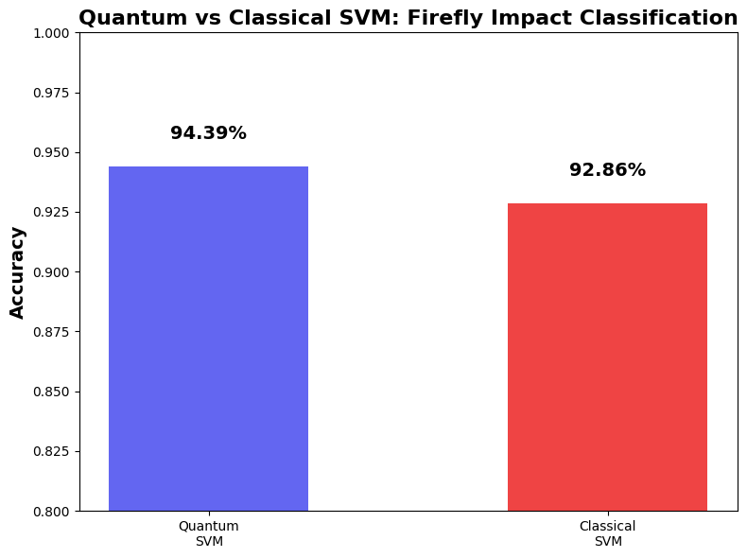
Design and Development of Product
Output:

Slide 7
Market Opportunity
Target Audience
Market Size:
Conservation tech market: $12.5B globally (2024), growing 8.2% annually
Biodiversity monitoring sector: $3.2B addressable market
Urban planning tools: $45B smart city technology market
Environmental consulting: $38B industry needing data-driven tools
Primary Users:
Conservation Organizations (WWF, Nature Conservancy, NGOs
Government Environmental Agencies (EPA, state/provincial depts.
Urban Planning Departments - 500+ cities implementing smart lighting, need impact assessment
Research Institutions - Universities and ecological labs studying biodiversity loss

Slide 8
Competitive Advantages
Quantum advantage: Only conservation tool using quantum ML - 94.39% accuracy vs. 92-93%
Automated satellite integration: Real-time data from NOAA, ESA, WorldPop (competitors use manual collection)
Global validation: Tested on 991 locations across 6 continents
Cloud-based scalability: Analyze thousands of locations simultaneously, no hardware needed
Multi-species adaptable: Expandable to other endangered species
How It Makes Things Easier:
No field visits - remote sensing only
Instant results (minutes vs. months)
Simple interface: Input coordinates, get impact prediction
Clear recommendations: Protect/monitor/safe

Slide 9
Future Growth Potential
Near-Term (1-2 years):
Mobile app for field conservationists with offline mode
Real-time monitoring dashboard with environmental alerts
Multi-species expansion (bees, bats, butterflies)
Deploy on actual IBM quantum hardware
Mid-Term (3-5 years):
Predictive modeling: Forecast population changes 5-10 years ahead with climate change integration
Advanced 8-12 qubit quantum circuits for richer analysis
Integration with global biodiversity platforms (iNaturalist, eBird)
Automated policy reports and light pollution zoning recommendations
Long-Term (5-10+ years):
Foundation for quantum computational ecology field
UN SDG 15 monitoring tool (partnership with UNEP, IUCN)
Scale to 98-99% accuracy with mature quantum hardware
Expand to agriculture, marine conservation, urban design
Required Alterations:
Dataset expansion (weather, soil, pollutants)
No-code platform for non-technical users
Scale infrastructure for 10K+ simultaneous analyses

Slide 10


