Slide 1
A Maximum Likelihood Approach to Extract Polylines from 2-D Laser Range Scans
Alexander Schaefer, Daniel Büscher, Lukas Luft, Wolfram Burgard

Slide 2
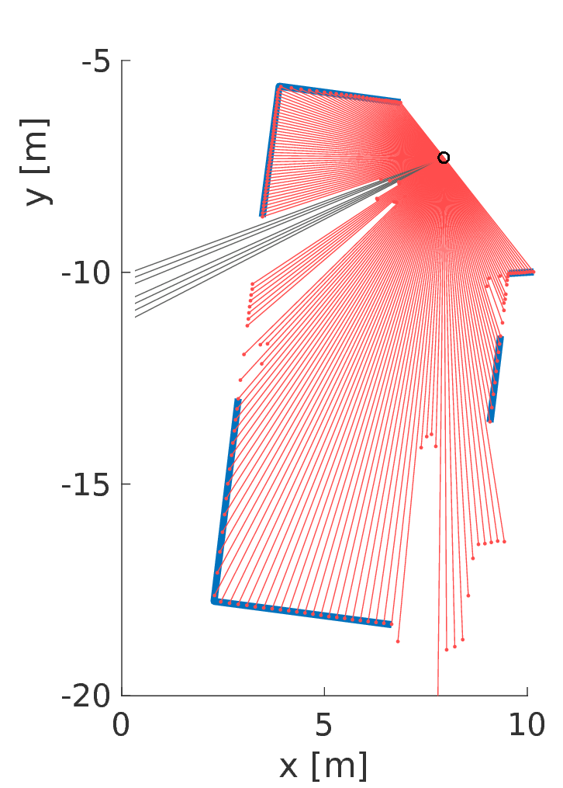
Motivation for line extraction
Man-made environments often consist of linear structures
We propose a probabilistic method to extract polylines from 2-D laser range scans
Key idea: maximize the meas. likelihood of a given scan with as few lines as possible
Two-step Probabilistic Line Extraction (PLE) algorithm:
Polyline Extraction
Polyline Optimization

Slide 3
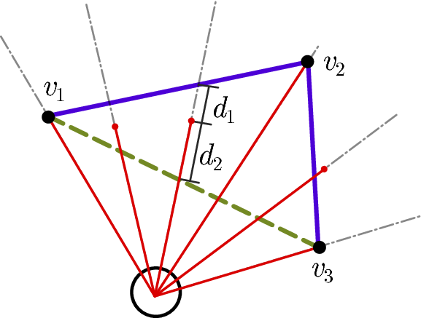

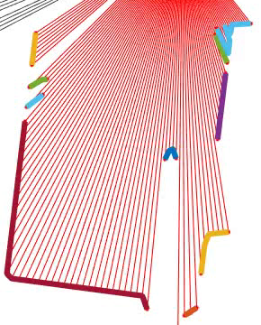
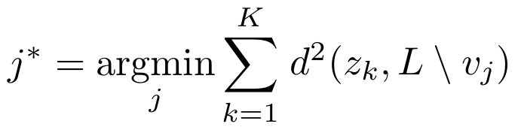

1. Polyline extraction
Start by connecting all neighboring scan endpoints
Very distant endpoints are not connected ( parameter)
Iteratively remove vertex j* such that the least error in meas. probability is induced
Also remove lines with few endpoints (set )
Stopping criteria: number of lines, error (increment), …
Notes:
First step: definition of the polyline topologies

Slide 4
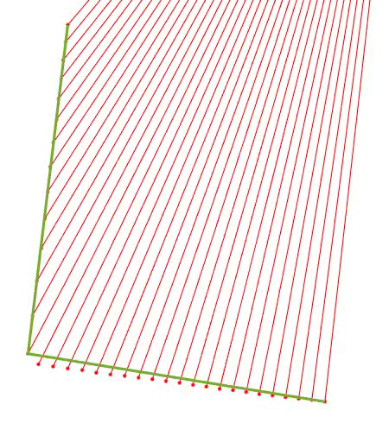
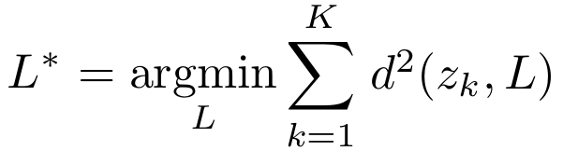
2. Polyline Optimization
Second step: optimize polyline vertex positions
Up to now, vertices positioned on ray endpoints (suboptimal)
Apply numerical optimization to further reduce meas. error
Endpoints of polylines allowed to move on the ray
Intermediate points move freely

Slide 5
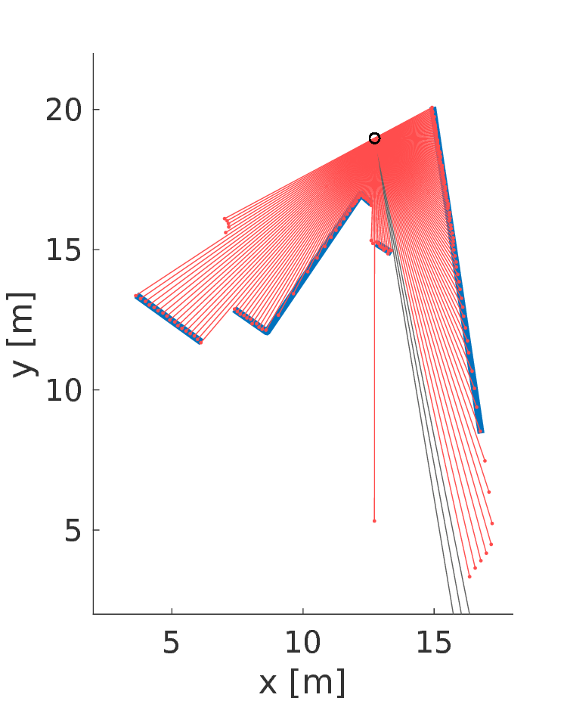
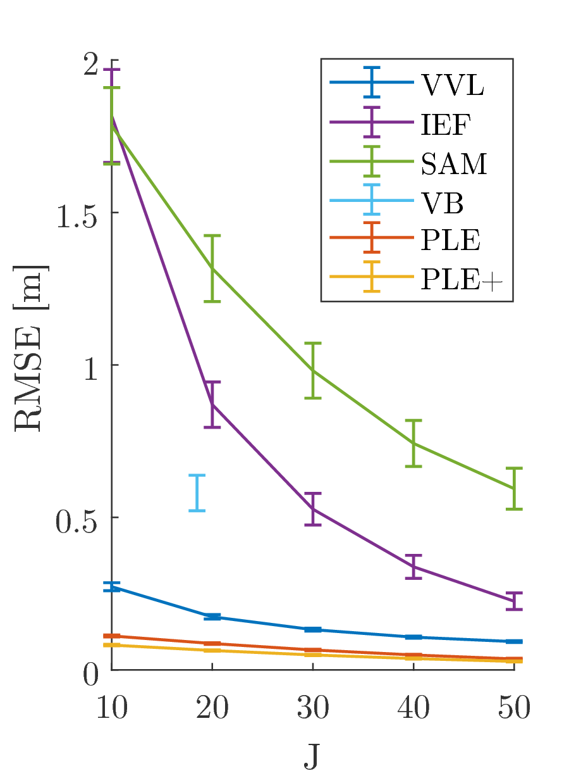
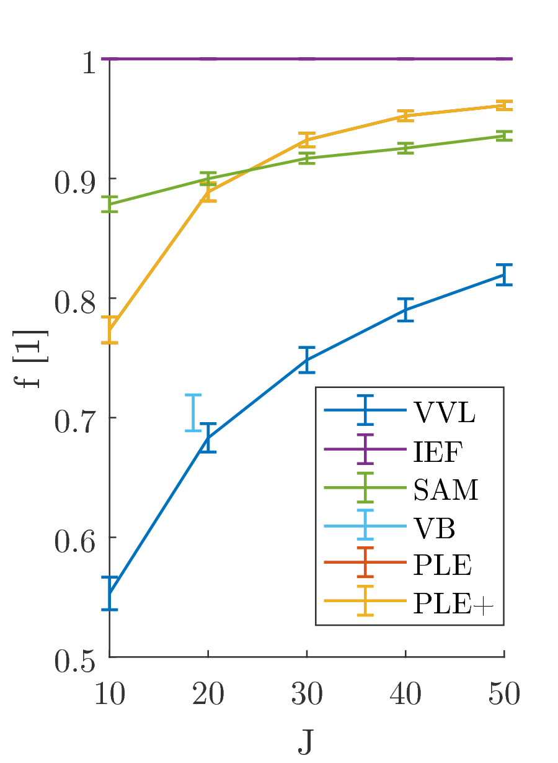
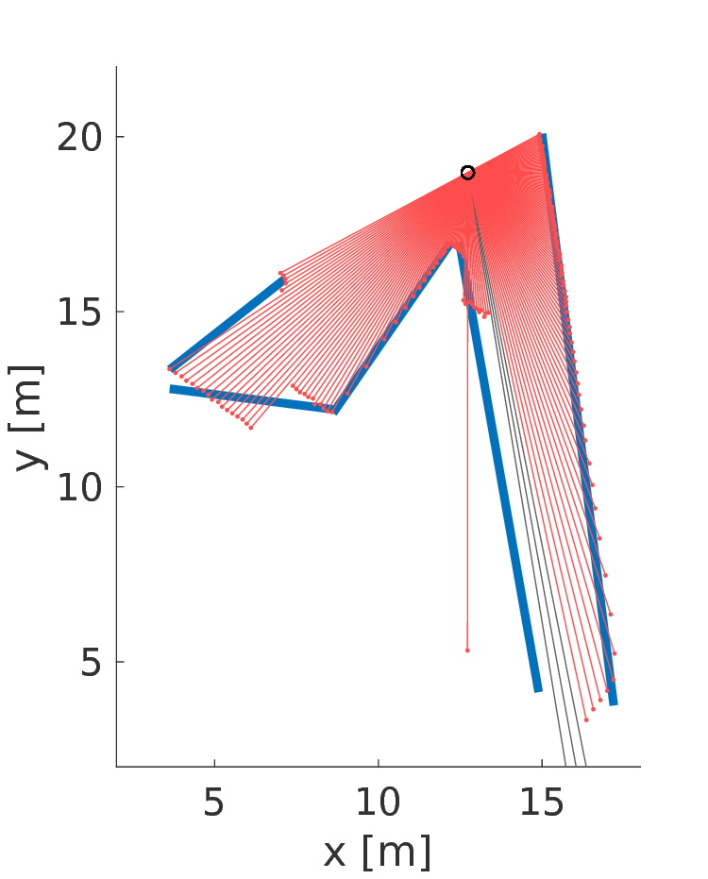
Results
PLE
Our PLE significantly outperforms other common algorithms
Evaluated on real and sim. data (RMSE, fraction reflected rays, …)
More details at the poster
Split-and-Merge
(SAM)

