Slide 1
Structure of Computer Systems
(Advanced Computer Architectures)
Course:
Gheorghe Sebestyen
Lab. works:
Anca Hangan
Madalin Neagu
Ioana Dobos

Slide 2
Objectives and content
design of computer components and systems
study of methods used for increasing the speed and the efficiently of computer systems
study of advanced computer architectures

Slide 3

Bibliography
Baruch, Z. F., Structure of Computer Systems, U.T.PRES, Cluj-Napoca, 2002
Baruch, Z. F., Structure of Computer Systems with Applications, U. T. PRES, Cluj-Napoca, 2003
Gorgan, G. Sebestyen, Proiectarea calculatoarelor, Editura Albastra, 2005
Gorgan, G. Sebestyen, Structura calculatoarelor, Editura Albastra, 2000
J. Hennessy , D. Patterson, Computer Architecture: A Quantitative Approach, 1-5th edition
D. Patterson, J. Hennessy, Computer Organization and Design: The Hardware/Software Interface, 1-3th edition
any book about computer architecture, microprocessors, microcontrollers or digital signal processors
Search: Intel Academic Community, Intel technologies (http://www.intel.com/technology/product/demos/index.htm), etc.
my web page: http://users.utcluj.ro/~sebestyen

Slide 4
Course Content
Factors that influence the performance of a computer systems, technological trends
Computer arithmetic – ALU design
CPU design strategies
  pipeline architectures, super-pipeline
  parallel architectures (multi-core, multiprocessor systems)
  RISC architectures
  microprocessors
Interconnection systems
Memory design
  ROM, SRAM, DRAM, SDRAM, etc.
  cache memory
  virtual memory
Technological trends

Slide 5
Performance features
execution time
reaction time to external events
memory capacity and speed
input/output facilities (interfaces)
development facilities
dimension and shape
predictability, safety and fault tolerance
costs: absolute and relative

Slide 6
Performance features
Execution time
  execution time of:
    operations – arithmetical operations
      e.g. multiply is 30-40 times slower than adding
      single or multiple clock periods
    instructions
      simple and complex instructions have different execution times
      average execution time = Σ t_{instruction}(i)*p_{instruction}(i)
        where p_{instruction}(i) – probability of instruction “i”
      dependable/predictable systems – with fixed execution time for instructions

Slide 7
Performance features
Execution time
  execution time of:
    procedures, tasks
      the time to solve a given function (e.g. sorting, printing, selection, i/o operations, context switch)
    transactions
      execution of a sequence of operations to update a database
    applications
      e.g. 3D rendering, simulation of fluids’ flow, computation of statistical data

Slide 8
Performance features
reaction time
  response time to a given event
  solutions:
    best effort – batch programming
    interactive systems – event driven systems
    real-time systems – worst case execution time (WCET) is guaranteed
      scheduling strategies for single or multi processor systems
  influences:
    execution time of interrupt routines or procedures
    context-switch time
    background execution of operating system’s threads

Slide 9
Performance features
memory capacity and speed:
  cache memory: SRAM, very high speed (<1ns), low capacity (1-8MB)
  internal memory: SRAM or DRAM, average speed (15-70ns), medium capacity (1-8GB)
  external memory (storage): HD, DVD, CD, Flash (1-10ms), very big capacity (0,5-12TB)
input/output facilities (interfaces):
  very divers or dedicated for a purpose
  input devices: keyboard, mouse, joystick, video camera, microphone, sensors/transducers
  output devices: printer, video, sound, actuators,
  input/output: storage devices
development facilities:
  OS services (e.g. display, communication, file system, etc.),
  programming and debugging frameworks,
  development kits (minimal hardware and software for building dedicated systems)

Slide 10
Performance features
dimension and shape
  supercomputers – minimal dimensional restrictions
  personal computers – desktop, laptop, tabletPC – some limitations
  mobile devices – “hand held devices” phones, medical devices
  dedicated systems – significant dimensional and shape related restrictions
predictability, safety and fault tolerance
  predictable execution time
  controllable quality and safety
  safety critical systems, industrial computers, medical devices
costs
  absolute or relative (cost/performance, cost/bit)
  cost restrictions for dedicated or embedded systems

Slide 11
Physical performance parameters
Clock signal’s frequency
  a good measure of performance for a long period of time
  depends on:
    the integration technology – the dimension of a transistor and path lengths
    supply voltage and relative distance between high and low states
  clock period = the time delay for the longest signal path
  = no_of_gates * delay_of_a_gate
  clock period grows with the complex CPUs
    RISC computers increase clock frequency by reducing the CPU complexity

Slide 12
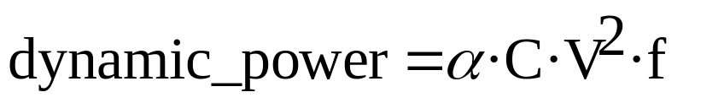
Physical performance parameters
Clock signal’s frequency
  we can compare computers with the same internal architecture
  for different architectures the clock frequency is less relevant
  after 60 years of steady grows in frequency, now the frequency is saturated to 2-3 GHz because of the power dissipation limitations
    where: α activation factor (0,1-1), C-capacitance, V-voltage, f-frequency
  increasing the clock frequency:
    technological improvement – smaller transistors, through better lithographic methods
    architectural improvement – simpler CPU, shorter signal paths

Slide 13
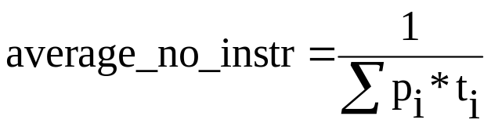
Physical performance parameters
Average instructions executed per second (IPS)
where p_{i} = probability of using instruction i
p_{i} = no_instr_{i} / total_no_instructions
    t_{i} – execution time of instruction i
  instruction types:
    short instructions (e.g. adding) – 1-5 clock cycles
    long instructions (e.g. multiply) – 100-120 clock cycles
    integer instructions
    floating point instructions (slower)
  measuring units: MIPS, MFlops, Tflops
  can compare computers with same or similar instruction sets
  not good for CISC v.s. RISC comparison
Type | Year | Freq. | MIPS
I4004 | 1971 | 0,74MHz | 0,09
I80286 | 1982 | 12 MHz | 2,66
I80486 | 1992 | 66MHz | 52
P III | 2000 | 600MHz | 2.054
Intel I7 | 2011 | 3.33GHz | 177.730

Slide 14
Physical performance parameters
Execution time of a program
  more realistic
  can compare computers with different architectures
  influenced by the operating system, communication and storage systems
  How to select a good program for comparison? (a good benchmark)
    real programs: compilers, coding/decoding, zip/unzip
    significant parts of a real program: OS kernel modules, mathematical libraries, graphical processing functions
    synthetic programs: combination of instructions in a percentage typical for a group of applications (with no real outcome):
      Dhrystone – combination of integer instructions
      Whetstone – contains floating point instructions too
  issues with benchmarks:
    processor architectures optimized for benchmarks
    compilation optimization techniques eliminate useless instructions

Slide 15
Physical performance parameters
Other metrics:
  number of transactions per second
    in case of databases or server systems
    number of concurrent accesses to a database or warehouse
    operations: read-modify-write, communication, access to external memory
    describes the whole computer system not only the CPU
  communication bandwidth
    number of Mbytes transmitted per second
    total bandwidths or useful/usable bandwidth
  context switch time
    for embedded and real-time systems
    example: EEMBC – EDN embedded microprocessor benchmark consortium

Slide 16
Principles for performance improvement
Moor’s Law
Ahmdal’s Law
Locality: time and space
Parallel execution

Slide 17
Principles for performance improvement
Moor’s Law (1965, Gordon Moor*) - “the number of transistors on integrated circuits doubles approximately every two years”
18 months law (David House, Intel) – “the performance of a computer is doubled every 18 month” (1,5 year), as a result of more transistors and faster ones

Slide 18
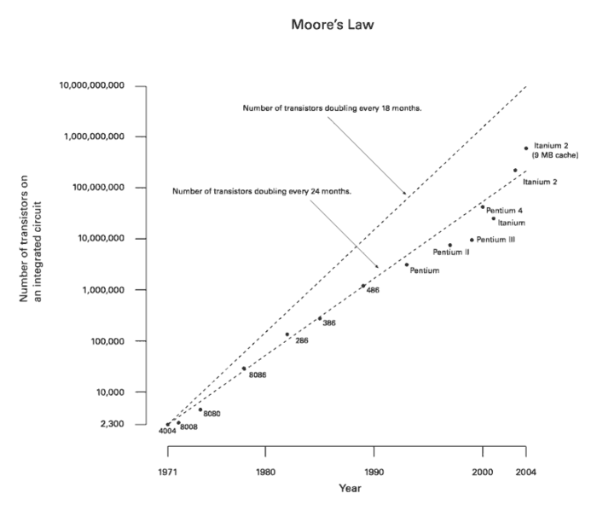
Moor’s law
Pentium 4
Pentium
‘486
‘386
‘286
8086
8080
4004

Slide 19
Principles for performance improvement
Semiconductor manufacturing_x000b_processes (source wikipedia)
10 µm — 1971 3 µm — 1975 1.5 µm — 1982 1 µm — 1985 800 nm . 1989 600 nm 1994 350 nm 1995 250 nm 1998 180 nm 1999 130 nm 2000 90 nm — 2002 65 nm — 2006 45 nm — 2008 32 nm — 2010 22 nm — 2012 14 nm — approx. 2014 10 nm — approx. 2016 7 nm — approx. 2018 5 nm — approx. 2020
Moor’s law (cont.)
  the grows will continue but not for long !!! (2013-2018)
  now the doubling period is 3 years
  Intel predicts a limitation to 16 nanometer technology (read more on Wikipedia)
Other similar grows:
  clock frequency – saturated 3-4 years ago
  capacity of internal memories (DRAMs)
  capacity of external memories (HD, DVD)
  number of pixels for image and video devices

Slide 20
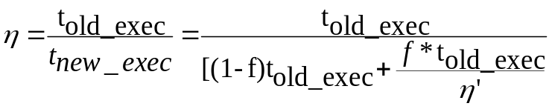

Principles for performance improvement
Precursors:
    90/10 principle: 90% of the time the processor executes 10% of the code
    principle: “make the common case fast”
    invest more in those parts that counts more
Amdahl’s law
  How to measure the impact of a new technology?
  speedup – η – how many times the execution is faster
where: η’ - the speedup of the new component
f - the fraction of the program that benefit from the improvement
  Consequence: the speedup is limited by the Amdahl’s law
Numerical example:
f = 0,1; η’=2 => η = 1,052 (5% grows)
f= 0,1 ; η’=∞ => η = 1,111 (11% grows)
Old time New time

Slide 21
Principles for performance improvement
Locality principles
  Time locality
    “if a memory location is accessed than it has a high probability of being accessed in the near future”
    explanations:
      execution of instructions in a loop
      a variable is used for a number of times in a program sequence
    consequence:
      good practice: bring the newly accessed memory location closer to the processor for a better access time in case of a next access => justification of cache memories

Slide 22
Principles for performance improvement
Locality principles
  Space locality
    “if a memory location is accessed than its neighbor locations have a high probability of being accessed in the near future”
    explanations:
      execution of instructions in a loop
      consecutive access to the elements of a data structure (vector, matrix, record, list, etc.)
    consequence:
      good practice:
        bring the location’s neighbors closer to the processor for a better access time in case of a next access => justification of cache memories
        transfer blocks of data instead of single locations; block transfer on DRAMs is much faster

Slide 23
Principles for performance improvement
Parallel execution principle
  “when the technology limits the speed increase a further improvement may be obtained through parallel execution”
  parallel execution levels:
    data level – multiple ALUs
    instruction level – pipeline architectures, super-pipeline and superscalar, wide instruction set computers
    thread level – multi-cores, multiprocessor systems
    application level – distributed systems, Grid and cloud systems
  parallel execution is one of the explanations for the speedup of the latest processors (look at the table at slide 11)

Slide 24
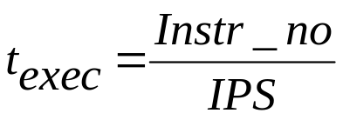
Improving the CPU performance
Execution time – the measure of the CPU performance
where: IPS – instructions per second
CPI – cycles per instruction
T_{clk}, f_{clk} – clock signal’s period and frequency
Goal – reduce the execution time in order to have a better CPU performance
Solution – influence (reduce or increase) the parameters in the above formulas in order to reduce the execution time

Slide 25
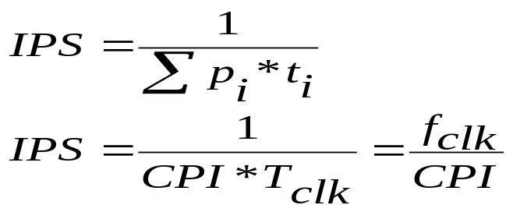
Improving the CPU performance
Solutions: increase the number of instructions per second
    How to do it ?
      reduce the duration of instructions
      reduce the frequency (probability) of long and complex instructions (e.g. replace multiply operations)
      reduce the clock period and increase the frequency
      reduce CPI
    external factors that may influence IPS:
      access time to instruction code and data may influence drastically the execution time of an instruction
      example: for the same instruction type (e.g. adding):
        < 1ns for instruction and data in the cache memory
        15-70 ns for instruction and data in the main memory
        1-10 ms for instruction and data in the virtual (HD) memory
External view
Architectural view

Slide 26
Improving the CPU performance
Solutions: reduce the number of instructions
  Instr_no – number of instructions executed by the CPU during an application execution
    improve algorithms,
    reduce the complexity of the algorithm,
    more powerful instructions: multiple operations during a single instruction
      parallel ALUs, SIMD architectures, string operations
    Instr_no = op_no / op_per_instr
    op_no – number of elementary operations required to solve a given problem (application)
    op_per_instr – number of operations executed in a single instruction (average value)
    increasing the op_per_instr may increase the CPI (next parameter in the formula)

Slide 27
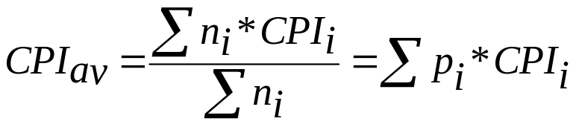
Improving the CPU performance
Solutions (cont.): reduce CPI
  CPI – cycles per instruction – number of clock periods needed to execute an instruction
    instructions have variable CPIs; an average value is needed
    where: n_{i} – number of instructions of type “i” in the analyzed program sequence
    CPI_{i} – CPI for instruction of type ”i”
    methods to reduce the CPI:
      pipeline execution of instructions => CPI close to 1
      superscalar, superpipeline => CPI є (0.25 – 1)
      simplify the CPU and the instructions – RISC architecture

Slide 28
Improving the CPU performance
Solutions (cont.): reduce the clock signal’s period or increase the frequency
  T_{clk} – the period of the clock signal or
  f_{clk} – the frequency of the clock signal
  Methods:
    reduce the dimension of a switching element and increase the integration ratio
    reduce the operating voltage
    reduce the length of the longest path – simplify the CPU architecture
Vcc
Δt’
Δt

Slide 29
Conclusions
ways of increasing the speed of the processors:
  less instructions
  smaller CPI – simpler instructions
  parallel execution at different levels
  higher clock frequency

