Slide 1
Structure of Computer Systems
Course 11
Parallel computer architectures

Slide 2
Motivations
Why parallel execution?
  users want faster-and-faster computers - why?
    advanced multimedia processing
    scientific computing: physics, info-biology (e.g. DNA analysis), medicine, chemistry, earth sciences)
    implementation of heavy-load servers: multimedia provisioning
    why not !!!!
  performance improvement through clock frequency increase is no longer possible
    power dissipation issues limit the clock signal’s frequency to 2-3GHz
  continue to maintain the Moor’s Law regarding performance increase through parallelization

Slide 3
How ?
Parallelization principle:
  “if one processor cannot make a computation (execute an application) in a reasonable time more processors should be involved in the computation”
  similar, as in the case of human activities
  some parts or whole computer systems can work simultaneously:
    multiple ALUs
    multiple instruction executing units
    multiple CPU-s
    multiple computer systems

Slide 4
Flynn’s taxonomy
Classification of computer systems
  Michael Flynn – 1966
    Classification based on the presence of single or multiple streams of instructions and data
  Instruction stream: a sequence instructions executed by a processor
  Data stream: a sequence of data required by an instruction stream

Slide 5
Flynn’s taxonomy
 | Single instruction stream | Multiple instruction streams
Single data stream | SISD – Single Instruction Single Data | MISD – Multiple Instruction Single Data
Multiple data streams | SIMD – Single Instruction Multiple Data | MIMD – Multiple Instruction Multiple Data

Slide 6
Flynn’s taxonomy
SD
MD
P
SI
C
P
M
.
C
.
I
D
.
M
SISD
P
SIMD
C
P
C
P
MI
C
P
M
.
.
.
.
.
.
.
.
.
.
.
M
.
C
P
C
P
MISD
MIMD
C – control unit
P – processing unit (ALU)
M - memory

Slide 7
Flynn’s taxonomy
SISD – Single instruction flow and single data flow
  not a parallel architecture
  sequential processing – one instruction and one data at a time
SIMD – Single instruction flow and multiple data flow
  data-level parallelism
  architectures with multiple ALUs
  one instruction processes multiple data
  process multiple data flows in parallel
  useful in case of vectors, matrices – regular data structures
  not useful for database applications

Slide 8
Flynn’s taxonomy
MISD – Multiple instruction flows and single data flow
  two view:
    there is no such a computer
    pipeline architectures may be considered in this class
  instruction level parallelism
  superscalar architectures – sequential from outside, parallel inside
MIMD – Multiple instruction flows and multiple data flows
  true parallel architectures
    multi-cores
    multiprocessor systems: parallel and distributed systems

Slide 9
Issues regarding parallel execution
subjective issues (which depends on us):
  human thinking is mainly sequential – hard to imagine doing thinks in parallel
  hard to divide a problem in parts that can be executed simultaneously
    multitasking, multi-threading
    some problems/applications are inherently parallel (e.g. if data is organized on vectors, if there are loops in the program, etc.)
    how to divide a problem between 100 -1000 parallel units
  hard to predict consequences of parallel execution
    e.g. concurrent access to shared resources
    writing multi-thread-safe applications

Slide 10
Issues regarding parallel execution
objective issues
  efficient access to shared resources
    shared memory
    shared data paths (buses)
    shared I/O facilities
  efficient communication between intelligent parts
    interconnection networks, multiple buses, pipes, shared memory zones
  synchronization and mutual exclusion
    causal dependencies
    consecutive start and end of tasks
  data-race and I/O-race

Slide 11
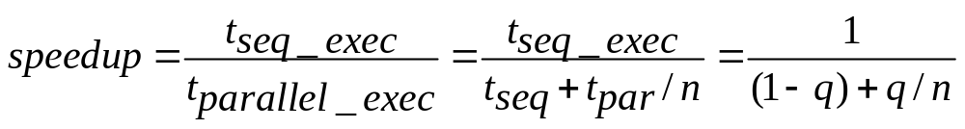
Amdahl’s Law for parallel execution
Speedup limitation caused by the sequential part of an application
  an application = parts executed sequentially + parts executable in parallel
where:
q – fraction of total time in which the application can be executed in parallel; 0<f<=1
(1-q) – fraction of total time in which application is executed sequentially
n – number of processors involved in the execution (degree of parallel execution )

Slide 12
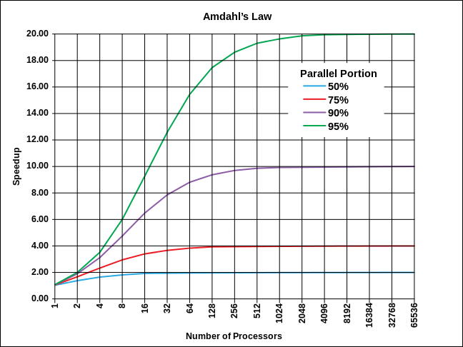
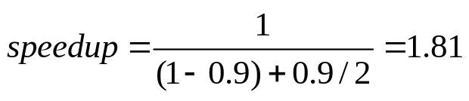
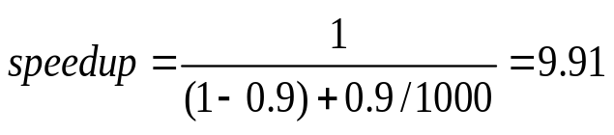
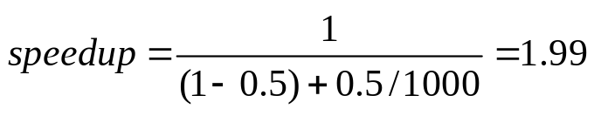
Amdahl’s Law for parallel execution
Examples:
  f = 0.9 (90%); n=2
  f = 0.9 (90%); n=1000
  f = 0.5 (50%); n=1000

Slide 13
Parallel architectures
Data level parallelism (DLP)
  SIMD architectures
  use of multiple parallel ALUs
  it is efficient if the same operation must be performed on all the elements of a vector or matrix
  example of applications that can benefit:
    signal processing, image processing
    graphical rendering and simulation
    scientific computations with vectors and matrices
  versions:
    vector architectures
    systolic array
    neural architectures
  examples:
    Pentium II – MMX and SSE2

Slide 14
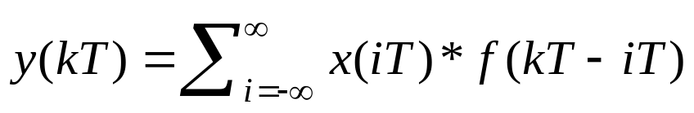
MMX module
destined for multimedia processing
  MMX = Multimedia Extension
used for vector computations
  adding, subtraction, multiply, division , AND, OR, NOT
  one instruction can process 1 to 8 data in parallel
  scalar product of 2 vectors – convolution of 2 functions
    implementation of digital filters (e.g. image processing)
x(0) x(1) x(2) x(3) x(4) x(5) x(6) x(7)
* * * * * * * *
f(0) f(1) f(2) f(3) f(4) f(5) f(6) f(7)
Σx(i)*f(i) i=0..3 i=4..8

Slide 15
Systolic array
Input flows
systolic array = piped network of simple processing units (cells);
  all cells are synchronized – make one processing step simultaneously
  multiple data-flows cross the array, similarly with the way blood is pumped by the heart in the arteries and organs (systolic behavior)
  dedicated for fast computation of a given complex operation
    product of matrices
    evaluation of a polynomial
    multiple steps of an image processing chain
  it is a data-stream-driven processing, in opposition to the traditional (von Neumann) instruction-stream processing
Input flows
Output flows
Output flows

Slide 16
Systolic array
Example: matrix multiplication
  each cell in each step makes a multiply-and-accumulate operation
  at the end each cell contains one element of the resulting matrix
b2,2
b2,1 b1,2
b2,0 b1,1 b0,2
b1,0 b0,1
b0,0
a0,2 a0,1 a0,0
a0,0*b0,0+ a0,1*b1,0+ ...
a0,1
a0,0*b0,1+ ..
a0,0
b1,0
b0,1
a1,2 a1,1 a1,0
b0,0
a2,2 a2,1 a2,0

Slide 17
Parallel architectures
Instruction level parallelism (ILP)
  MISD – multiple instruction single data
  types:
    pipeline architectures
    VLIW – very large instruction word
    superscalar and super-pipeline architectures
Pipeline architectures – multiple instruction stages performed by specialized units in parallel:
    instruction fetch
    instruction decode and data fetch
    instruction execution
    memory operation
    write back the result
  issues – hazards
    data hazard – data dependency between consecutive instructions
    control hazard – jump instructions’ unpredictability
    structural hazard – same structural element used by different stages of consecutive instructions
  see course no. 4 and 5

Slide 18
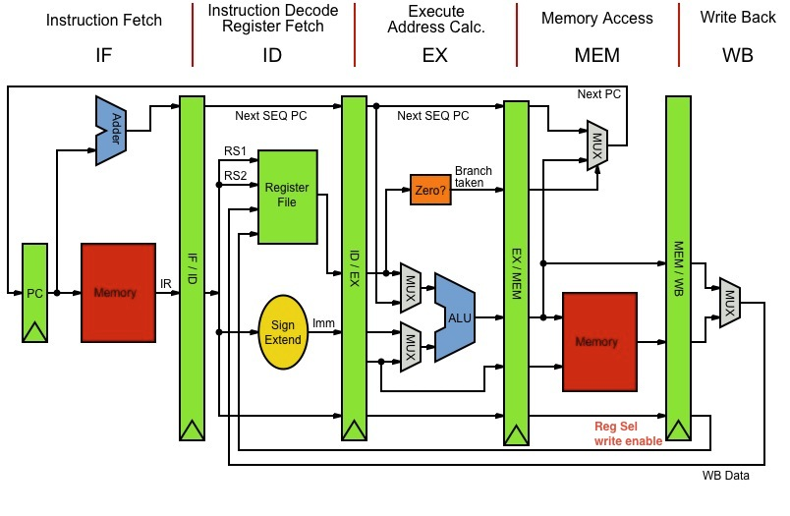
Pipeline architecture
The MIPS pipeline

Slide 19
Parallel architectures
Instruction level parallelism (ILP)
VLIW – very large instruction word
  idea –a number of simple instructions (operations) are formatted into in a very large (super) instruction (called bundle)
    it will be read and executed as a single instruction, but with some parallel operations
    operations are grouped in a wide instruction code only if they can be executed in parallel
    usually the instructions are grouped by the compiler
    the solution is efficient only if there are multiple execution units that can execute operations included in an instruction in a parallel way

Slide 20
Parallel architectures
Instruction level parallelism (ILP)
VLIW – very large instruction word (cont.)
  advantage: parallel execution, simultaneous execution possibility detected at compilation
  drawback: because of some dependencies not always the compiler can find instructions that can be executed in parallel
  examples of processors:
    Intel Itanium – 3 operations/instruction
    IA-64 EPIC (Explicitly Parallel Instruction Computing)
    C6000 – digital signal processor (Texas Instruments)
    embedded processors

Slide 21
Parallel architectures
Instruction level parallelism (ILP)
Superscalar architecture:
  “more than a scalar architecture”, towards parallel execution
  superscalar:
    from outside – sequential (scalar) instruction execution
    inside – parallel instruction execution
      example: Pentium Pro – 3-5 instructions fetched and executed in every clock period
  consequence: programs are written in a sequential manner but executed in parallel

Slide 22
Parallel architectures
Instruction level parallelism (ILP)
Superscalar architecture (cont.)
  Advantages: more instructions executed in every clock period;
    extend the potential of a pipeline architecture
    CPI<1
  Drawback: more complex hazard detection and correction mechanisms
  Examples:
    P6 (Pentium Pro) architecture: 3 instructions decoded in every clock period
IF ID ex Mem WB
IF ID ex Mem WB
IF ID ex Mem WB
IF ID ex Mem WB
IF ID ex Mem WB
IF ID ex Mem WB

Slide 23
Parallel architectures
Instruction level parallelism (ILP)
Super-pipeline architecture
  pipeline extended to extremes
    more pipeline stages (e.g. 20 in case of NetBurst architecture)
    one step executed in half of the clock period (better than doubling the clock frequency)
Pipeline (classic)
IF ID ex Mem WB
IF ID ex Mem WB
IF ID ex Mem WB
IF ID ex Mem WB
Super-pipeline
IF ID ex Mem WB
IF ID ex Mem WB
IF ID ex Mem WB
IF ID ex Mem WB
Super-scalar
IF ID ex Mem WB
IF ID ex Mem WB
IF ID ex Mem WB
IF ID ex Mem WB

Slide 24
Superscalar,EPIC, VLIW
 | Grouping instructions | Functional unit assignment | Scheduling
Superscalar | Hardware | Hardware | Hardware
EPIC | Compiler | Hardware | Hardware
Dynamic VLIW | Compiler | Compiler | Hardware
VLIW | Compiler | Compiler | Compiler
From Mark Smotherman, “Understanding EPIC Architectures and Implementations”

Slide 25
Superscalar,EPIC, VLIW
Compiler
Hardware
Code generation
Superscalar
Instr. grouping
Instr. grouping
EPIC
Functional unit assignment
Functional unit assignment
Dynamic VLIW
Scheduling
Scheduling
VLIW
From Mark Smotherman, “Understanding EPIC Architectures and Implementations”

Slide 26
Parallel architectures
Instruction level parallelism (ILP)
We reached the limits of instruction level parallelization:
  pipelining – 12-15 stages
    Pentium 4 – NetBurst architecture – 20 stages – was too much
  superscalar and VLIW – 3-4 instructions fetched and executed at a time
Main issue:
  hard to detect and solve efficiently hazard cases

Slide 27
Parallel architectures
Thread level parallelism (TLP)
  TLP (Thread Level Parallelism)
    parallel execution at thread level
    examples:
      hyper-threading – 2 threads on the same pipeline executed in parallel (up to 30% speedup)
      multi-core architectures – multiple CPUs on a single chip
      multiprocessor systems (parallel systems)
Th1
Core1
Core2
Core1
Core2
IF ID Ex WB
L1 C
L1 C
L1 C
L1 C
Th2
L2 Cache
L2 Cache
Hyper-threading
Main memory
Multi-core and multi-processor

Slide 28
Parallel architectures
Thread level parallelism (TLP)
Issues:
    transforming a sequential program into a multi-thread one:
      procedures transformed into threads
      loops (for, whiles, do ...) transformed into threads
    synchronization
    concurrent access to common resources
    context-switch time
    => thread-safe programming

Slide 29
Parallel architectures
Thread level parallelism (TLP)
programming example:
  result: depend on the memory consistency model
    no consistency control: (a,b) ->
      Th1;Th2 => (5,100)
      Th2;Th1 => (1,50)
      Th1 interleaved with Th2 => (5,50)
    thread level consistency:
      Th1 => (5,100) Th2=>(1,50)
int a = 1;
int b=100;
Thread 1
Thread 2
a = 5;
print(b);;
b = 50;
print(a);;

Slide 30
Parallel architectures
Thread level parallelism (TLP)
when do we switch between threads?
  Fine grain threading – alternate after every instruction
  Coarse grain – alternate when one thread is stalled (e.g. cache miss)

Slide 31
Forms of parallel execution
Hyper-threading
simultaneous multithreading
Fine grain threading
Coarse grain threading
Multiprocessor
Superscalar
Processor time
Cycles
Stall
Thread 2
Thread 4
Thread 1
Thread 3
Thread 5

Slide 32
Parallel architectures
Thread level parallelism (TLP)
Fine-Grained Multithreading
  Switches between threads on each instruction, causing the execution of multiple threads to be interleaved
  Usually done in a round-robin fashion, skipping any stalled threads
  CPU must be able to switch threads every clock
  Advantage: it can hide both short and long stalls,
    instructions from other threads executed when one thread stalls
  Disadvantage: it slows down execution of individual threads, since a thread ready to execute without stalls will be delayed by instructions from other threads
  Used on Sun’s Niagara

Slide 33
Parallel architectures
Thread level parallelism (TLP)
Coarse-Grained Multithreading
  Switches threads only on costly stalls, such as L2 cache misses
  Advantages
    Relieves need to have very fast thread-switching
    Doesn’t slow down thread, since instructions from other threads issued only when the thread encounters a costly stall
  Disadvantage:
    hard to overcome throughput losses from shorter stalls, due to pipeline start-up costs
    Since CPU issues instructions from 1 thread, when a stall occurs, the pipeline must be emptied or frozen
    New thread must fill pipeline before instructions can complete
  Because of this start-up overhead, coarse-grained multithreading is better for reducing penalty of high cost stalls, where pipeline refill << stall time
  Used in IBM AS/400

Slide 34
Parallel architectures
PLP - Process Level Parallelism
Process: an execution unit in UNIX
  a secured environment to execute an application or task
  the operating system allocates resources at process level:
    protected memory zones
    I/O interfaces and interrupts
    file access system
Thread – a ”light weight process”
  a process may contain a number of threads;
  threads share resources allocated to a process
  no (or minimal) protection between threads of the same process

Slide 35
Parallel architectures
PLP - Process Level Parallelism
Architectural support for PLP:
  Multiprocessor systems (2 or more processors in one computer system)
    processors managed by the operating system
  GRID computer systems
    many computers interconnected through a network
    processors and storage managed by a middleware (Condor, gLite, Globus Toolkit)
    example - EGI – European Grid Initiative
    a special language to describe:
      processing trees
      input files
      output files
    advantage - hundreds of thousands of computers available for scientific purposes
    drawback – batch processing, very little interaction between the system and the end-user
  Cloud computer systems
    computing infrastructure as a service
    see Amazon:
      EC2 – computing service – Elastic Computer Cloud
      S3 – storage service – Simple Storage Service

Slide 36
Parallel architectures
PLP - Process Level Parallelism
It’s more a question of software and not of computer architecture
  the same computers may be part of a GRID or a Cloud
Hardware Requirements:
  enough bandwidth between processors

Slide 37
Conclusions
data level parallelism
  still some extension possibilities, but depends on the regular structure of data
instruction level parallelism
  almost at the end of the improvement capabilities
thread/process parallelism
  still an important source for performance improvement

