Slide 1
Structure of Computer Systems
Course 6
Multi-core systems

Slide 2
Multithreading and multi-processing
Exploiting different forms of parallelism:
  data level parallelism (DLP) – same operations on a set of data – SIMD architectures, multiple ALUs
  instruction level parallelism (ILP) – instructions phases executed in parallel – pipeline architectures
  thread level parallelism (TLP) – instruction sequences/streams executed in parallel – hyper-treading, multiprocessor architectures (mult-icore, GRID, cloud, parallel computers)
Thread level parallelism execution issues:
  synchronization between thread
  data consistency
  concurrent access to shared resources
  communication between threads

Slide 3
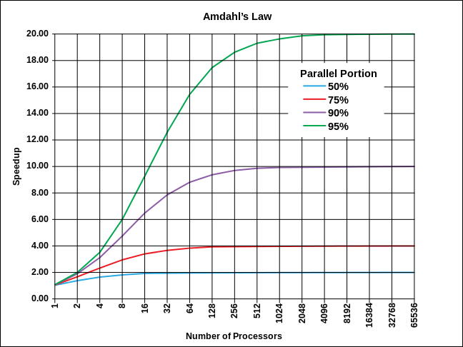
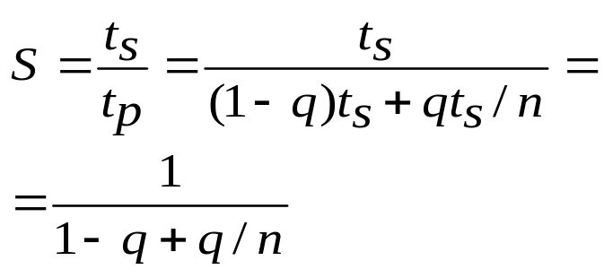
Multiprocessing
Limits of performance increase
Amdahl’s law
  S - speedup of a parallel execution
  ts – time for sequential execution
  tp – time for parallel execution
  q fraction of a program which can be executed in parallel
  n – number of nodes/threads
Examples:
q=50%, n->∞ => S=2
q=75%, n->∞ => S=4
q=95%, n->∞ => S=20

Slide 4
Hyper-threading
hyper-treading - parallel execution of instruction streams on a single CPU
Idea: when a tread is stalled because of some hazard cases another thread can be executed
Solution:
  two threads executed in parallel on the same pipelined CPU
  after every stage two buffers (registers) store the partial results of the two threads
Speedup – approximately 30%
The operating system will detect 2 logical CPUs !!
Single threaded
IF
ID
Ex
M
Wb
Thread
Thread 1
Hyper threaded
IF
ID
Ex
M
Wb
Thread 2

Slide 5

Multiprocessors
Parallel execution of instruction streams on multiple CPUs
Implementations:
  multi-core architectures – multiple CPUs in a single integrated circuit (IC)
  parallel computers – multiple CPUs on different ICs, but in the same computer infrastructure
  distributed computing facilities – multiple CPUs on different computers, connected through a network
    network of PCs
    GRID architectures – distributed computing resources for virtual organizations (VOs), manly for batch processing
    cloud architectures – computing resources (execution and storage) offered as a service; it can be hired dynamically
  combination of all above: multi-cores on parallel computers, building distributed computing facilities

Slide 6
Multi-core processors
Why multi-core:
  Difficult to make single-core clock frequencies even higher; in the last 4-5 years the clock frequency growth saturated at 2.5-3 GHz
  power consumption and dissipation problems (figher frequency means more power)
  pipeline architectures (instruction level parallelism) reached their efficiency limits (around 20 pipeline stages)
  designing a very complex CPU (with multiple optimization schemes involved) requires coordination of very large designing teams
  many new applications are multithreaded (e.g. servers that solve multiple concurrent requests, agent systems, gaming, simulation, etc.)

Slide 7
Multi-core processors
Issues (decision choices):
  same or different functionalities for CPUs (homogeneous v.s. heterogeneous CPUs)
    symmetric cores (SMP – Symmetric multi-core processor) – every core has the same structure and functionality
    asymmetric cores (ASMP) – there are coordination cores and (simpler) specialized cores
  the relation with the memory
    symmetric memory access - the SYMA
    non-uniform memory access – NUMA
  connection between cores
    common bus – parallel or network-based (see network-on-chip)
    crossbar – multiple connections controlled with a switch
    memory hierarchy (cache) – common memory zones

Slide 8
Multi-core processors
architectural solutions
Core
Core
Core
Core
Core
Core
L1
L1
L1
L1
L1
L1
L2
L2
Switch
crossbar
L2
L3
L3
Memory
Memory
Module 1
Memory
Module 2
Symmetric multi-core with private L1 cache and shared L2 and memory
Symmetric multi-core partially shared L2 and L3

Slide 9
Multi-core processors
architectural solutions (cont.)
Processor 1 Processor 2
Core (2x SMT)
Local
Store
Local
Store
Core
Core
Core
Core
L1
Core
Core
L1
L1
L1
L1
Ring network
L2
Switch
Switch
Core
Core
L2
L2
Local
Store
Local
Store
Memory
Module
Memory
I/O
Heterogeneous multi-core with local and shared cache
Two processors with two cores and shared memory

Slide 10
Multi-core processors
Shared cache
  high speed memory used by a number of cores (CPUs)
  advantages:
    efficient allocation of existing memory space
    one core may pre-fetch data for the other core
    sharing of common data
    no cache coherence problems
    less accesses to external memory
  drawbacks:
    conflict between cores when allocating space on the cache; one core may replace the other core’s data
    more complex control circuit and longer latency time because of the switching
    one core may lock the access to the other core

Slide 11
Multi-core processors
Cache coherence of private memory
  How to keep the data consistent across caches?
    solutions:
      write through – every write is made also in the memory – not so efficient
      snooping and invalidation – cores are snooping the bus and invalidates their cache line if a write from another core affects its caches content (e.g. Pentium Pro’s P6 bus – snooping phase)
core 1
core 2
core 3
core 4
cache
cache
cache
cache
write
inconsistency
Read
Memory

Slide 12
Multi-core processors
Symmetric v.s. asymmetric cores
  Symmetric architecture
    all cores are the same
    cores can perform any tasks; they are interchangeable
    Advantages:
      easy to build (simple replication),
      easy to program, to compile and to execute multithreaded programs
    examples:
      Intel, AMD - Dual and Quad core, Core2,
      SUN - UltraSparc T1 (Niagara) – 8 cores

Slide 13
Multi-core processors
Symmetric v.s. asymmetric cores (cont.)
  Asymmetric (heterogeneous) architecture
    some cores have different functionalities:
      1-2 master cores and many slave (simpler) cores
      1 main core and multiple specialized cores (graphics, Fp, multimedia)
    compilations should take into consideration what functionalities can be performed by each core
    Advantages:
      can integrate much more simple cores
    examples:
      IBM – cell processor – used for Playstation 3

Slide 14
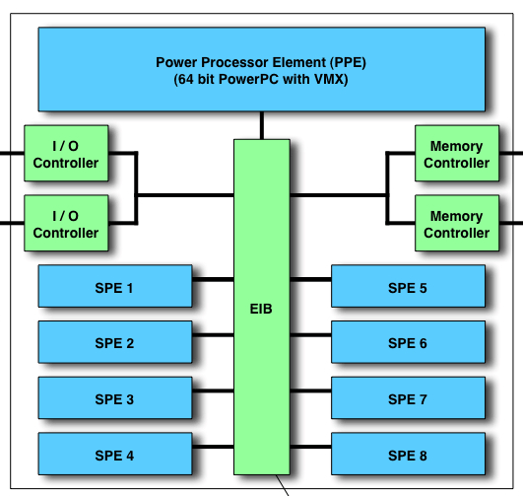
Multi-core processors
Asymmetric (heterogeneous) architecture
  IBM cell architecture: 9 cores
    1 PPE - power processor element
      coordination and data transfer
    8 SPEs - Synergistic Processing Element
      specialized mathematical units
    applications:
      supercomputers
      playstations
      home cinema
      video cards

Slide 15
Multi-core processors
Advantages of multi-core processors:
  Signals between different CPUs travel shorter distances, those signals degrade less.
  These higher quality signals allow more data to be sent in a given time period since individual signals can be shorter and do not need to be repeated as often
  Cache coherency circuitry can operate at a much higher clock rate than is possible if the signals have to travel off-chip.
  A dual-core processor uses slightly less power than two coupled single-core processors.

Slide 16
Multi-core processors
Disadvantages of multi-core processors:
  Ability of multi-core processors to increase application performance depends on the use of multiple threads within applications.
  Most current video games will run faster on a 3 GHz single-core processor than on a 2GHz dual-core processor (of the same core architecture.
  Two processing cores sharing the same system bus and memory bandwidth limits the real-world performance advantage.
  If a single core is close to being memory bandwidth limited, going to dual-core might only give 30% to 70% improvement.
  If memory bandwidth is not a problem, a 90% improvement can be expected.

Slide 17
Multi-core processors
Thread affinity
  we can specify if a thread may be executed on any core or just on a specific core
    soft affinity: - controlled by the operating system
      an interrupted thread should continue on the same core
    hard affinity – flags associated to a thread that indicate on which core(s) may be executed
      useful for real-time and control applications – to reduce the load on a core on which critical threads are executed

