Slide 1
DISTRIBUTED Sorting
(SORTING NETWORKS)

Slide 2
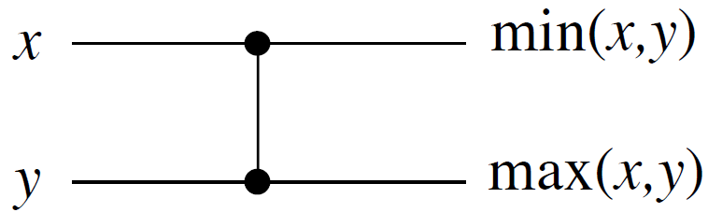
Comparator
wire
Input
wires
Output
wires
Works in O(1) time
Simply put: if x > y then swap(x,y)
Sorting at its most basic level

Slide 3
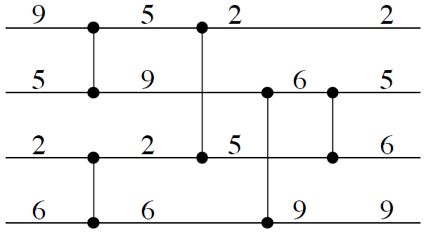
Example of Comparison Network
Input
Output
Wires go straight, left to right.
Each comparator has inputs/outputs on a pair of wires.

Slide 4
Depth - Example
Depth 1
Depth 2
Depth 3
Depth of 1 = max grouping of disjoint comparators
(disjoint at end points)

Slide 5
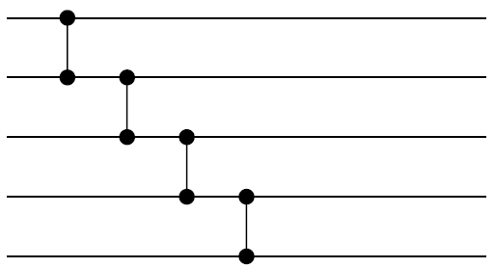
Sorter (example)
Foundation: Bubble-Sort Idea
Find the max of 5 values (Exercise)
Complete the network below

Slide 6
Bubblesort (solution)
| | | |
| | |
| |
|

Slide 7
Zero-one principle
How can we test if a comparison network sorts?
  We could try all n! permutations of input.
  But we will see that we need to test “only” 2^{n} permutations.
Theorem (0-1 principle)
If a comparison network with n inputs sorts all 2^{n} sequences of 0’s and 1’s, then it sorts all sequences of arbitrary numbers.

Slide 8
Increasing functions
A function f mapping real numbers to real numbers is increasing if and only if
For any pair of numbers x,y
If x ≤ y then f(x) ≤ f(y)
Examples of increasing functions:
Log(x), exp(x), square(x) (but not 1/x)

Slide 9
Important Lemma
Lemma: If a comparison network transforms a = <a₁, a₂, . . . , a_{n}> into
b = <b₁, b₂, . . . , b_{n}>,
then for any monotonically increasing function f , it transforms
f(a) = <f(a₁), f(a₂), . . . , f(a_{n})> into
f(b) = <f(b₁), f(b₂), . . . , f(b_{m})>.

Slide 10
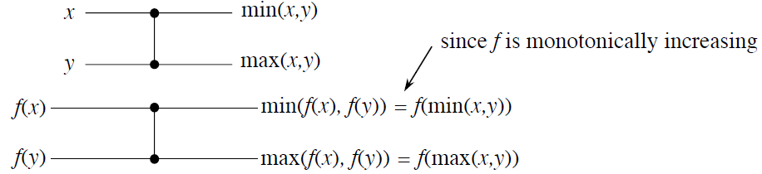
Proof of Lemma
Important property:
This follows since: x ≤ y implies that f(x) ≤ f(y) so min(f(x),f(y)) = f(x) = f(min(x,y))
max(f(x),f(y)) = f(y) = f(max(x,y))
Then use induction on the depth

Slide 11
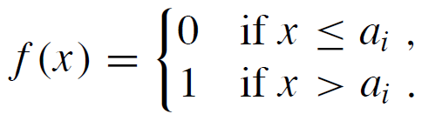
Proof of 0-1 principle
Suppose that the principle is not true, so that an n-input comparison network sorts all 0-1 sequences, but there is a sequence <a₁, a₂, . . . , a_{n}> such that a_{i} < a_{j} but a_{i} comes after a_{j} in the output.
Define the monotonically increasing function

Slide 12
Proof 0-1 principle (cont.)
By our lemma proven before:
If we give the input
<f(a₁), f(a₂), . . . , f(a_{n})>,
then in the output we will have
f(a_{i}) after f(a_{j})
But this results in an unsorted 0-1 sequence. A contradiction.

