Slide 1
I search the different model’s behavior
What I have done this week

Slide 2
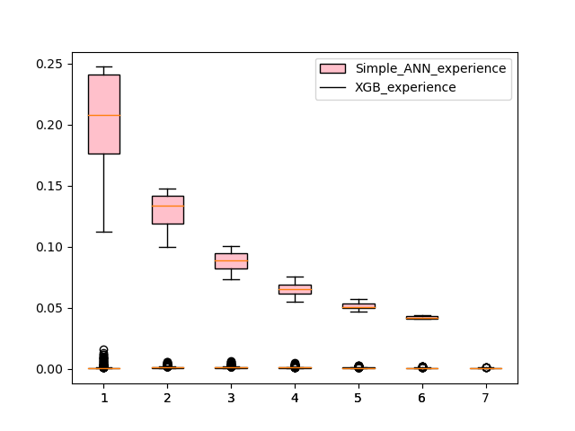
Simple ANN vs XGboost

Slide 3
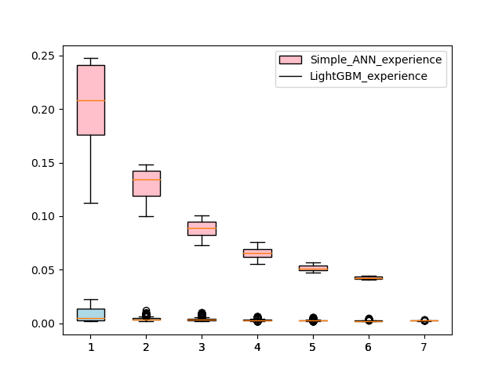
Simple ANN vs LightGBM

Slide 4
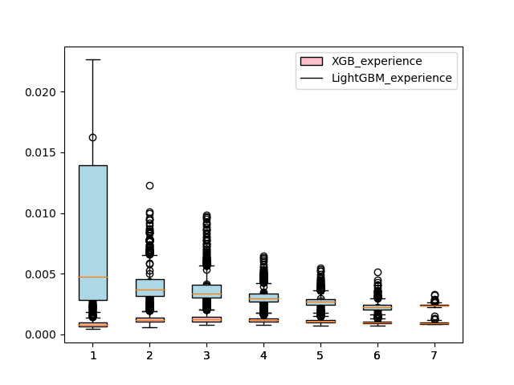
XGBoost vs LightGBM

Slide 5
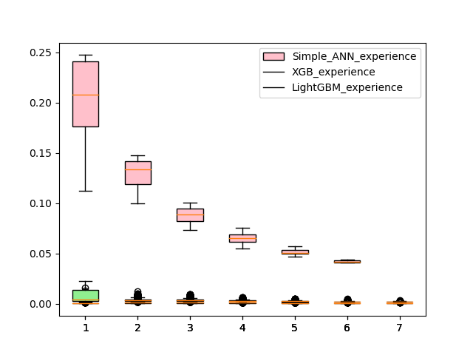
XGB vs LightGBM vs Simple ANN

