Slide 2
My input and output
X[i]=[Pcs[0], Pcs[1], Pcs[2], -critical presure
Tcs[0], Tcs[1], Tcs[2], -critical temperature
Omg[0],[1],[2], - acentric factor
T, -Initial temperature
P, - Initial presure
Zs[0],[1],[2] ] -material component
I add 5 more element as in put since I think it will be helpful to the output
The input is based on three fixed material
Y[i]=[Gas_Zs[0], Gas_Zs[1], Gas_Zs[2], -material component in gas_phase
Liq_Zs[0], Liq_Zs[1], Liq_Zs[2], -material component in liquid_phase
gas_fraction - material fraction in gas
liquid_fraction - material fraction in liquid
All above is for three material: ['methane', 'ethane', 'nitrogen']

Slide 3
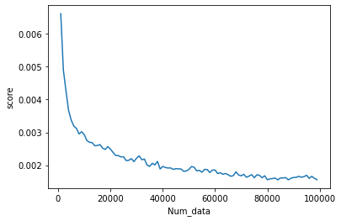
What I have done this week
X[i]=[Pcs[0], Pcs[1], Pcs[2],Tcs[0], Tcs[1], Tcs[2], Omg[0], Omg[1], Omg[2],T, P,Zs[0], Zs[1], Zs[2] ]
Y[i]=[Gas_Zs[0], Gas_Zs[1], Gas_Zs[2],Liq_Zs[0], Liq_Zs[1], Liq_Zs[2], gas_fraction, liquid_fraction
Use Xgboost to fit Data
1 How number of data effect MSE score(take a lot of time
2 Grid search: find best parameters
loss
Grid search

Slide 4
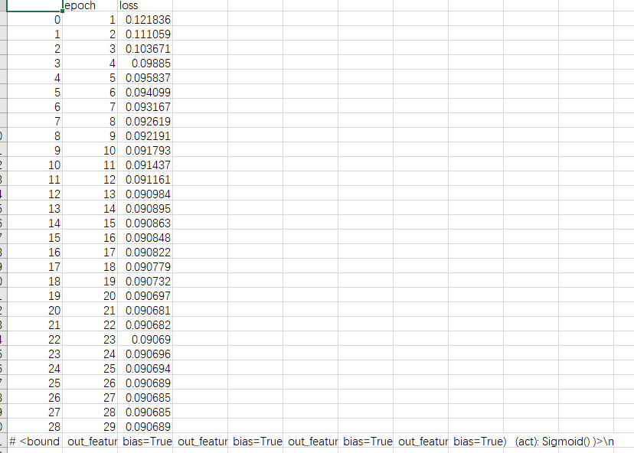
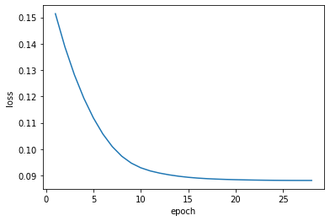
What I have done this week
X[i]=[Pcs[0], Pcs[1], Pcs[2],Tcs[0], Tcs[1], Tcs[2], Omg[0], Omg[1], Omg[2],T, P,Zs[0], Zs[1], Zs[2] ]
Y[i]=[Gas_Zs[0], Gas_Zs[1], Gas_Zs[2],Liq_Zs[0], Liq_Zs[1], Liq_Zs[2], gas_fraction, liquid_fraction
Use ANN to fit Data (it is much harder to train than XGboost)

Slide 5
What I have done this week
X[i]=[Pcs[0], Pcs[1], Pcs[2],Tcs[0], Tcs[1], Tcs[2], Omg[0], Omg[1], Omg[2],T, P,Zs[0], Zs[1], Zs[2] ]
Y[i]=[Gas_Zs[0], Gas_Zs[1], Gas_Zs[2],Liq_Zs[0], Liq_Zs[1], Liq_Zs[2], gas_fraction, liquid_fraction
Use ANN model to fit the data with mass_balance_loss
The way I judge Mass_balance_loss:
gas_zs[i]*gas_fraction + liquid_zs[i]* liquid_fraction=original material fraction
The way I implement Mass_balance_loss: MSE(y,ypred)+
MSE( gas_zs[i]*gas_fraction + liquid_zs[i]* liquid_fraction, original material fraction )
Unfortunately, This doesn’t perform very well

Slide 6
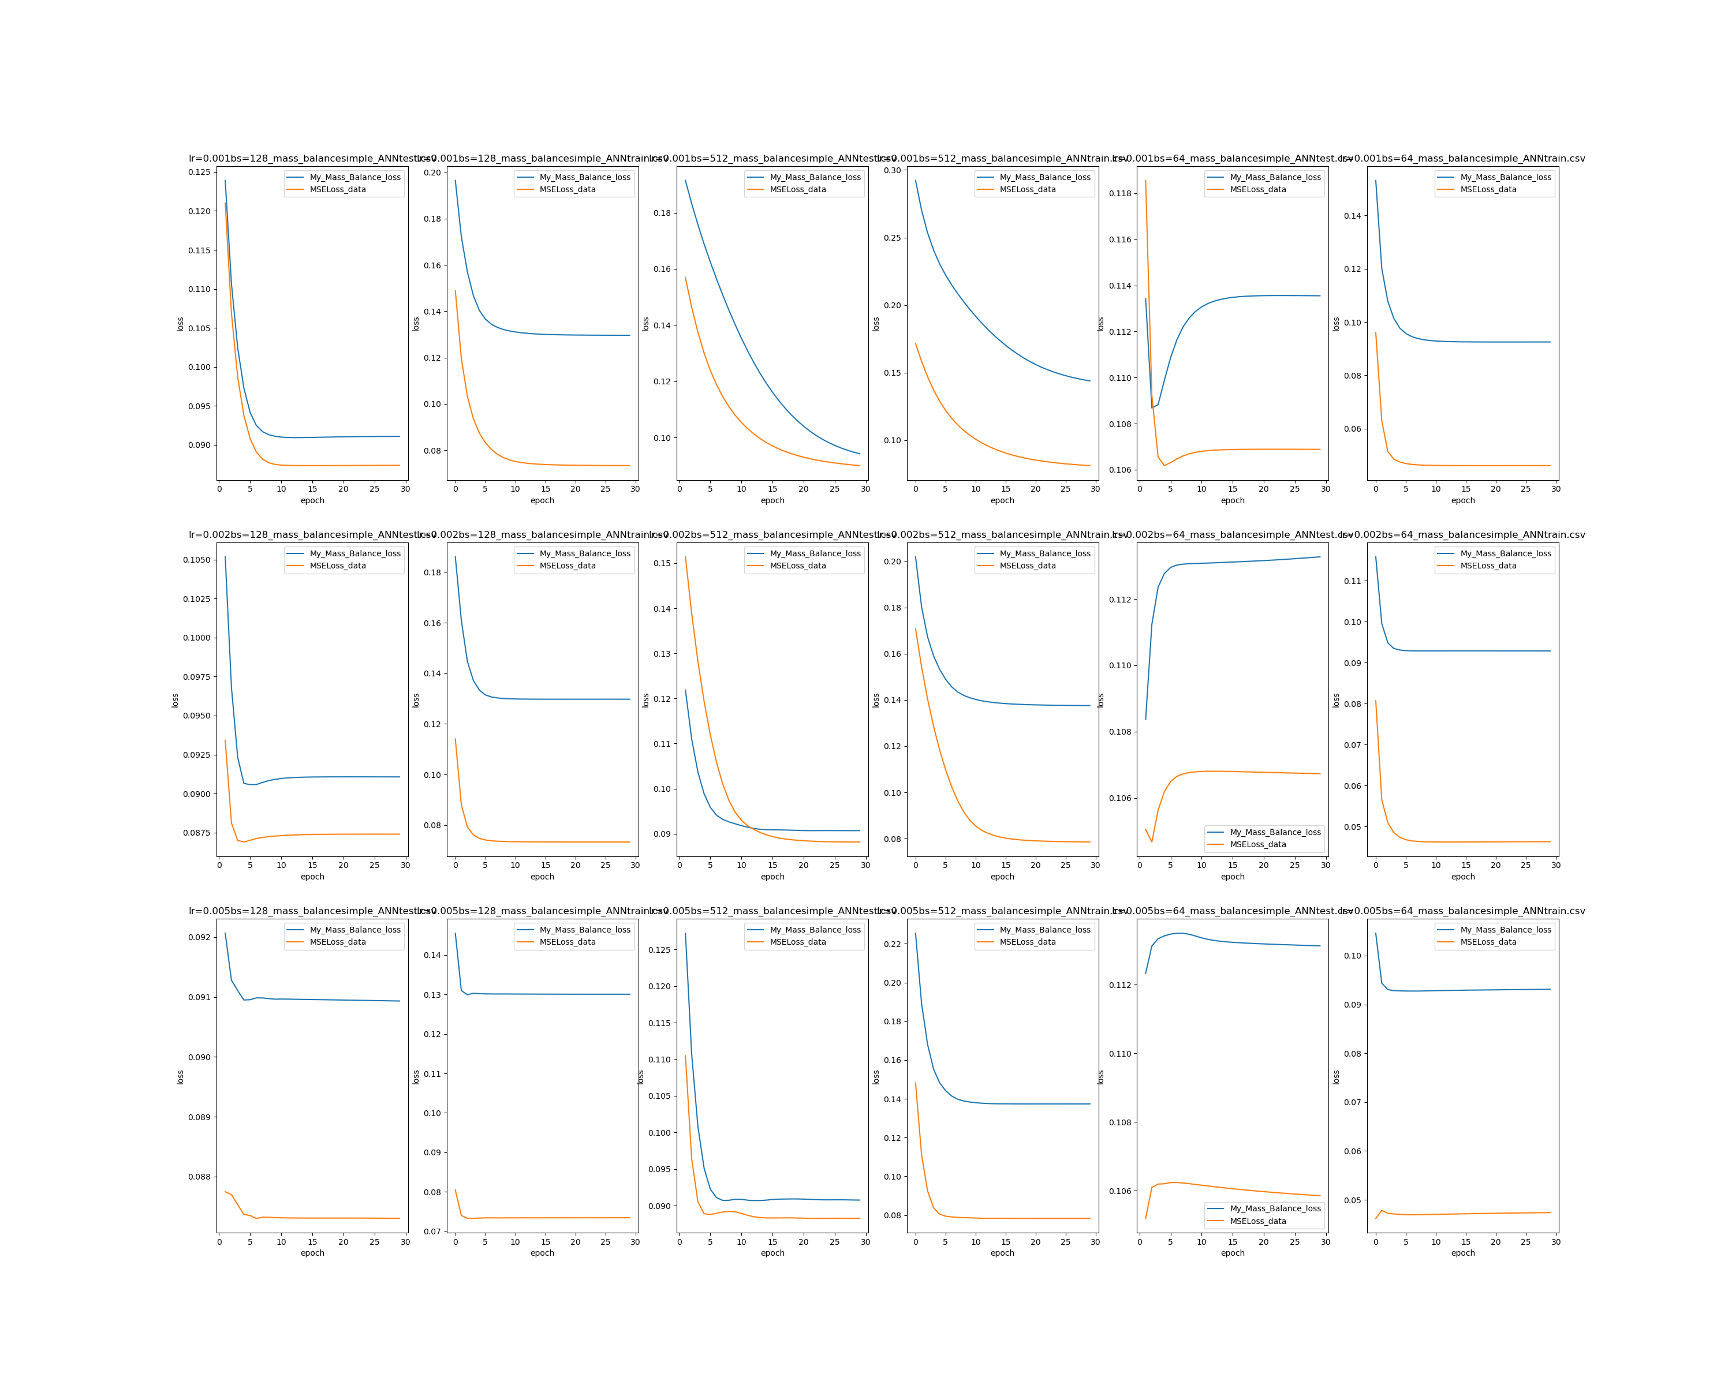
It seems In all case in change of Learning rate and batchsize, the mass balance loss is less than original loss
What I have done this week
* I only use mass_balance_loss in train, and change back to original loss in evaluation

Slide 7
It seems In all case in change of Learning rate and batchsize, the mass balance loss is bigger than original loss
What I have done this week
* I only use mass_balance_loss in train, and change back to original loss in evaluation

Slide 8
Think about it…
1 why ANN is much worse than Xgboost
I the reason is that
1 can only fit realative simple function like exp(x)+exp(y)or log(x)+log(y) but not x*y
2 some data havent happened before(increase training size)
3 my ANN too simple
It MIGHT be true, I am trying to proved it

Slide 9
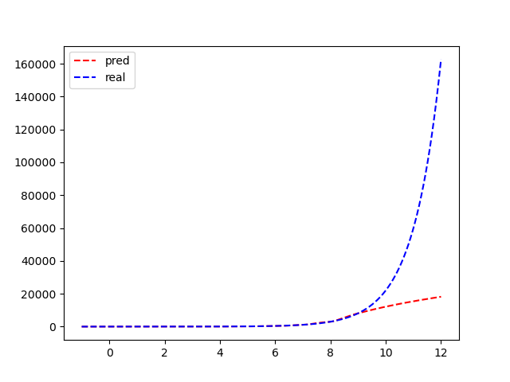
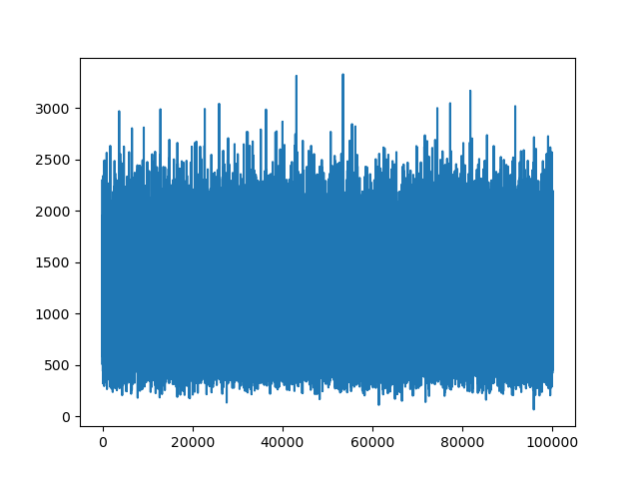
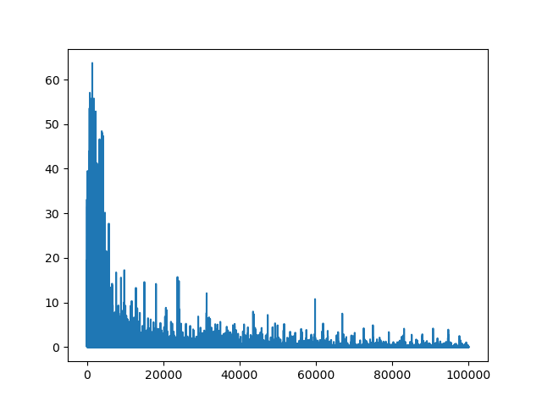
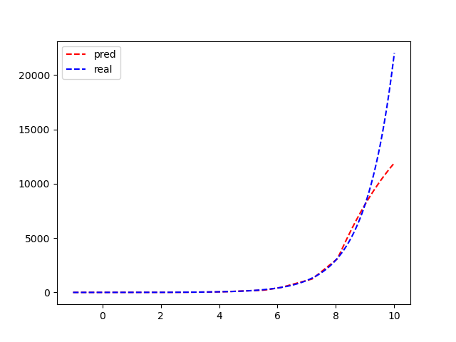
Prove:only approxmate simple function
exp
X*Y(loss)
Solve equation(loss)

Slide 10
What I will do next week
X[i]=[Pcs[0], Pcs[1], Pcs[2],Tcs[0], Tcs[1], Tcs[2], Omg[0], Omg[1], Omg[2],T, P,Zs[0], Zs[1], Zs[2] ]
Y[i]=[Gas_Zs[0], Gas_Zs[1], Gas_Zs[2],Liq_Zs[0], Liq_Zs[1], Liq_Zs[2], gas_fraction, liquid_fraction
Use c1-c7 mix material and record data and analyze it in more complex situation
Use more complex ANN model to fit the data() and try to find best parameter(DNF-Net , TabNet 1D-CNN)

