Slide 1
I search the different model’s behavior
What I have done this week

Slide 2
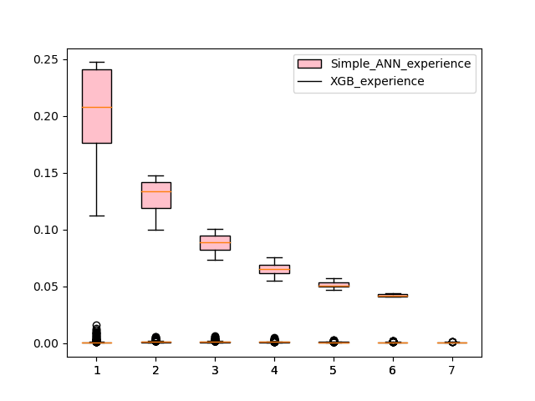
Simple ANN vs Xgboost in MSEloss

Slide 3
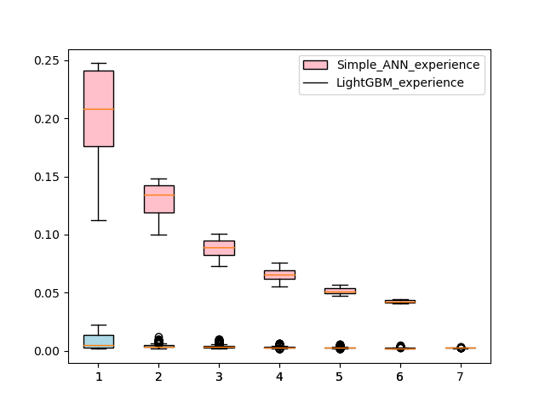
Simple ANN vs LightGBM in MSEloss

Slide 4
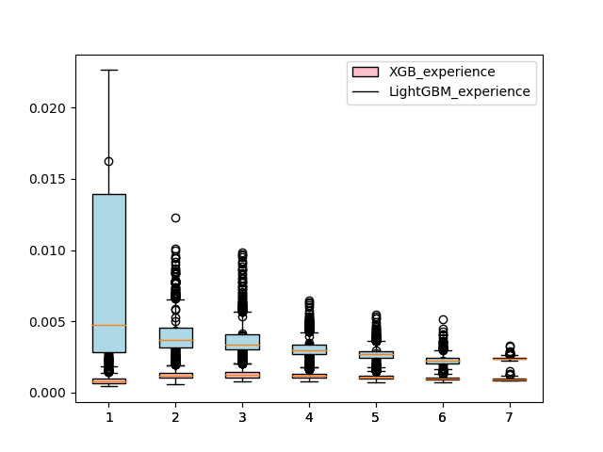
XGBoost vs LightGBM in MSEloss

Slide 5
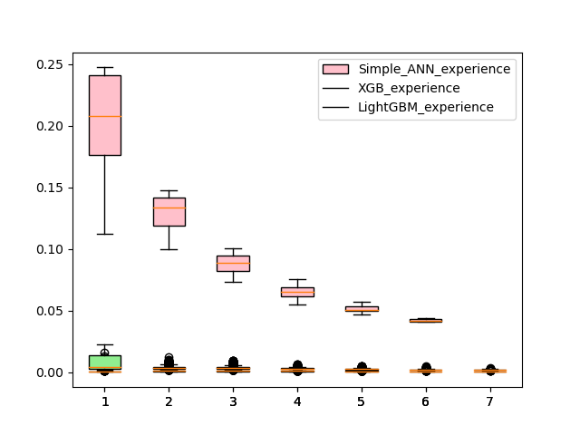
XGB vs LightGBM vs Simple ANN in MSEloss

Slide 6
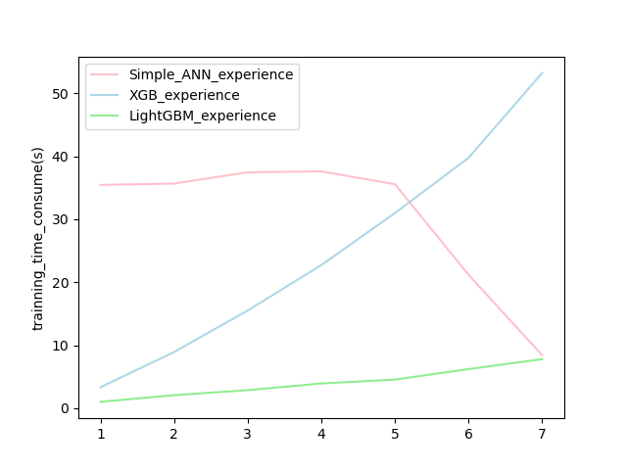
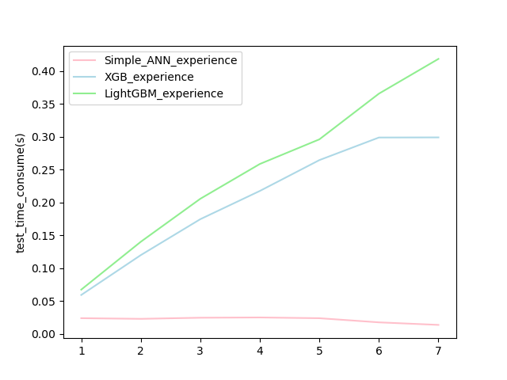
Simple ANN vs LightGBM in train time (in same machine)
The time of simple ANN doesn’t increase with mixture, it might because the parallal power of GPU is too high. I can also because the test sample is relative low(10 times)

Slide 7
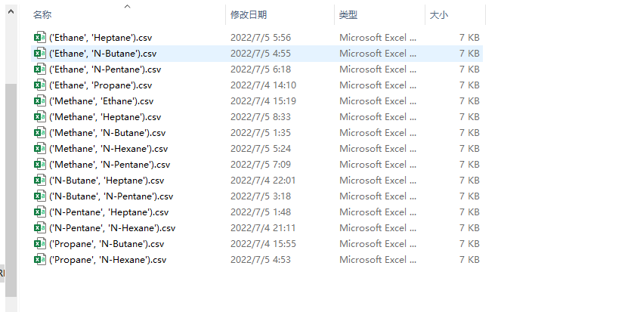
About PINN
I finish the code part, the HPC system is still running and generating data
I turned to use grid search since it support parallel programming

Slide 8
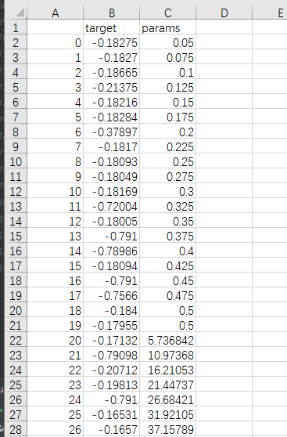
PINN
The data may shows that change rate of Physical constrain doesn’t benefit much for MSEloss
target: MSEloss
params: ratial of Mass loss in MSELoss from 0.05 to 100

Slide 9
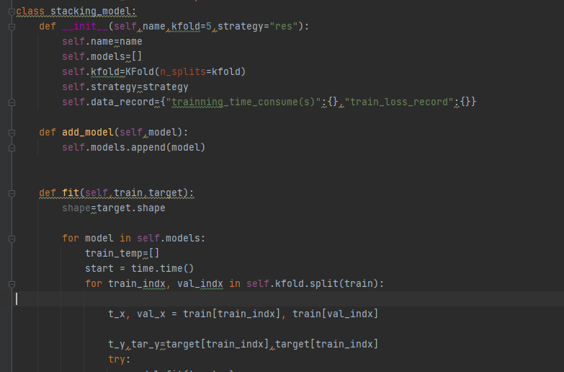
About model essemble
I write a class and it can automatically stack as many model as I want
It is going to be sent to HPC to see the performance

