Slide 1

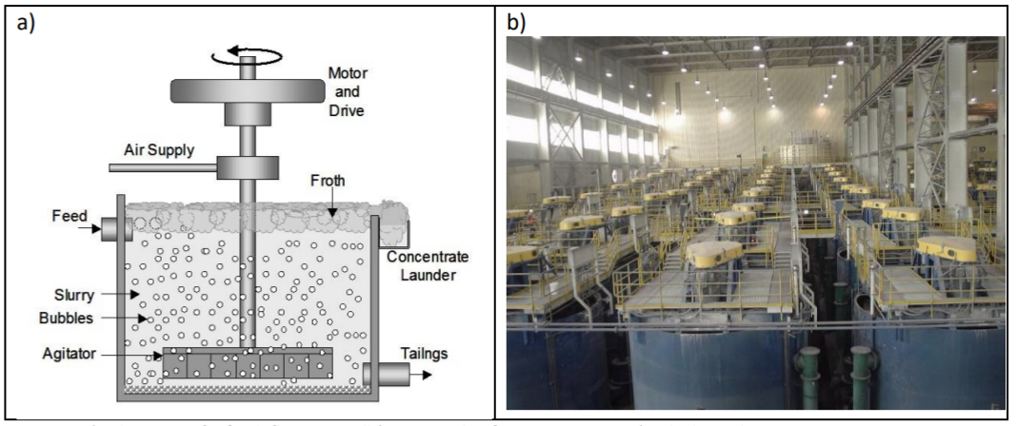
ACSE 4.2: The Gormanium Rush
Optimal mineral recovery using Genetic Algorithms
Team sphalerite

Slide 2
Introduction
Code Structure
Circuit Simulation
Circuit Validation
Genetric Algorithm
Convergence Analysis
Limitations & Improvements
Team sphalerite

Slide 3
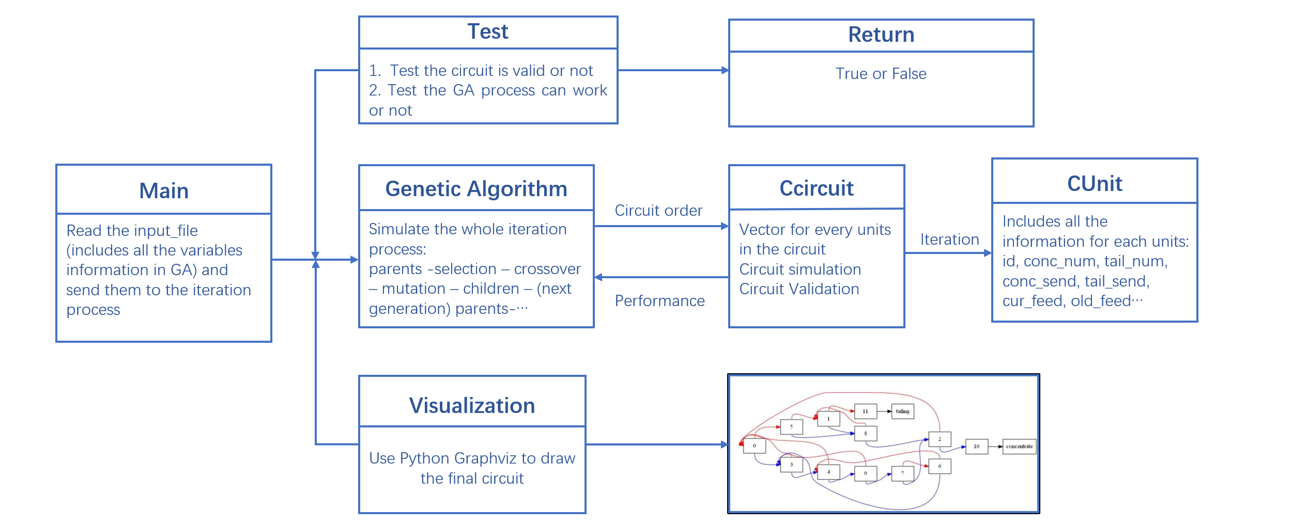
Code Structure
Team sphalerite

Slide 4
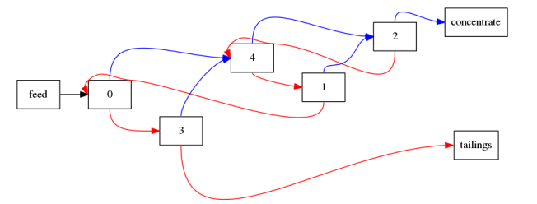
Introduction
Circuits are represented by the vectors.
i.e. 0 is the feedpoint, 5 is the concentrate, 6 is the tailings
0 goes to 4 and 3, 1 goes to 2 and 0, 2 goes to 5 and 4...
vector : 0 | 4 3 | 2 0 | 5 4 | 4 6 | 2 1
Team sphalerite

Slide 5
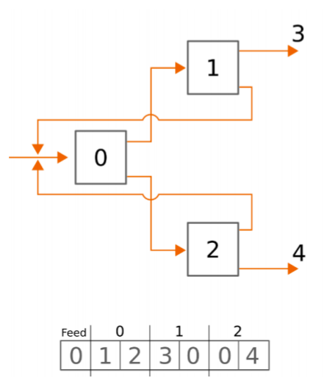
Circuit Simulation
This process will simulate how circuit working to separate the "variable" and waste.
It will use a input circuit order vector, and return the economic performance of this circuit.
We set a vector for each units, and stores their detailed information as well
Unit 0, 1, 2 | id, mark, next concentrate unit, next tailing units, current input feed, old input feed
Destination unit 3, 4 | id, mark, next concentrate unit = -1; next tailing units=-1 current input feed, old input feed
This is a loop to separete over and over again until:
1. it reaches to iteration time,
2. the difference between the current and old input feed is small enough
Team sphalerite

Slide 6
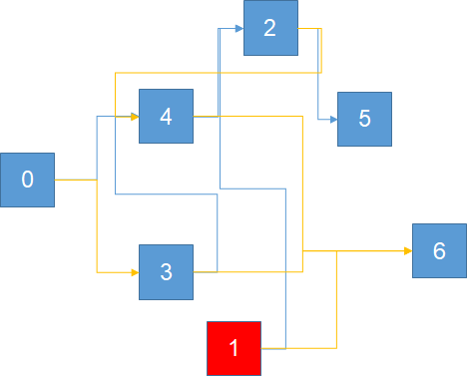
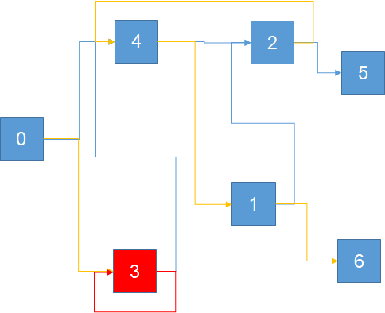
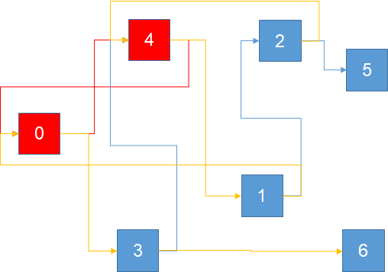
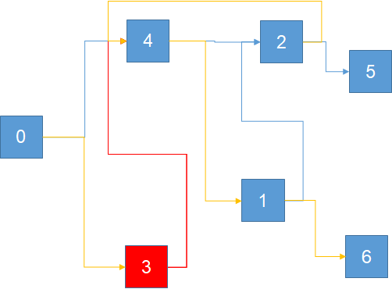




Circuit Validation
2.Every unit must have a route forward to both of the outlet streams
3. No self-recycle
1.Every unit must be accessible from the feed
4.Two different destinations of out stream
Team sphalerite

Slide 7
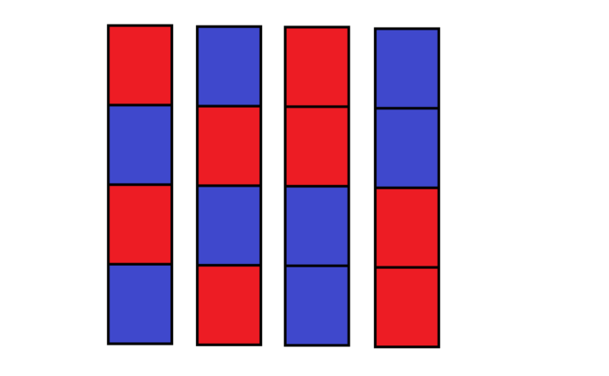
Genetic Algorithm
1. Generate a certain number of parent vectors using initial random collection of valid circuits.
2. Calculate the fitness value based on our evaluate performance function.
......
fitness value: a b c d
Team sphalerite

Slide 8
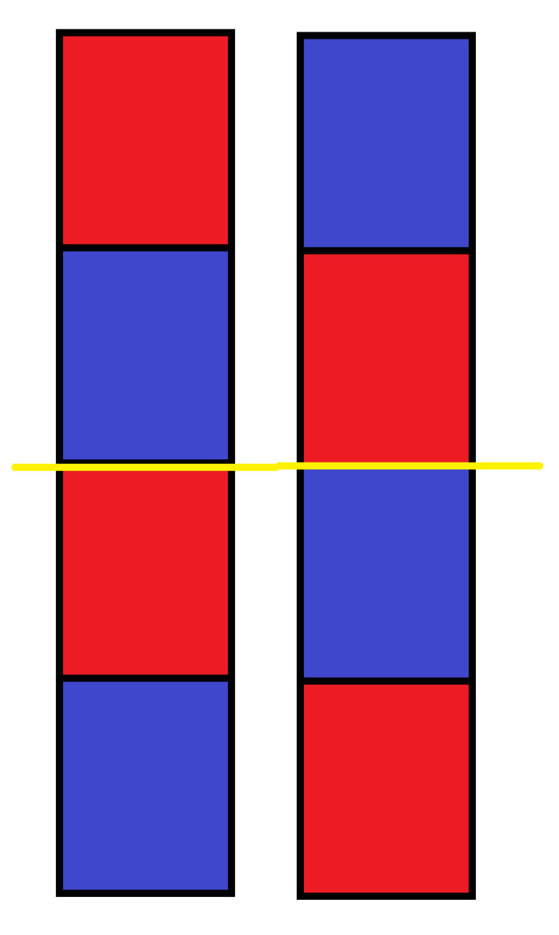
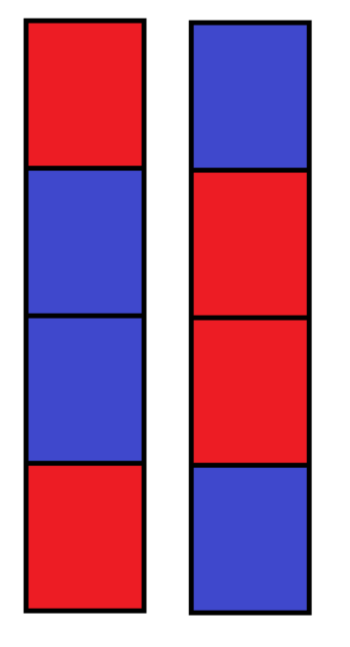
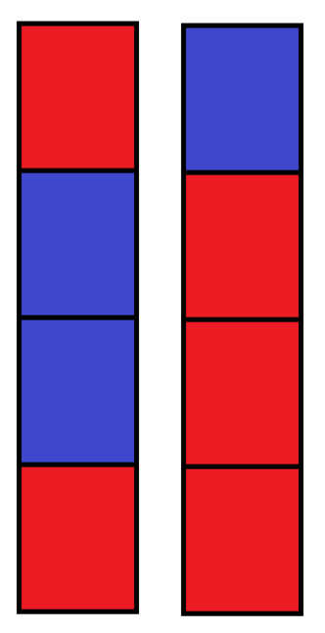
Genetic Algorithm
3. Iteration
(1) Select the parent vector with the best performance and pass it into the next generation. (2) Choose a pair of parent vectors and decide whether to crossover them randomly; If crossover doesn’t happen, pass them into the next generation. And we make an improvement on calculating the probability of choosing parent vector: using a log calculation instead of making the probability varies linearly depending on the fitness value of each parent vector. (3) For each number of child vectors generated last step, decide whether to mutate.
cross over
cross point
mutation
Team sphalerite

Slide 9
Genetic Algorithm
4. Check the child vectors after crossover and mutation if they are valid.
5. Keep on doing iteration(step 3 ~ 4) until the number of child vectors is the same as parent vectors.
6. Keep on doing the whole algorithm until we reach the stopping criteria. Here, the criterion we set is if all vectors in a generation are the same; If this criterion is true, which means we have got the answer.
Team sphalerite

Slide 10
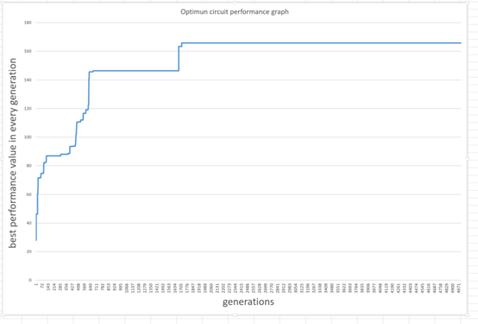
Convergence Analysis (GA)
Parameters | unit_num = 10 | num offspring = 100
 | P(crossing) = 90% | P(mutation) = 0.2%
 | mutate step = 1 | GA tolerance = 1%
Max_Performance | 165.764
Best Circuit Order | 3,8,2,5,11,8,4,8,6,7,1,9,3,8,0,9,5,9,7,10,8
Analysis | 1. The speed to convergence is quick and satisfied. When iteration time reaches to 1716 times, the highest performance remains itself, which means this process reaches to convergence. 2. The robustness of the final solution seems very good. When the highest performance is reached, the performance value does not fluctuate with generation increasing.
Team sphalerite

Slide 11
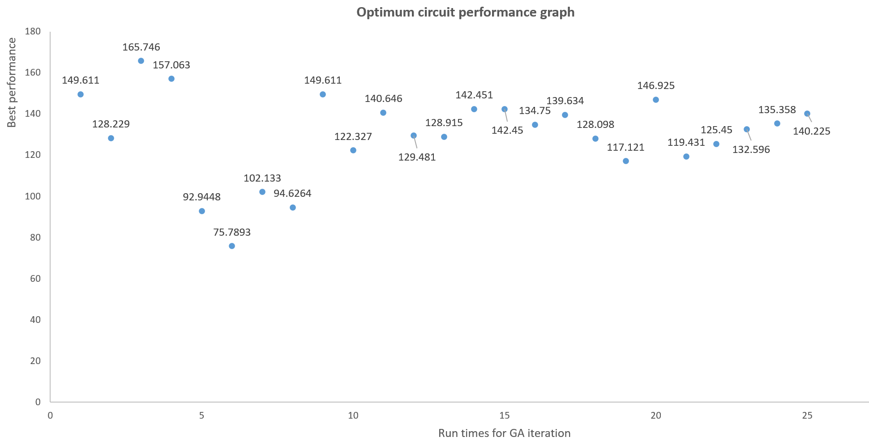
Convergence Analysis (GA)
Parameters | unit_num = 10 | num offspring = 100
 | P(crossing) = 90% | P(mutation) = 0.2%
 | mutate step = 1 | GA tolerance = 1%
Max Performance | 165.764
Best Circuit Order | 3,8,2,5,11,8,4,8,6,7,1,9,3,8,0,9,5,9,7,10,8
Findings | 1. The average of convergence is good enough. Average:1979.4 generation Max: 3442 generation Min: 144 generation 2. Question of locally optimal solution Cannot always find the best solution for this circuit.
Team sphalerite

Slide 12
Convergence Analysis (GA)
Influenced by the GA parameters analysis
Parameters' change | Influence
Population size increases | The converge rate of our model will decrease, but the performance of find the global maximum ability will increase. Because we Increased randomness of our offspring and the probability to get the global maximum increase.
Crossover rate increases
Mutation rate increases
Team sphalerite

Slide 13
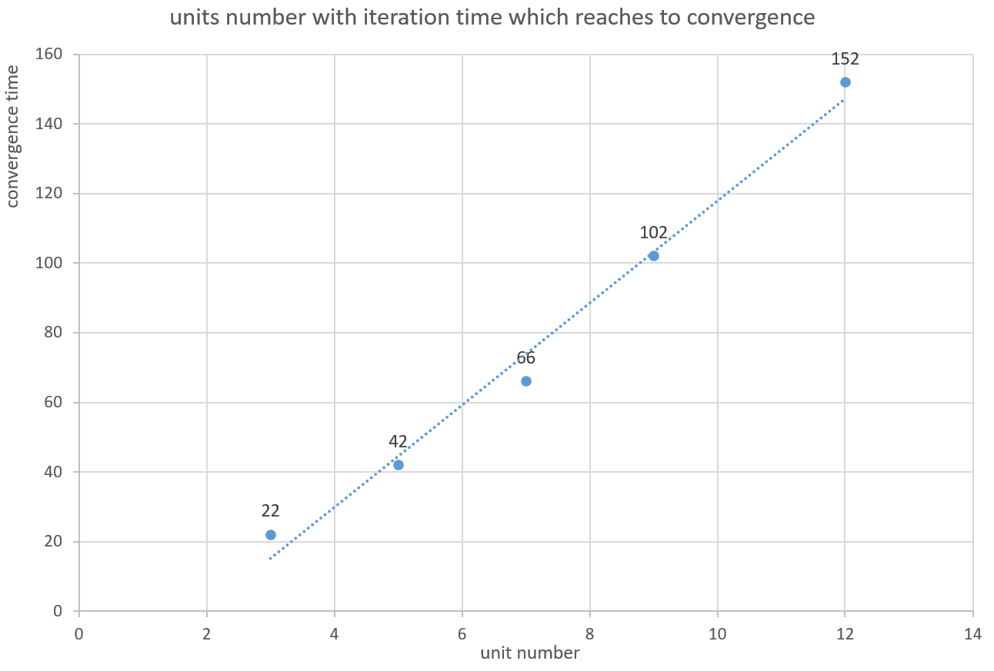
Convergence Analysis (Circuit Simulation)
Parameters | unit_num = 3, 5, 7, 9 ,12
 | iteration time = 1000 | tolerance = 1e-6
times reach to convergence | 22, 42, 66, 102, 152
Analysis | 1. The speed to convergence is quick and satisfied. It seems that when a valid circuit is given, it will reach to convergence in a high speed 2. The relationship between the units number and the convergence time can be seem as linear
Team sphalerite

Slide 14
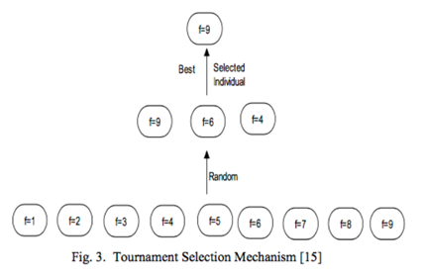
Limitations & Improvements
Proportionate Roulette Wheel Selection
Tournament Selection[1]
Less complexity O(n) Easy to parallelize Not easy to fall into the local best No need to sort all fitness values

Slide 15
Thank you for your listening !
Reference list:
[1] Comparisons of selection strategy in genetic algorithm Computer Engineering and Design 2009,30(23) P5471-P5478 http://www. doc88.com/p-3983487959243.html
[2]Problem Statement for Genetic Algorithms Project, http://github.com/acse-2020/acse-4-gormanium-rush-sphalerite/blob/main/Problem%20Statement%20for%20Genetic%20Algorithms%20Project.pdf
Team sphalerite

