Slide 1
BACHELOR'S THESIS
Cross-Modal Face-Voice Biometric
Matching in Multilingual Environments
Student: Fedor-Florin AXIUC
Coordinator: Prof. dr. ing. Mircea GIURGIU
Faculty of Electronics, Telecommunications and Information Technology
2026
1 / 19

Slide 2
Contents
1
Introduction
Objectives and scope
2
State of the Art
FAME challenge, published baselines
3
Theoretical Foundation and Architecture
Encoders, translators, fusion, loss functions
4
Implementation
Datasets, technical challenges, RO-FaceVoice
5
Experimental Results
Component comparison, Urdu and Romanian evaluation
6
Conclusions
Limitations, contributions, future work
2 / 19

Slide 3
1 INTRODUCTION
Objectives
1.
Build a system that matches a face to a voice across different spoken languages
2.
Combine pre-trained unimodal encoders through a shared, comparable embedding space
3.
Systematically isolate which architectural decisions actually drive performance
4.
Evaluate cross-lingual generalization
5.
Contribute an original evaluation resource for an unstudied language: Romanian
Intro
State of the Art
Theoretical Foundation
Implementation
Results
Conclusions
3 / 19

Slide 4
2 STATE OF THE ART
State of the Art
Face-voice Association in Multilingual Environments (FAME), MAVCeleb benchmark
System | Challenge | Urdu EER | Key Contribution
FOP [1] | FAME baseline | 37.90% | Orthogonal Projection Loss
MFV-KSD [2] | FAME 2024, 1st | 19.90% | Keynote speaker diarization front-end + three-stage training
RFOP [3] | FAME 2026 | 33.10% | Revisits fusion and orthogonal projection, focusing on relevant semantic information
XM-ALIGN [4] | FAME 2026 | not released | Explicit MSE alignment + implicit shared-classifier alignment
Simic et al. [5] | FAME 2026, 1st | 23.99% (avg) | Angular margin loss + auxiliary age-gender features
As we can see, even state of the art struggle to achieve a below 20% EER
Intro
State of the Art
Theoretical Foundation
Implementation
Results
Conclusions
4 / 19

Slide 5
3 THEORETICAL FOUNDATION AND ARCHITECTURE
Face Encoder: ArcFace
iResNet50 backbone, pretrained on VGGFace2, frozen. Deng et al. [6]. Pretrained on VGGFace2 [7].
Trained with Additive Angular Margin Loss, not standard softmax classification.
Embeddings are L2-normalized before the loss is computed, removing magnitude as a variable entirely.
A fixed angular margin is added directly inside the loss, forcing identity separation to happen by angle, not by any other geometric shortcut.
Configuration | Urdu similarity
VGG16 (softmax) | 0.0972
ArcFace (final) | 0.4941
Change | +408%
Intro
State of the Art
Theoretical Foundation
Implementation
Results
Conclusions
5 / 19

Slide 6
3 THEORETICAL FOUNDATION AND ARCHITECTURE
Voice Encoder: ECAPA-TDNN
Pretrained on VoxCeleb1+2, frozen. Desplanques et al. [8], VoxCeleb [9].
SE-Res2Blocks: multi-scale temporal convolutions with squeeze-and-excitation channel attention [10][11].
Attentive Statistics Pooling replaces simple averaging with a learned, per-frame weighting [12].
Trained with AAM-Softmax, the same angular-margin family of loss as ArcFace.
Configuration | Romanian similarity
ResNet18 (repurposed) | 0.1377
ECAPA-TDNN (final) | 0.2532
Change | +65%
Intro
State of the Art
Theoretical Foundation
Implementation
Results
Conclusions
6 / 19

Slide 7
3 THEORETICAL FOUNDATION AND ARCHITECTURE
Shared Embedding Space
Face (512-D) and voice (192-D) embeddings live in different, incompatible spaces. Two small trainable networks, the Modality Translators, project both into one shared 512-D space.
Translators | Value
Face / Voice dims | 512, 192 -> 256 -> 512
Dropout | 0.3
Activation | ReLU, LeakyReLU(0.2)
Output | L2-normalized
Range [-1, +1], depends only on angle; magnitude is cancelled entirely.
The condition this depends on:
Cosine similarity is meaningful only if the encoder's own training forces identity information into direction. Angular margin training guarantees this, by construction; standard classification training does not.
Encoder training | Angle = identity
Softmax (VGG16, ResNet18) | No
Angular margin (ArcFace, ECAPA) | Yes
Intro
State of the Art
Theoretical Foundation
Implementation
Results
Conclusions
7 / 19

Slide 8
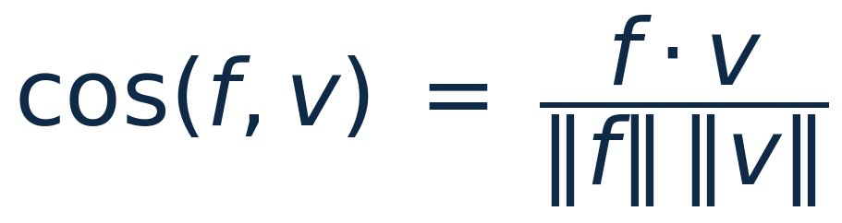
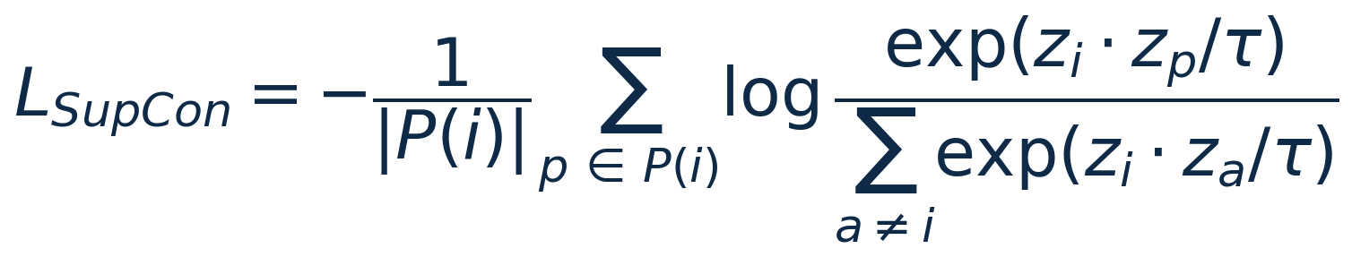
3 THEORETICAL FOUNDATION AND ARCHITECTURE
Loss Functions
Loss | Mechanism | Applied to | Temperature
InfoNCE [13] (weight 10.0) | Correct voice must outscore all others in-batch | Translator outputs, pre-fusion | 0.1
Cross-Entropy (weight 1.0) | Classifies fused embedding into 198 identities | Fused output | n/a
OPL [1] (baseline) | Different identities pushed toward a 90 degree angle | Fused output | n/a
SupCon [14] (weight 0.5) | Same identity pulled together, others pushed apart | Fused output | 0.1
SupCon needed scale to be better: at 64 identities, batches often held one example per person, so the pull-together term had nothing to act on and OPL performed better. At 198 multilingual identities, batches reliably contained same-identity pairs, and SupCon overtook OPL.
Cosine similarity: comparison operator used at evaluation.
OPL [1]: fixed target, identity toward angle 0, others toward 90.
SupCon [14]: same identity must outscore all others in the batch.
Intro
State of the Art
Theoretical Foundation
Implementation
Results
Conclusions
8 / 19

Slide 9
3 THEORETICAL FOUNDATION AND ARCHITECTURE
The Attention Mechanism
Hyperparameter | Value
Heads | 8
Embedding dim | 512
Sequence length | 2 tokens
Dropout | 0.3
Multi-head attention [15]. A correction, not a reconstruction: attention's output is added onto the original translator embeddings through a residual connection. Fusion exists only because Cross-Entropy requires one combined vector to classify;
Intro
State of the Art
Theoretical Foundation
Implementation
Results
Conclusions
9 / 19

Slide 10
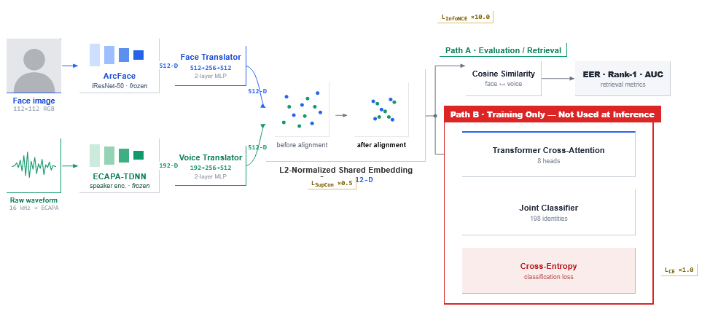
3 THEORETICAL FOUNDATION AND ARCHITECTURE
System Architecture
Fig. 6. Pipeline. Path A (evaluation) uses translator outputs directly. Path B (training only) adds Transformer cross-attention fusion and a classifier; neither is invoked at inference.
Intro
State of the Art
Theoretical Foundation
Implementation
Results
Conclusions
10 / 19

Slide 11
4 IMPLEMENTATION
Training Configuration
Setting | Value
Optimizer | Adam
Learning rate | 0.001
Weight decay | 1e-4
LR scheduler | ReduceLROnPlateau, factor 0.5, patience 5
Batch size | 64
Early stopping | patience 15 epochs
Hardware | Google Colab, NVIDIA Tesla T4 GPU
Intro
State of the Art
Theoretical Foundation
Implementation
Results
Conclusions
11 / 19

Slide 12
4 IMPLEMENTATION
Datasets
Dataset | Identities | Languages | Utterances
MAVCeleb v1 | 70 (64 labeled) | English, Urdu | 18,385
MAVCeleb v2 | 84 | English, Hindi | 20,715
MAVCeleb v3 | 58 | English, German | 3,812
198 unique identities across four languages: the multilingual backbone this system was trained on.
Intro
State of the Art
Theoretical Foundation
Implementation
Results
Conclusions
12 / 19

Slide 13
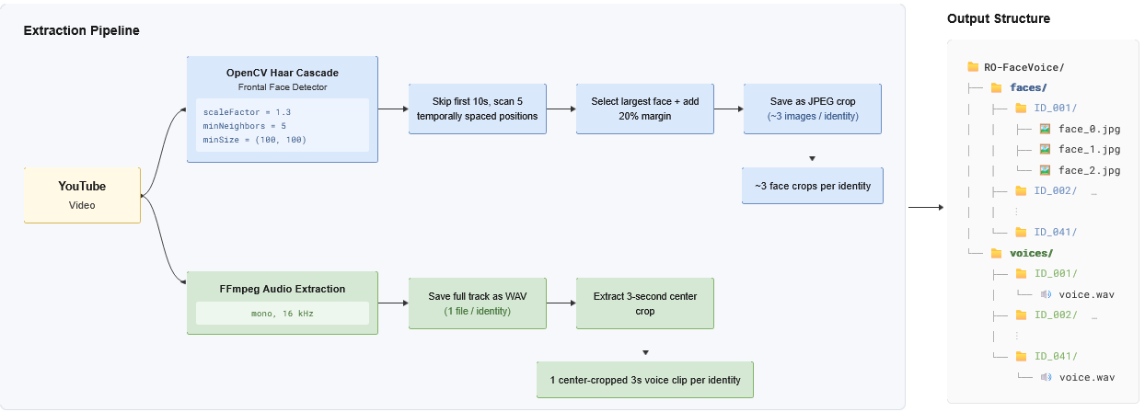
4 IMPLEMENTATION
Building RO-FaceVoice
No MAVCeleb data includes Romanian; testing on a genuinely unseen language required building this corpus.
Fig. 7. RO-FaceVoice construction: YouTube collection, face extraction (OpenCV Haar cascade), voice extraction (FFmpeg), anonymized output structure. Result: 41 identities, 147 utterances, never seen in training.
Intro
State of the Art
Theoretical Foundation
Implementation
Results
Conclusions
13 / 19

Slide 14
5 EXPERIMENTAL RESULTS
Component Comparison
Five configurations, one variable changed at a time
Configuration | Identities | Urdu sim. | Urdu EER | RO sim. | RO Rank-1
ResNet18 + OPL, EN | 64 | n/a | n/a | 0.1377 | Not tested
VGG16+ECAPA+OPL, EN | 64 | 0.0382 | ~50% | 0.2532 | Not tested
VGG16+ECAPA+SupCon, EN | 64 | 0.0204 | 47.06% | 0.2252 | Not tested
VGG16+ECAPA+SupCon, ML | 198 | 0.0972 | 43.60% | 0.2265 | 2.44%
ArcFace+ECAPA+SupCon, ML | 198 | 0.4941 | 9.10% | 0.3323 | 4.88%
Urdu Verification
Metric | Value
EER | 9.10%
Rank-1 (51/64) | 79.69%
AUC | 0.9538
FOP baseline | 37.90%
Known identities, unseen language, unseen recordings. At this threshold, roughly 1 in 11 verification attempts is misclassified: a substantial reduction from the published baseline.
Protocol note: not the fully unseen-unheard protocol FOP and FAME use; the comparison above is directional, not strict.
Intro
State of the Art
Theoretical Foundation
Implementation
Results
Conclusions
14 / 19

Slide 15
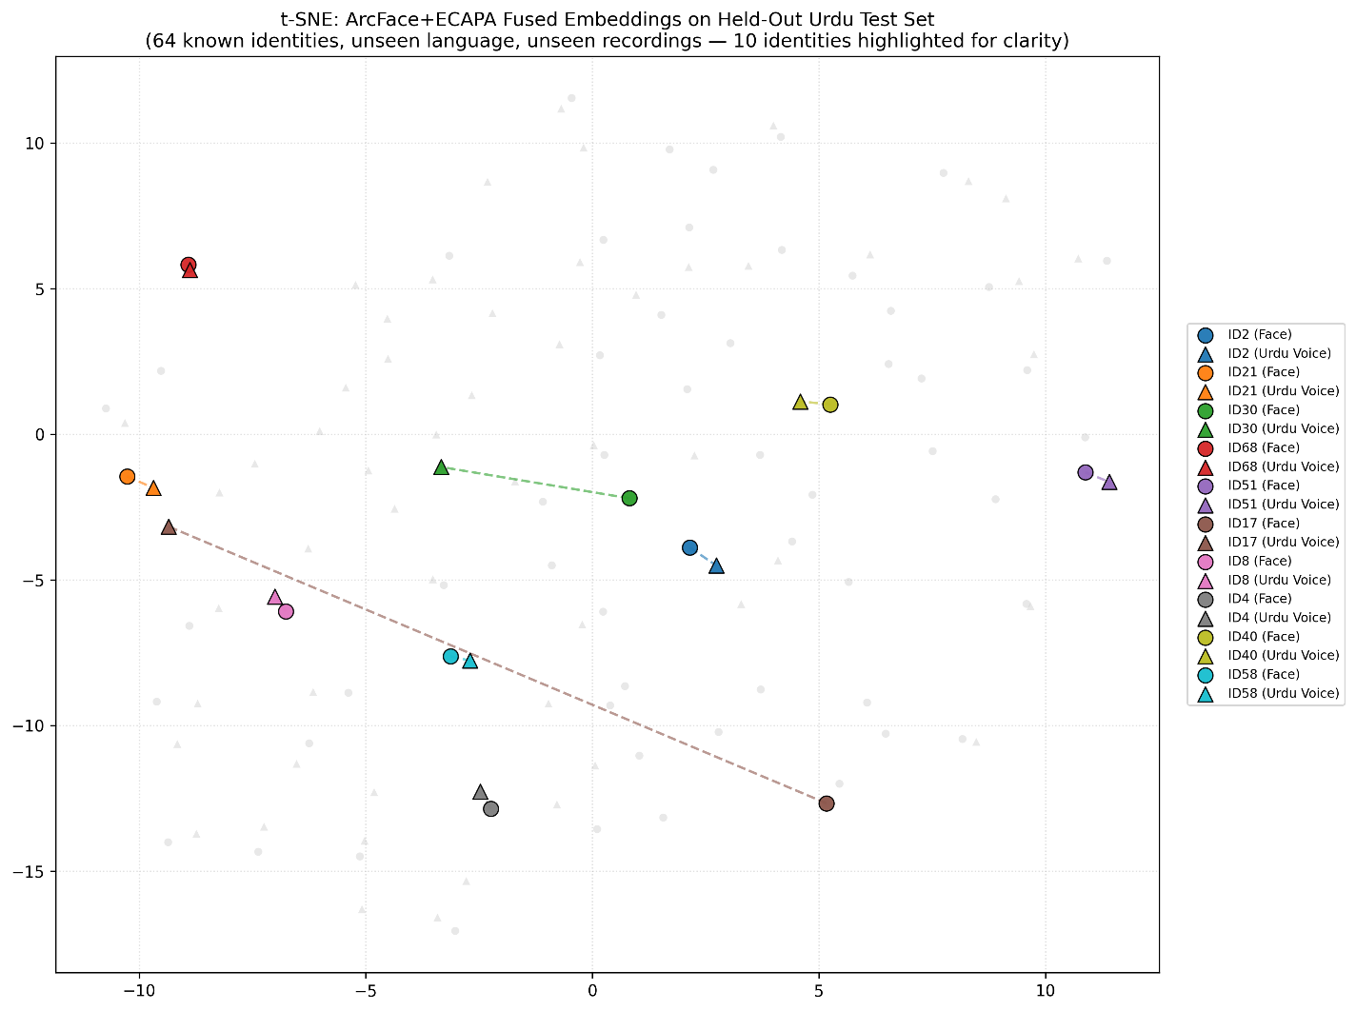
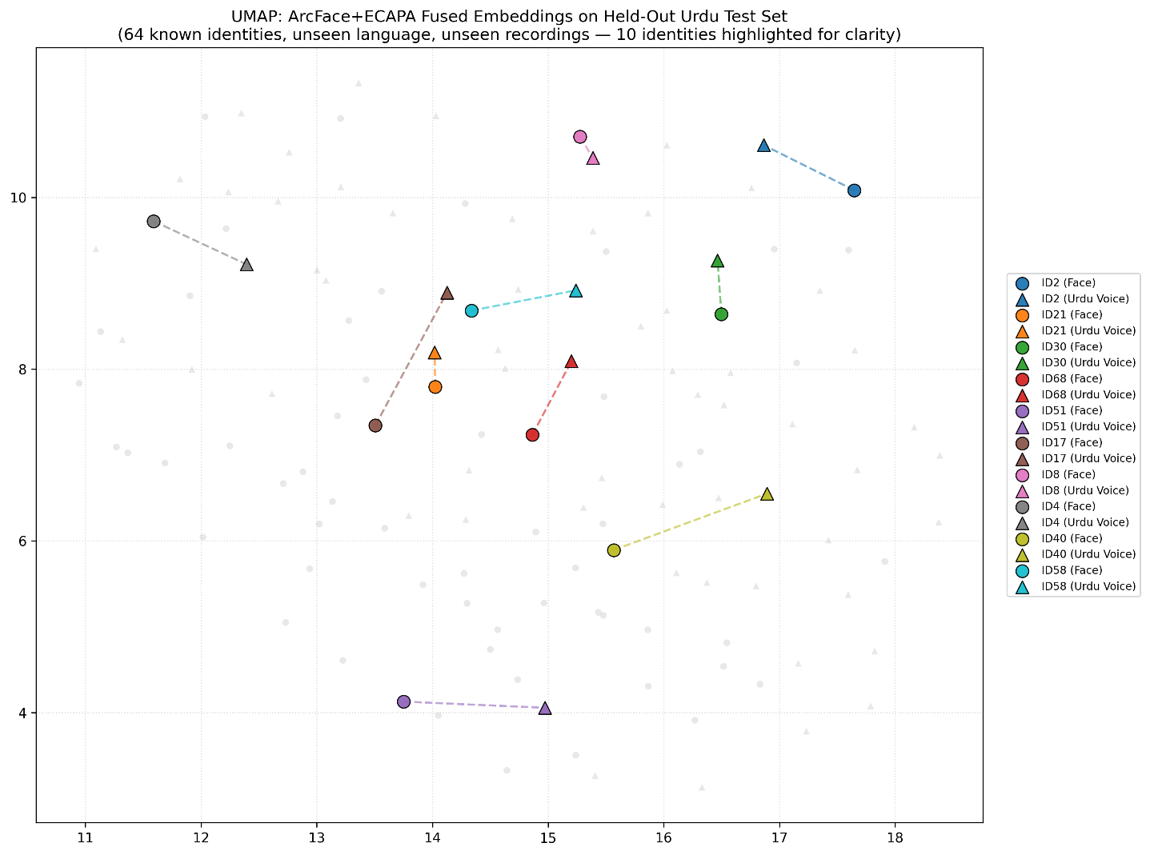
5 EXPERIMENTAL RESULTS
Embedding Space Visualization
t-SNE
Parameter | Value
Perplexity | 25
Early exag. | 24.0
Init | PCA
Metric | cosine
UMAP
Parameter | Value
n_neighbors | 15
min_dist | 0.8
Metric | cosine
t-SNE projection: matching face and voice points from the same identity should land close together, since t-SNE preserves local neighborhood structure.
UMAP projection: the same expectation, checked with a method that better preserves global structure between clusters.
Intro
State of the Art
Theoretical Foundation
Implementation
Results
Conclusions
15 / 19

Slide 16
6 CONCLUSIONS
Limitations
Limitation | Detail
Protocol difference | Urdu EER is known-identity, unseen-language; not directly comparable to FOP/FAME's unseen-unheard baselines
Romanian corpus scale | 41 identities, 147 utterances: a small, preliminary evaluation
Training set size | 198 identities, far smaller than VoxCeleb (7,000+) or VGGFace2 (9,131)
Fusion module unused at inference | Verification through the fused embedding alone performs at chance
Intro
State of the Art
Theoretical Foundation
Implementation
Results
Conclusions
16 / 19

Slide 17
6 CONCLUSIONS
Contributions and Future Work
Contributions
Future Work
RO-FaceVoice corpus: first Romanian face-voice dataset, extending the field to a previously uncovered language. The comparison method: evidence for how much each architectural decision contributes.
Expand the dataset:
more identities and utterances, especially for Romanian.
Diagnose the fusion module:
why cross-attention collapses to chance when relied on alone at inference.
Intro
State of the Art
Theoretical Foundation
Implementation
Results
Conclusions
17 / 19

Slide 18
Conclusion
One finding explains three results
The angular geometry ArcFace and ECAPA-TDNN impose on their embeddings, is what makes cosine similarity meaningful at all. It explains the largest single gain in the component comparison, it explains why Urdu adaptation succeeds for known identities, and its absence in a frozen encoder explains why Romanian, a fully unseen case, remains modest.
Metric | Value
Urdu EER | 9.10%
Urdu Rank-1 | 79.69%
Romanian Rank-1 | 4.88%
Training / RO identities | 198 / 41
Thank you.
19 / 19

Slide 19
Bibliography
[1] M. S. Saeed, M. H. Khan, S. Nawaz, M. H. Yousaf, and A. Del Bue, "Fusion and Orthogonal Projection for Improved Face-Voice Association," ICASSP, 2022.
[9] A. Nagrani, J. S. Chung, and A. Zisserman, "VoxCeleb: A Large-Scale Speaker Identification Dataset," Interspeech, 2017.
[2] R. Tao et al., "Multi-Stage Face-Voice Association Learning with Keynote Speaker Diarization," arXiv:2407.17902, 2024.
[10] J. Hu, L. Shen, and G. Sun, "Squeeze-and-Excitation Networks," CVPR, 2018.
[3] A. Hannan, F. Malik, H. Jabbar, S. S. Sadiq, and M. Noman, "RFOP: Rethinking Fusion and Orthogonal Projection for Face-Voice Association," arXiv:2512.02860, 2025.
[11] S. Gao, M.-M. Cheng, K. Zhao, X.-Y. Zhang, M.-H. Yang, and P. Torr, "Res2Net: A New Multi-Scale Backbone Architecture," IEEE TPAMI, vol. 43, no. 2, 2021.
[4] Z. Fang, S. Tao, J. Wang, and L. He, "XM-ALIGN: Unified Cross-Modal Embedding Alignment for Face-Voice Association," arXiv:2512.06757, 2025.
[12] K. Okabe, T. Koshinaka, and K. Shinoda, "Attentive Statistics Pooling for Deep Speaker Embedding," Interspeech, 2018.
[5] C. Simic, K. Riedhammer, and T. Bocklet, "Shared Multi-modal Embedding Space for Face-Voice Association," arXiv:2512.04814, 2025.
[13] A. van den Oord, Y. Li, and O. Vinyals, "Representation Learning with Contrastive Predictive Coding," arXiv:1807.03748, 2018.
[6] J. Deng, J. Guo, N. Xue, and S. Zafeiriou, "ArcFace: Additive Angular Margin Loss for Deep Face Recognition," CVPR, 2019.
[14] P. Khosla et al., "Supervised Contrastive Learning," NeurIPS, vol. 33, 2020.
[7] Q. Cao, L. Shen, W. Xie, O. M. Parkhi, and A. Zisserman, "VGGFace2: A Dataset for Recognising Faces Across Pose and Age," FG, 2018.
[15] A. Vaswani et al., "Attention Is All You Need," NeurIPS, vol. 30, 2017.
[8] B. Desplanques, J. Thienpondt, and K. Demuynck, "ECAPA-TDNN: Emphasized Channel Attention, Propagation and Aggregation in TDNN Based Speaker Verification," Interspeech, 2020.

