Slide 1

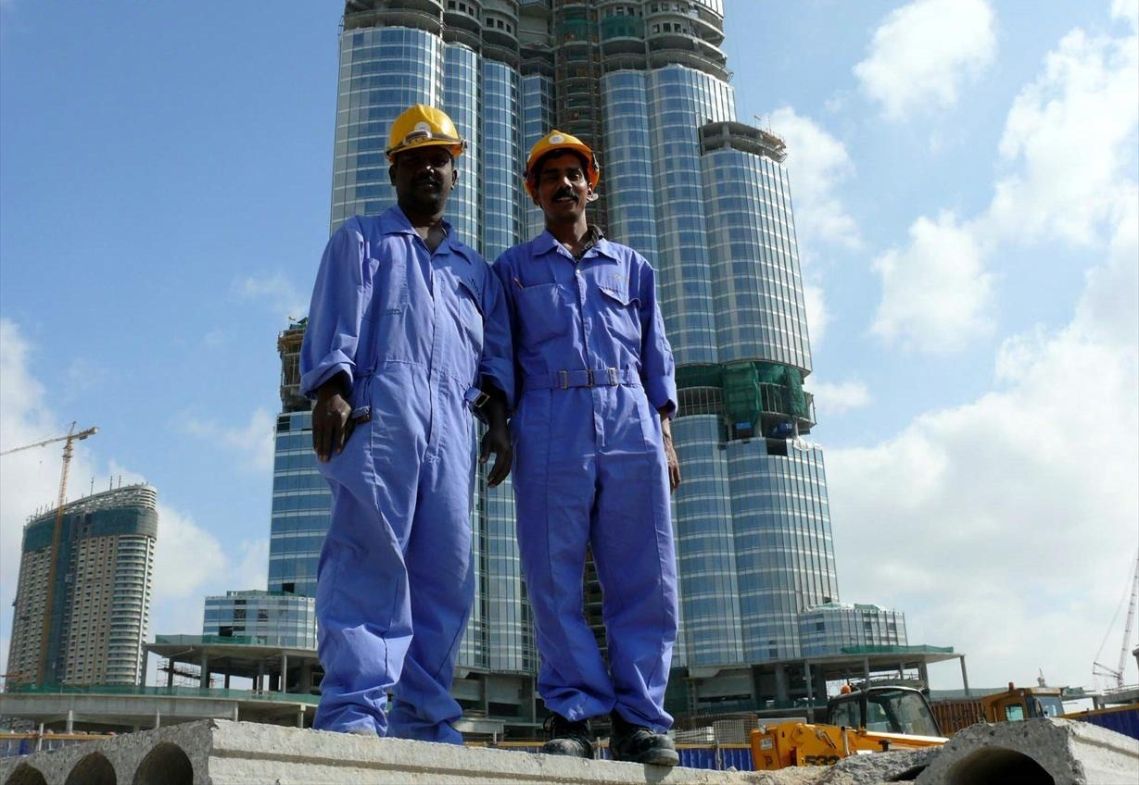
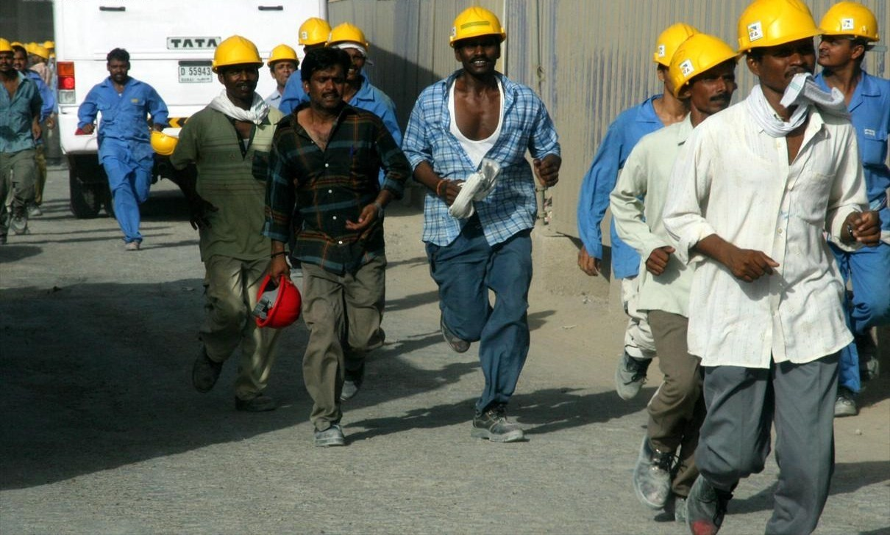
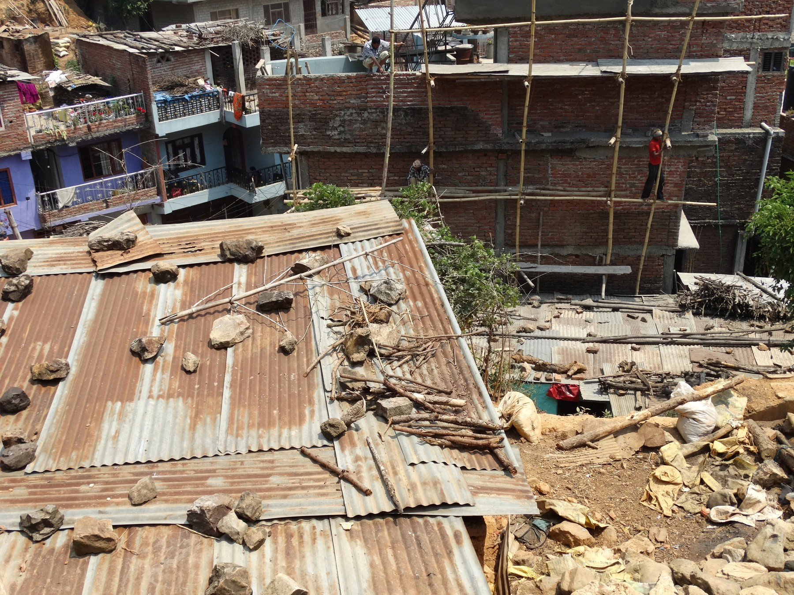
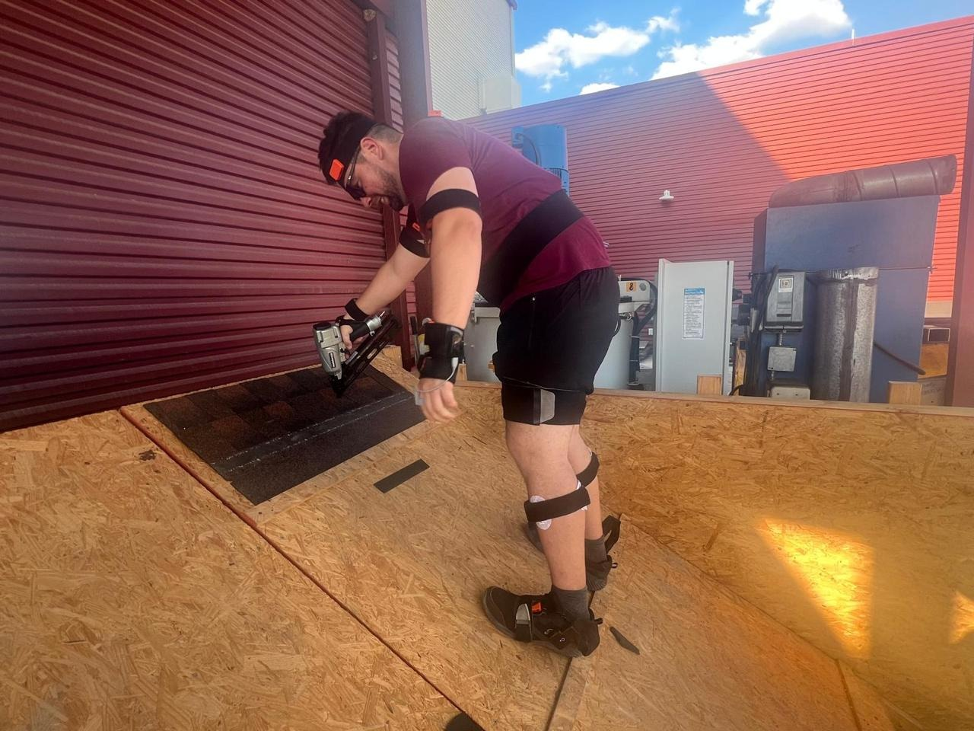
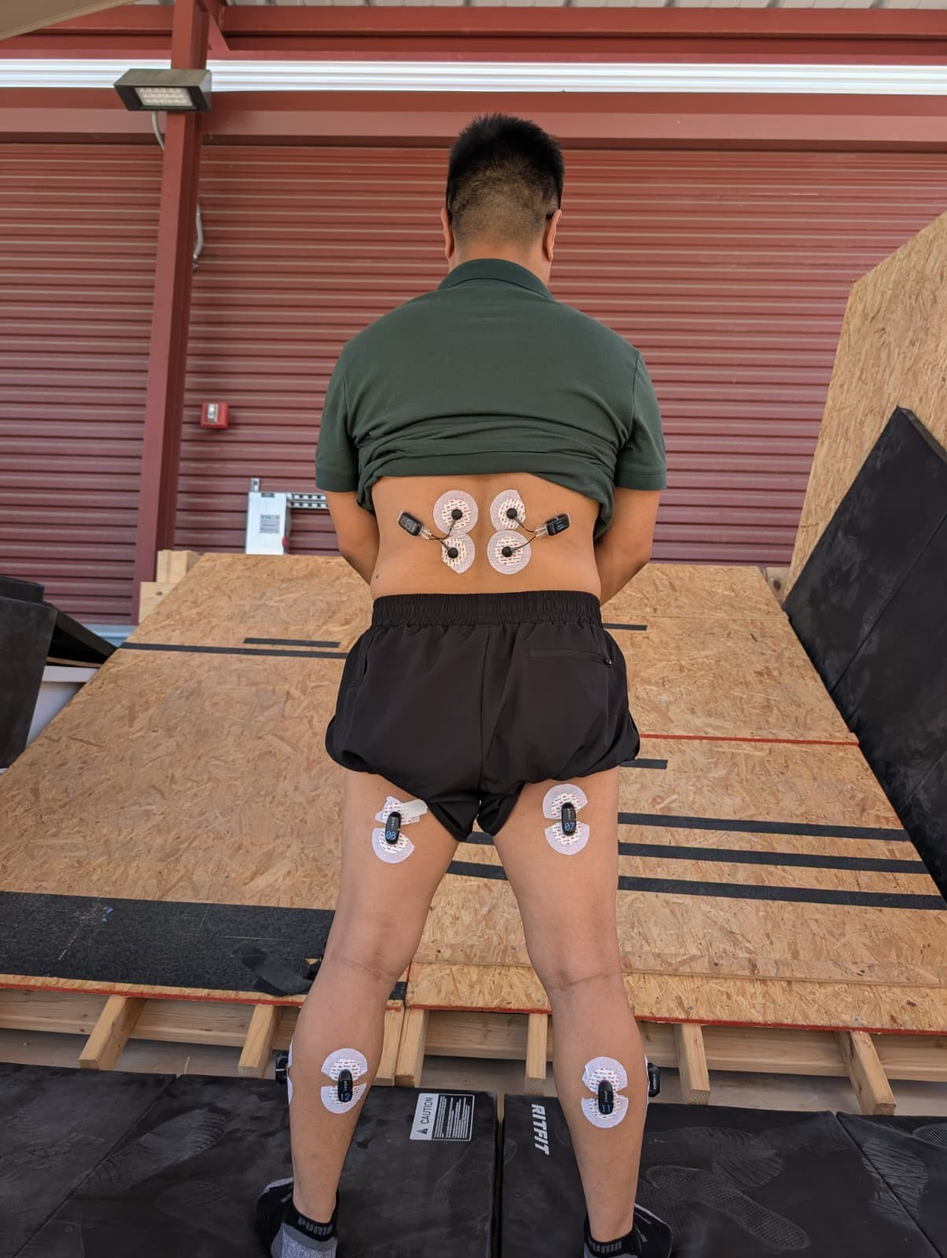
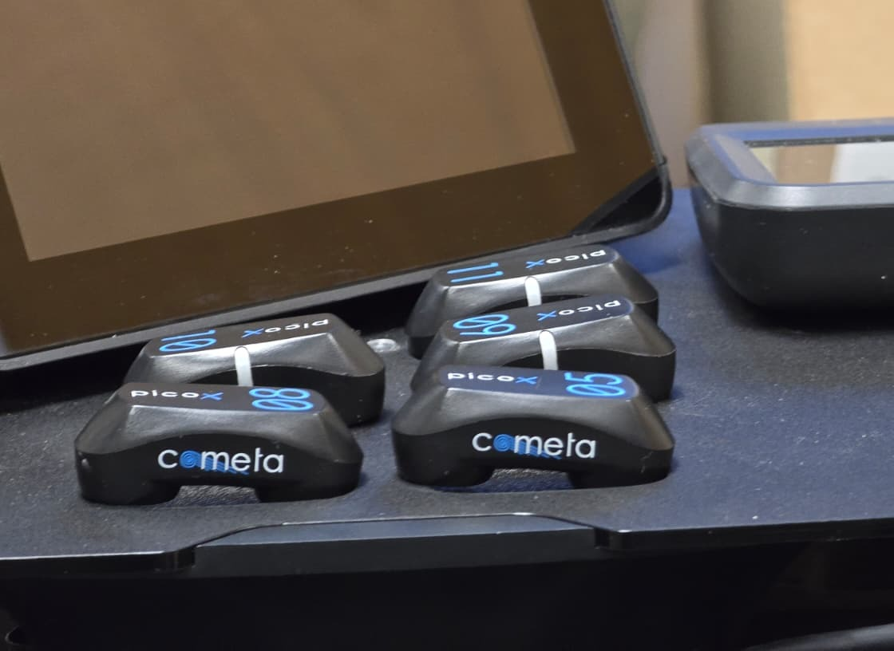
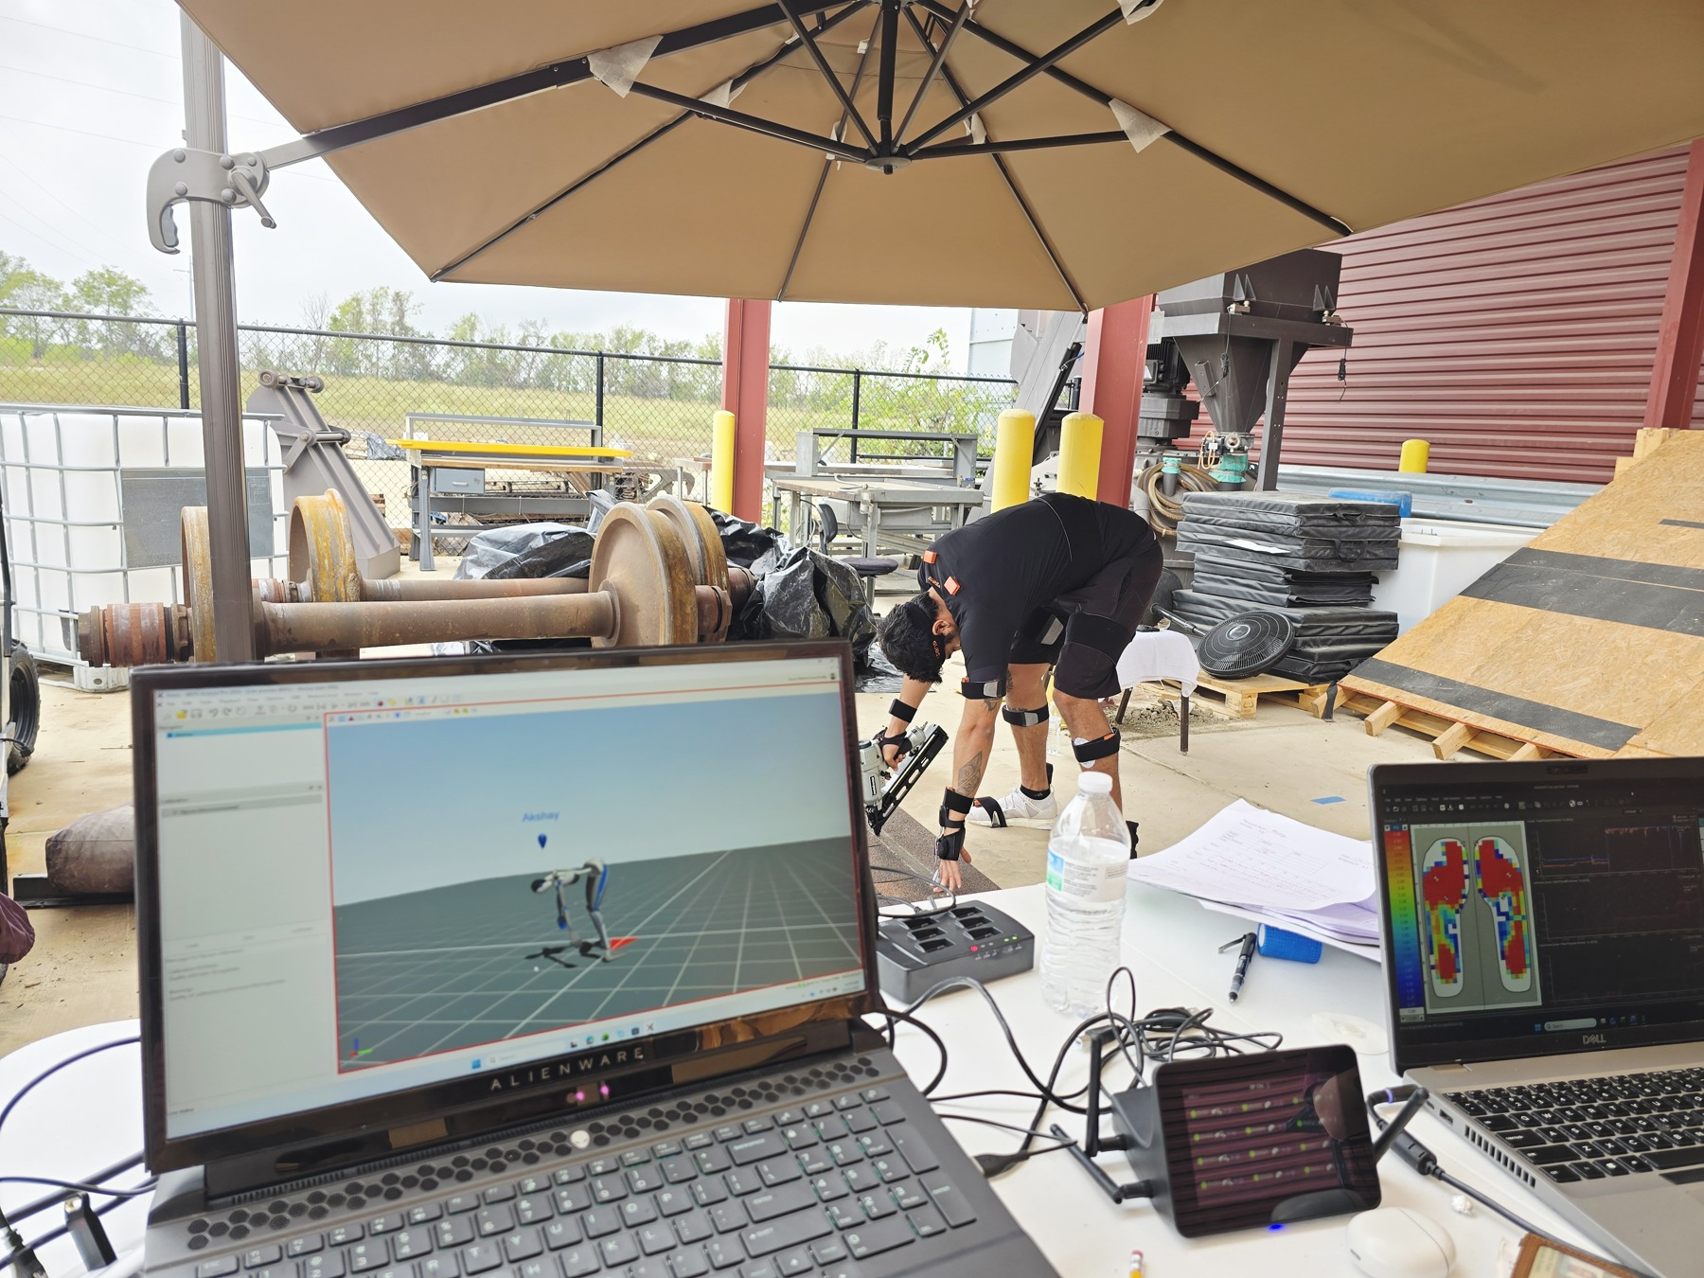
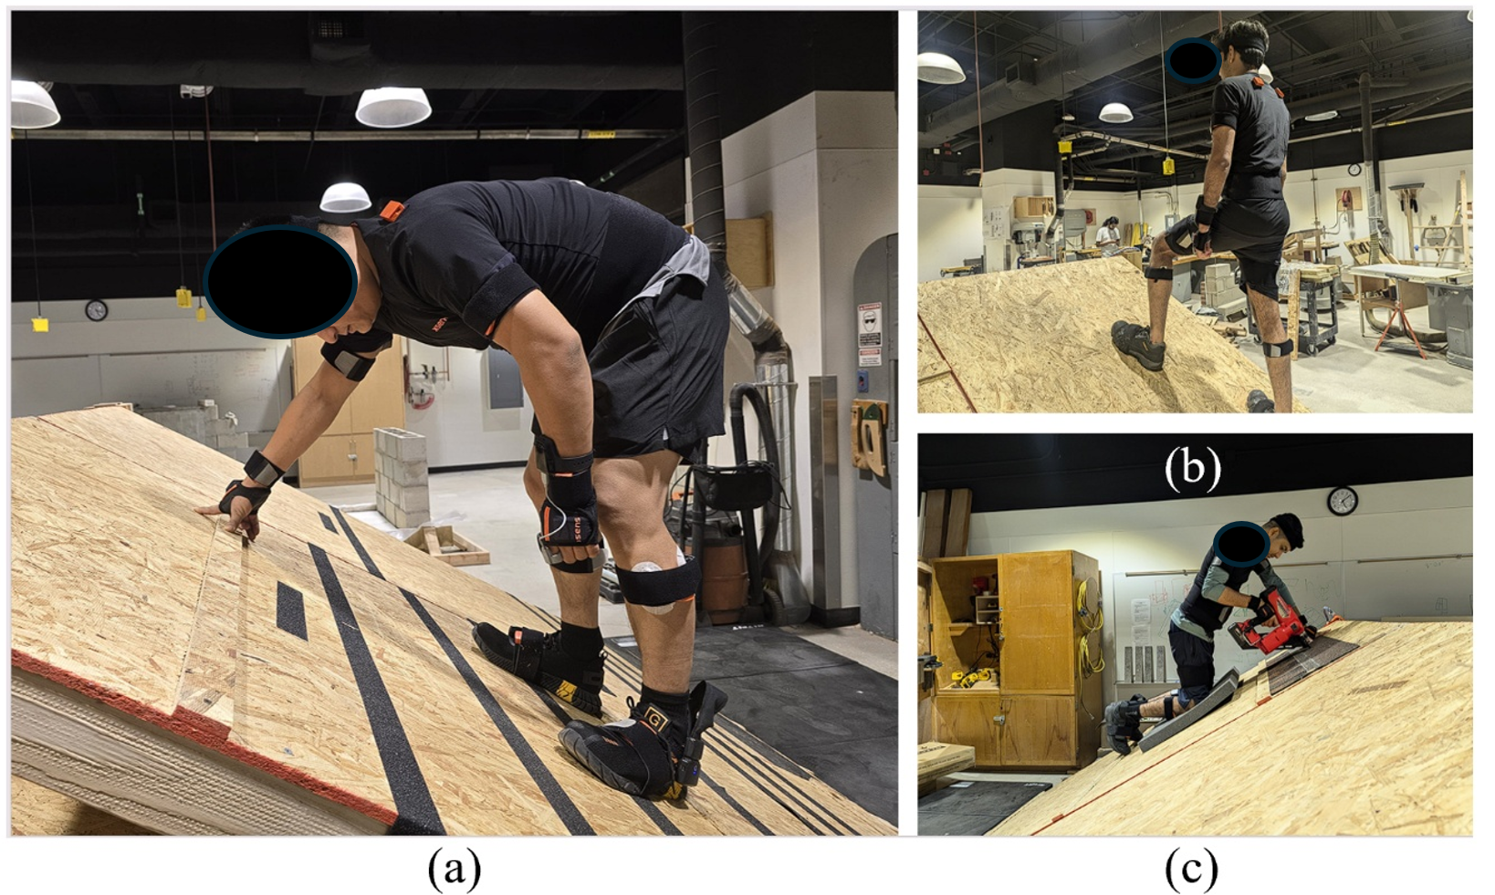
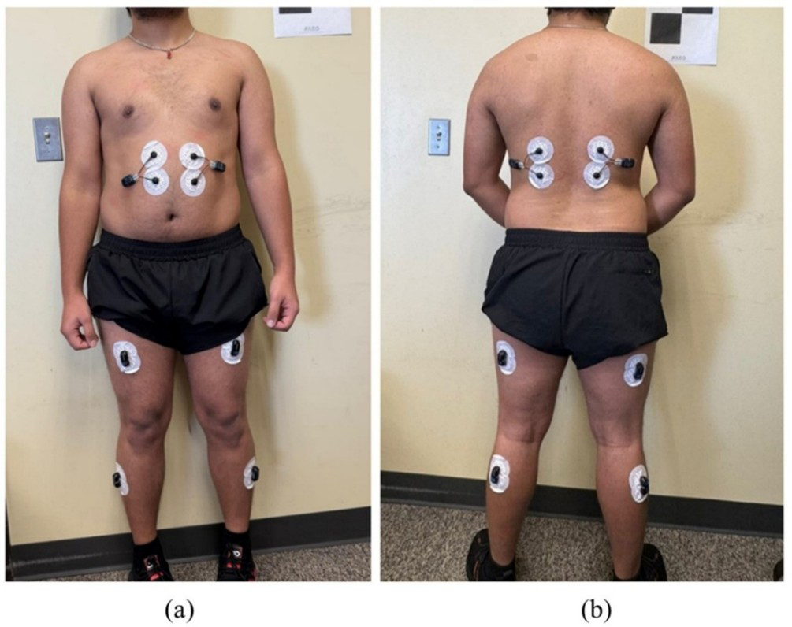
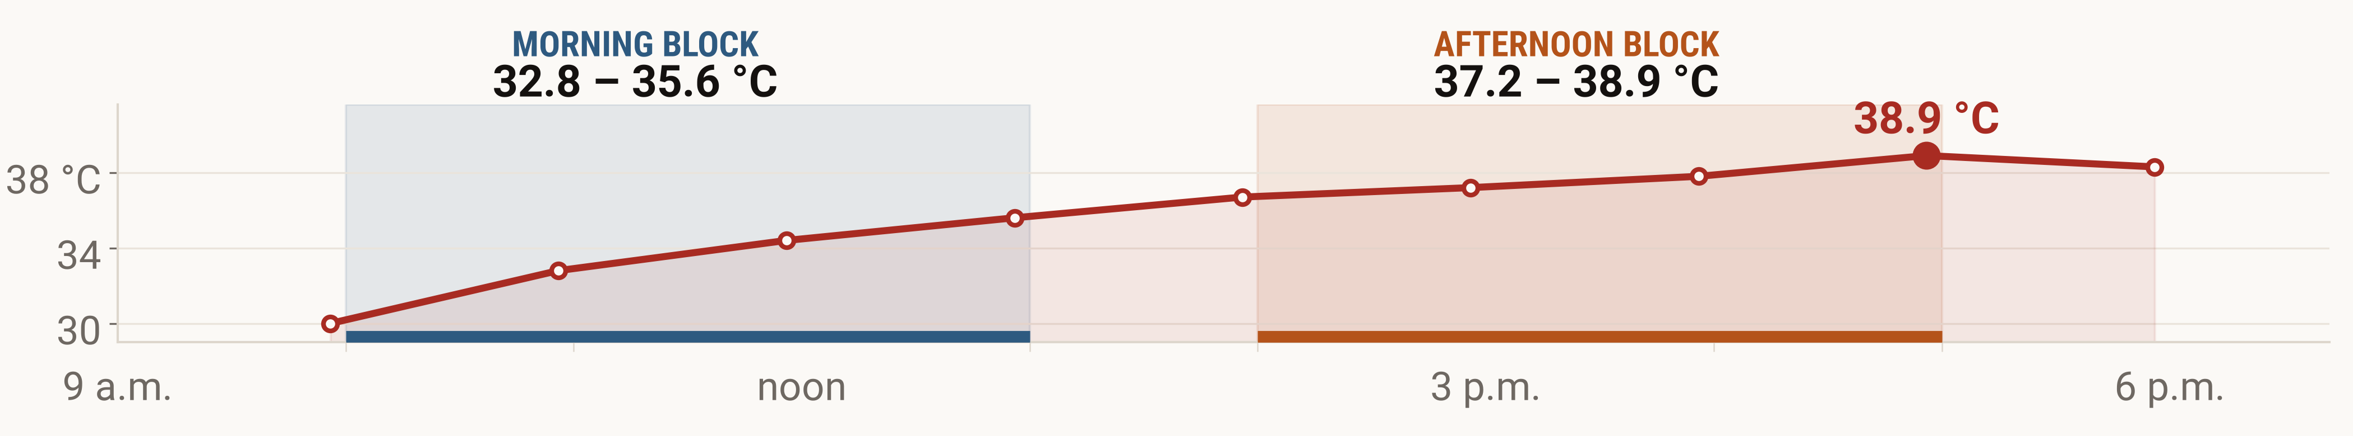
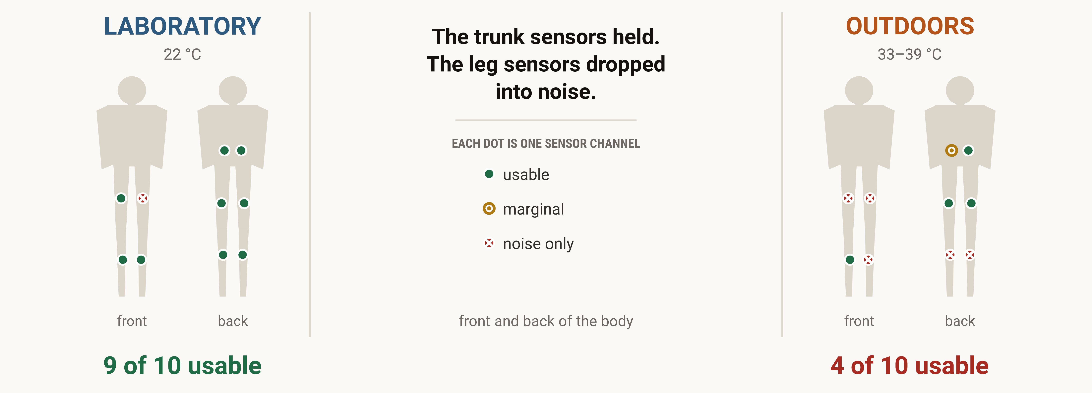
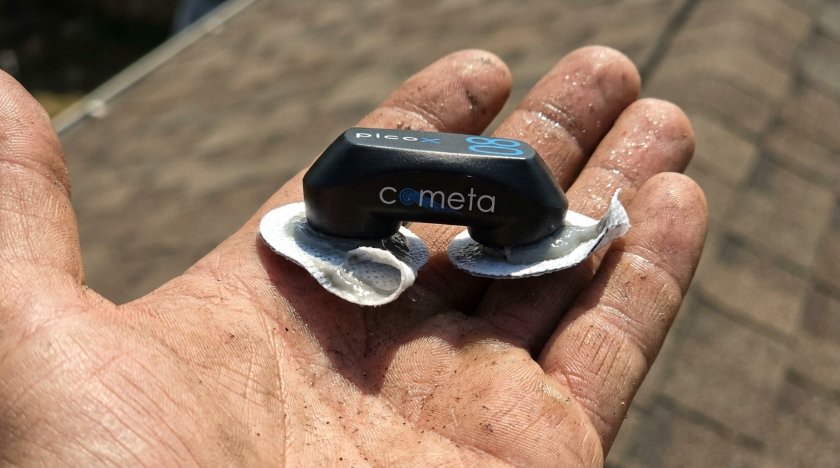
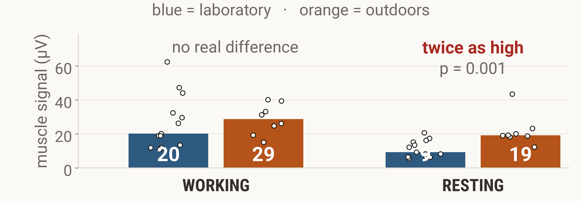
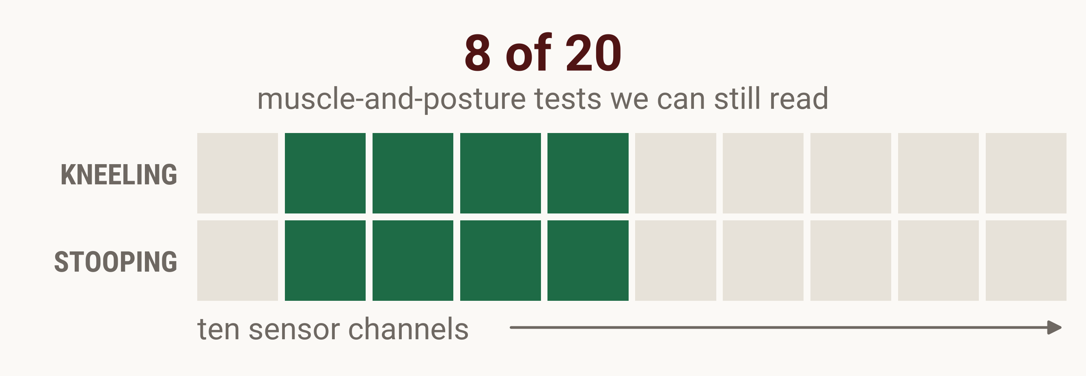
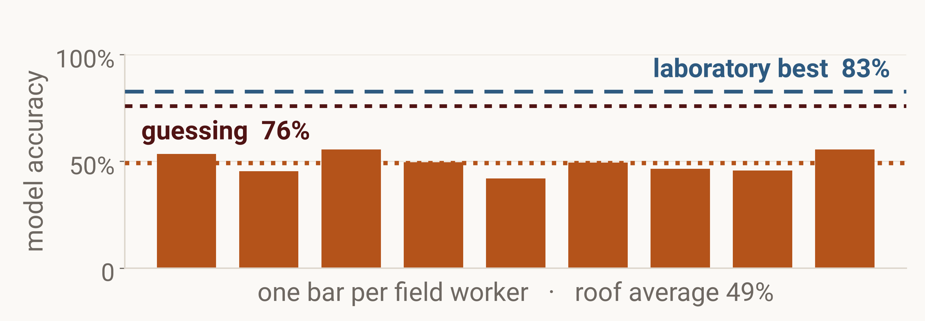
Wearable sEMG fatigue monitoring on roofers in hot environments
Sujan Acharya and Krishna P. Kisi, Ph.D., P.E. · Texas State University
19th Annual ASNEngr Conference
Houston, Texas · November 21, 2026
1
Abstract
Nepali migrants build much of the Gulf, roofing through summer afternoons on short contracts, with musculoskeletal disorders carried home rather than recorded.
Muscle fatigue precedes those disorders and the falls that injure roofers. Surface EMG (sEMG) tracks fatigue as it builds, before a worker feels it, so a body-worn sensor could warn in time. Nearly all of that evidence comes from cool laboratories.
We ran one protocol twice: indoors on a 30° platform, then at 33–39 °C on an outdoor roof mock‑up. Nine of ten channels were usable indoors, four outdoors, and the model fell to 49%, below a 76% majority-class guess. Heat and sweat took the leg channels first, so placement decides whether a study measures fatigue or noise. Nepal builds the same roofs, with no such field data.
Gulf towers
shift change in the heat
roof work at home
2
Methodology
In the laboratory
On an outdoor roof mock-up in the heat
A channel counts only if it passes all three checks
1 Above the noise floor
2 Above its own rest
3 In the muscle band
bigger than the sensor's own 3–5 µV noise
working signal beats the same channel at rest
median frequency between 50 and 150 Hz
our roof platform
on the worker
the sensor itself
the field station
the same 30° platform, indoors
ten muscles, trunk to calf
One session day: 32.8 °C through the morning block, 38.9 °C by five. NOAA station KHYI, San Marcos, 14 August 2025.
13 laboratory participants · 9 roof workers · Texas State University IRB #9962
3
Results
9
4
2.3×
1.3×
9
19
20
8
LABORATORY
OUTDOORS
LABORATORY
OUTDOORS
LABORATORY
OUTDOORS
POSSIBLE
WE CAN READ
sensor channels we could use
signal working vs resting
signal while resting
muscle-and-posture tests
out of ten
higher is easier to read
µV at the lower back
kneeling and stooping
Illustration (AI generated)
Why this happened
Sweat breaks the contact, so the signal gets smaller.
Heat and holding a posture lift the resting level.
Small muscles start closest to the noise, so they cross into it first.
Rest is no longer rest
Most comparisons are gone
The model inherits the damage
19 µV on the roof against 9 µV in the lab.
Each dot is one worker.
the leg muscles that matter for balance are the ones we lost
trained one worker at a time, it lands at 49% on roof data
4
Lessons Learned
5
Conclusion
Trunk first
Check the signal live
Teach it where workers train
A sensor setup that works in a cool laboratory did not survive a hot roof: nine usable channels became four, the leg channels went first, and the fatigue model fell to 49%, below guessing.
Field sEMG studies should be validated where the work happens: place the lower-back channels first, check every channel live before recording, and report which channels survived. In Nepal, where no roof-worn data exist, these rules are a starting point for the first field data set.
both sides of the lower back, plus one leg channel
a dead channel cannot be fixed later
vocational centres, pre-departure briefings
Where Nepal stands: no roof-worn field data exists for Nepali workers. The evidence base is Gulf-employer reports and Western labs, so these lessons are where Nepali researchers can start, on placement and on what a study can claim.
22 workers · 30° platform · one processing pipeline · every number here is computed from the recordings at print time · Limitation: different people in each setting, 13 in the laboratory and 9 on the roof, not the same workers tested twice
Reference: Acharya, S., Kisi, K., Gautam, S. R., Mahmud, T., & Kayastha, R. (2025). A high-performance hybrid transformer–LSTM–XGBoost model for sEMG-based fatigue detection in simulated roofing postures. Buildings, 15(17), 3005.
Gulf and Nepal photographs: Imre Solt (CC BY-SA 3.0) and Adam Jones (CC BY-SA 2.0), via Wikimedia Commons.
Sweat-on-the-electrode image: made with Google Flow (Nano Banana 2).

