Slide 1

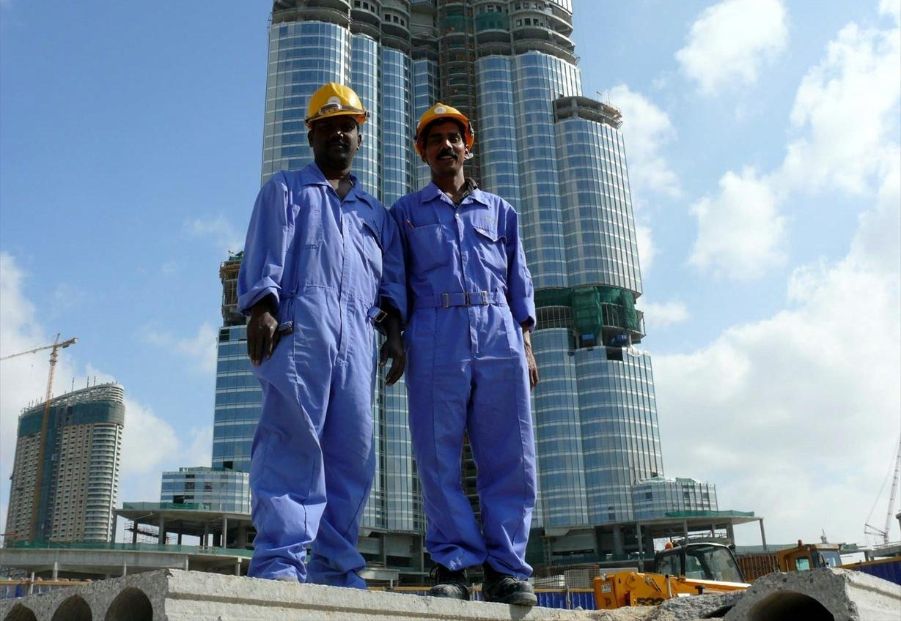
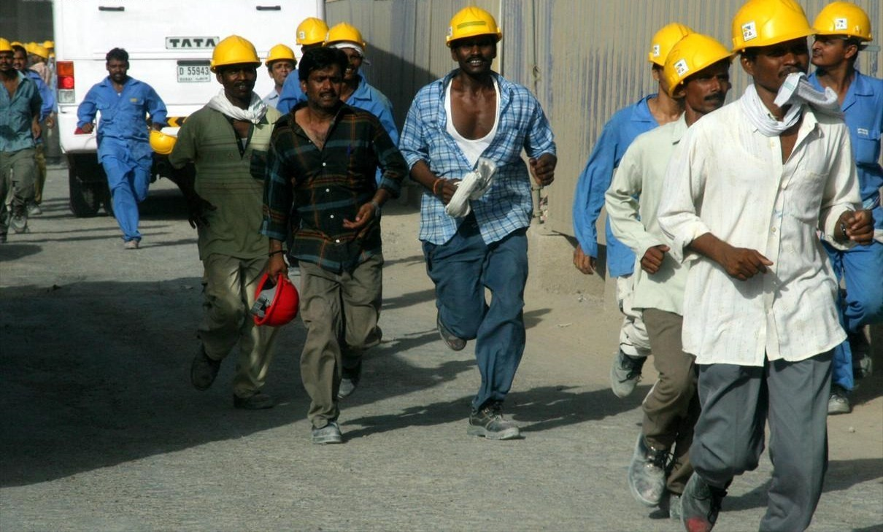
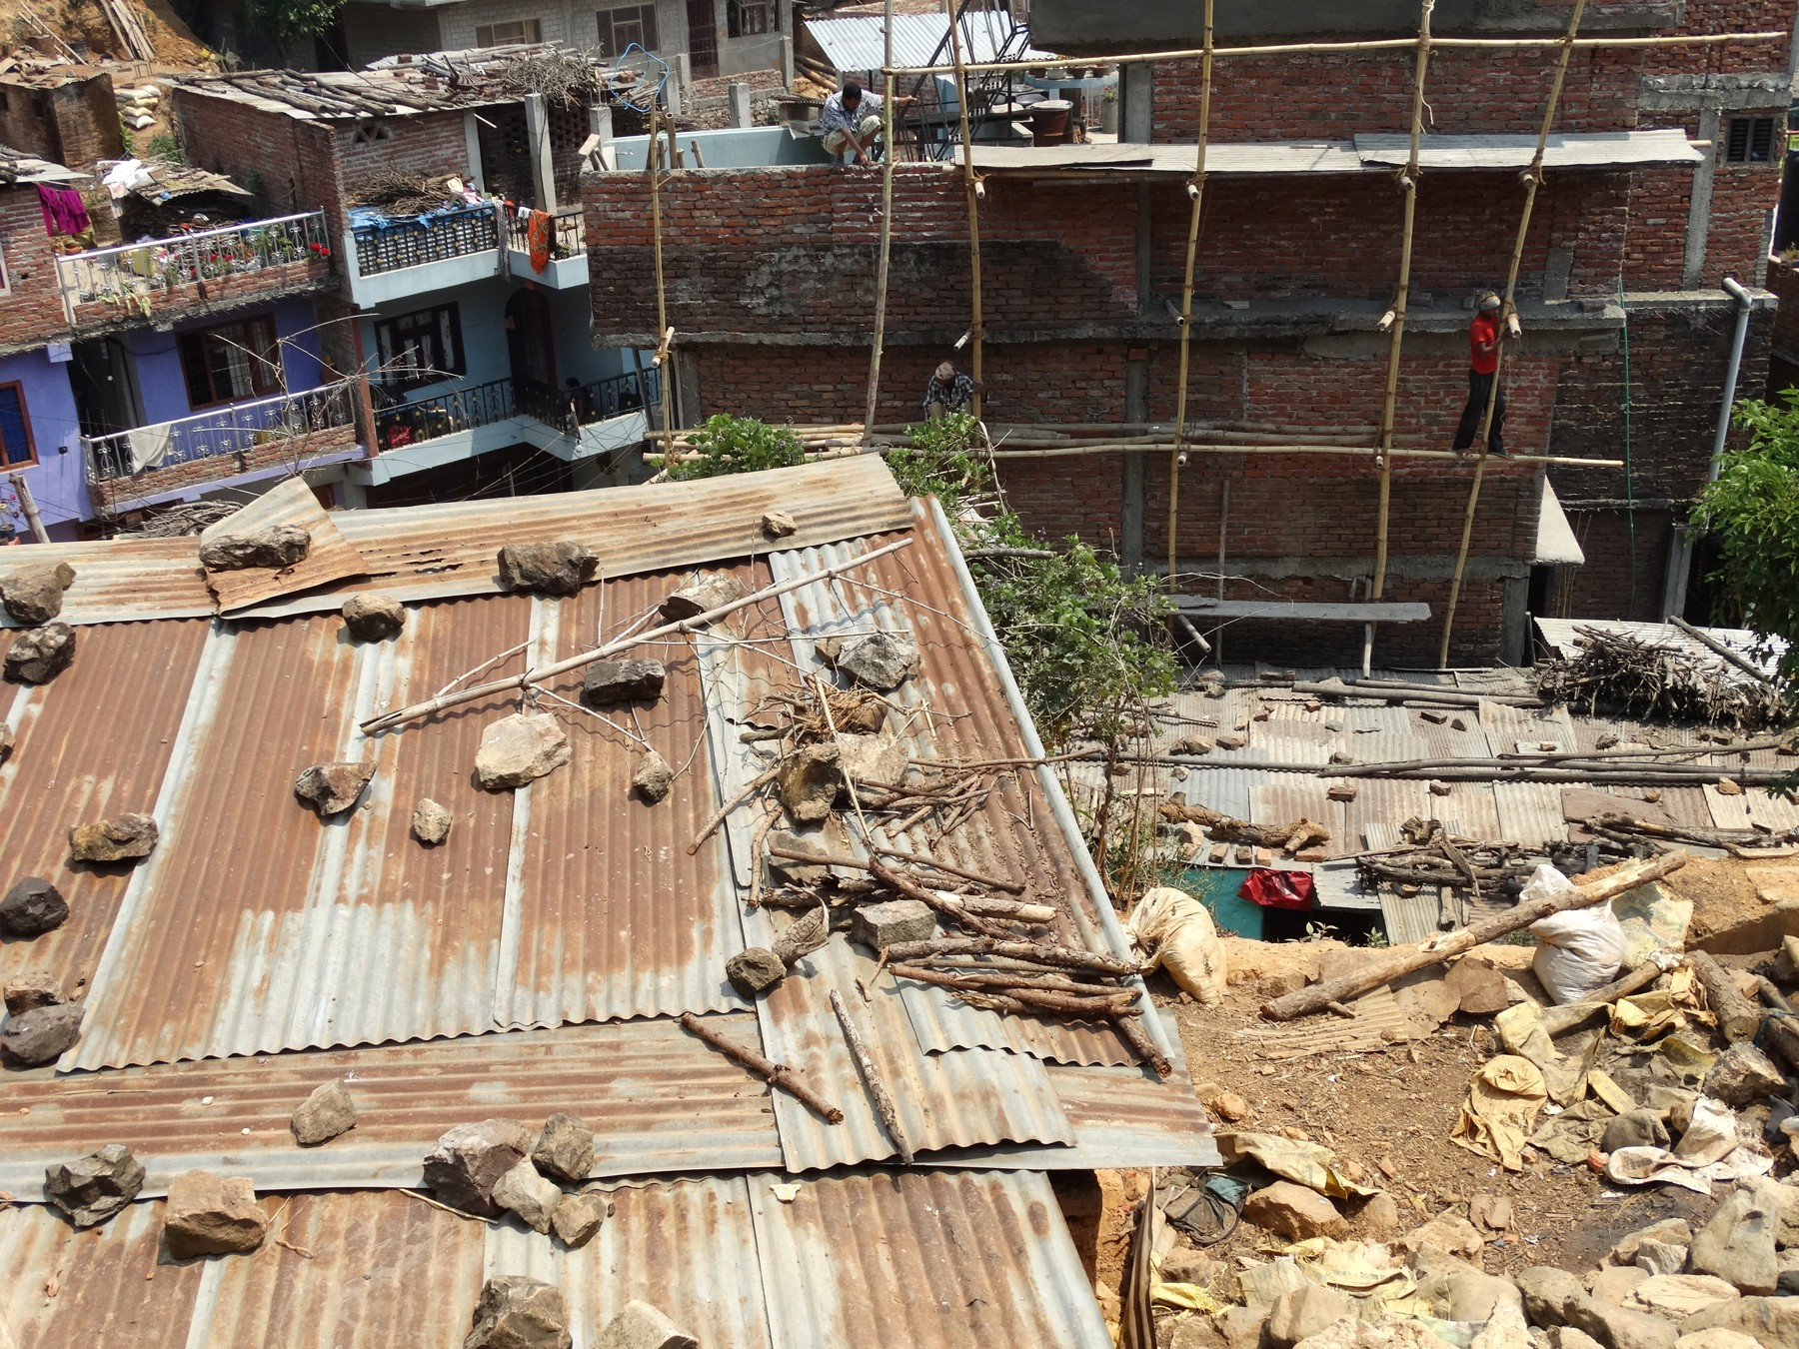
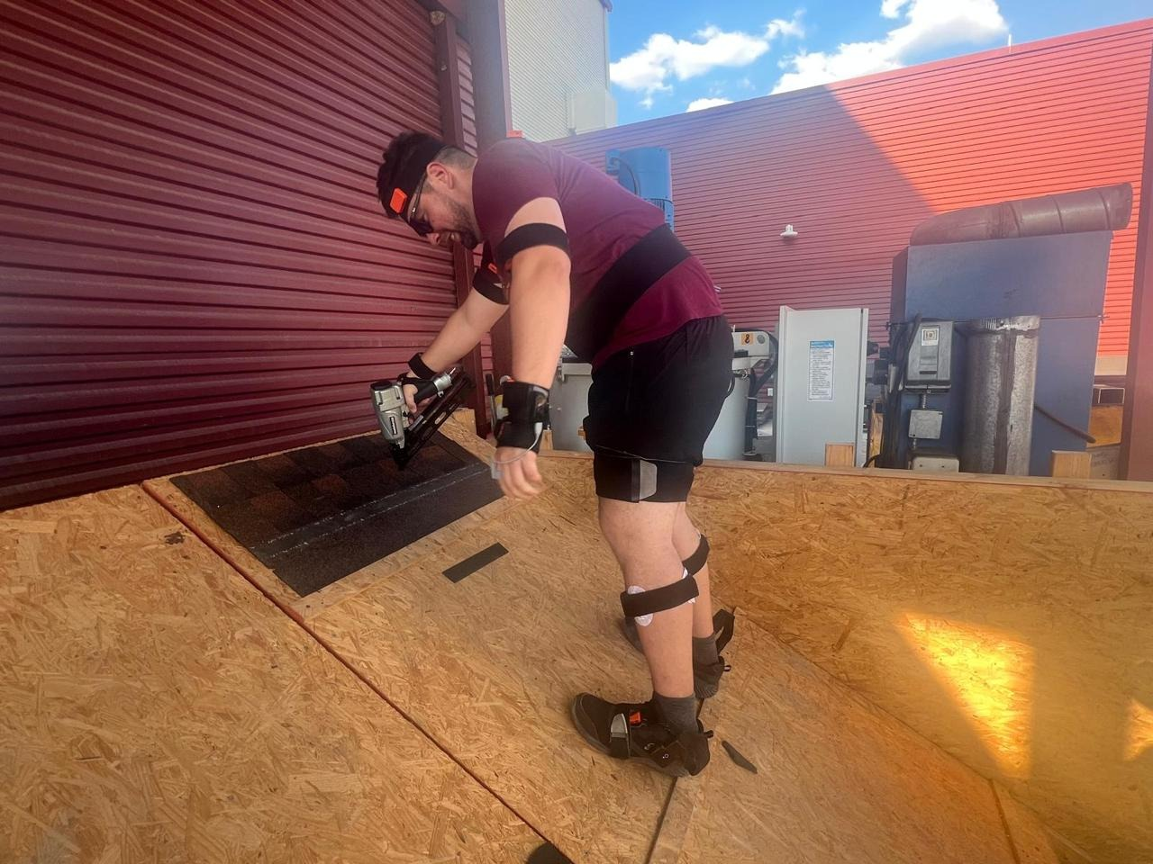
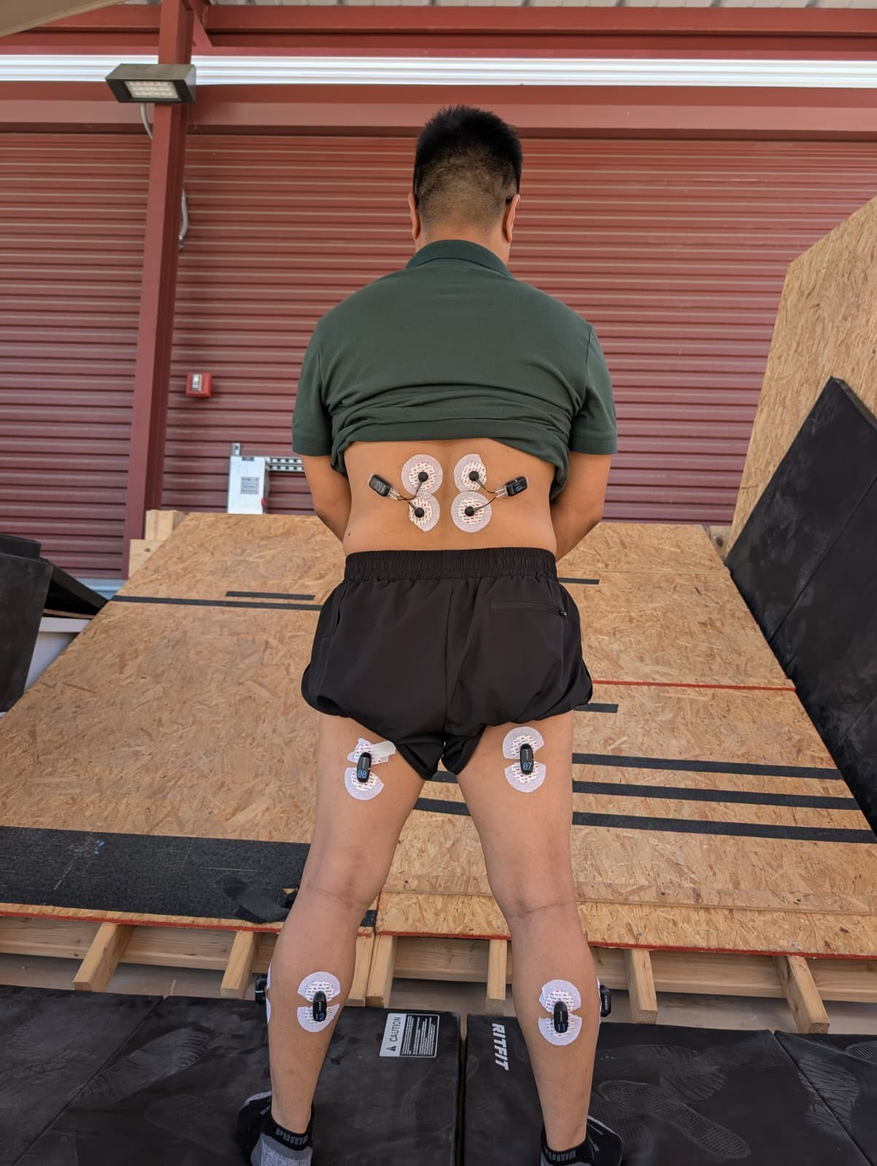
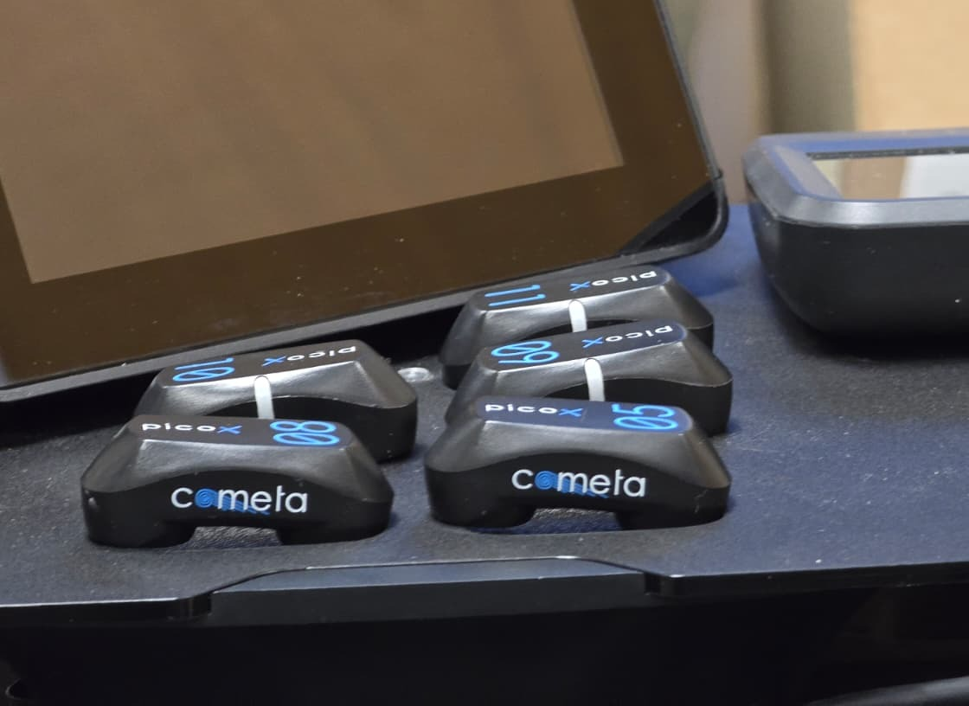
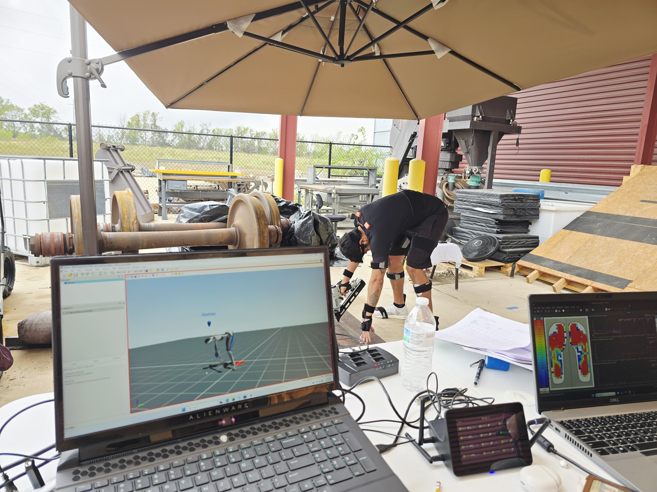
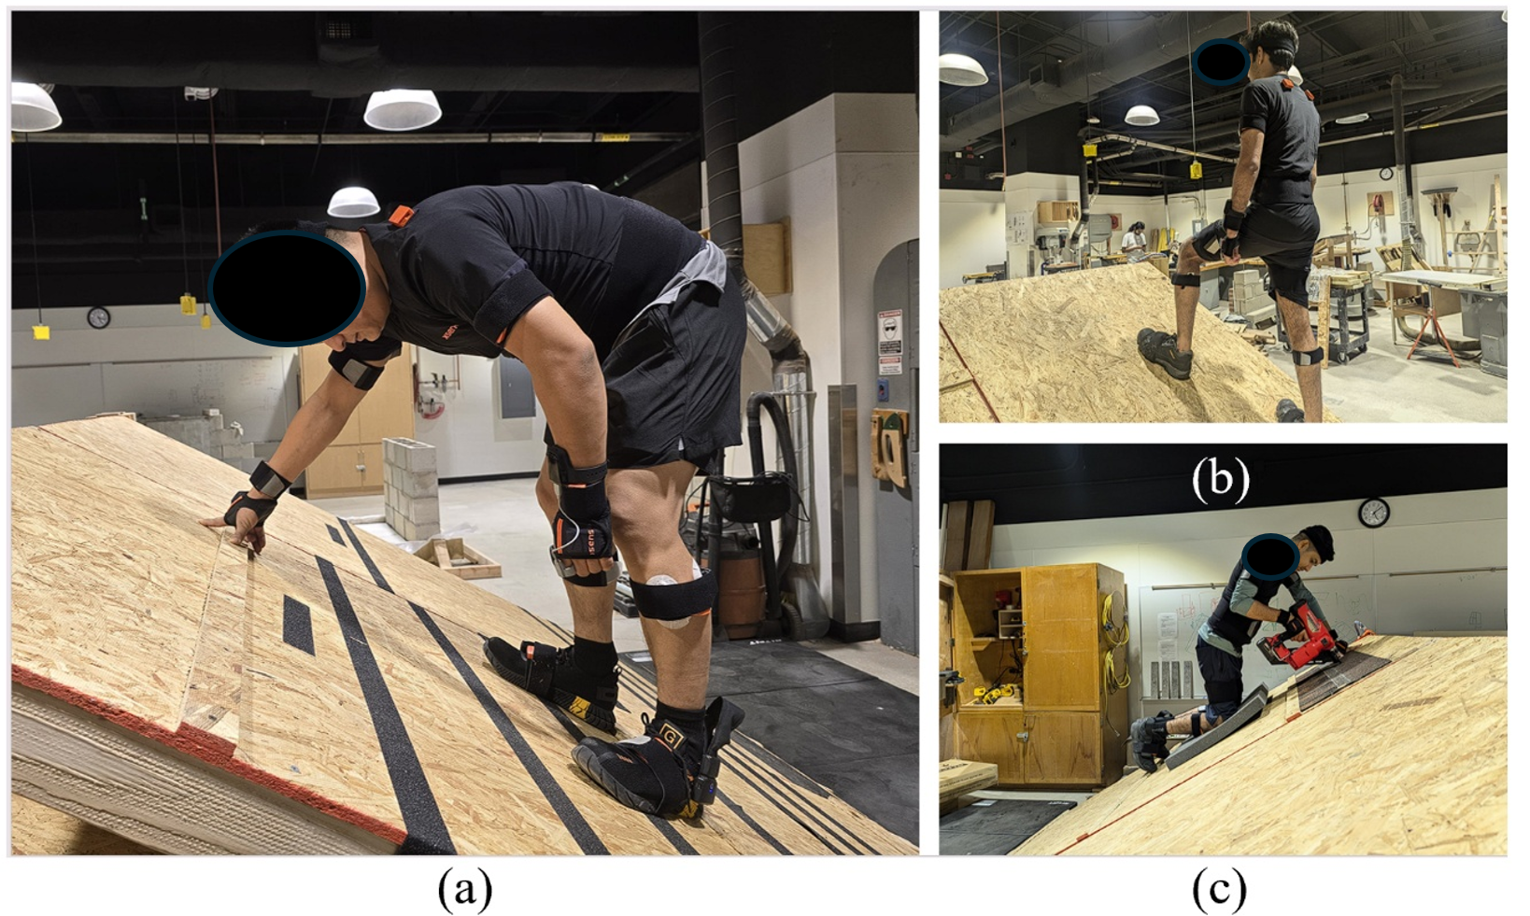
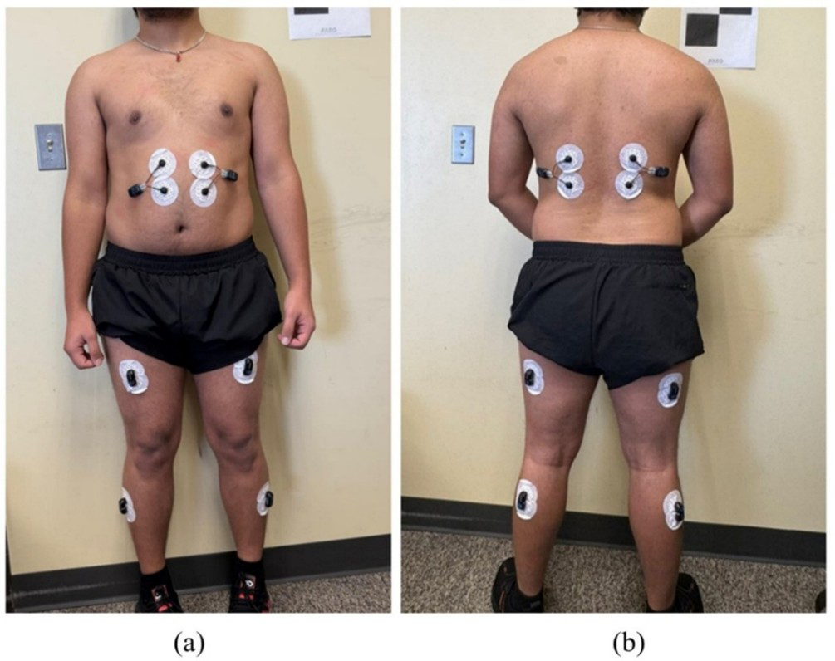
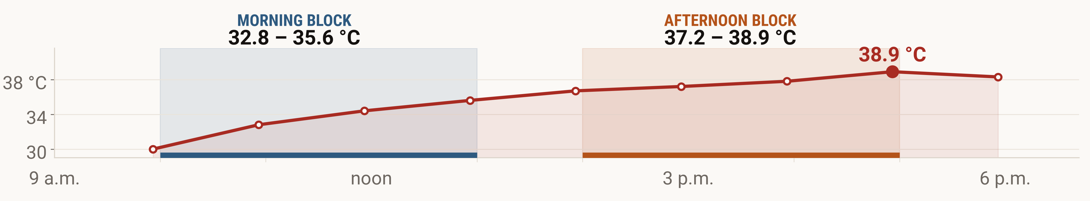
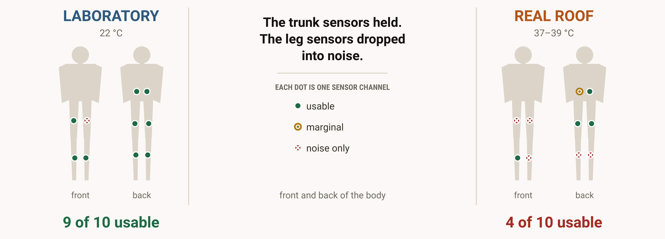
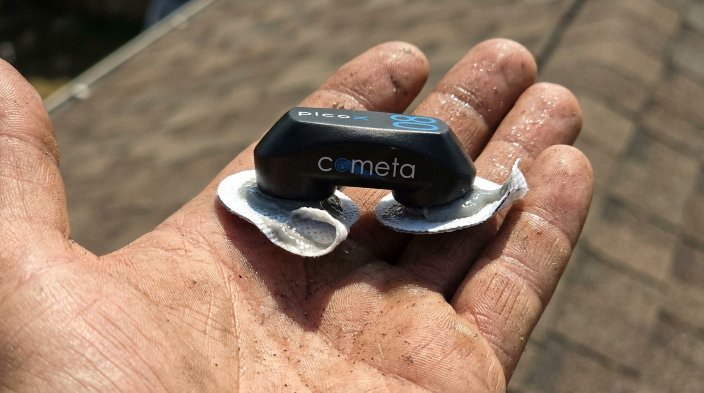
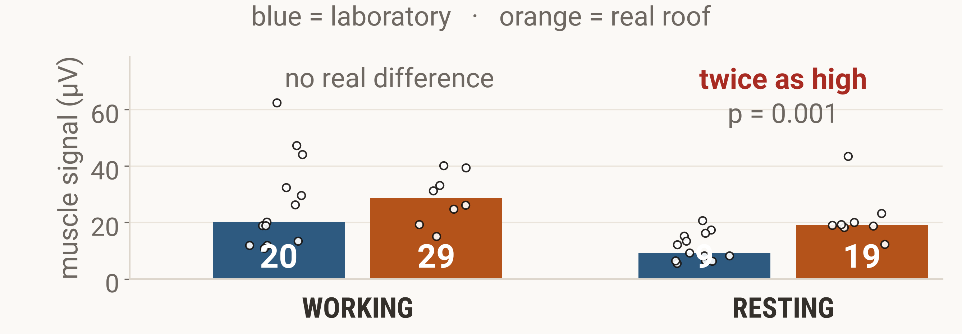
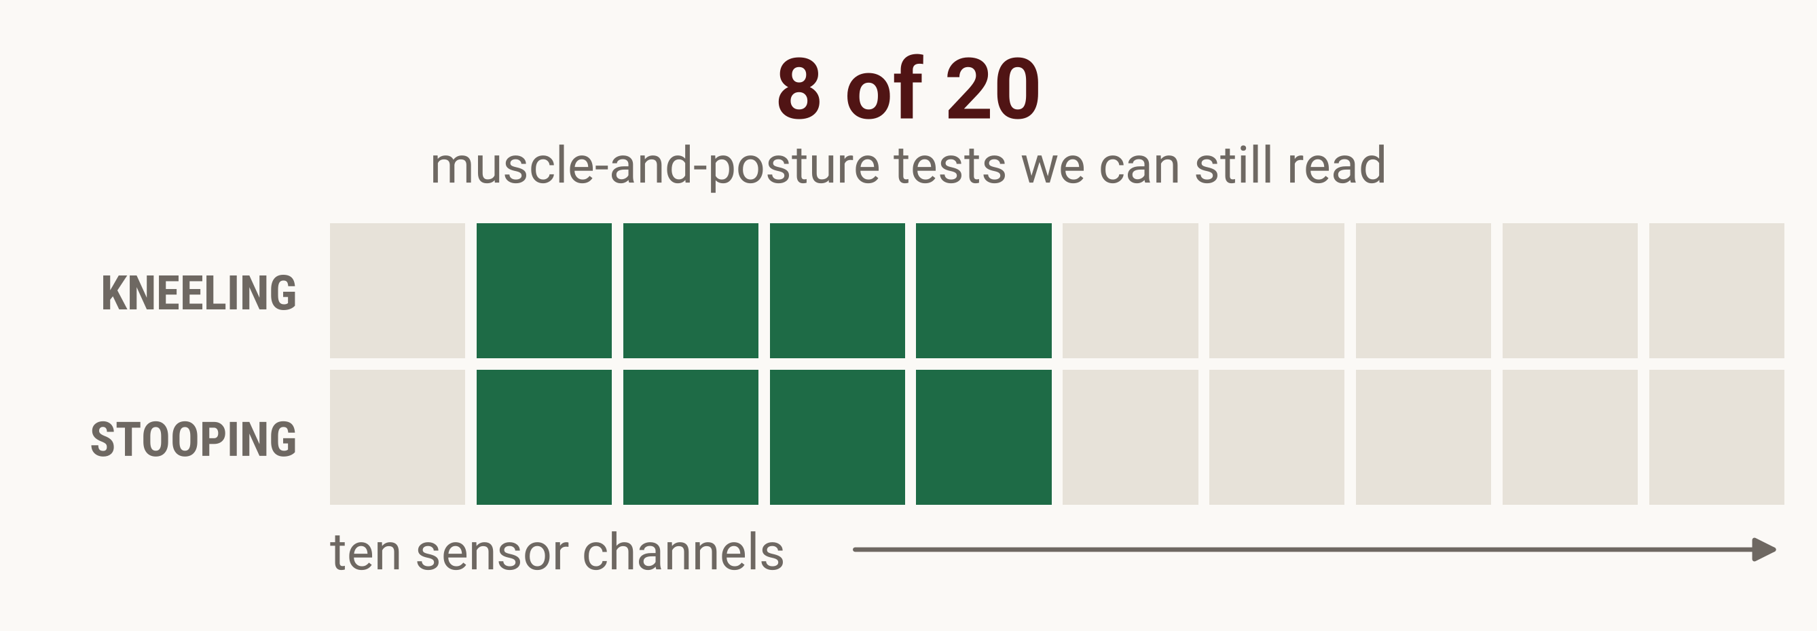
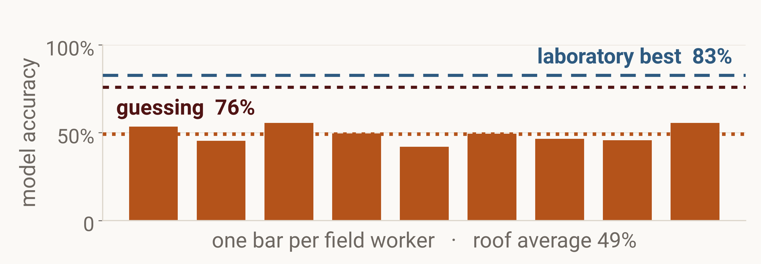
Nine of Ten Muscle Sensors Worked in the Lab.
On a Hot Roof, Only Four Did.
19th Annual ASNEngr Conference
Houston, Texas · November 21, 2026
Sujan Acharya and Krishna P. Kisi, Ph.D., P.E.
Texas State University
1
Background
Nepali workers build in the heat.
Thousands of Nepali workers put up towers in the Gulf. Roofs at home go up the same way: in the sun, with nobody watching for heat strain.
Sensors worn on the body could warn a worker in time. Almost every test of those sensors has been run in a cool, quiet laboratory.
Gulf towers
shift change in the heat
roof work at home
2
Methodology
In the laboratory
On a real roof
A channel counts only if it passes all three checks
1 Above the noise floor
2 Above its own rest
3 In the muscle band
bigger than the sensor's own 3–5 µV noise
working signal beats the same channel at rest
median frequency between 50 and 150 Hz
our roof platform
on the worker
the sensor itself
the field station
the same 30° platform, indoors
ten muscles, trunk to calf
One session day: 32.8 °C through the morning block, 38.9 °C by five. NOAA station KHYI, San Marcos, 14 August 2025.
13 laboratory participants · 9 roof workers · Texas State University IRB #9962
3
Results
9
4
2.3×
1.3×
9
19
20
8
LABORATORY
REAL ROOF
LABORATORY
REAL ROOF
LABORATORY
REAL ROOF
POSSIBLE
WE CAN READ
sensor channels we could use
signal working vs resting
signal while resting
muscle-and-posture tests
out of ten
higher is easier to read
µV at the lower back
kneeling and stooping
Illustration (AI generated)
Why this happened
Sweat breaks the contact, so the signal gets smaller.
Heat and holding a posture lift the resting level.
Small muscles start closest to the noise, so they cross into it first.
Rest is no longer rest
Most comparisons are gone
The model inherits the damage
19 µV on the roof against 9 µV in the lab.
Each dot is one worker.
the leg muscles that matter for balance are the ones we lost
trained one worker at a time, it lands at 49% on roof data
4
Discussion
Trunk first
Check the signal live
Teach it where workers train
5
Limitations
What to take to Nepal
both sides of the lower back, plus one leg channel
a dead channel cannot be fixed later
vocational centres, pre-departure briefings
Small groups of different people: 13 in the laboratory and 9 on the roof, not the same workers tested twice.
Check the sensors before the session, not after.
22 workers · 30° platform · one processing pipeline · every number here is computed from the recordings at print time
Reference: Acharya, S., Kisi, K., Gautam, S. R., Mahmud, T., & Kayastha, R. (2025). A high-performance hybrid transformer–LSTM–XGBoost model for sEMG-based fatigue detection in simulated roofing postures. Buildings, 15(17), 3005.
Gulf and Nepal photographs: Imre Solt (CC BY-SA 3.0) and Adam Jones (CC BY-SA 2.0), via Wikimedia Commons.
Sweat-on-the-electrode image: made with Google Flow (Nano Banana 2).

