Slide 2
agent_interface
AddNewCommand
choose_interface
Add_COA_command
model_table_body
onboard_model
my-range-slider
Model_table_body
select_mode
Model_table_head
Model_table_subhead
Coa_update
Triggers

Slide 3
Visualization
Telemetry A
Telemetry B
Telemetry C
New COA
Generate
Timeline
COA List
Interfaces
New Action
COA Actions
Interface A
Action A
Action Parameters A
COA Editor
Interface B
Action B
Action Parameters B
Interface C
Action C
Action Parameters C

Slide 4




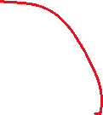














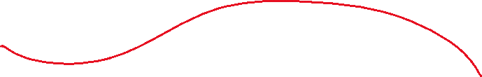



Visualization
Telemetry A
Telemetry B
Telemetry C
New COA
Generate
Timeline
COA List
Interfaces
New Action
COA Actions
Interface
Action A
Action Parameters A
COA Editor
COA Name
Action B
Action Parameters B
Agent
Action C
Action Parameters C

Slide 5
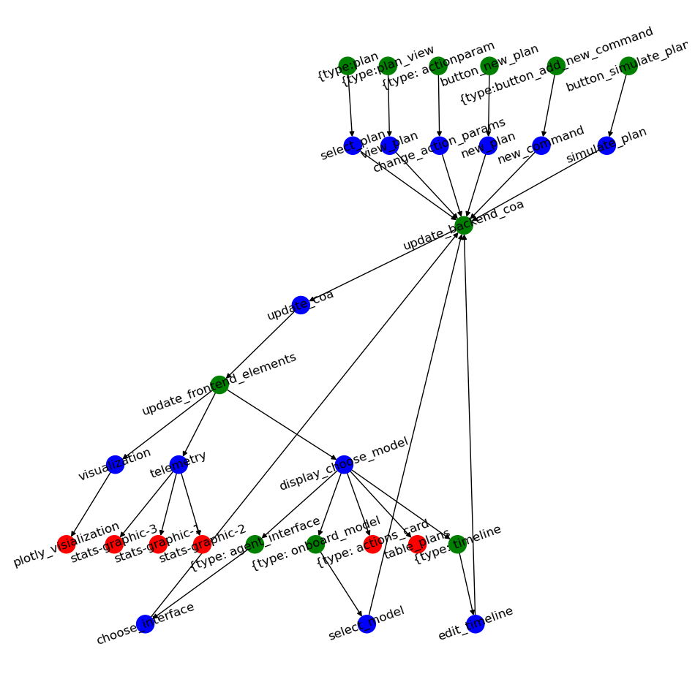
Backend
COA Interface
Front End
SIM Parameters
COA Library:
Agent Type – “type_i”
COA’s Saved By Type
Joint COA’s (Plans) contain refs to COAs

Slide 6
How we should understand the stack:
COACH Wrapper
Turns a PettingZoo Env into a COACH Env.
Course of Action C.. Hierarchy
COACH Env’s Load a list of agent models, and then given courses of action for each model runs the env forward a specified amount of time. COACH env’s can also pause the env and simulate forward without running them. A properly implemented COACH env has easily trasferable states.
DASH Frontend
Provides user interactivity
Gym COACH
Converts A COACH env into a PettingZoo Gym by making the choices of how actions are mapped to COAs, what a time step consists of
Simulation [PettingZooEnv]
Any multiagent simulation with a standard PettingZoo Interface
Base Sim, Standard RL Works
COA Based Env, agents run roles. To apply standard RL must decide how COA’s will be generated, what a time step is.

