Slide 1
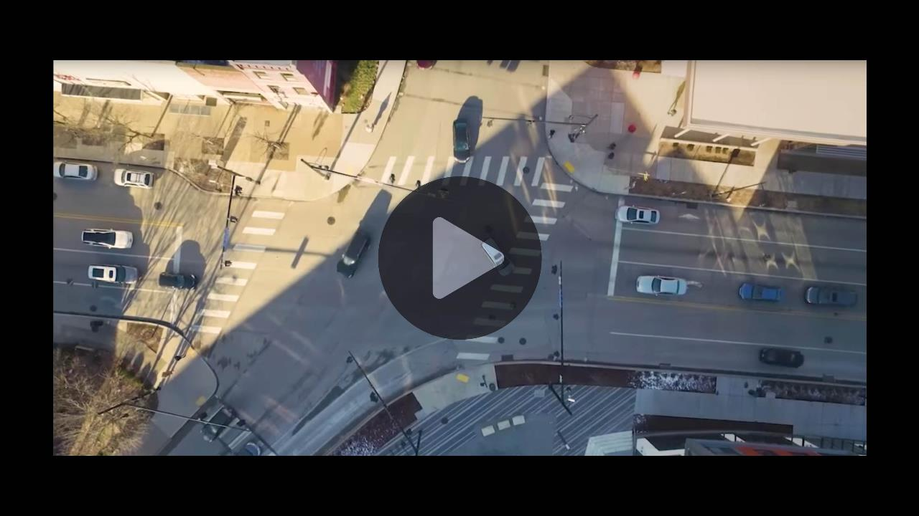

Slide 2
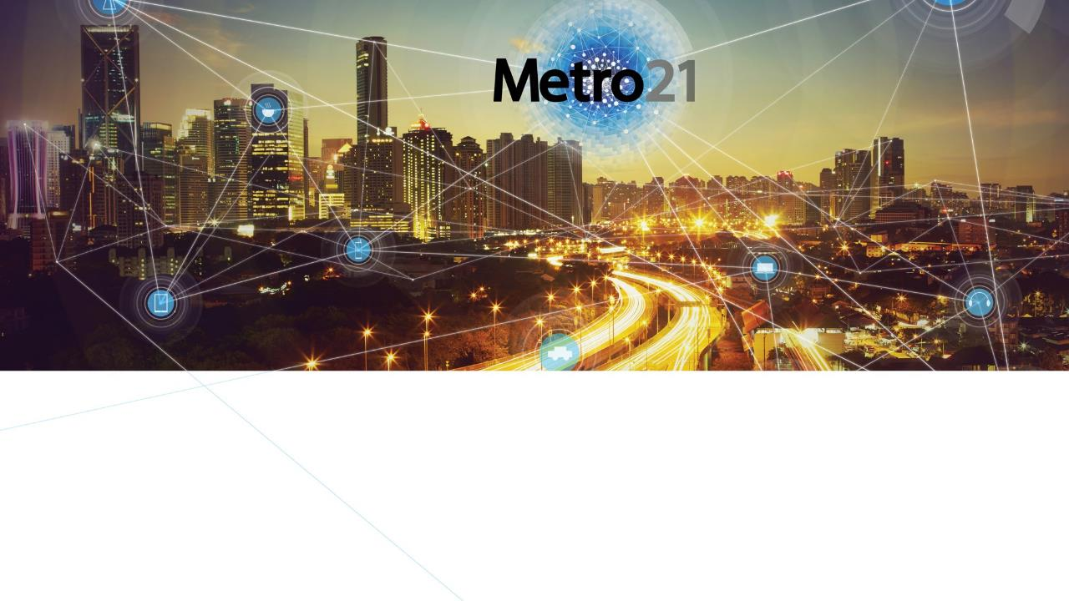
Smart Cities Institute
http://metro21.cmu.edu
Overview

Slide 3
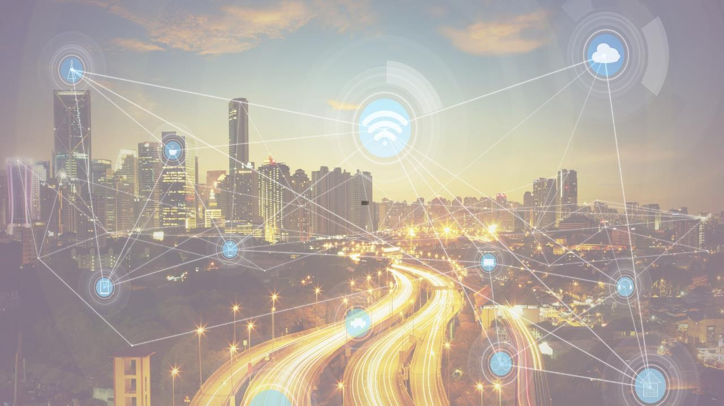
Mission
Develop 21st Century solutions to the challenges facing metropolitan regions.

Slide 4
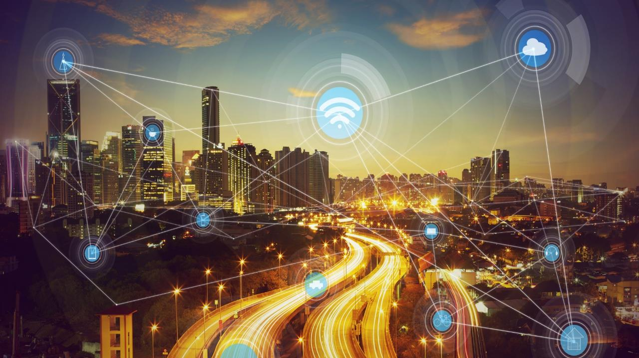
Metro21 Quick Facts
Formed in 2014, Metro21 spun out of Traffic21, Carnegie Mellon's successful transportation institute and two USDOT National University Transportation Centers.
Metro21 is a university-wide institute.
Metro21's backbone is its strong partnerships with government agencies, the private sector and the non-profit sector.

Slide 5
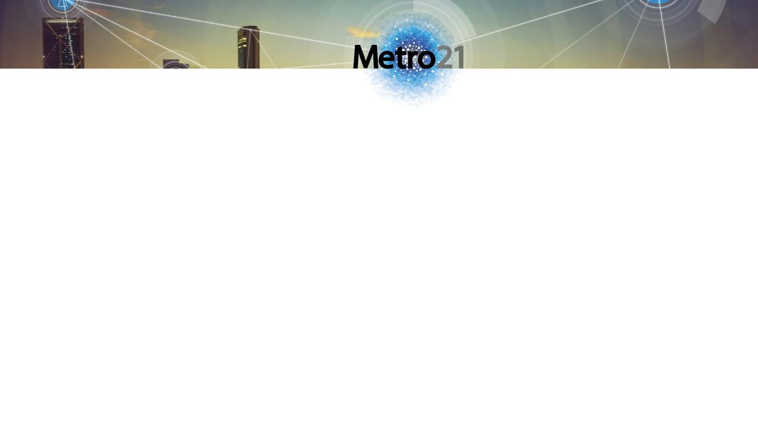
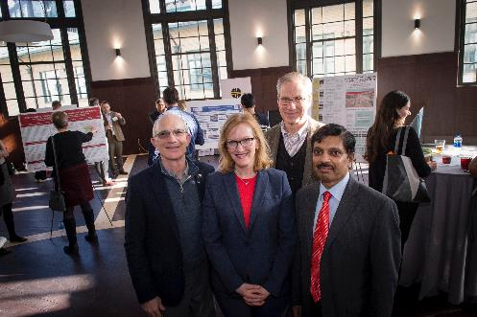
Metro21 – Core Leadership
Smart Cities Institute
Director: Dr. Raj Rajkumar,
George Westinghouse Professor of
Electrical and Computer Engineering
Executive Director: Karen Lightman
Distinguished Fellow: Rick Stafford,
Distinguished Service Professor of
Public Policy and former Director of the Traffic21 Institute
Stan Caldwell, Executive Director, Traffic21 Institute
Chelsea Cavlovic, Senior Administrative Coordinator

Slide 6
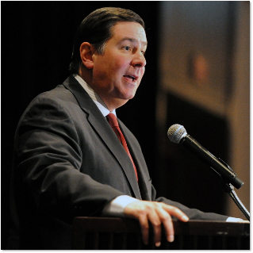
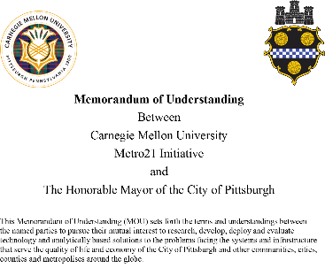
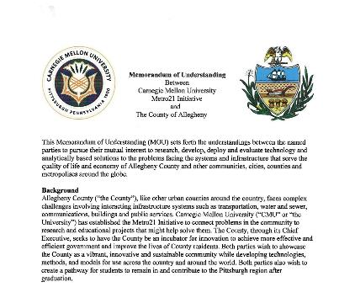
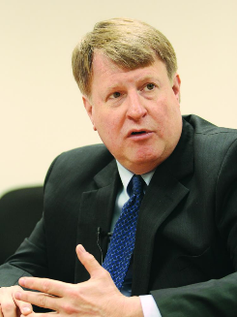
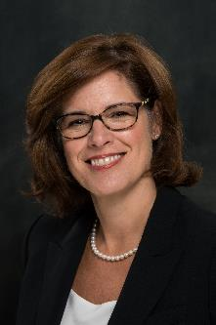
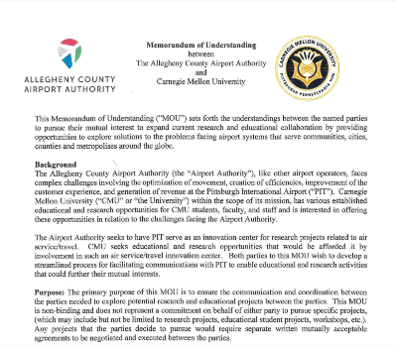

Slide 7
Smart Cities Institute
Executive Committee
Robert Dammon, Dean, Tepper School of Business
Rebecca Doerge, Dean, Mellon College of Science
James Garrett, Dean, College of Engineering
Farnam Jahanian, President, Carnegie Mellon University
Ramayya Krishnan, Dean, Heinz College
Dan Martin, Dean, College of Fine Arts
Andrew Moore, Dean, School of Computer Science
Richard Scheines, Dean, Dietrich College of Humanities and Social Sciences
Governing Deans

Slide 8

The Metro21 Family
Smart Cities Institute
Notes:
Explain the relationship with Traffic21, Mobility21, UTCs, and other partners – talk about coordination of centers (be specific and descriptive)

Slide 9

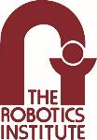
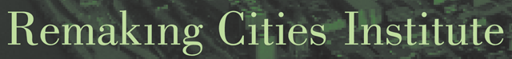

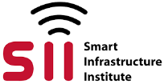
Smart Cities Institute
Metro21 Partners at CMU

Slide 10






A Smart City: A “System of Systems”
,,,
Far greater than an assembly of technologies and data
Safe mobility
Net zero energy
Clean air and water
Economic
prosperity
Safe and healthy citizens
Smart buildings and infrastructure
…

Slide 11

Pillars of Metro21
Inter-disciplinary focus:
people, technology and policy
Intellectual core:
scholarship, science and education
Solutions to real-world problems:
    Research, Development and Deployment (RD&D)

Slide 12
Sampling of Pittsburgh Case Studies

Slide 13
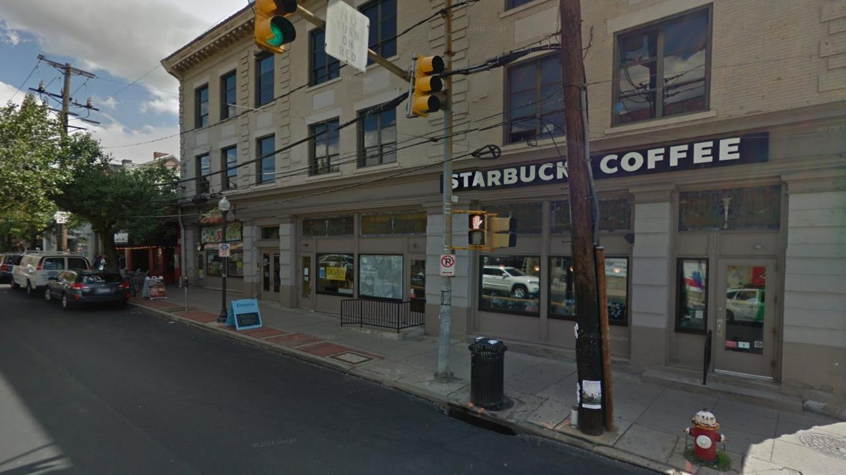





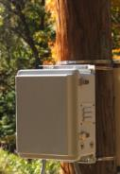
Camera Positioning on Street Light/Traffic Light Poles
Networking
Power+Data
Power
Compute/networking node:
Small cabinet at ~6ft
(contains processing + accepts power)
Plan is to perform dense, high-resolution capture of busy intersections. (Approximately 10-20 cameras observing a single intersection from different angles.)

Slide 14
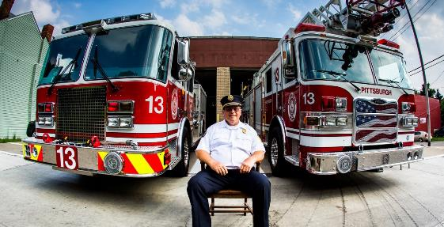
Smart Cities Institute
Fire Risk Analysis
Historical fire incident and inspection data
Predictive models of structure fire risk
Prioritize commercial properties at greatest risk

Slide 15
Smart Cities Institute
Wireless Infrastructure Enabling Smart Cities
Advanced wireless testbed
Public and private sectors
Advanced at-scale wireless infrastructure

Slide 16

Innovation and Entrepreneurship
Smart Cities Institute
Metro21 has built momentum that has launched several startups

Slide 17
Summary
Smart Cities Institute
The Metro21: Smart Cities Institute leverages innovations in technology, policy and their interplay to have a positive impact on metropolitan societies.
Metro21 solves real-world problems assisted by an intellectual core of scholarship, education and expanding knowledge.
Metro21 is developing a science of smart cities.
Metro21 works closely with government, private sector and non-profit partners.

Slide 18
Partner with CMU to stay on the cutting edge of smart-city solutions. Contact our world-renowned leaders and join us on the road to a better future.
Karen Lightman, Executive Director karenlightman@cmu.edu
Follow us: @Metro21CMU

