Slide 1

STRAY ANIMAL SAVIORs

Slide 2

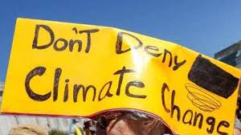
Climate change
Climate change is a significant variation of average weather conditions—say, conditions becoming warmer, wetter, or drier—over several decades or more.

Slide 3
Imperiled ecosystems
Climate change is increasing pressure on wildlife to adapt to changing habitats—and fast.
Many species are seeking out cooler climates and higher altitudes, altering seasonal behaviors, and adjusting traditional migration patterns. These shifts can fundamentally transform entire ecosystems and the intricate webs of life that depend on them.
As a result, according to a 2014 IPCC climate change report, many species now face “increased extinction risk due to climate change.” And one 2015 study showed that mammals, fish, birds, reptiles, and other vertebrate species are disappearing 114 times faster than they should be, a phenomenon that has been linked to climate change, pollution, and deforestation—all interconnected threats.

Slide 4
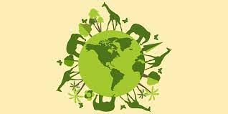
Animal conservation
Reduction in numbers of one animal can also have a chain effect on other species that are important to human beings.
All animals play an important role in the eco system.
The loss or reduction of certain species can have a flow on effect; including an affect on human food and water source that are critical to our survival.
By conserving wildlife, we're ensuring that future generations can enjoy our natural world and the incredible species that live within it. To help protect wildlife, it's important to understand how species interact within their ecosystems, and how they're affected by environmental and human influences.

Slide 5
Problem: TROUBLED ANIMALS
Almost everyday we come across animals outside of their natural habitat.
Often times lost from the forest, in pain, and clueless where to head to mainly due to:
- Animal Cruelty:
Various human activities involving animals have adverse impacts on them. Animal cruelty can be broken down into two main categories: active and passive.
Active animal cruelty takes place when someone deliberately inflicts harm on an animal.
Passive cruelty is typified by cases of neglect, in which the cruelty is a lack of action rather than the action itself. Oftentimes passive animal cruelty is accidental, born of ignorance.
- Migrated animals:
During these days of lockdown across various parts of India, we see reports of ‘wild’ animals coming over to the cities, towns and urban clusters.
To get a perspective of this, note that of the total land area of the world, which is about 510 million square km, 30% is desert and 24% mountainous, leaving us humans to occupy about 45-50% of the remaining area when we started to live as communities about 17,000 years ago.

Slide 6
Solution: platform to report these animals
In every locality there are government as well as NGO’s working towards rescuing these troubled animals.
Our aim is to fill the gap between the two, ie. the animals and the rescue groups, hassle free through the users which can be literally anybody with a phone!
Animals
Stray animals
Wild from the forests
Us
Reporting
Awareness
Rescue Groups
Government bodies
NGO’s
Data collection

Slide 7
(Name of app)
WHO WHAT WOW?
- Any app user can find verified rescue groups near to them & report the animals to concerned authorities in one place in near real time.
- Simultaneously the data collected can be used by researchers to find patterns in animal migration in order to devise methods to protect them.
- Essential technologies needed:
GPS location data for nearest rescue groups relative to user location
Data source to manage GPS data
API to access data

Slide 8


architecture
User
Cloud
Search Engine
Web App

Slide 9
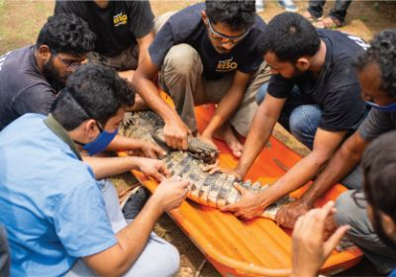

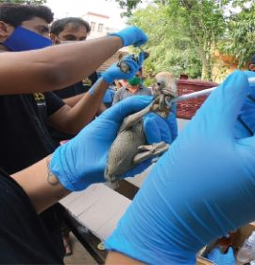
There are some groups or NGO’s which helps such distressed animals to find better shelter

Slide 10
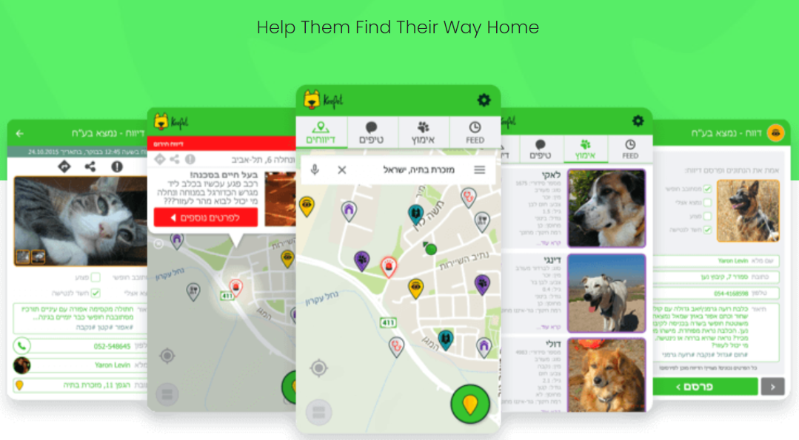
Our Idea is to let any user find verified rescue groups near to them & report the animals to concerned authorities in near real time.

Slide 11
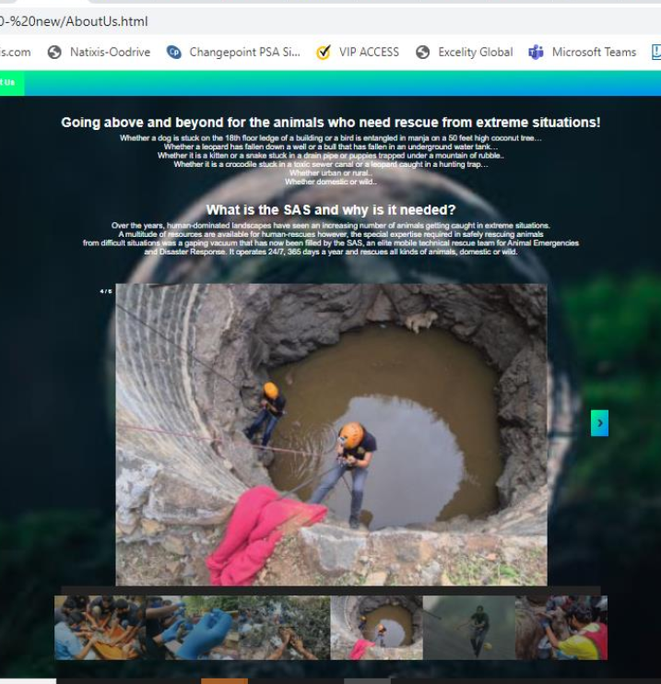
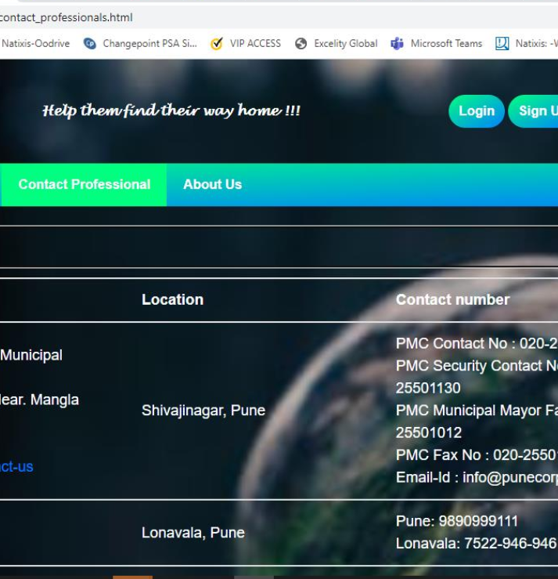
Snapshots from our website

Slide 12
THANK YOU
Presented By:
Anuja Jagtap
Arti Karad
Deepika Chandnani
Shivangi Mulmule
Vidhi jain

