Slide 1

Software Development Analytics: Our Experiences and the Way Forward
Vikrant Kaulgud and Vibhu S. Sharma ☺

Slide 2
Agenda
PIVoT - Why & What
Learnings
Trends

Slide 3
Some observations…
Process metrics like Cost performance does not translate to quality
Training on development techniques may not lead to widespread adoption
Insights in to an individual’s importance to a project were non-trivial
Usage of tools does not automatically lead to increase in quality
Process Warnings: It’s simply too late to fix!

Slide 4
Motivation behind our work…
Top-down delivery process metrics and monitoring
Bottom-up comprehension of software development activities
Process monitoring (e.g., CMMI) standardized measurement and monitoring of software delivery in a largely technology-agnostic manner.
Process monitoring does not always provide ‘right warnings at the right time’.
On the other hand, data generated by software development activities like version control actions, tool executions etc. provide fine-grained and “in-process” view of development.
Insights can be generated near real-time, allowing proactive intervention.

Slide 5
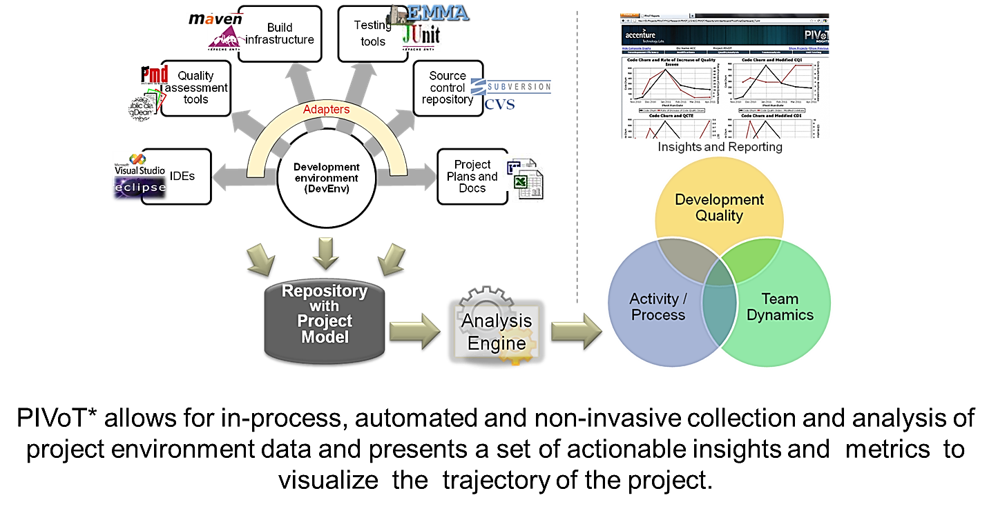
PIVoT framework
Framework principles
Insights are based on on-ground activity data
Data should be collected at source of activities, without human intervention
Data collection should be non-invasive
Insights design approach: Outcome-oriented design
Determine intended outcome
Define insight
Determine visualization
Design data analysis
Enumerate data required for analysis
Select and configure data sources

Slide 6
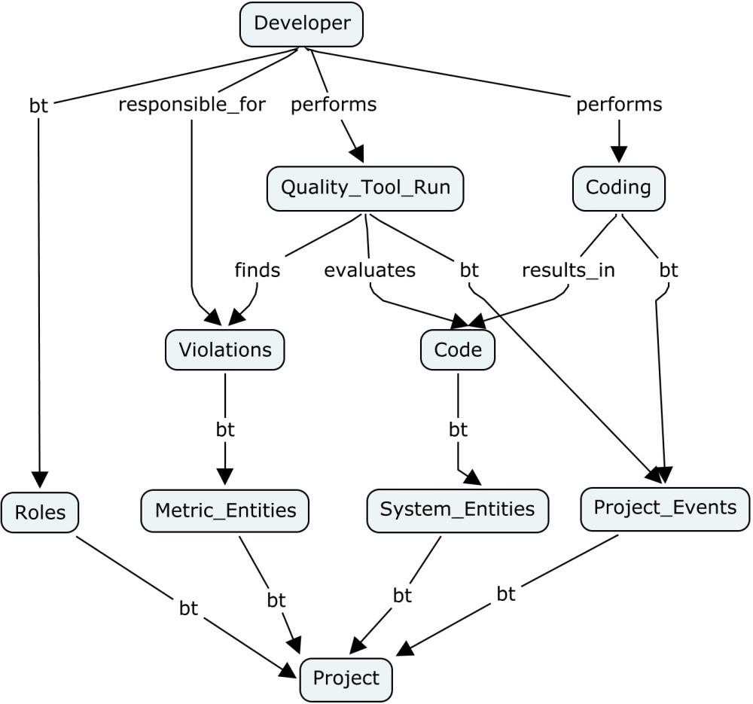
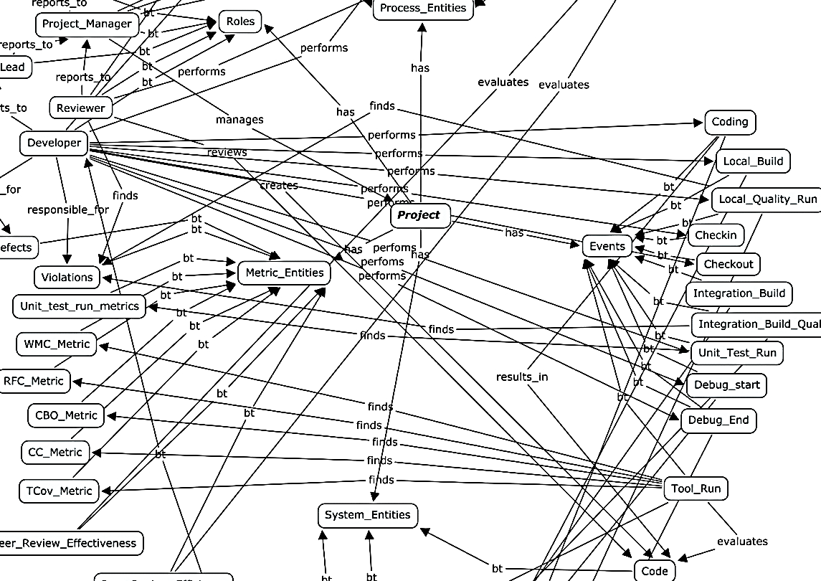
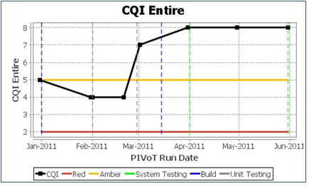
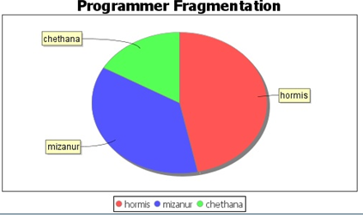
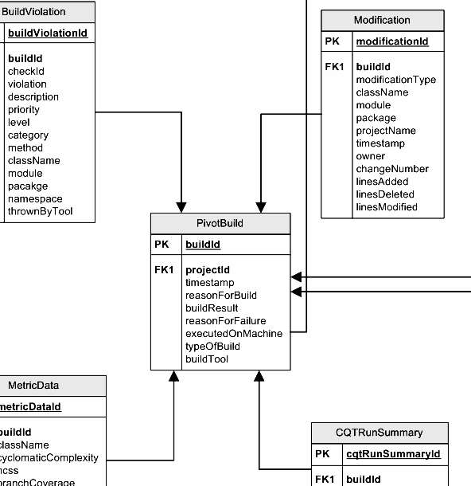
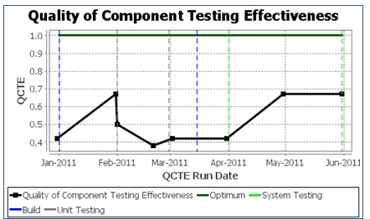
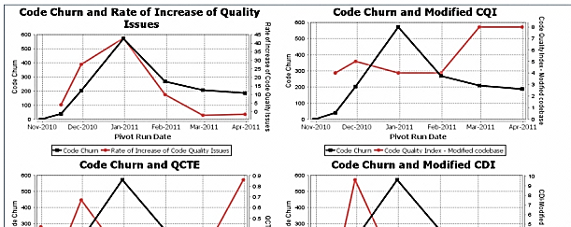
PIVoT project model & insights
Code Quality
Code Quality Index : CQI
Top Code Quality Issues and Categories
Rate of Increase of Code Quality Issues
Component Testing
Quality of Component Testing Effort (QCTE)
UnTested and Poorly Tested Components
Coverage for Complex Components
Development Efﬁciency
Cost of Development Index: CDI
Code Churn
Per package Code Churn trends
Top code contributors
Per package code contributors.
Team Analysis
Highly Connected Resources
Poorly Connected and Disconnected Resources
Programmer Fragmentation
Composite Reports
Code churn and rate of increase of quality issues,
Code churn and QCTE
Code churn and CQI

Slide 7
Key learnings
Positive behavioral change can be effected by a well-designed insight.
Metrics and insights need to be intuitive defined to for project managers to adopt and take action on them.
Integrating the insights obtained through development data and associating it with the Agile release / sprint plans and roles helps manage feature velocity and technical debt.
Planned roles change and are important to understand team dynamics. The changes are visible only through objective on-ground data.
Data-driven approach to measuring micro-process adoption provides fine-grained insights for methodology adoption.
Balancing between insights and privacy is a generally important consideration for any tool that uses data or meta-data to identify patterns and suggests recommendations

Slide 8
Way forward – trends impacting further research in software development analytics
Crowd sourced Development
Development in the cloud
Large-scale distribution of developers and resulting ineffectiveness of traditional process monitoring approaches.
For a client-critical software project, it is essential to know how the ‘crowd’ developers are adopting key practices such as frequent unit testing, code quality analysis etc.
Standardization of the development environment used by crowd-developers and data collection is a challenge
Modernization of distributed awareness techniques to handle new configuration management systems and techniques, large-scale distribution, and offering better visualization and actions to developers is required
A big advantage of development in the cloud, is the automatic standardization of IDEs, tools etc.
The consistent data collection challenge can be mitigated by using cloud-based IDEs.
Cloud IDEs provide an easy way to capture all development activities leading to creation of better project models, better activity correlation and more precise insights.

Slide 9
Way forward – trends impacting further research in software development analytics
Paradigm of IoT
Emergence of Cognitive
Usage of the sensors and actuators IoT paradigm to software development leads to interesting new ways software development analytics.
“Software actuators” embedded in code can remove subjectivity in actions taken based on certain insights.
Actuator design, DSLs for rapid development of Actuators, testing of automated actions are different areas that need to mature to make full use of the IoT paradigm.
Maintaining relevance of insights and prescribing contextual actions is key for long-term adoption of a software development analytics framework.
Learning from human actions and refining metric thresholds and actions is important.
Incremental and adaptive learning of faults and causality.

Slide 10
Summary
Significant changes in the environments in which insights are generated (Crowd and Development in Cloud), new insights required for managing ever-increasing distributed developer workforce (distributed team awareness and coordination),
insights driving intelligent software (IoT inspired ‘software actuators’), and finally insights frameworks that leverage cognitive techniques for inferencing patterns and learning are the basis for future research in software development analytics

