Slide 1
Empirical Analysis on Parallel Tasks in Crowdsourcing Software Development
Razieh Saremi, Ye Yang
Software Engineering Program
School of Systems and Enterprises
Stevens Institute of Technology
ASE’15 NOV 9, 2015

Slide 2
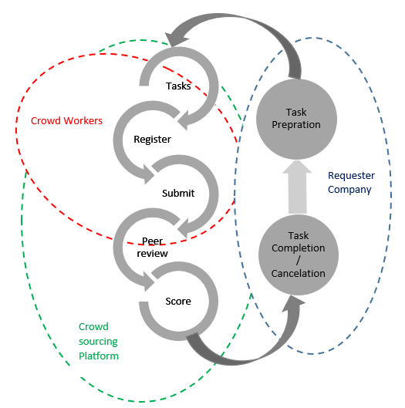
Introduction
Crowdsourced Software Development (CSD)
Reported benefits
shortened schedule due to mass parallel development
innovative solutions based on the “wisdom of crowds”
reduced cost due to the pre-pricing and bidding effects
Option for rapid development?
Lack of project level analysis
General Competitive CSD Processes

Slide 3
Needs for Decision Support in CSD
Developer Recommendation
Task Scheduling
Task Pricing
Failure Prediction

Slide 4
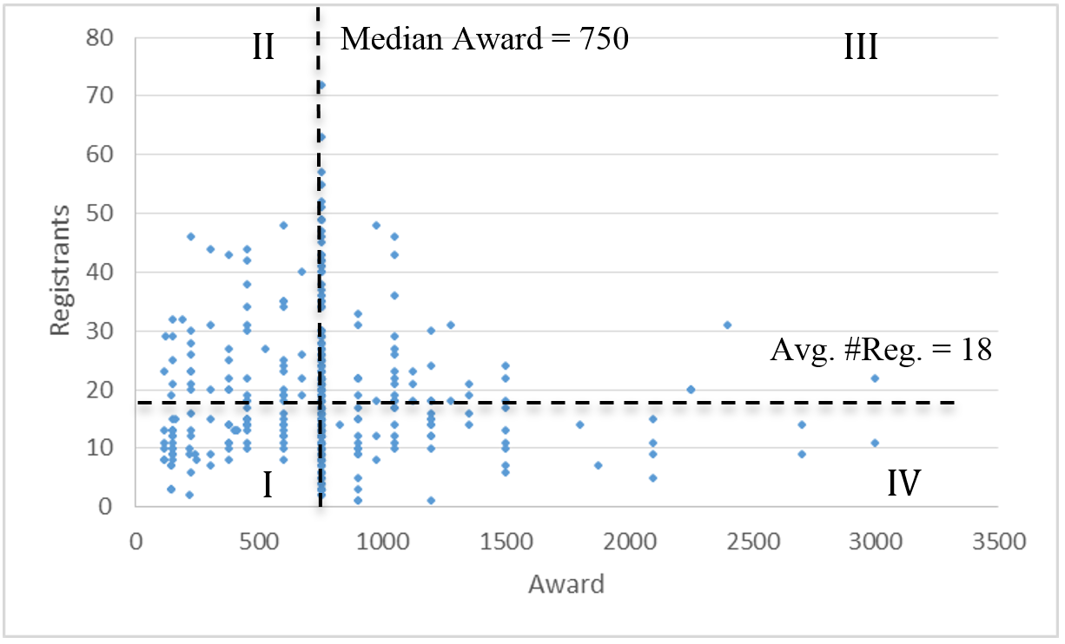
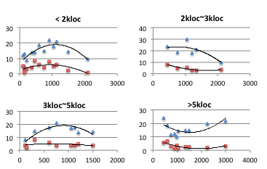
Relationship between Award and Worker Behavior
#Registrants vs. Award
#Registrants vs. #Submissions
Optimal Award
#Registration vs. Submission Ratio

Slide 5
Task Scheduling in CSD
Example
Research questions
To what extent, CSD is employed to increase task parallelism?
Is there any patterns between task parallelism and award?
To what extent, CSD projects can achieve both task parallelism and work behaviors.
Project
(Task) 1
worker 1
worker 2
(Task) 3
worker 1
Batch 2
worker 2
Batch 1
(Task) 2
worker 3
worker 4
...
(Task) 4
...

Slide 6
Attributes Used
Category | Metric | Measurement
Task Setting | Award | Dollars in task description
 | # of parallel Task (n) | Total number of tasks uploaded in a limited period of time ( month or week)
Worker Performance | # Registrants | Number of registrants that are willing to compete on total number of tasks in specific period of time
 | # Submissions | Number of submissions that a task receives by its submission deadline in specific period of time
Task outcome | # Completed tasks | Number of Acceptable submissions that a task receives by its submission deadline in specific period of time
 | # Cancelled tasks | Number of none-acceptable submissions that a task receives by its submission deadline in specific period of time
 | Failure rate | # Cancel tasks/ n
 | Stability | Average(#submissions/#registration)

Slide 7
Analysis
I: General task parallelism trend in CSD
II: Correlation between task parallelism and award
III: Correlation between task parallelism and task completion

Slide 8
Dataset
Dataset: 403 individual projects including 4908 software development tasks from Jan 2014 to Feb2015
Mostly one-month-duration
Submissions reviewed by experts to check the final results and grant the scores
Task failure:
No submission or
Score < 75
Task Types
First2Finish: The first person to submit a passing entry wins
Assembly Competition: Assemble previous tasks
Bug Hunt: Find and fix available Bugs
Code: Programing specific task
UI Prototype

Slide 9
Sample projects characteristics
 | # tasks | Application | Top 3 Technology Involved | Top 3 Challenge type | Top Platform Type
Project I | 156 | Topcoder API | Java (21),Node.js (123) SQL(4), REST (4) | First2Finish (85) ,Assembly Competition (67), Code(2) , Bug Hunt (2) | HTML, DocuSign, Heroku, NodeJS (142), Other
Project II | 306 | Topcoder, Web Arena IDE | Node.js(45),Angular.js (53), CSS (53), JavaScript (53), Bootstrap (53), HTML5 (53), CSS (51) | First2Finish (114),Assembly Competition(36), Bug Hunt(120) | Facebook, HTML(158), Other, NodeJSEC2,Heroku,unknown
Project III | 177 | Topcoder Community | Angular.js (39), PHP (33, CSS (35) | Assembly Competition(51),First2Finish (93),Code (16) | NodeJS, Wordpress (151),Heroku,EC2,Beanstalk,AWS, HTML ,Unknown, Other
Project IV | 277 | Hercules Android APP | HTML5 (16), iOS (77), Android (177) | First2Finish(241),Bug Hunt (23), Assembly Competition (7) | iOS, Android(161), Mobile,HTML,EC2,Other,Unknown

Slide 10
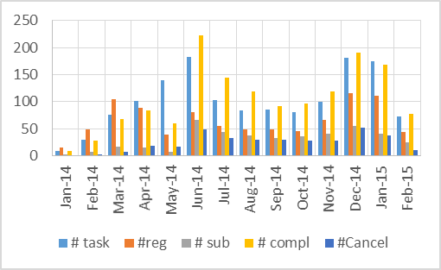
Trend of overall uploading tasks and associated award
Dataset: 403 individual projects includes 4908 component development/testing/assembly tasks from Jan 2014 to Feb2015
4 projects with more than 100 tasks selected for further analysis
Notes:
an overall profile of the distribution pattern of task uploaded and associated award rate per month for four sample projects. As it is shown by passing time the number of uploaded task raised to reach the maximum number, which included most number of small decomposed tasks per project, then it smoothly starts to decrease. And again, in September another increasing happens which lead us to the second peak in December, this can be due to new product launch, or a lot of debug tasks uploading in order to completing the projects. Obviously associated award would follow the same pattern.

Slide 11
Parallelism and Maximum uploaded tasks
Maximum #tasks don’t correspond to max award%
Individual task size negatively influences on associated award
Notes:
maximum uploaded task is not representing the maxim award associated with the projects, since tasks size and award have direct influence, number of decomposed tasks and total amount of associated award have negative influence
based on project scheduling methods, at first most of uploaded tasks are in the design category which are relatively big size, then it turn to implementation and development which makes the opportunity of decomposing the project to more number of mini tasks, next step would be test and deployment that develop bigger task size to work on, consequently cause reduction in total number of uploaded tasks and total award associated with them will increase due complexity of tasks or required skills to perform it

Slide 12
Statistics of Task Parallelism by Month
 |  | # Task | Award | # Reg | # Sub | # comp task | #Can tasks
Sample Project 1 | Min | 1 | 30 | 6 | 0 | 0 | 0
 | Median | 5.5 | 3850 | 69 | 12 | 5.5 | 0
 | Max | 57 | 43225 | 763 | 117 | 51 | 6
 | Average | 16.35 | 8233.21 | 155.28 | 30.57 | 15.21 | 1.14
Sample Project 2 | Min | 3 | 280 | 18 | 4 | 3 | 0
 | Median | 26 | 20910 | 274 | 37 | 23 | 3
 | Max | 95 | 34671 | 752 | 159 | 89 | 10
 | Average | 33.92 | 20853.84 | 318.15 | 62.07 | 30.84 | 3.076
Sample Project 3 | Min | 2 | 2300 | 30 | 5 | 2 | 0
 | Median | 25 | 10632 | 235 | 49 | 16 | 8
 | Max | 47 | 22426 | 410 | 97 | 38 | 10
 | Average | 23.81 | 12842.09 | 219.72 | 49.18 | 17.45 | 6.36
Sample Project 4 | Min | 2 | 355 | 43 | 5 | 2 | 0
 | Median | 26.5 | 8667.5 | 147 | 43.5 | 22 | 3
 | Max | 93 | 21045 | 464 | 173 | 82 | 25
 | Average | 35.64 | 10180.92 | 172.28 | 61.92 | 29.21 | 6.57

Slide 13
Task Parallelism vs. Task Award%
Award and Tasks and Registrants:
Positive correlation of 0.44 between total number of uploaded tasks and total prize associated
Notes:
project II took longer period of time to decompose the project to more number of uploaded tasks, which based on table 2, as maximum tasks type is bug hunt, the time making sense.
However unexpectedly, in project IV we are facing two peaks in number of uploaded tasks, which may happen due to different version of the software production and also the specific production phase that project started to be crowdsourced

Slide 14
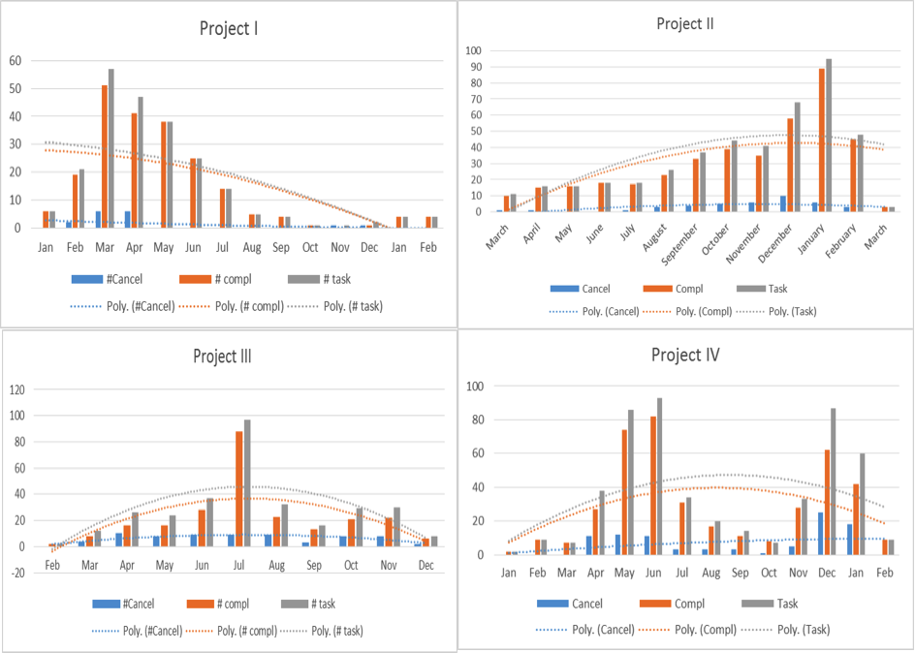
Task Parallelism vs. Stability
Failure rate = # cancel tasks / # total tasks
(1) On average, 23% of the registrants submit their files by submissions deadline;
(2) Stability of the projects is changing based on the number of uploading tasks

Slide 15
Schedule Acceleration
Project | Project I | project II | Project III | Project IV
Effort (Worker-day) | 6005.7 | 11037.2 | 8552.7 | 13841
Effort (Worker-month) | 273 | 501.7 | 388.8 | 629.1
Duration (months) | 9 | 13 | 11 | 14
McConnell | 19.1 | 23.3 | 21.5 | 25.2
COCOMO II | 17.7 | 20.9 | 19.5 | 22.3
QSAM | 16.5 | 22.4 | 19.7 | 25.1
SAR (McConnell) | 2.1 | 1.8 | 2 | 1.8
SAR (COCOMO II) | 2 | 1.6 | 1.8 | 1.6
SAR (QSAM) | 1.8 | 1.7 | 1.8 | 1.8

Slide 16
Future Work
Future Work
Mining task descriptions to derive better task parallel metrics
Mining patterns in task decomposition/scheduling
Consider more attributes such as worker motivation patterns, worker tenure and achievement level, etc.
Analyze impact of different task decomposition methods
Vertical decomposition vs. horizontal decomposition
Develop analytics for task decomposition w.r.t staffability and expected outcomes

Slide 17

Thank you!

