Slide 1
Jairus Hihn Jet Propulsion Laboratory, California Institute of Technology Tim Menzies North Carolina State University
Data Mining Methods and Cost Estimation Models
Why is it so hard to infuse new ideas?
ACTION15: Actionable Analytics for Software Engineering
Lincoln, Ne.
© 2015. All rights reserved.
Notes:
scott

Slide 2
Introduction
In this talk we will describe our experiences and lessons learned from our ten year journey in conducting and infusing data mining methods into the world of cost estimation
10 years ago with 2CEE we failed to make it to the launch pad
This time we have launched and even have a few early users but will we make it to a stable earth orbit
Notes:
scott

Slide 3
Background
Everyone in an organization knows just enough about cost to be dangerous
Current cost methods have been in use for over 30 years and even then there is still some resistance to the use of cost models over expert judgment bottom up methods
Infusing new ways of doing things is hard and takes time
There is minimal to no cross fertilization of ideas between academia and practitioners in industry
Stakeholder Communication is layered
Notes:
scott

Slide 4
A Script Writers Version of the Conversation Between a SME and DME
SME: Is there a “model” I can show my stakeholders?
DME: Sort of but it changes everytime as it depends on what you are comparing to.
SME: The cluster make no sense.
DME: But the MREs are great.
DME: By the way I have a brand new method that works even better.
SME: (Walks away feeling as if they are walking on quicksand wondering why he ever got involved with this DME)
SME: (Frustrated) What are the actual parameter values in the locally calibrated COCOMO so I can see if they make any sense.
DME: We do not know we just know how the different types of models perform. That’s a lower order question. We can do all sorts of things.
Notes:
scott

Slide 5
History of Industry Cost Estimation Methods

Slide 6
One of the Keys to Success was this time we have a hook
The purpose of the model is to
Supplement current estimation capabilities
Be effective in the very early lifecycle when our knowledge is fuzzy
uses high level systems information (Symbolic Data)
Be usable by Cost Estimators, Software Engineers and Systems Engineers
Methodology handles
small sample sizes
noisy and sparse data
Notes:
scott

Slide 7
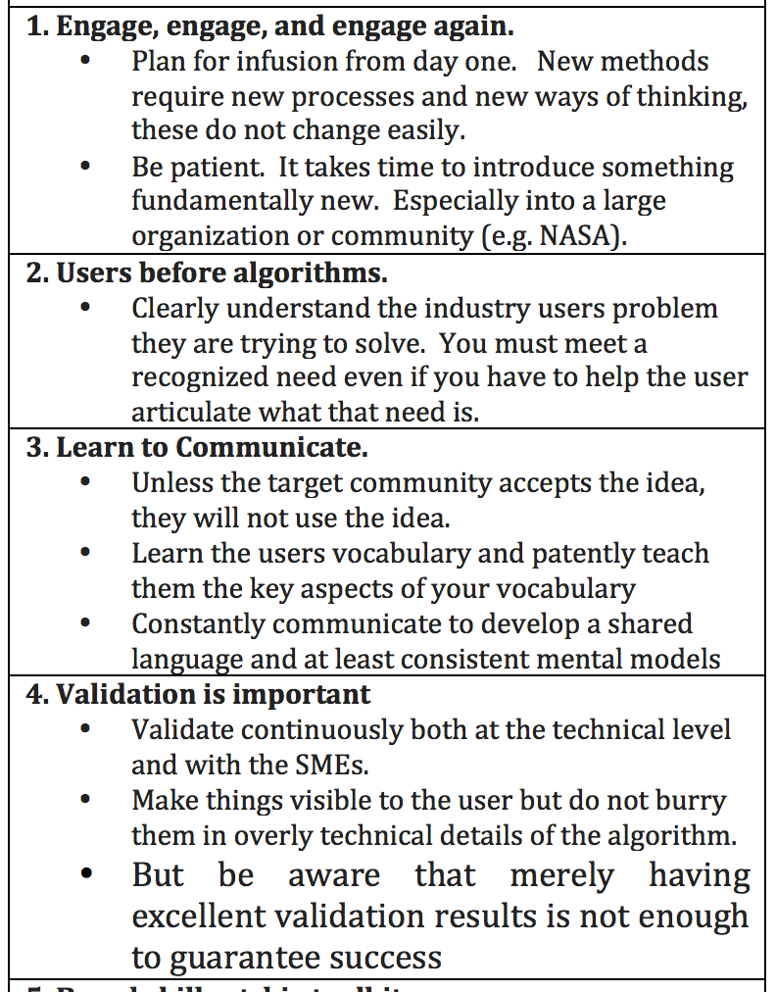
Keys to Success - 1
Notes:
scott

Slide 8
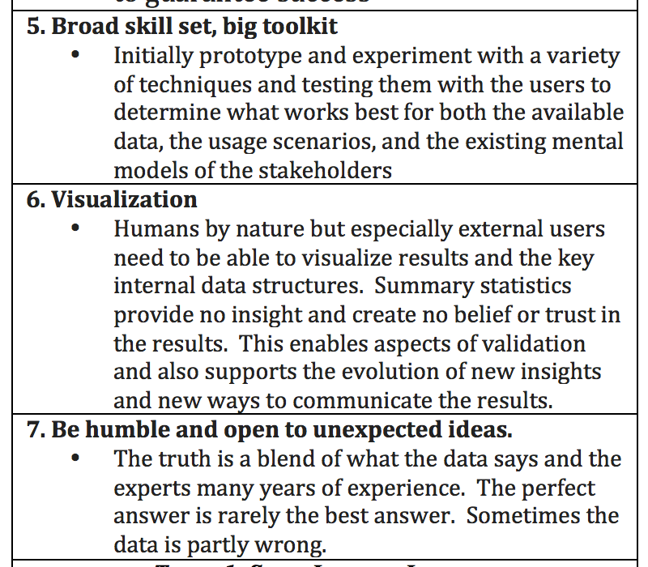
Keys to Success - 2
Notes:
scott

Slide 9
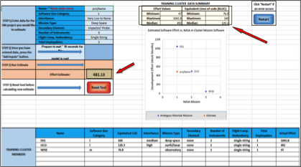
First Stab Prototype Interface
Notes:
scott

Slide 10
Next Step
This capability will be released through the NASA ONCE Portal on December 4th for use by NASA and its contractors so we will launch
But …
Notes:
scott

