Slide 1



Analytics for Software Project Management –
Where Are We and Where Do We Go?
Guenther Ruhe
Joint paper with:
Maleknaz Nayebi
Roberta Cabral Mota Mujeeb Mufti

Slide 2

What do we mean by “Analytics for software project management?”
Analytics
SENG
ASPM
Project
management

Slide 3
Types of Analytics (Kaisler et al. 2014)
Descriptive: A set of techniques for reviewing and examining the data set(s) to understand the data and analyze business performance (what had happened?)
Diagnostic: A set of techniques for determine what has happened and why (why did it happen?)
Predictive: A set of techniques that analyze current and historical data to determine what is most likely to (not) happen (what will happen?)
Prescriptive: A set of techniques for computationally developing and analyzing alternatives that can become courses of action – either tactical or strategic – that may discover the unexpected (what should happen?)
Decisive: A set of techniques for visualizing information to facilitate human decision-making.

Slide 4

Project management
Application of knowledge, skills, tools and techniques to project activities to meet the project requirements.
Project management is accomplished through the application and integration of 47 logically grouped project management processes divided into five process groups: initiating, planning, executing, monitoring and controlling, and closing. (Duncan 2013).

Slide 5
Analytics for Software Project Management –
Where Are We and Where Do We Go?
- SM Study
- RQ’s
- Findings
- Discussion

Slide 6
Systematic mapping study selection process
15,406 papers
7,306 papers
2,906 papers
Searching databases
Apply inclusion criteria
Apply exclusion criteria
Exclusion based on title & keywords
Exclusion based on abstract
Exclusion based on full-text
320 papers
193 papers
115 papers

Slide 7
Keywords used in electronic libraries
{“Analytical”, “Analysis”, “Analytics”, “Analyzing”, “Software Analytics”, “Data Science”}
AND
{“Software Management”, “Project Management”, “Software Development”, “Software Project Management”}.
Inspec, Science Direct, Scopus, IEEE, ACM Dig. Library

Slide 8
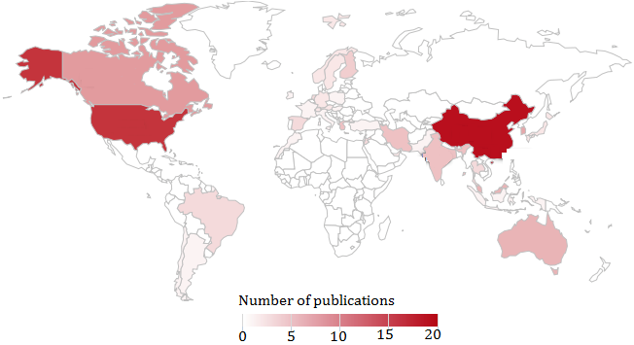
Where the papers were coming from?
Canada
USA
China
Taiwan
India

Slide 9
Research questions
RQ1 (Types of analytics):
What types of analytics has been used across the different software project management knowledge areas defined in the Software PMBOK?
RQ2 (Access to data):
To what extent was data used from open repositories or made publicly available?
RQ3 (Validation of results):
To what degree was validation done and if so, what was the percentage using real world data?
RQ4 (Reuse and replication):
How much are the retrieved papers (i) cross-referencing each other and (ii) using mutual datasets?

Slide 10
Knowledge areas & analytical techniques
Distribution of papers across knowledge areas of SPM &
types of analytical techniques
 | Descriptive | Diagnostic | Predictive | Prescriptive | Total
Stakeholder management | 1 | 2 | 0 | 0 | 3
Procurement management | 0 | 0 | 0 | 3 | 3
Risk management | 6 | 2 | 12 | 4 | 24
Communication management | 0 | 0 | 0 | 0 | 0
Human resource management | 0 | 0 | 1 | 7 | 8
Quality management | 0 | 3 | 5 | 2 | 10
Cost management | 0 | 0 | 25 | 1 | 26
Time management | 0 | 1 | 4 | 4 | 9
Scope management | 1 | 2 | 1 | 7 | 11
Integration management | 5 | 1 | 7 | 5 | 18
other | 1 | 0 | 1 | 1 | 3
Total | 14 | 11 | 56 | 34
0
20
30

Slide 11
Pareto chart - publications across PMBOK knowledge areas

Slide 12
Availability of datasets
4
8
10
13
14
13
10
13
15
15

Slide 13
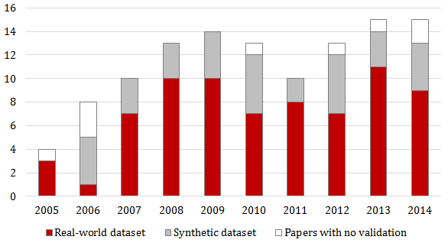
Distribution of papers using validation with real vs. synthetic data sets

Slide 14
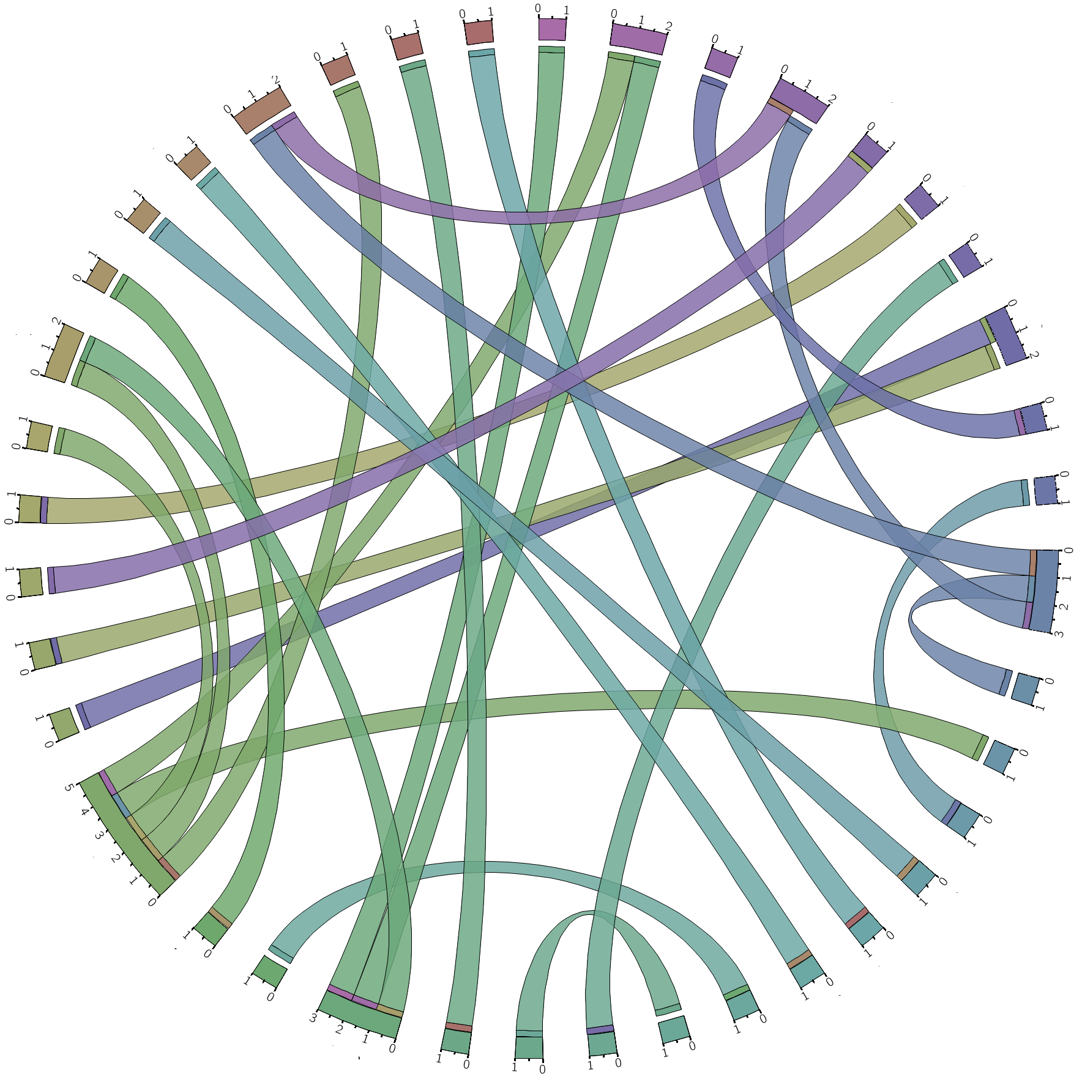
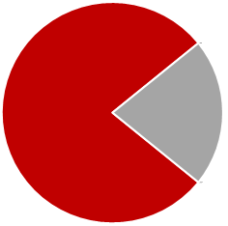
Cross-referencing
94 papers
with no connection
to each other
26 papers with connections
Bannerman, P. L. (2008). Risk and risk management in software projects: A reassessment. Journal of Systems and Software, 81(12), 2118-2133. → most cross-references (5)

Slide 15
Classification of analytical questions
Buse, Zimmermann: Information needs for software development analytics. ICSE 2012: 987-996

Slide 16
Comparative analysis
Comparing | Rank 1 | Rank 2 | Rank 3 | Rank 4
Importance in practice | Descriptive | Diagnostic | Prescriptive | Predictive
Difficulty in practice | Predictive | Prescriptive | Descriptive | Diagnostic
# of research papers | Predictive | Prescriptive | Descriptive | Diagnostic

Slide 17
Additional: Usage of hybrid techniques

Slide 18


Main findings - Discussion
93.9% of papers provide some form of validation.
37.3% made data openly accessible.
Just 23% of the papers connected, replicated or reused previous models.
Only 4% shared joined data
Open: Evaluation of industrial usefulness of results
Open: No trend from supporting developers towards also supporting managers

Slide 19
References
[1]D. Dalcher, "Rethinking Success in Software Projects: Looking Beyond the Failure Factors," in Software Project Management in a Changing World, ed: Springer, 2014, pp. 27-49.
[2] AE Hassan, "Software Analytics: Going beyond Developers," IEEE Software, vol. 4, 2013.
[3] R. Buse, T, Zimmermann, "Information Needs for Software Development Analytics,“ 34th International Conference on Software Engineering (ICSE), 2012.
[4] S. Kaisler, F. Armour, and J. A. Espinosa, "Introduction to big data: Challenges, opportunities, and realities minitrack," in 2014 47th HICSS International Conference on, 2014, pp. 728-728.
[5] PMI, Software Extension to the PMBOK Guide, Fifth ed. Project Management Institute (PMI), USA: IEEE Computer Society, 2013.
[6] T. Menzies, "Beyond data mining; towards idea engineering," in Proceedings of the 9th International Conference on Predictive Models in Software Engineering, 2013, pp. 1-6.
[7] T. Menzies, E. Kocaguneli, B. Turhan, L. Minku, and F. Peters, Sharing Data and Models in Software Engineering: Sharing Data and Models: Morgan Kaufmann, 2014.
[8] G. Ruhe and C. Wohlin, Software Project Management in a Changing World: Springer, 2014.

