Slide 1

Rollins Tennis Archive
Madhav Khanal: Lead Programmer
Richard Stoiberer: Project Manager
Stella Fruijtier: Data Scientist/Data Visualization

Slide 2
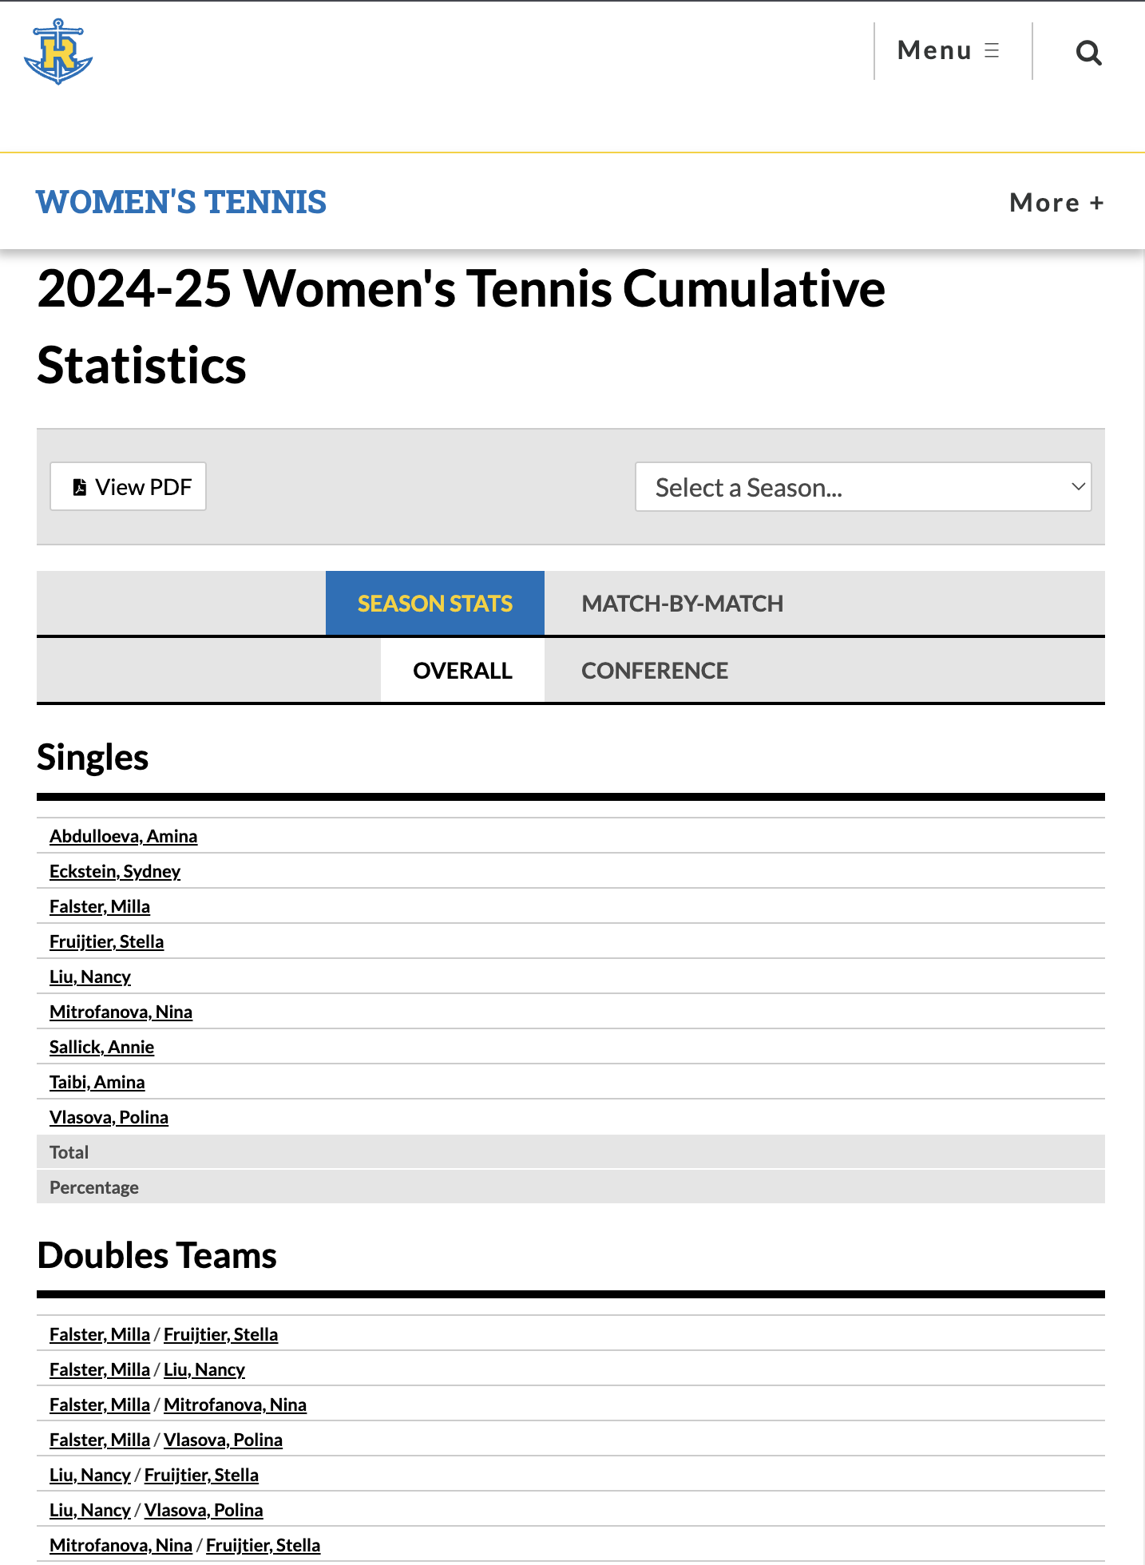
Project Recap
Build a simple full-stack application that organizes Rollins Tennis player bios, match results, and statistics.
Store players, matches, and seasons using OOP structure
Allow filtering/searching of players and matches
Show useful team and individual statistics
The goal is to improve the existing Rollins Tennis statistics page by creating a cleaner, more organized system where all player information is easy to find in one place.

Slide 3
Demo

Slide 4
OOP Principles
Classes and Objects: Player, Match, SinglesMatch, DoublesMatch, Result, Season
Encapsulation: all fields declared priveate, using getter and setter methods
Inheritance: through Match class hierachy
Abstraction: Match class is abstract
Polymorphism: both SinglesMatch and DoublesMatch inherit from Match, so it can store them iin the same collections

Slide 5
Lessons & Challenges
Challenges:
Designing OOP structure working both for singles and doubles
Organizing match data for efficient filtering and statistics
Ensuring consistent data transfer between backend and frontend
Creating meaningful statistics while keeping logic maintainable

Slide 6
Thank you

