Slide 1

Rollins Tennis Archive
Madhav Khanal: Lead Programmer
Richard Stoiberer: Project manager
Stella Fruijtier: Data Scientist, Data visualization

Slide 2
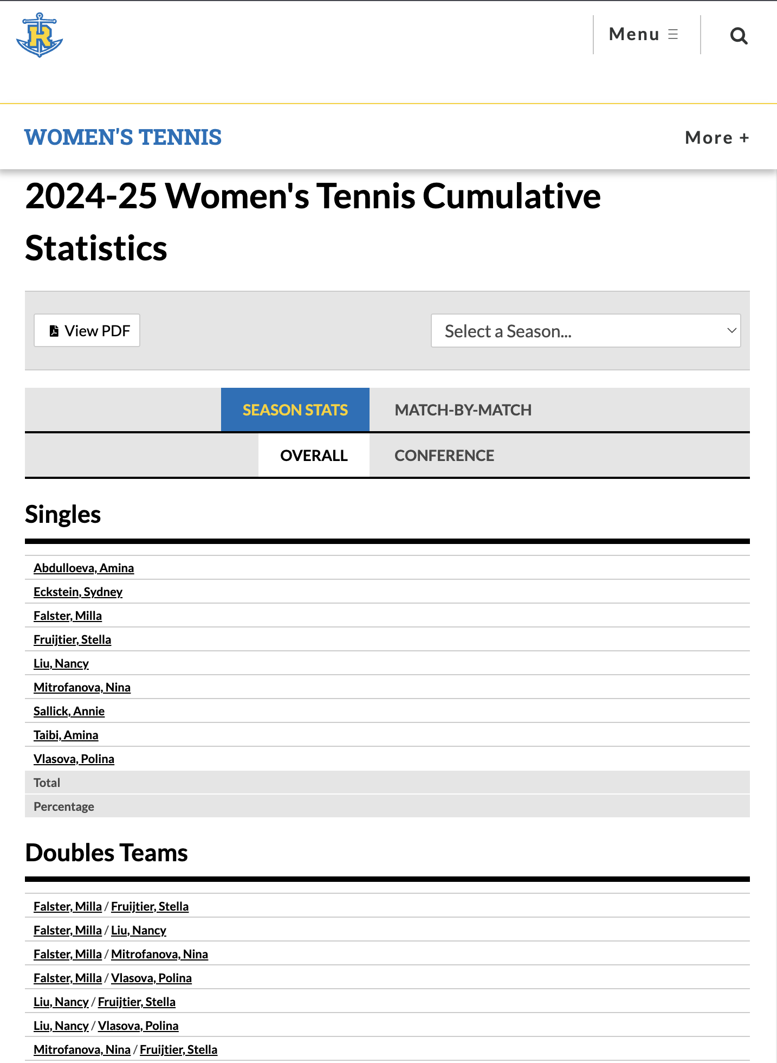
Project Recap
Build a simple full-stack application that organizes Rollins Tennis player bios, match results, and statistics.
Store players, matches, and seasons using OOP structure
Allow filtering/searching of players and matches
Show useful statistics
The goal is to improve the existing Rollins Tennis statistics page by creating a cleaner, more organized system that makes all player information easy to find in one place.

Slide 3
Progress update
Implemented Login Page
Linked to actual data
UML Diagram

Slide 4
Demo

Slide 5
What’s next
Fix front end bug (pictures)
Work on aesthetics details
Written report

Slide 6
Thank you

