Slide 1
Spark Streaming
Data with Wings
Never stop the movement

Slide 2
Agenda
Spark overview
Spark Streaming overview
Processing streams from meetup.com
Little intro to stateful stream processing
All together

Slide 3

There will be no pictures of cats!

Slide 4
Lambda Architecture
BATCH
SERVING
Hourly/Daily Loads
BUFFER
Real-time Decision
Making
SPEED
Every Second
Near
Real-time
Views

Slide 5
Do you see any problems with Lambda Architecture?

Slide 6
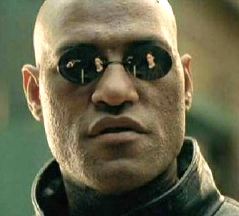
Spark Overview
What if you could write programs operating with petabyte size datasets and large streams same way you operate Iterable collections?

Slide 7
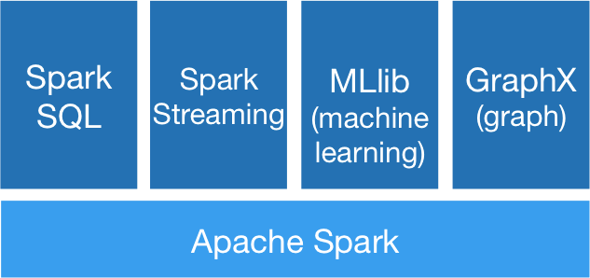
Apache Spark

Slide 8
Resilient Distributed Dataset
Resilient - resilience is addressed by tracking the log of operations performed on the dataset. Because of the side effects are eliminated, every lost partition can be recalculated in case of a loss.
Distributed - the dataset is partitioned. We can specify partitioning scheme for every operation.
Dataset - can be built from regular files, HDFS large files, Cassandra table, HBase table, etc.

Slide 9
Obligatory word count
lines = spark.textFile("hdfs://...")
lines.flatMap{line: line.split(“ “)}
.map({word: (word, 1)})
.reduceByKey(_+_)

Slide 10
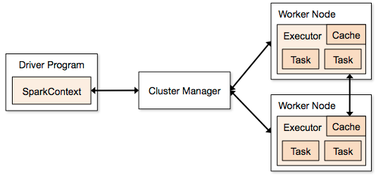
Spark Runtime

Slide 11

Spark is like Yoda and Hulk combined

Slide 12
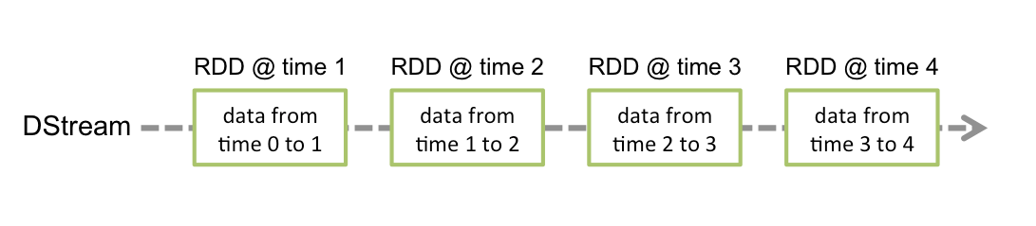
Discretized Stream
New RDD every second
https://spark.apache.org/docs/1.2.0/streaming-programming-guide.html

Slide 13
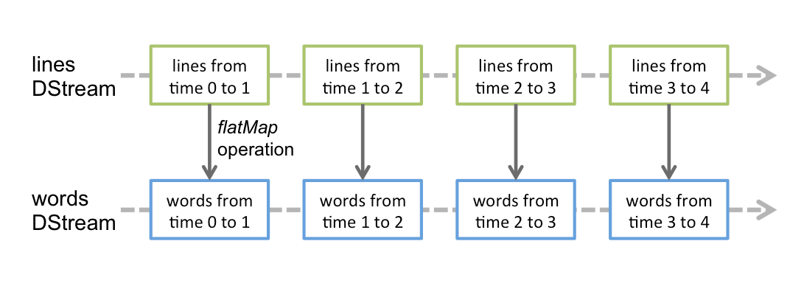
DStream - still pretty
You operate on stream just like on collections
https://spark.apache.org/docs/1.2.0/streaming-programming-guide.html

Slide 14
meetup.com Streams
Let’s play with meetup.com streams:
Events
RSVPs

Slide 15
RSVP Schema
{ "event" : { "event_id" : "220993343",
"event_name" : "Paper Collage",
"event_url" : "http://www.meetup.com/ELEOS-Art-School-Studio/events/220993343/",
"time" : 1427551200000
},
"group" : {...},
"guests" : 0,
"member" : { "member_id" : 120762942,
"member_name" : "Esther",
"photo" : "http://photos1.meetupstatic.com/photos/member/b/b/0/thumb_159962992.jpeg"
},
...
}

Slide 16
Event Schema
{ "description" : "<p>90 Minute walking tour with your dog! Please arrive early.</p>\n<p>Tour of Balboa Parks spookiest locations on ...>",
"duration" : 5400000,
"event_url" : "http://www.meetup.com/SanDiegoDogWalkers/events/220302036/",
"group" : {...},
"id" : "220302036",
"maybe_rsvp_count" : 0,
"mtime" : 1425785739616,
"name" : "After Dark Ghost Walking Tour in Balboa Park with your dog!",
"payment_required" : "0",
"rsvp_limit" : 20,
"status" : "upcoming",
"time" : 1426993200000,
"utc_offset" : -25200000,
"venue" : {....},
"venue_visibility" : "public",
"visibility" : "public",
"yes_rsvp_count" : 13
}

Slide 17
Meetup Receiver
Receiver is the way to pump data to spark streaming.
In our case, we connect to meetup streaming api and send json to Spark.
Code is a bit long, but you can explore it:
https://github.com/actions/meetup-stream/blob/master/src/main/scala/receiver/MeetupReceiver.scala

Slide 18
Intro to Stateful Stream Processing
def locaitonCounts(eventsStream: DStream[(Venue,Event)])=
liveEvents .filter{case(venue,event)=>venue.country==“usa”}
.map{case(venue,event)=>(venue.toCityState,1)}
.updateStateByKey(countForLocaiton)
.print
def countForLocaiton(counts: Seq[Int], initCount: Option[Int])
=Some(initCount.getOrElse(0) + counts.sum)

Slide 19
How it works again…?
Incoming Stream
CityState | Count
San Francisco,CA | 1
Miami, FL | 1
CityState | Count
San Francisco,CA | 1
Miami, FL | 1
10 sec
11 sec
CityState | Count
San Francisco, CA | 5
LA, CA | 3
Portland, OR | 2
CityState | Count
San Francisco, CA | 6
LA, CA | 3
Portland, OR | 2
Miami, FL | 1
State Stream

Slide 20

Aerial refueling
http://commons.wikimedia.org/wiki/File:Aerial_refueling_CH-53_DF-SD-06-02984.JPG

Slide 21
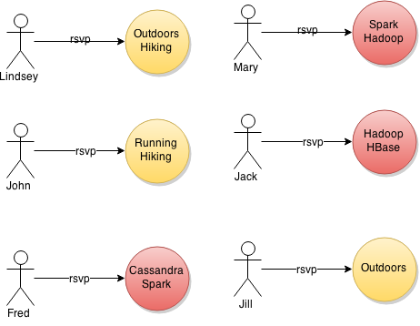
meetup.com connection recommendation app

Slide 22
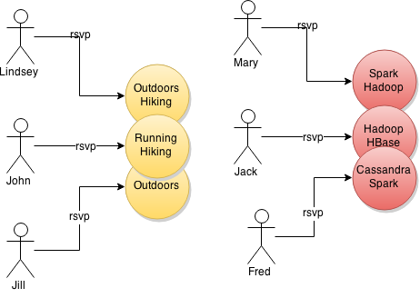
Meetup Event Clustering

Slide 23
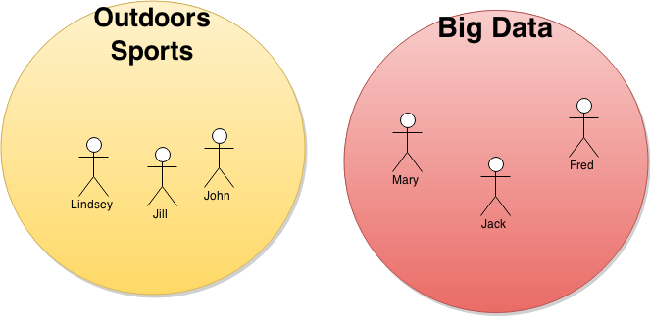
Meetup Professional Connection Recommendation

Slide 24
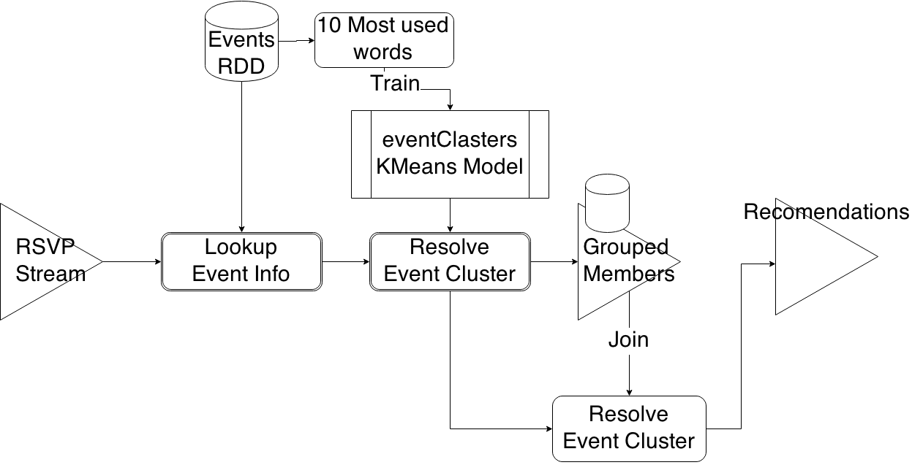
Meetup Recommendations
Pipeline

Slide 25
Initializing RSVP Stream and the Event Dataset
val conf = new SparkConf()
.setMaster("local[4]")
.setAppName("MeetupExperiments")
.set("spark.executor.memory", "1g")
.set("spark.driver.memory", "1g")
val ssc=new StreamingContext(conf, Seconds(1))
val rsvpStream = ssc.receiverStream(
new MeetupReceiver(“http://stream.meetup.com/2/rsvps”)).flatMap(parseRsvp)
val eventsHistory = ssc.sparkContext.textFile("data/events/events.json", 1).flatMap(parseEvent)

Slide 26
Broadcasting Dictionary
val localDictionary=Source
.fromURL(getClass.getResource("/wordsEn.txt"))
.getLines
.zipWithIndex
.toMap
val dictionary=ssc.sparkContext
.broadcast(localDictionary)

Slide 27
Feature Extraction
10 most popular words in the description.
def eventToVector(event: Event): Option[Vector]={
val wordsIterator = event.description.map(breakToWords).getOrElse(Iterator())
val topWords=popularWords(wordsIterator)
if (topWords.size==10) Some(Vectors.sparse(dictionary.value.size,topWords)) else None
}
val eventVectors=eventsHistory.flatMap{event=>eventToVector(event)}

Slide 28
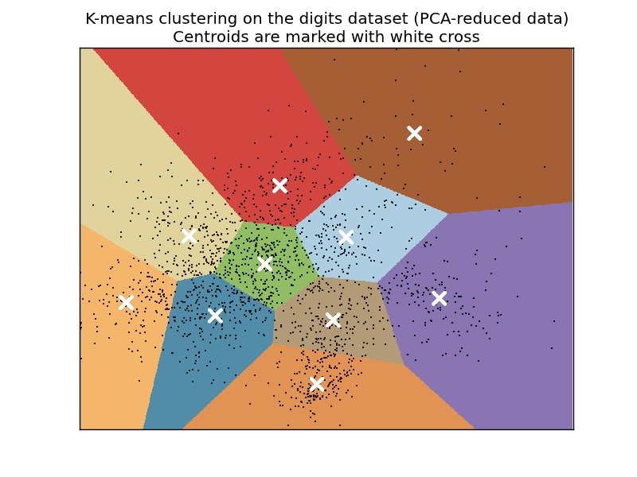
Training based on existing dataset
val eventClusters = KMeans.train(eventVectors, 10, 2)
http://scikit-learn.org/0.11/auto_examples/cluster/plot_kmeans_digits.html

Slide 29
Event History By ID
val eventHistoryById=eventsHistory
.map{event=>(event.id, event.description.getOrElse(""))}
.reduceByKey{(first: String, second: String)=>first}
(220302036,“…description1 …”) (220302037,“…description2 …”) (220302038,”…description3 …”)

Slide 30
Streaming lookups
Looking up the event description by eventId from rsvp.
val rsvpEventInfo = membersByEventId.transform(
rdd=>rdd.join(eventHistoryById)
)
(eventId, (member, response), description)
(220819928,((Member(Some(cecelia rogers),Some(162556712)),yes),"...")
(221153676,((Member(Some(Carol),Some(183499291)),no),”...")
…

Slide 31
Streaming Clustering
val memberEventInfo = rsvpEventInfo
.flatMap{
case(eventId, ((member, response), event)) => {
eventToVector(event).map{ eventVector=>
val eventCluster=eventClusters.predict(eventVector)
(eventCluster,(member, response))
}
}}

Slide 32
Clustering members
def groupMembers(memberResponses: Seq[(Member, String)], initList: Option[Set[Member]]) = {
val initialMemberList=initList.getOrElse(Set())
val newMemberList=(memberResponses :\ initialMemberList) {
case((member, response), memberList) =>
if (response == "yes") memberList + member else memberList - member
}
if (newMemberList.size>0) Some(newMemberList) else None
}
val memberGroups = memberEventInfo.updateStateByKey(groupMembers)

Slide 33
Recommendations
val recommendations=memberEventInfo
.join(memberGroups)
.map{
case(cluster, ((member, memberResponse), members)) =>
(member.memberName, members-member)
}
(Some(Mike D) -> Set(Member(Some(Sioux),Some(85761302)), Member(Some(Aileen),Some(12579632)), Member(Some(Teri),Some(148306762))))

Slide 34

Questions

