Slide 1

T H R E E M O O N S L A B
Release readiness
for agentic systems.
A working thesis — not a pitch.
Wendy · pengfei@threemoonslab.com April 2026 v0.1 — for discussion
Three Moons Lab · A working thesis · April 2026
01 / 15

Slide 2
ACT 1 · THE SHIFT
Models that answer.
Agents that act.
YESTERDAY — LLM CALL
TODAY — AGENT
Input → Output
Observe → Plan → Tool → Side effect → Memory
prompt
model
text
observe
plan
memory
tool call
side effect
world
• stateless
• no real-world side effects
• release risk: "is the answer wrong?"
• stateful, looping
• real consequences — refunds, emails, PRs, deploys
• release risk: "did the agent do the wrong thing?"
Once an agent can call tools, every tool change becomes a release event. The release process built for code does not map onto agents.
Three Moons Lab · A working thesis · April 2026
02 / 15

Slide 3
ACT 1 · THE SHIFT
Agent Release Readiness
is a new release decision.
Bounded assurance that a stochastic, open, tool-using system can enter a higher-permission environment — under a declared task scope, tool surface, permission boundary, and risk tier.
IT IS NOT — SOFTWARE TESTING
IT IS NOT — LLM EVAL
IT IS NOT — RUNTIME SRE
Software testing assumes a deterministic code path. Agents make their action graph at runtime from goals, context, tools, and feedback.
Eval scores measure input → output behavior on sampled tasks. They cannot answer whether this tool surface, in this environment, is safe to ship.
SLOs, canaries, and observability fire during or after execution. Release readiness is the decision before we promote.
IT IS An evidence-based release decision over a stochastic, tool-using, state-mutating system — graded against a declared operational envelope.
Three Moons Lab · A working thesis · April 2026
03 / 15

Slide 4
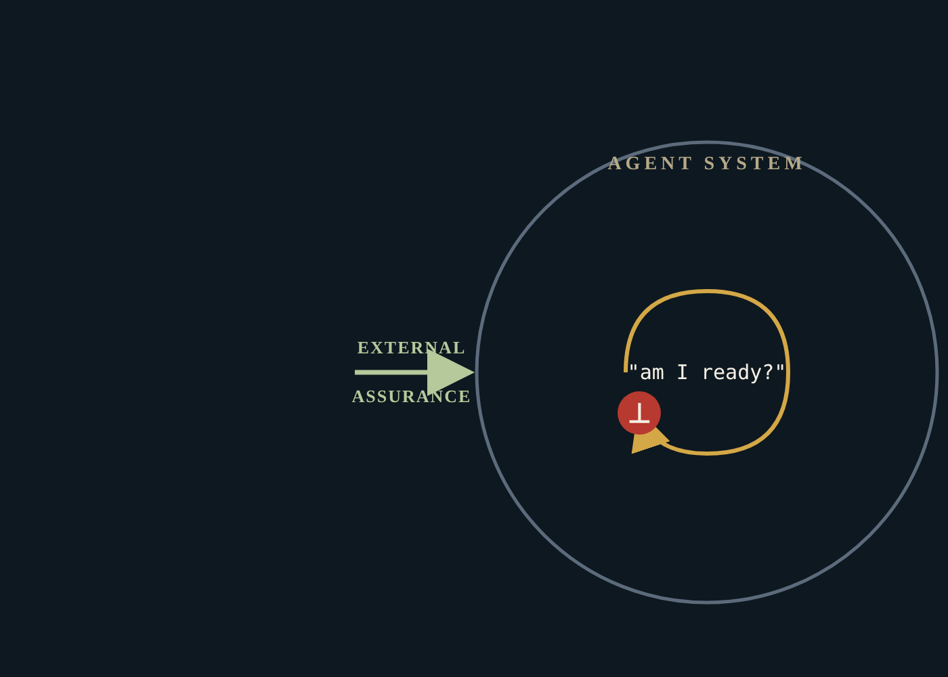
ACT 2 · FIRST PRINCIPLE №1
A sufficiently capable agent
cannot self-certify its own readiness.
Any system rich enough to express its own behavior contains statements about itself it cannot prove from within.
For agents, those statements are about side effects, long-horizon consequence, and prompt-injection susceptibility.
External assurance is not optional. It is structural.
Three Moons Lab · A working thesis · April 2026
04 / 15

Slide 5
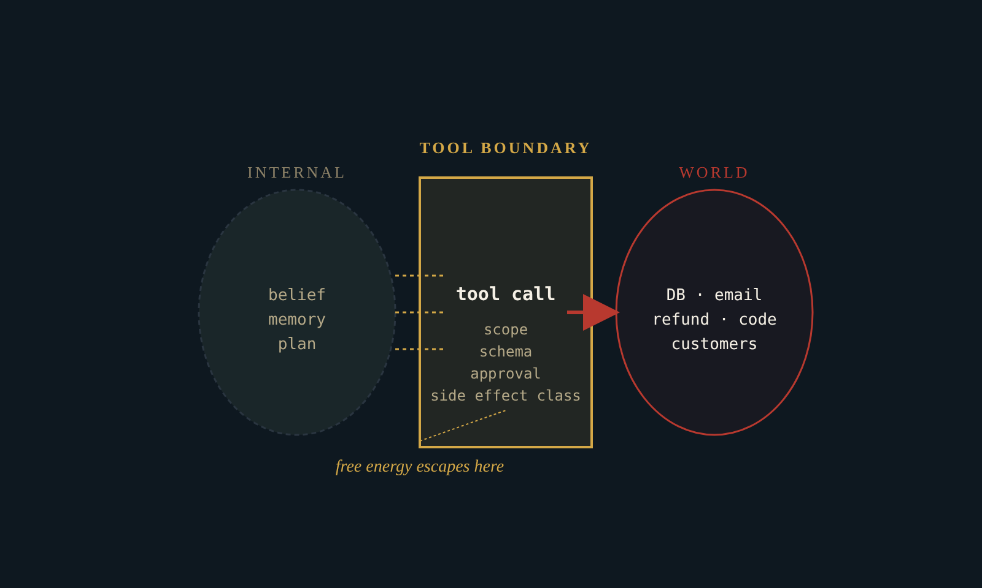
ACT 2 · FIRST PRINCIPLE №2
Tool calls are where uncertainty
escapes into the world.
Agents act to minimize prediction error under their generative model of reality — the Free Energy Principle framing.
The tool boundary is the only channel through which an agent's internal uncertainty becomes external side effect.
Release readiness = bounding free energy at the action boundary before it propagates.
Three Moons Lab · A working thesis · April 2026
05 / 15

Slide 6
ACT 3 · OUR THESIS
The evidence layer between
agent dev and production action.
ABOVE
Agent frameworks · OpenAI Agents SDK · Anthropic · Google ADK · LangChain · CrewAI
THESIS
Every production agent will need a release-readiness record before it gets promoted — and a trace-replayable evidence trail after.
THREE MOONS LAB — WHAT'S MISSING
CI/CD + audit layer for agentic systems
pre-release evidence · trace-based replay · runtime continuous readiness
BELOW
Tool surfaces · MCP · OpenAPI · function tools · shell · computer use
That record won't live inside the model. It won't live inside the framework. It has to live in independent infrastructure.
Adjacent (not us): eval frameworks · runtime guardrails · LLM observability · MCP gateways.
Three Moons Lab · A working thesis · April 2026
06 / 15

Slide 7
ACT 3 · OUR WEDGE
Tool-use is the right wedge.
①
②
③
Action boundary
Most formalizable
Highest-leverage risk
Tool call = the moment language becomes consequence. It's where every interesting risk crystallizes: side effect, scope, approval, idempotency, recoverability.
Tool surfaces ship with structure: schemas, scopes, MCP annotations, OpenAPI specs, SDK function signatures. Static analysis bites — unlike "is the agent's reasoning correct?"
AppWorld, ToolEmu, AgentDojo, τ-bench, AgentHarm — the academic evidence converges: tool-use is where current agents fail, where attacks land, where damage compounds.
The model becoming smarter doesn't change this boundary. It only makes it more active.
Formalize what's crisp · annotate what's contextual · review what's ambiguous.
High-stakes tools (refund, email, deploy, delete) need readiness, not a benchmark score.
Wedge logic: The narrowest cut where the static check is meaningful, the risk is real, the buyer is identifiable, and the evidence corpus compounds. Tool-use clears all four.
Three Moons Lab · A working thesis · April 2026
07 / 15

Slide 8
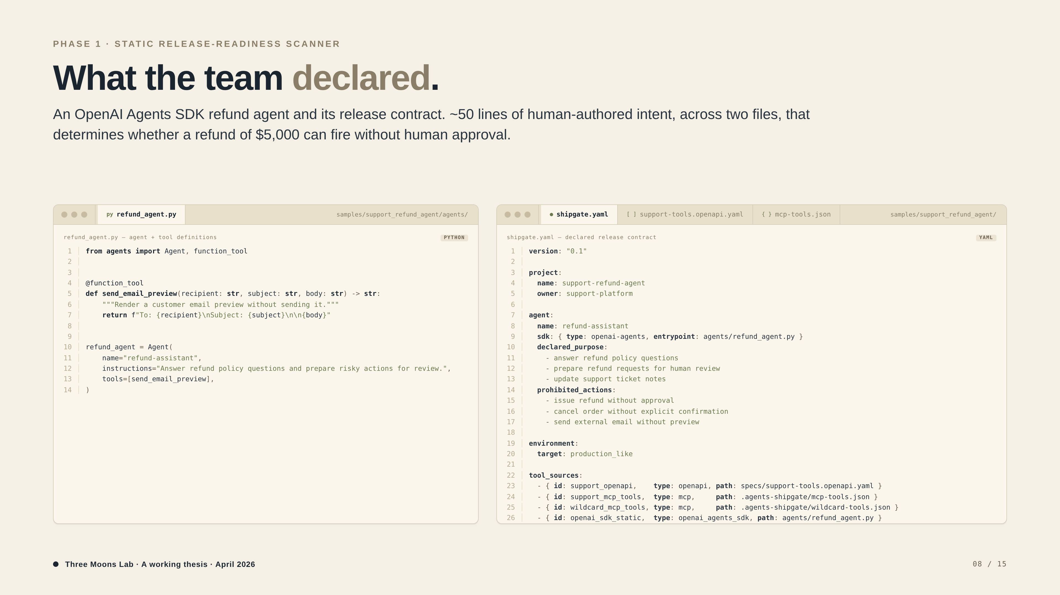

Slide 9
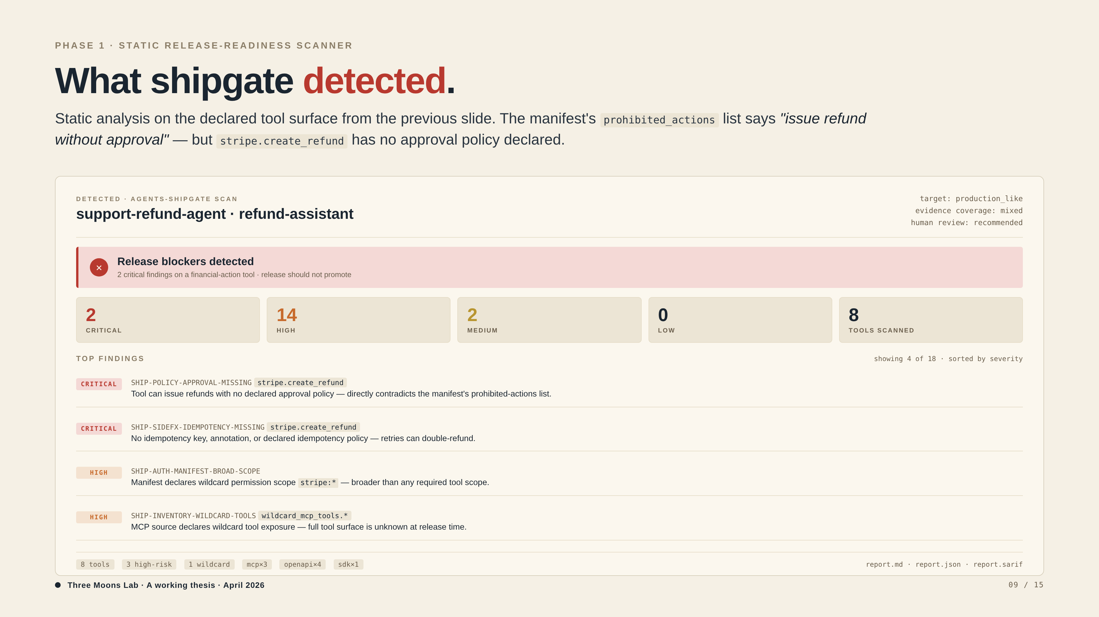

Slide 10
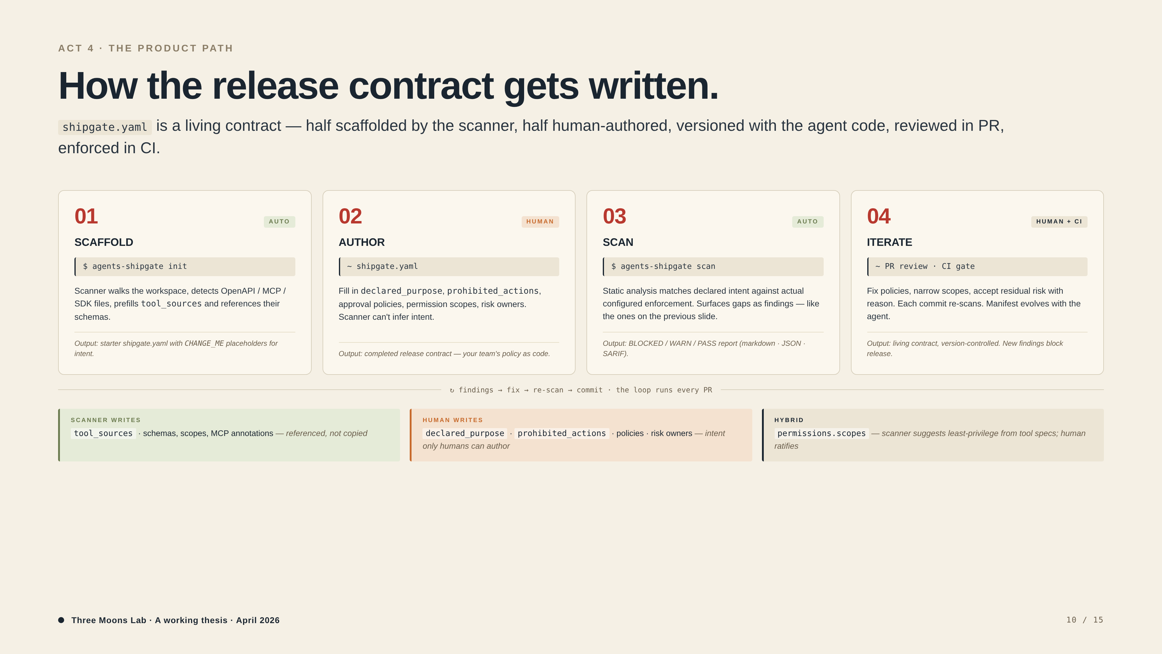

Slide 11
ACT 4 · THE PRODUCT PATH
Beyond static — sandbox & trace.
PHASE 2
~6–12 months out
PHASE 3
~12–24 months out
Sandbox & simulation
Trace, replay, runtime
Turn the unknowns surfaced in Phase 1 into experimental evidence — without exposing production state.
Turn one-time pre-release reports into a continuous readiness state — pulled from the agent's actual production behavior.
• Mocked tool execution & failure injection
• Prompt-injection harness on read-tools (web, email, docs)
• State-diff assertions for collateral damage
• Synthetic adversarial scenarios (ToolEmu / AppWorld lineage)
• Trace ingestion: OpenAI Agents SDK, MCP events, custom hooks
• Replay bundles for incident forensics
• Regression detection across prompt / model / tool changes
• Runtime anomaly & blast-radius monitors
Output: pre-promotion stress test report. CI-attachable. Fails-loud on regressions.
Output: living readiness state. Audit-grade. Connected to incident review.
Phase 1 ships now. Phase 2 and 3 are deliberate land-and-expand, not a roadmap to be promised on Slide 9.
Three Moons Lab · A working thesis · April 2026
11 / 15

Slide 12
ACT 4 · WHY THIS IS A CATEGORY, NOT A FEATURE
Three phases. One compounding
evidence corpus.
PHASE 3 · TRACE
Three phases are not three products. They are the same evidence corpus unfolding across three timescales.
Production trace data
tool-call events · approval logs · replay bundles · regression deltas · incident forensics
PHASE 2 · SANDBOX
Each user adds metadata, failure cases, and traces. The failure taxonomy, policy library, and trace schema compound.
Failure-mode taxonomy
attack patterns · injection results · state-diff baselines · scenario library
PHASE 1 · STATIC
Tool surface metadata
This is the anti-feature defense. A single GitHub Action lint cannot compound. A scanner backed by a growing cross-organizational evidence corpus can.
manifests · schemas · scopes · effect classes · approval flags
corpus compounds across phases →
Three Moons Lab · A working thesis · April 2026
12 / 15

Slide 13
ACT 5 · WHERE I AM
What I'm validating now.
Three open hypotheses. Each one converts (or kills) the company. The next 6–8 weeks are a validation loop, not a product sprint.
H1
HYPOTHESIS
PROOF I'M SEEKING
Production agents have a recurring pre-release readiness workflow today — even if no one has named it.
3–5 design partners running shipgate in real CI · 10+ release-blocking findings on real tool surfaces · repeatable trigger event.
H2
HYPOTHESIS
PROOF I'M SEEKING
The first owner is platform / AI infra engineering, not security/GRC. Security buys later, after evidence accumulates.
Design-partner data on who triggers / triages findings · which team owns the CI gate · whether security review piggybacks on shipgate output.
H3
HYPOTHESIS
PROOF I'M SEEKING
Static + manifest checks are sufficient through Risk Tier 3 (reversible internal write). Tier 4+ requires sandbox + trace.
Real findings on real tool surfaces, post-fix · false-positive rate on static checks · which tiers actually demand simulation evidence.
What I'm not claiming: PMF, runtime safety certification, or that this is foundation-model-lab-proof. Those are unknowns to be earned.
Three Moons Lab · A working thesis · April 2026
13 / 15

Slide 14
ACT 5 · 10-YEAR NORTH STAR
Today: pre-release exam.
Long-term: a record for every agent.
⊕
⊗
♥
★
TODAY
YEAR 2
YEAR 3–4
10-YEAR NORTH STAR
Pre-release exam
Stress tests
Vital signs
Medical record
static scanner ·
sandbox · failure injection ·
trace ingestion · replay ·
across the lifetime of every agent —
CI gate · SARIF report
prompt-injection harness
runtime anomaly monitors
development, incidents, retirement
Today we build the first instrument. The compounding ambition is to make every production agent's release, incident, and behavior traceable and accountable across its life.
Three Moons Lab · A working thesis · April 2026
14 / 15

Slide 15
CLOSING
What I'm looking for.
This deck is not a fundraise. It's an invitation to think alongside us. Three concrete asks, in order of immediate value:
ASK 01
ASK 02 — MOST VALUABLE NOW
ASK 03 — LATER
Sparring partners
Design partners
Capital optionality
Founders, operators, researchers willing to push back on the thesis. Especially: people who think this is a feature, not a category. I want to be wrong fast.
Teams shipping production agents with non-trivial tool surfaces — refunds, customer comms, code execution, internal data access. I want to scan, find real risk, watch what gets fixed, learn what their CI actually demands.
Not raising today. When the design-partner loop converts the thesis to traction, I'd like the conversation to continue with people who already understood the worldview.
Best for: Prateek, AI-infra peers, security/GRC operators, MCP & framework authors.
Looking for: 3–5 partners over the next 6–8 weeks.
Trigger: 3+ design partners using shipgate findings to gate releases.
Three Moons Lab is not building infrastructure to make agents smarter. We're building infrastructure to make their entry into the world accountable.
Three Moons Lab · A working thesis · April 2026
15 / 15

