Slide 1








AUTONOMI
Autonomi's Loki Mode
Autonomous multi-agent development with self-verification. PRD in, tested code out.
Created by Lokesh Mure Powered by Autonomi (v7.26.0)
v7.26.0

Slide 2



The Problem & The Solution
THE CHALLENGE
THE LOKI MODE ADVANTAGE
Development is bottlenecked by manual coding, testing, and deployment cycles.
Orchestrates 41 specialized agent roles across 8 domains for full-lifecycle delivery.
Existing AI frameworks focus on single tasks or linear code generation.
Transforms a single PRD into a fully built, tested, and deployed product.
Significant gaps remain in business operations and infrastructure management.
Autonomous multi-agent execution with minimal human intervention required.
98.78%
HumanEval Success Rate Proven Technical Excellence

Slide 3









Framework Architecture: 8 Domains
DOMAIN
AGENTS
CORE RESPONSIBILITY
4
Project initialization and base environment setup
Bootstrap
6
Requirement analysis and deep domain research
Discovery
5
System design and optimal tech stack selection
Architecture
8
Full-stack coding and core feature implementation
Development
5
9-gate quality control and 3-reviewer blind review
QA
4
Agent coordination and real-time task management
Orchestration
5
Marketing, sales, and business operation strategy
Growth
4
Infrastructure as Code (IaC) and cloud delivery
Deployment
Total Orchestration
41
Fully Autonomous Software Delivery Lifecycle

Slide 4
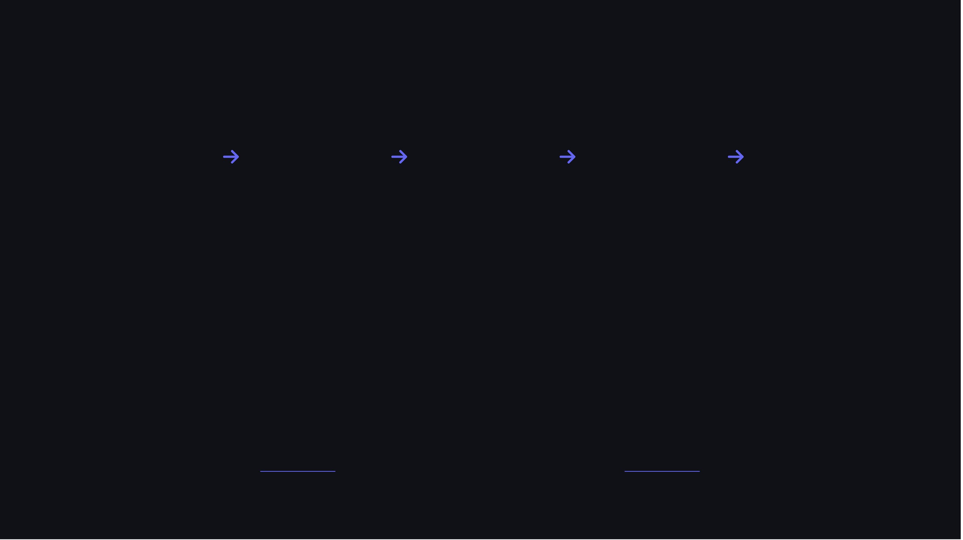





The RARV Cycle & CoVe Protocol
REASON
ACT
REFLECT
VERIFY
COMPOUND
Identifying next tasks and identifying hallucinations early.
Executing code changes, commits, and autonomous iterations.
Updating working memory and extracting learnings from failures.
Running 9 gates via Chain-of-Verification (CoVe) independent review.
Consolidating episodic memory into long-term semantic knowledge.
arXiv 2309.11495
SELF-VERIFYING AUTONOMOUS LOOP

Slide 5
9 Quality Gates & Test Integrity
AUTOMATED VERIFICATION PIPELINE
01
Input Guardrails
02
Static Analysis
HUMANEVAL SUCCESS
03
Blind Review (3 Reviewers)
04
Anti-Sycophancy Checks
98.78%
05
Output Guardrails
06
Severity-Based Blocking
162/164 Problems Solved
07
Test Coverage Gates
08
Mock Detector
9 Gates + RARV Cycle Integration
09
Test Mutation Detector

Slide 6



Multi-Provider & Memory Systems
PROVIDER SUPPORT
MEMORY SYSTEMS
PROGRESSIVE ISOLATION
Claude Code: Tier 1 primary, E2E-verified
Episodic: Full interaction traces
Semantic: Generalized patterns
--worktree: Isolated execution
Cline: Experimental provider
--pr / --ship: Git automation
Zettelkasten: Cross-note linking
--detach: Background execution
Aider: Experimental, 18+ models
Consolidation: Experience to Knowledge
Presets: AWS/GCP/Azure/Kube
Codex: Experimental provider

Slide 7



Enterprise Platform Hardening
CONCURRENT SESSIONS
MIGRATION ENGINE V2
OBSERVABILITY
SQLite State: High-performance state mirroring
loki run: Parallel execution across multiple issues
Deterministic Hooks: post_file_edit, post_step
Audit Trails: Full trace of agent actions
Session Locking: Per-session PID/lock files
Phase Gates: Immutable verification gates
Dashboard v2: Real-time WebSocket monitoring + Live App Preview
Detached Mode: No-hup background runs
Auto-Rollback: Immediate recovery on fail

Slide 8





Real-World Use Cases
BMAD METHOD NATIVE INTEGRATION: Consume product briefs and PRDs directly via --bmad-project
Task Management SaaS
E-Commerce Platform
Full-stack application with complex auth and real-time sync. Built from BMAD epic/story breakdowns.
High-performance React storefront with Stripe integration. Generated from a single BMAD PRD.
Next.js
TypeScript
Prisma
React
Node.js
Stripe
BUILT AUTONOMOUSLY
BUILT AUTONOMOUSLY
Developer Dashboard
Landing Page Generator
Real-time analytics dashboard with D3.js visualizations. Integrated with SQLite state layer.
AI-powered marketing engine with A/B testing. Deployed via Vercel with autonomous IaC.
React
D3.js
WebSocket
Next.js
Tailwind
OpenAI
BUILT AUTONOMOUSLY
BUILT AUTONOMOUSLY

Slide 9









Why Loki Mode is Better (v7.26.0)
FEATURE
LOKI MODE (AUTONOMI)
CREWAI / AUTOGEN / LANGGRAPH
Lifecycle
PRD to Deployment + Business Ops
Primarily Code or Task focused
Parallelism
41 Agent Roles + Recursive Sub-Planning
Typically linear or small teams
Quality
9-Gate Blind Review + CoVe
Basic reflection or manual review
Infrastructure
Concurrent Sessions + Per-Session Lock
Single execution thread only
Execution
RARV + Migration Engine V2
Simple Loop or Graph patterns

Slide 10







Meet the Mind: Lokesh Mure
Lokesh Mure
KEY ACHIEVEMENTS
@asklokesh
Creator of Loki Mode, the flagship autonomous framework for Autonomi.
ARCHITECTURE PHILOSOPHY
Founder of LokiMCPUniverse, featuring 25+ production-ready MCP servers.
Auto-scaling
Defense in Depth
Architected multi-cloud solutions serving 10M+ users with 99.9% success rates.
Fault-tolerant
Optimized
Open-source contributor focused on building "What Works" in the AI agent space.
EXPERTISE
Cloud & Agentic AI Solutions Architect with a focus on enterprise GenAI integration and large-scale infrastructure design.

Slide 11


Conclusion & Get Started
Autonomi's Loki Mode v7.26.0 is the most advanced autonomous framework for production software delivery. Join the Autonomi revolution and ship better code, faster.
$
npm install -g loki-mode
$
loki start ./prd.md
# RARV Cycle + CoVe Initiated... # 41 Agent Roles | Concurrent Session #1 # Quality Gates: v7.26.0 Ready
autonomi.dev
github.com/asklokesh/loki-mode
Autonomi Cloud - coming soon

