Slide 1
CPSC 470A7 Blackjack Project
Adam Nugent, Jordan Smith, RaQuan Veal

Slide 2
Blackjack Description
Prompts user or set of users for local or online multiplayer, number of players, and player class simple names, then plays rounds of Blackjack with the specified players until each player runs out of money. If an illegal player name is provided, the program terminates.

Slide 3
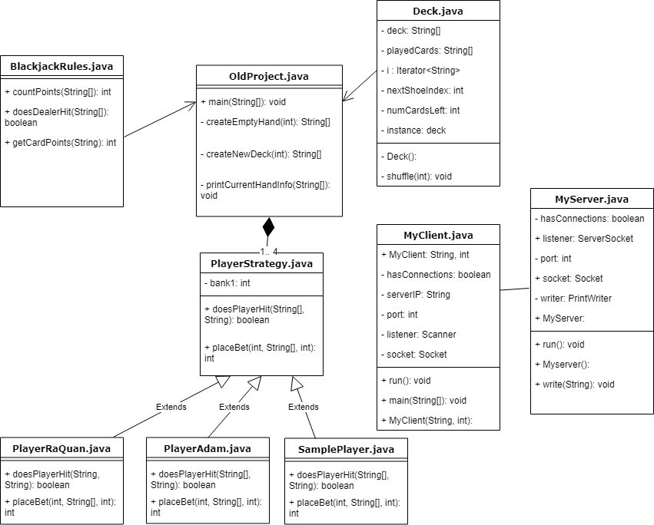
UML Class Diagram

Slide 4
Design Patterns
Strategy
Players can implement their own strategy for playing Blackjack by overriding the doesPlayerHit and placeBet methods in the PlayerStrategy abstract class.
Iterator
Iterate through a deck of cards in Deck class.
Iterate through a list of players and remove them when they run out of money.
Singleton
Player access to methods in Deck class
In our version of Blackjack we play with only one deck, so we only need a single instance of Deck.

Slide 5
Design Patterns (cont.)
Observer
The Server Host serves as the "Observable" and the players connected Observe it for updates.
Proxy
The way Online Play works is through classes called "Server.java" and "Client.java". These are objects that allow control and manipulation of the ServerSocket and normal Sockets, which fits the definition of Proxy.

Slide 6
Demo

