Slide 1

Funktionale Programmierung vs. Domain-Driven-Design
Mike Sperber

Slide 2
Obvious Differences
OOP
classes, methods, objects
state via mutation
abstract classes
nominal type systems
tower of concepts
FP
functions, data
pervasive immutability
algebraic data types
structural type systems
higher-order abstractions

Slide 3
Mutability
“Though OOP came from many motivations, two were central. [...] to find a more flexible version of assignment, and then to try to eliminate it altogether.”
Alan Kay, History of Smalltalk Communications of the ACM, 1996
Notes:
N

Slide 4
Obvious Synergies
PL evolution:
generics
lambda expressions
stream-oriented programming
records
switch expressions
pattern matching
lightweight concurrency
Kotlin
value objects FTW
”Immutable DDD”
FP + Strategic DDD
more expressive names in Haskell

Slide 5
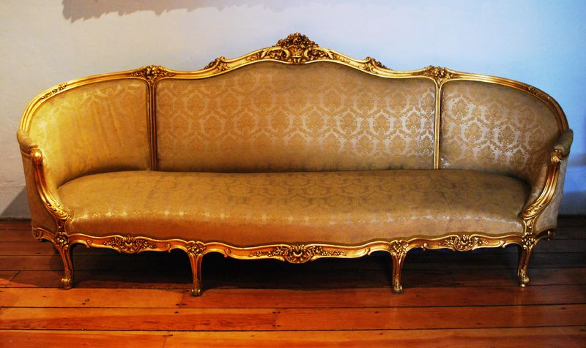


AEKI Shopping Cart
put articles in cart—always
choose shipping address
go to checkout
no shipping furniture to Packstation
don’t lose input data
combine two carts
Source: Wikimedia (sofa), Wikimedia (candle diffuser)

Slide 6
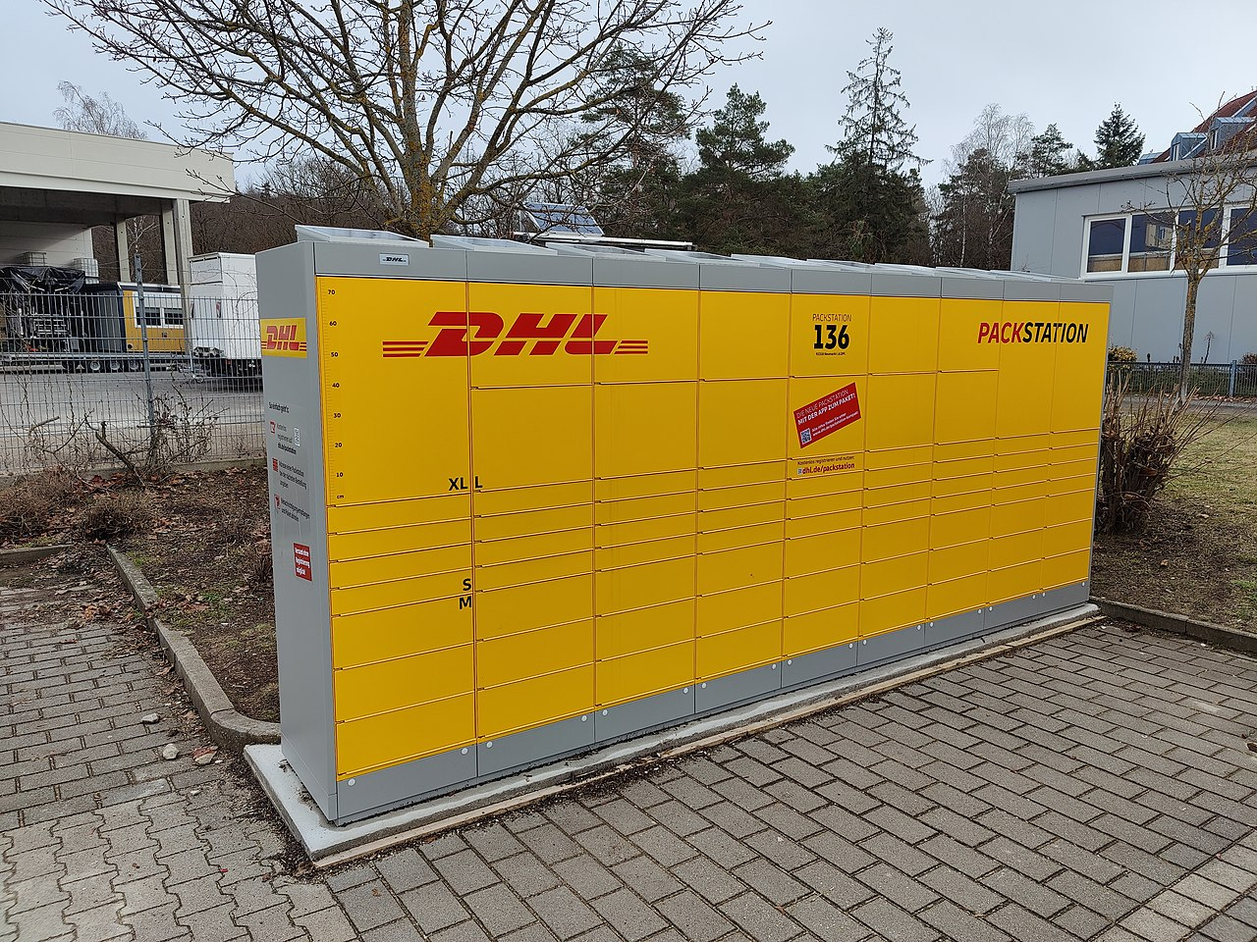
Packstation
Source: Wikipedia

Slide 7
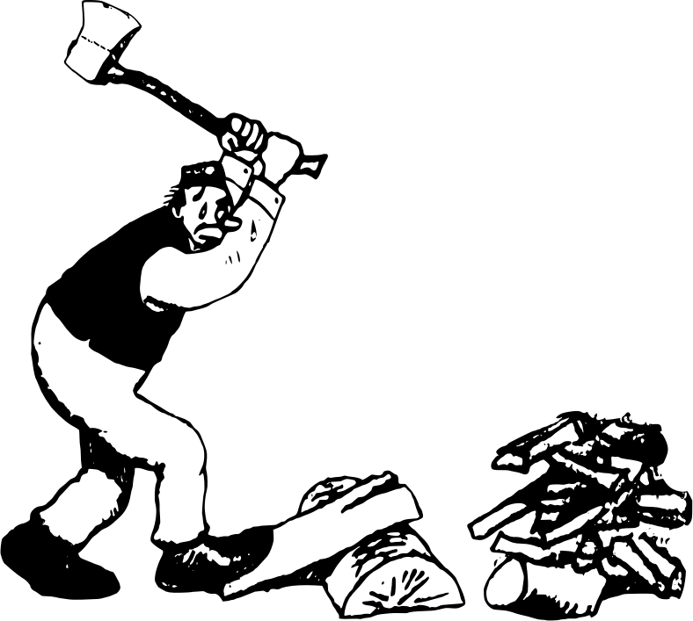

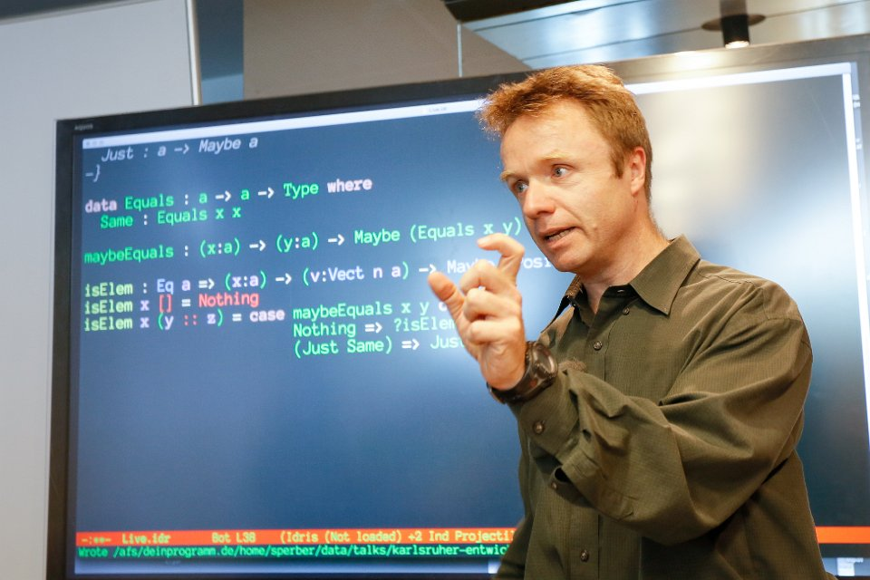
BDD vs. Design Recipes

Slide 8


Simplicity vs Generality
“Before Reuse Comes Use”
“Abstraction, abstraction, abstraction”
simplicity
generality
Notes:
these Henning:

Slide 9


Ubiquitous Language vs. Abstraction
“shopping cart”
“monoid,” “monad”
domain things—DDD ✅, FP 🤷
implicit/emergent domain things 🤼‍♂️ ❓
domain-independent abstractions FP/mathematics ✅
Notes:
These Henning: Naming things is important for DDD people, and be honest FP people are not great in that

Slide 10
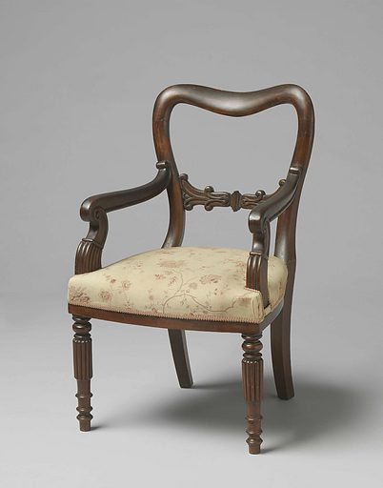
Entities vs. Value Objects vs. Domain
difference well-defined?
good for what?
domain or technology?
Notes:
Mike: we haven’t talked about Entity vs Value and we will not talk about it now.

Slide 11


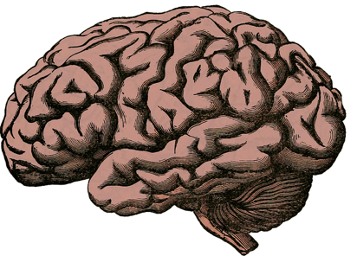
What Is It That We’re Modeling?

Slide 12
Not Friends, Yet
Collaborative Modeling Processes
Strategic Design Ubiquitous Language
BDD Operation Signatures
TDD Test Cases & Functions
Design Recipes Data Analysis
Design Recipes Functions
Abstraction Types & Combinator Models
Correctness & Consistency Math

