Slide 1
Finding Dogs a Home
Kit Hui

Slide 2
Table of Contents
1. Problem Statement
2. Data Wrangling
3. EDA/Statistics
4. Machine Learning

Slide 3
Problem Statement
1 .5 million shelter animals is euthanized every year
1 in 5 animals don’t leave the shelter
The goal of this project is to understand dependencies between adoption and euthanization rates and isolate factors that attribute to improved adoption rates whereby we can transfer animals from one shelter to another in a more automated and systematic way.

Slide 4
Problem Statement
-6.5 million animals enter a shelter every year and 1 .5 million shelter animals is euthanized every year
-1 in 5 animals don’t leave the shelter
The goal of this project is to understand dependencies between adoption and euthanization rates and isolate factors that attribute to improved adoption rates whereby we can transfer animals from one shelter to another in a more automated and systematic way.

Slide 5
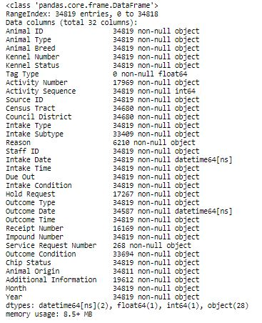
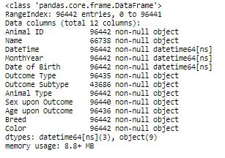
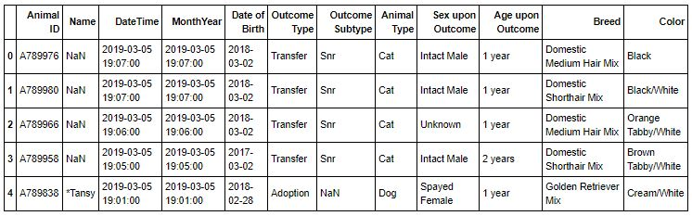
Datasets
Working with common and
uncommon features
https://data.austintexas.gov/Health-and-Community-Services/Austin-Animal-Center-Outcomes/9t4d-g238
https://www.dallasopendata.com/City-Services/Dallas-Animal-Shelter-Data/7h2m-3um5
https://data.louisvilleky.gov/dataset/animal-service-intake-and-outcome
https://data.sonomacounty.ca.gov/Government/Animal-Shelter-Intake-and-Outcome/924a-vesw

Slide 6
Data Wrangling
- Rename uncommon description
- Drop unneeded columns
- Create month and year column from datetime column
Create new columns from existing column (like neutered male to Neutered column and Sex column)
Merge dataset
Mislabel data set to average (dogs > 20yo to average)
Uncommon features remain in dataset to analysis impact of important features on adoption and euthanization

Slide 7
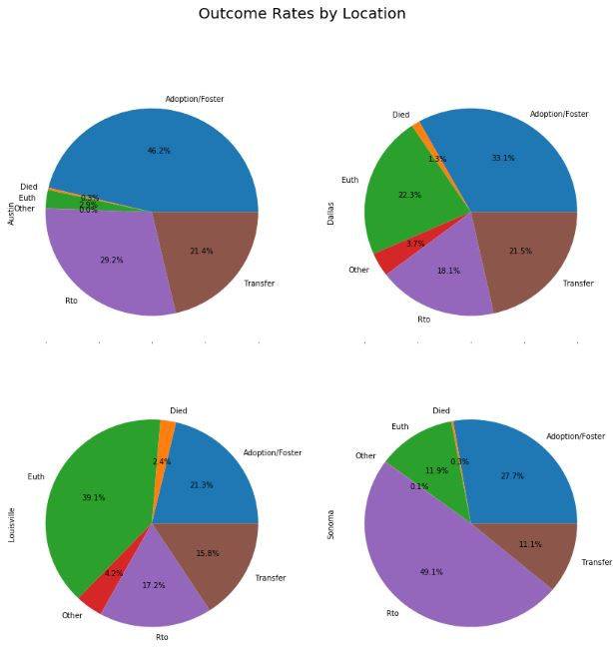
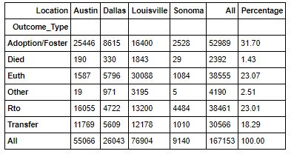
Outcome Rates
- Overall dog euthanization is 23%
- Adoption is only 31% where all others were either returned to owner or transferred away
-Louisville has 40% Euthanization and Austin have 3%
-Austin leads as having the highest adoption rate of 46%
- Transfer across all region is about 20%
In this project, the scope would only be concentrated on adoption and euthanization

Slide 8
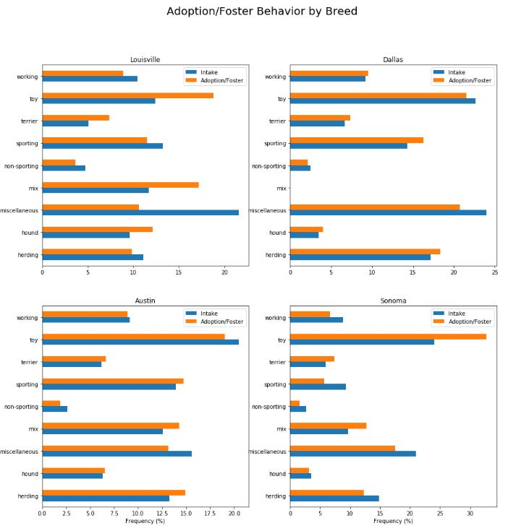
Adoption by Breed
-Comparing to intake distribution, owners tend to adopt toy breed across all region whereas miscellaneous breed is the least favored breed to adopt
-In Louisville, toy breed accounts for 20% of all adoption whereas miscellaneous breed only accounts for 10% even though intake frequency is 21%
-Dallas and Austin has intake distribution similar to adoption distribution
-Other breeds tends to fall along with the distribution

Slide 9
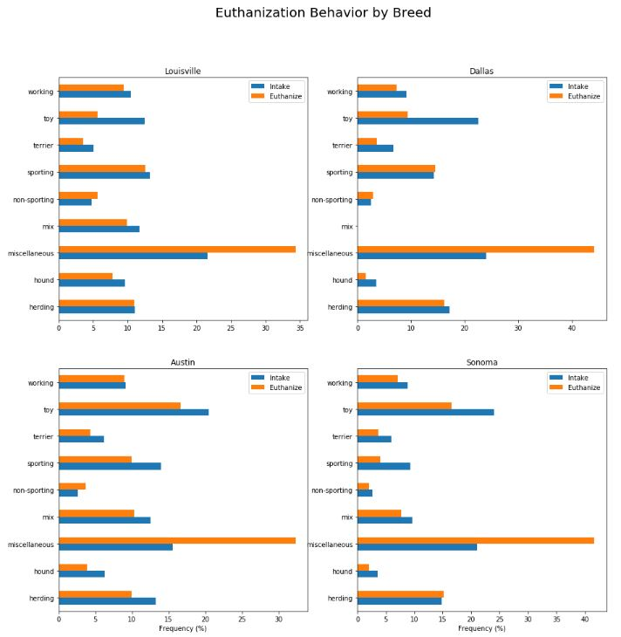
Euthanization by Breed
-Comparing to intake distribution, miscellaneous breed tends to be euthanized with some location accounting for more than 40%
Toy breed has the lowest euthanization /intake ratio
Sporting breed also have low euthanization rate for sporting breeds that tends to be higher in Dallas and Louisville

Slide 10
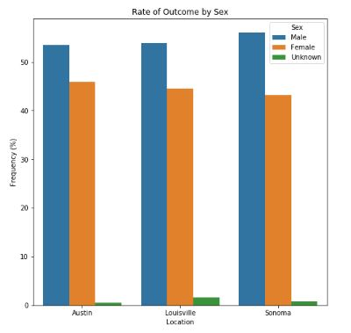
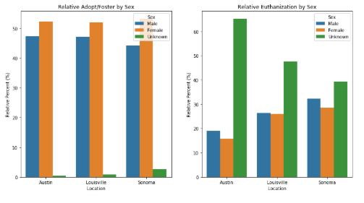
Gender
Assumption: Outcome = Intake
- Intake of male dogs (53.8%) is higher than female dogs (45%)
-Relative percentage of female adoption is higher in all location than male in all location
-Unknown gender is more likely to be euthanized. Female has the lowest relative euthanization rate
Is intake of male dogs actually higher than intake of female dogs? Also is the adoption rate of female dog higher than that of male dog?

Slide 11
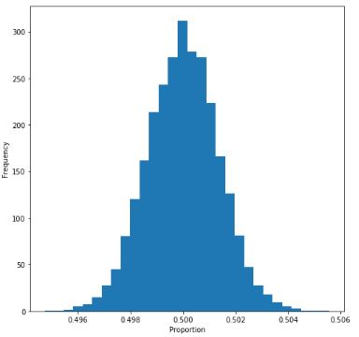
Statistical Testing of Gender
Test #1:
Null hypothesis: P(male) = P(female)
Alternative hypothesis: P(male) > P(female)
Alpha = 0.5%
Bootstrap (10000 bootstrap replicates) and one sided proportion test shows p-value < 0.0.
p-value = 0 therefore, reject null hypothesis and accept alternative hypothesis
Test #2:
Null hypothesis: P(male adoption rate) = P(female adoption rate)
Alternative hypothesis: P(female adoption rate) > P(male adoption rate)
Alpha = 0.5%
Bootstrap (10000 bootstrap replicates) and one sided proportion test shows p-value < 0.0.
p-value = 0 therefore, reject null hypothesis and accept alternative hypothesis

Slide 12
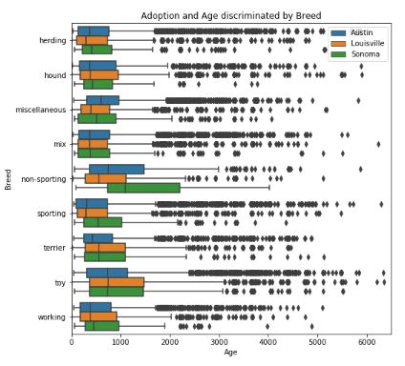
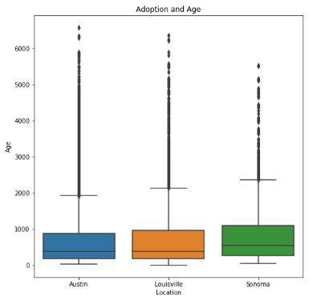
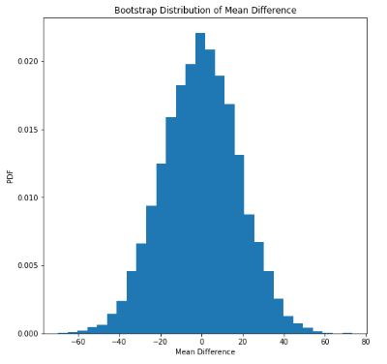
Age Effect on Adoption
Mean age of adoption in Sonoma (2.4yo) is higher than those of Louisville and Austin (2.0yo and 2.1yo respectively)
Null hypothesis: μ(adoption age in Sonoma) = μ(adoption age in Austin)
Alternative hypothesis: μ(adoption age in Sonoma) > μ(adoption age in Austin)
Alpha = 0.5%
Bootstrap for mean difference(10000 bootstrap replicates)
p-value = 0.013 therefore, reject null hypothesis and accept alternative hypothesis
For some location, owners tend to adopt older aging dogs
***All age are measured in days
-For most breeds, adoption age for one location aligns with that of another
- For non-sporting breed, adoption age varies significantly among locations

Slide 13
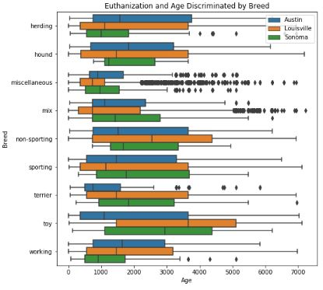
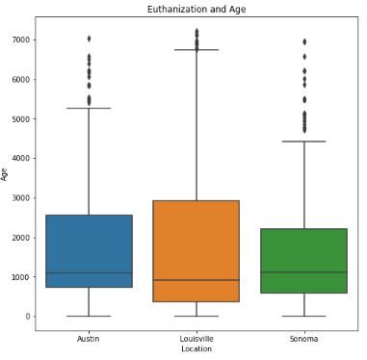
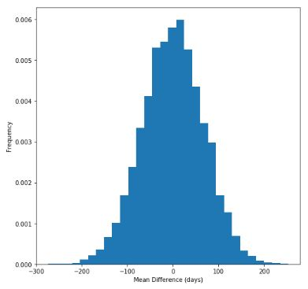
Age Effect on Euthanization
Mean age of euthanization in Sonoma (4.6yo) is lower than those of Louisville and Austin (4.8yo and 4.7yo respectively)
Null hypothesis: μ(euthanization age in Sonoma) = μ(euthanization age in Louisville)
Alternative hypothesis: μ(ethanization age in Sonoma) > μ(euthanization age in Austin)
Alpha = 0.5%
Bootstrap for mean difference(10000 bootstrap replicates)
p-value = 0.013 therefore, reject null hypothesis and accept alternative hypothesis
For some location, owners tend to adopt older aging dogs
Louisville have the lowest median age of euthanization (2.5yo) compared to Austin and Sonoma (3.0yo and 3.1yo respectively) but has the highest mean age of euthanization. This means the distribution of animals entering Louisville is slightly more uniform and right skewed whereas Austin and Sonoma is less uniformly distributed.
Median age of euthanization of specific breed is location dependent unlike that of adoption rate where the median is similar across all region

Slide 14
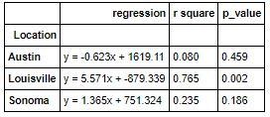
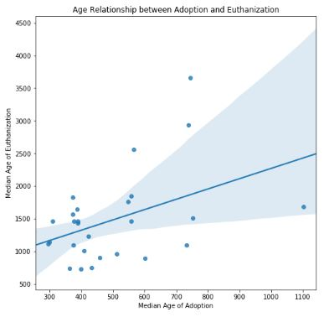
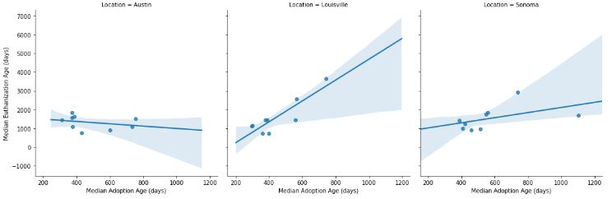
Age relationship between Adoption and Euthanization
Each point is the measurement of median age for each breed.
In Louisville, age has a linearly, statistically significant relationship between median age of euthanization and adoption. In other words, euthanization age and adoption age are highly dependent in Louisville. Louisville age discriminant
Median(breed1, euth)/Median(breed1, adopt) = Median(breed2, euth)/Median(breed2, adopt)
In other locations, median age of adoption and euthanization is breed independent of one another.
Median(breed1, euth)/Median(breed1, adopt) != Median(breed2, euth)/Median(breed2, adopt)

Slide 15
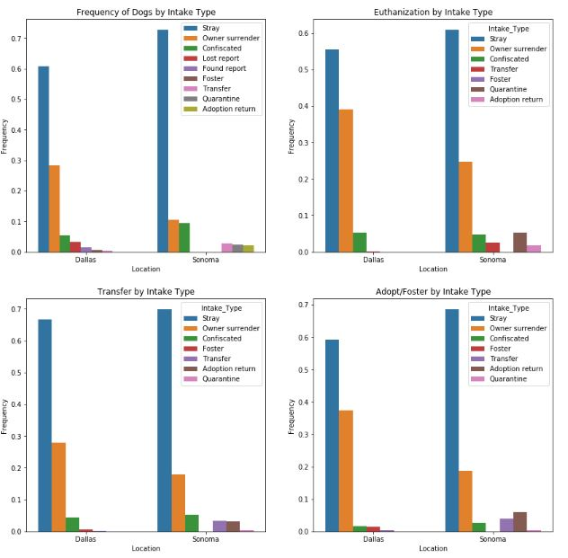
Intake Dogs at Shelters
***Only Dallas and Sonoma record this information
The leading factor into dogs in shelter is stray dogs taking up more than 60% of the population.
Second most common is owner surrender, however, in Sonoma it only counts for about 10% nearly tie with confiscation.
Owner surrender tends either be euthanized or adopted at 40% and 35% in Sonoma respectively and 25% and 20% in Dallas respectively compared to less than 30% and 10% intake in Dallas and Sonoma respectively

Slide 16
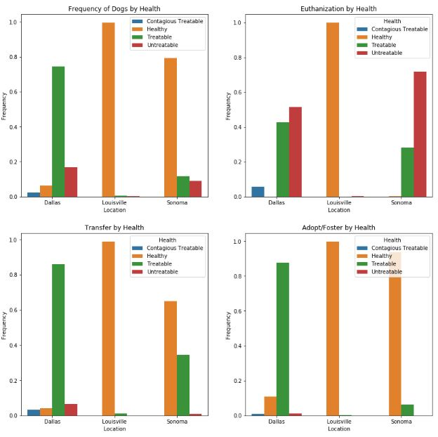
Dog Health and Outcome
-80%% of dogs in Dallas is unhealthy but a little less than 80% is treatable
- Almost all of the dogs in Louisville is healthy, and therefore almost all of the dogs in any outcome are disproportionally healthy
-In Somona the proportions are completely different with almost 80% of healthy dogs.
-In all locations, untreatable sickness likely leads to euthanization negligible adoption and transfer frequency.
- In Dallas a negligible percentage of healthy dogs are euthanized whereas in Sonoma, 1 in 6 healthy dogs are euthanized.
- Over 85% of people seeking for adoption at Dallas takes in a dog with treatable condition and roughly the same percentage was taken in as healthy

Slide 17
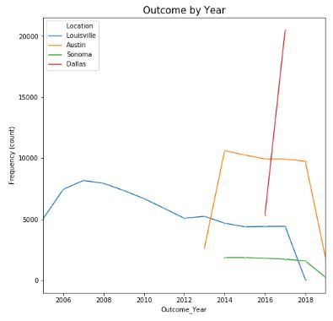
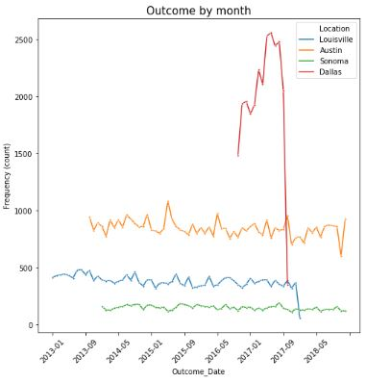
Time Series
- Limited data from Dallas, Austin and Sonoma
-For the most parts shelters have consistent outcome rates
- Spikes and trough of outcome frequency occur roughly periodically in Austin, in other words, season by affect outcome rates
-dramatic inconsistency for the first and last year of the data collected, likely a result of data collection break in the middle of the year
Can see that for some location, data towards the end deviates substantially
Also for Austin, data stops at September. These accounts for the inconsistency of year graph

Slide 18
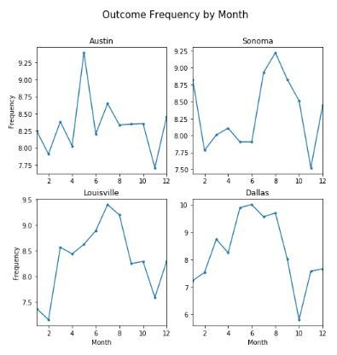
Outcome by Month
Sharp decline in outcome in October/November period. For Dallas, a peak in June to the tough in October experienced a decline of over 40%.
- In all location, peak outcome rate surpass 9%.
- Peak outcome rate is typically around summer for most location
- Outcome rate early into the year is also a typical weak
- Austin has the most consistent outcome rate hovering around 8% compared to and average of 8.33%

Slide 19
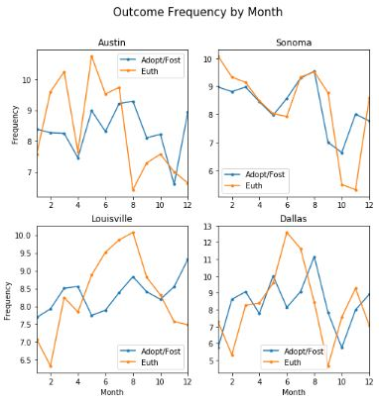
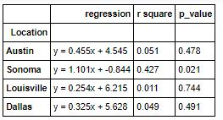
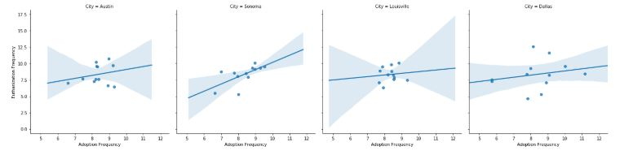
Adoption and Euthanization dependency on Month of Year
- In Sonoma, it appears that the dependency between euthanization and adoption rate is very high and appears to align almost entirely above one another. This is surprising because assumption is that as adoption increase, euthanization decrease with other factors aside.
- In Austin and Louisville, there doesn’t appear to be any patterns. But for Dallas, it may have some sort of delay.
- p-value of the regression aligns with the claims. Sonoma has a statistically significant linear relationship between adoption and euthanization based on month whereas the other locations have weak/no dependency

Slide 20
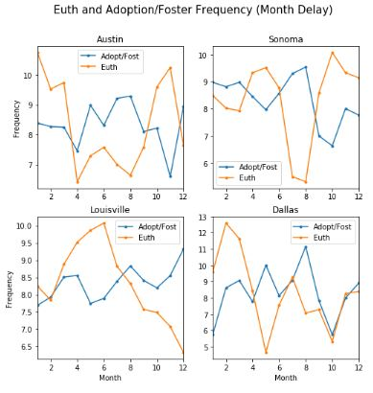

Adoption and Euthanization dependency on Month of Year cont.
Assumption:
Euthanization frequency is delayed
The delay factor is less than 5 months
The dependency is inversely related (tough match up with peak)
Algorithm:
Loop across delay time
Adjust euthanization backwards by 1 month
Measure and save best r-value with negative slope
Visually, for the most part all locations have a good match up with Austin seemly having the best outcome from the frequency delay

Slide 21
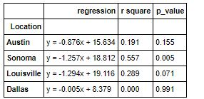
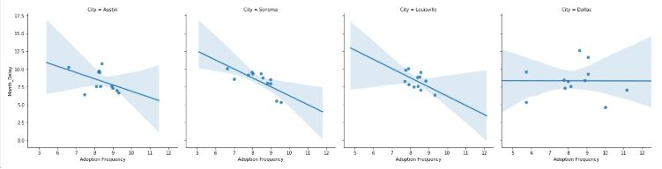
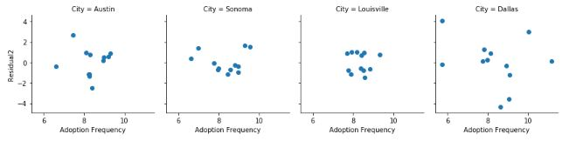
Adoption and Euthanization dependency on Month of Year cont.
Dallas did not find any dependency based on the criteria whereas other have significant improvement in correlation values
However, p-values shows there isn’t a statistically significant linear model that correlates euthanization and adoption in Louisville, Austin and Dallas using months

Slide 22
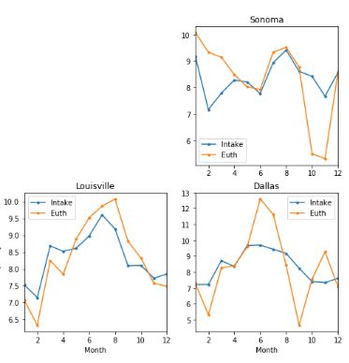
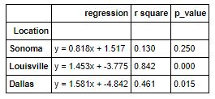
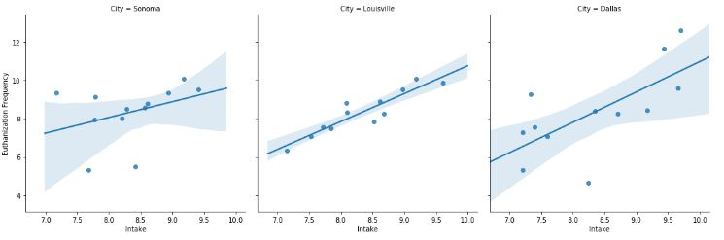
Intake Frequency and Euthanization Temporal Relationship
For Louisville has a high r-square value and low p-value. This corresponds to the fact that increase intake frequency correlates to spike in euthanization. This may be a result of space constraint in these facility
This is also generally true in dallas with p-value of 0.015
***Austin data is missing

Slide 23
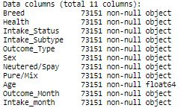
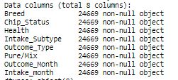
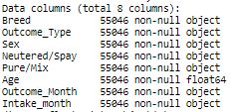
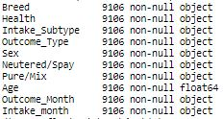
Machine Learning
Strategy: Machine learning on every location independently with many important factors missing
Target = Outcome_Type
Louisville Dallas Austin Sonoma

Slide 24
Machine Learning cont.
Logistic regression model (cv= 3, ‘C’ hypertuning)
Bernoulli naïve bayes (cv = 3, ‘alpha’ hypertuning)
Support vector machine (cv = 3, ‘C’ hypertuning)
K-Nearest Neighbor (cv = 3, ‘n_neighbors’ hypertuning)
Random forest (cv = 3, ‘n_estimator’ hypertuning)
Deep learning(6 hidden layer, Batch normalization every other layer, dropout for all other layers, ‘relu’ activations, loss = ‘categorical_crossentropy’, batch_size = 256, eposch = 50, validation split = 0.3)
***cv: cross validation

Slide 25
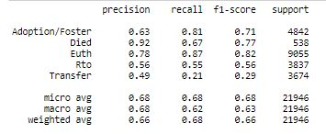
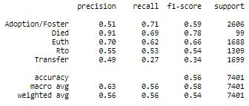
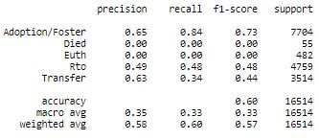
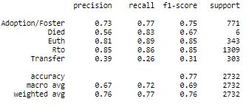
Best Accuracy on Test and Train Data
Louisville: Deep learning model with 68.3% on validation data, 68.2% on test data
Dallas: Deep learning model with 55.3% on validation data, 55.6% on test data
Austin: Deep learning model with 59% on validation data, 60.1% on test data
Sonoma: Deep learning model with 78.2% on validation data, 77.2% on test data
Bad accuracy for Dallas, is the data useless?

Slide 26
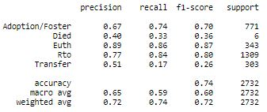
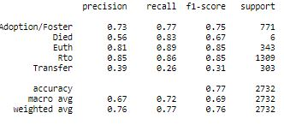
Choosing the right model
High recall rate of euthanization is more humane
High precision rate of euthanization is more economical
To select where to transfer, choose a place with high precision of adoption
Even for Dallas, euthanization prediction is relatively good. Deep learning with best f1-score of 0.66
Logistic regression on Sonoma for best precision
Deep learning on Sonoma for best recall

Slide 27
Future Works
Improve the featuring engineering of Age, Breed and Color
Study the effects of features on RTO and Transfer
Study the interdependencies of RTO, Transfer, Adoption and Euthanization rates
Simplify outcome types with only survived and alive to improve accuracy and better target for euthanized dogs.
Cross validate with other hyperparameters to improve accuracy
Weight average all the models to create an ensemble model
Engineer model to improve accuracy of euthanization rate and adoption rate
Use transfer learning

