Slide 1

Strings, Formatters, and Wrappers

Slide 2
Strings, Formatters, and Wrappers
1. Using the String Class
2. The StringBuffer Class
3. Formatting and Parsing for the World
4. Text Processing with Regular Expressions
5. Formatting and Parsing Streams
6. Wrapping the Primitives

Slide 3
Formatting and Parsing for the World
Understanding the Locale Class
Locale(String language)
Locale(String language, String country):
Locale(String language, String country, String variant)
Example:
Locale locale = new Locale("en"); // English language
Locale locale = new Locale("en", "UK");
// English language, United Kingdom
Locale locale = new Locale("it", "DE", "WIN_TX_Austin"))

Slide 4
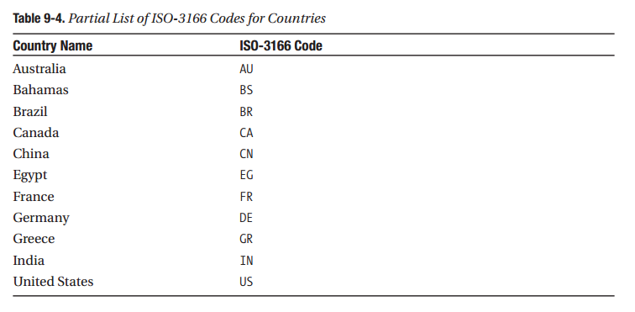

Slide 5
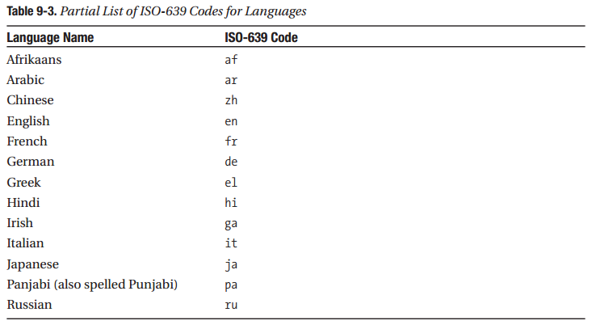

Slide 6
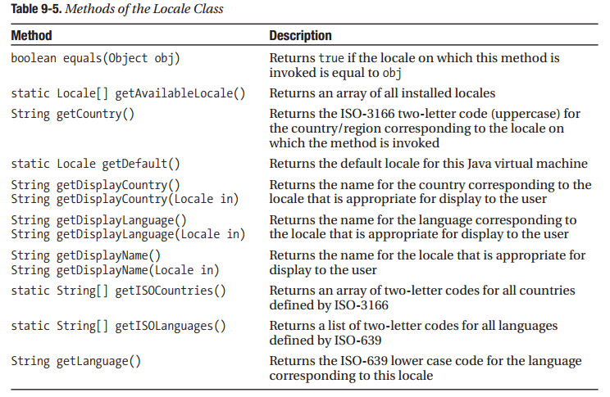

Slide 7
Formatting Numbers and Currencies
NumberFormat.getInstance();
NumberFormat.getCurrencyInstance();
NumberFormat.getPercentInstance();
Có 3 bước :
1. Tạo một Locale
2. Tạo một NumberFormatobject thích hợp bằng cách sử dụng Locale từ bước 1 như một tham số.
3. Sử dụng các NumberFormatobject để định dạng một số.
--Code demo--

Slide 8
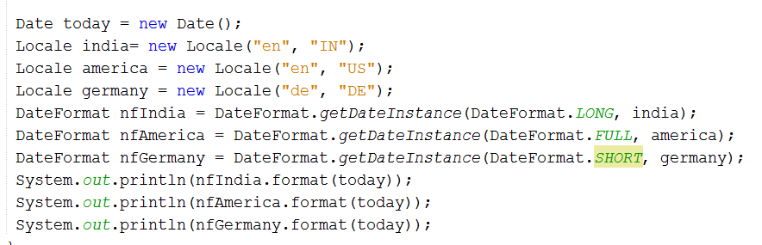
Formatting Dates

Slide 9
Formatting Streams
Formatter Class
PrintWriter Class

Slide 10
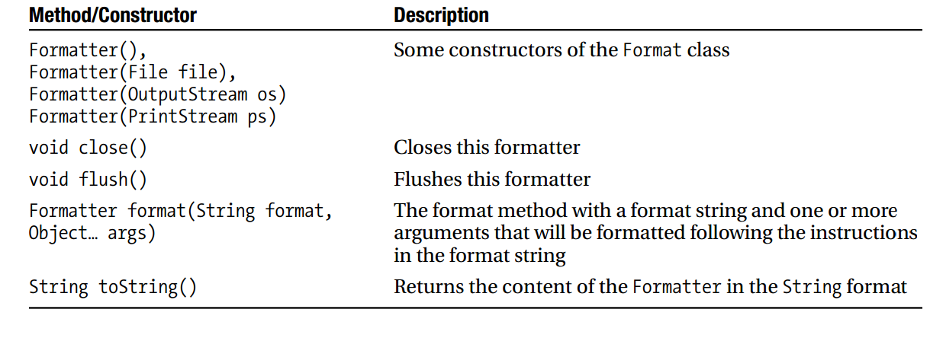
Formater Class

Slide 11
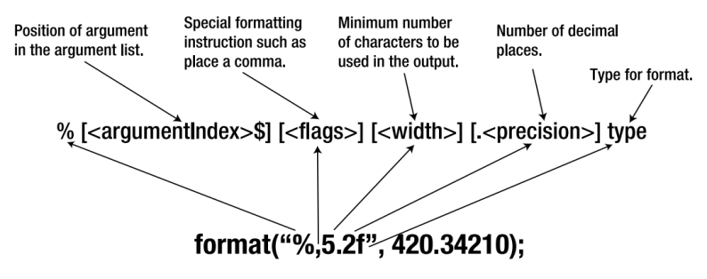
format(<format specifier>, <argument>);
The <format specifiers> has the following syntax:
%[<argumentIndex>$][<flags>][<width>][.<precision>] <type>

Slide 12
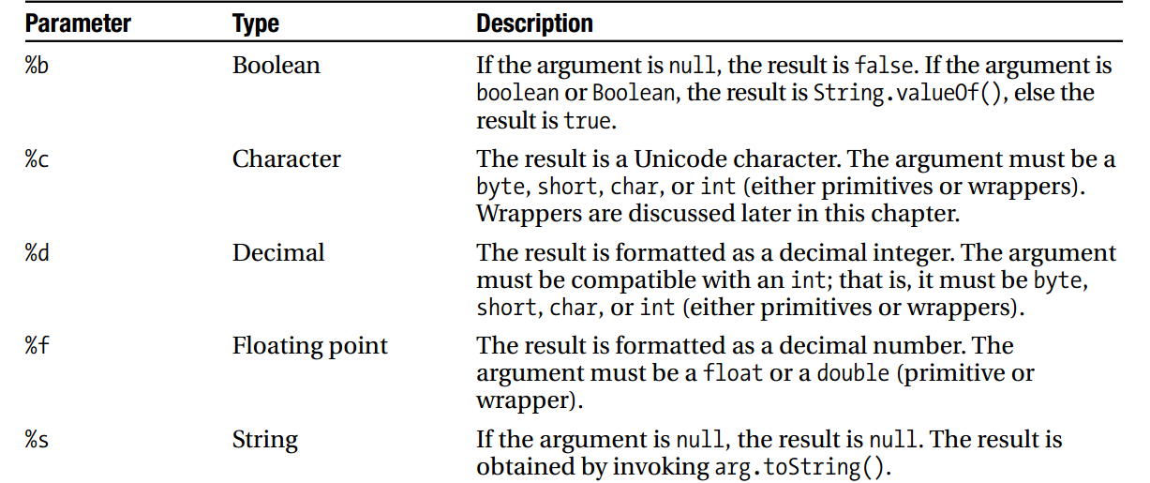

Slide 13
Parsing Streams Scanner Class
The input text that needs to be parsed can be passed to the Scanner constructor as a String, File, or an InputStream

Slide 14
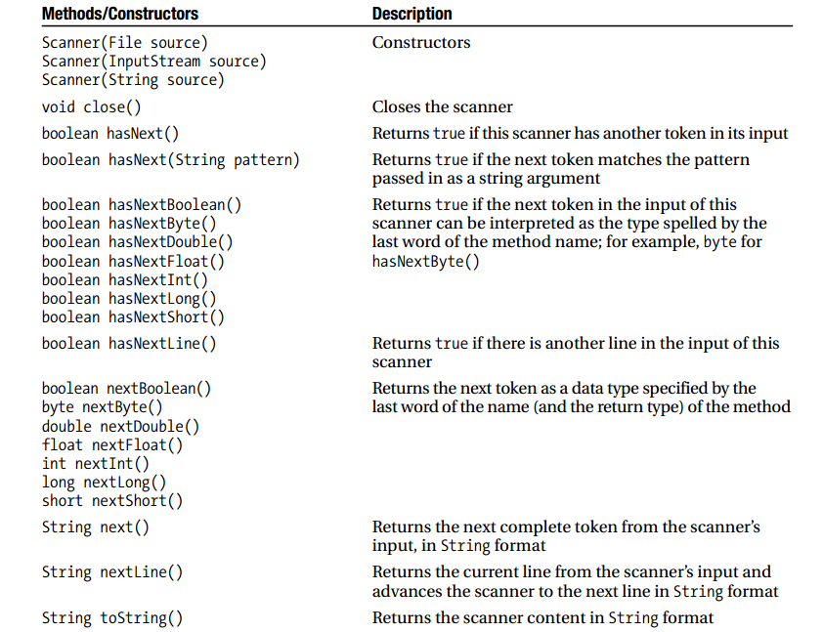

Slide 15
Example

