Slide 1
Object Ordering
It is often desired that the data is stored in an ordered fashion, so that when we need a specific data item from a collection, we know where to go to get it. So, ordering improves performance of retrieval operations such as searches.

Slide 2
Natural Ordering
As you know, a list is ordered by index, but not sorted by the element values. Some kind of sort algorithm is used to sort the elements of a list by values. You can sort a list by using the following static method of the Collections class:
Collections.sort(list);
If the list consists of String elements, they will be sorted in alphabetical order; if it consists of the Date elements, they will be ordered in chronological order. String and Date classes implement the Comparable interface, which has a single method:
int compareTo(T obj)

Slide 3
T specifies the type of the passed-in object. It returns a negative integer, zero, or a positive integer if the object on which this method is invoked is less than, equal to, or greater than the object passed in as an argument. The objects of classes such as String and Date that implement the Comparable interface are ordered automatically when the sort() method is invoked on the list that contains those objects. This ordering is called natural ordering

Slide 4
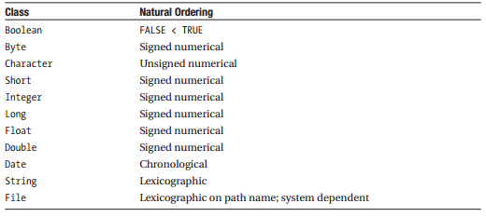
Summarizes some of the common Java classes that implement the Comparable interface and thereby support natural ordering.

Slide 5
Defining Ordering Using Comparator
Suppose a collection has objects that you want to sort in a certain order, but either the class of the objects does not implement the Comparable interface or the order in which you want to sort the objects is other than the natural order. In this case, you need to use the Comparator interface. In other words, you need to provide a Comparator, an object of a class that implements the Comparator interface. Of course, you will write this class and define what it means to be greater than, equal to, or smaller than. So, the Comparator that you will provide will encapsulate an ordering.

Slide 6
Like the Comparable interface, the Comparator interface consists of a single method:
int compare(T o1, T o2)
The compare(…) method compares the two objects passed in as arguments, and returns a negativeinteger, zero, or a positive integer if the first argument is less than, equal to, or greater than the second. The compare(…) method throws a ClassCastException if either of the arguments has an inappropriate type for the Comparator

Slide 7
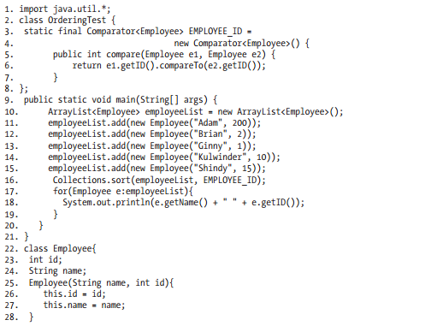

Slide 8
Understanding Autoboxing
Primitive data types cannot participate in object-like activities.
Each primitive type has a corresponding wrapper class that stores the values of that type, and they can act as objects. So, you wrap a primitive value into the corresponding wrapper object and then that value can act as an object type. This process is called boxing
When you need the primitive value back, you retrieve it from the wrapper by invoking an appropriate method on it. This is called unboxing
If there is a lot of boxing and unboxing going on, your program becomes cluttered and you are doing the same thing over and over again: boxing and unboxing. J2SE 5.0 presents a solution to this problem by automating boxing and unboxing, a feature known as autoboxing

Slide 9
Autoboxing is the capability to assign a primitive value to a corresponding wrapper type; the conversion from primitive type to wrapper type is automated. Auto-unboxing is the reverse of autoboxing—that is, the capability to assign a wrapper type to the corresponding primitive type; the conversion from wrapper to primitive is automated
“Autoboxing” is also sometimes used, for short, to refer to both autoboxing and auto-unboxing. Without autoboxing, you will need to do wrapping and un-wrapping manually
public Double areaOfASquare(Double side){
double d = side.doubleValue();
double a = d*d;
return new Double(a);
}

Slide 10
But now in J2SE 5, you can simply replace the preceding code fragment with the following:
public Double areaOfASquare(Double side){
return side*side;
}

Slide 11
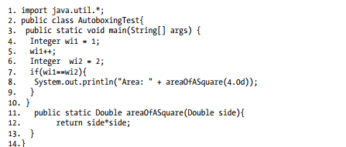

Slide 12
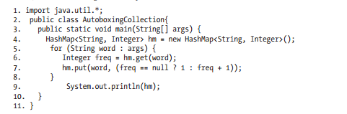
We started the discussion on autoboxing with the issue of how to put primitive values into the collections using wrappers.

