Slide 1
Wrapping the Primitives
Wrapper classes are used to convert any data type into an object.
The primitive data types → object = wrapper classes.

Slide 2
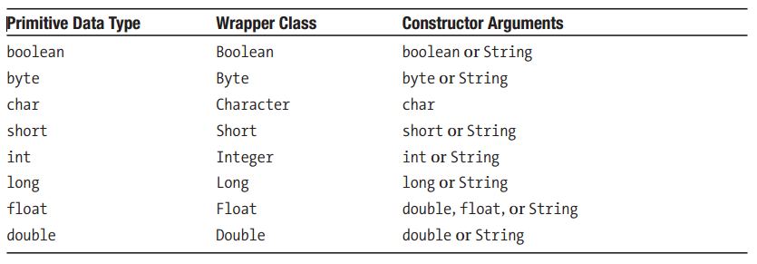
Creating Objects of Wrapper Classes
Creating Wrapper Objects with the new Operator

Slide 3
you can always pass the corresponding primitive data type as an argument to a wrapper class constructor
You can also pass a String as an argument to any wrapper class constructor except Character.
The Character constructor only takes the obvious argument: char.
You can pass double as an argument to the Float constructor but not vice versa

Slide 4
An instance of a wrapper class may be created by calling the corresponding constructor and by passing an appropriate argument
The value may also be passed as a variable
Note that there is no way to modify a wrapped value—that is, the wrapped values are immutable

Slide 5
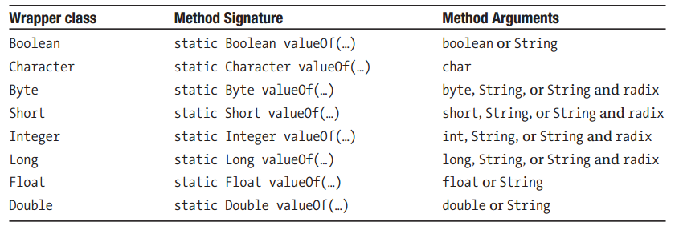
Wrapping Primitives Using a static Method
You can create a wrapper object by using the static valueOf()method that all the wrapper classes offer. Because it’s a static method, it can be invoked directly on the class (without instantiating it),and will return the corresponding object that is wrapping what you passed in as an argument.

Slide 6
Note the following about the arguments allowed in the valueOf(…)method calls:
The valueOf(…)method in the Character class accepts only char as an argument, while any other wrapper class will accept either the corresponding primitive type or String as an argument.
The valueOf(…)method in the integer number wrapper classes (Byte, Short, Integer, and Long) also accepts two arguments together: a String and a radix, where radix is the base

Slide 7
Now that you know how to wrap a primitive in a wrapper class, a natural question to ask is:How can I get my primitive back? Yes, you are right; there are some methods you can use to retrieve the primitive values from the wrapper objects

Slide 8
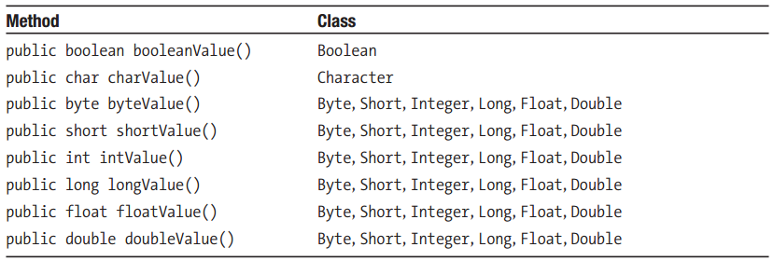
Methods to Extract the Wrapped Values
A storage capability without the corresponding retrieval capability is not of much use. Once you store a primitive in a wrapper object, often you will want to retrieve the stored primitive at a later time. The methods to extract the values from the wrapper classes are listed in Table

Slide 9
The Instant Use of Wrapper Classes
If you do not need to store a value in a wrapper but just want to perform a quick operation on it, such as converting the type, you can do it by using an appropriate staticmethod of the appropriate wrapper class. For example, all the wrapper classes except Character offer a staticmethod that has the following signature:
static <type> parse<Type>(String s)
The <type>may be any of the primitive types except char, and the <Type>is the same as <type>with the first letter uppercased

Slide 10
