Slide 1



AI
mendel_prompts.py
DEC 2023
Bandersnatch
Team member: Tanay, Aldwin, Spencer, Kezhi
Openmesh
HyperCycle
Notes:
Good afternoon ladies and gentlemen. We are Bandersnatch, a team of committed individuals that joined the hackathon to seek a challenge.

Slide 2
Team
Tanay - Project Manager and Engineer
Bandersnatch
Formed on a sunny Sunday afternoon
Hasty complex problem -> Hasty solution
Aldwin - Product Owner and Engineer
Spencer - Data Scientist and Engineer
Ted - Infrastructure Architect and Engineer
Openmesh
HyperCycle
Notes:
Quick Team Introduction:
-Introduce your team in a few words and touch on key aspects of your journey leading up to it
- let each team member introduce themself, how they heard about the hackathon
- Team Formation Story: Briefly mention how your team was formed.
- Hook: Start with a compelling statement or question to grab the audience’s attention.
POTENTIAL HOOK - "Ever been in a hurry to solve a complex problem? Imagine hastily crafting a genetic algorithm to do just that. Today, we're diving into the fascinating world of rapidly engineered genetic algorithms with LLMs"

Slide 3
Our Development Journey
Brainstorming
Prototype
Analysis
Implementation
Understanding the requirements of the initial challenge
Creating a clear and robust strategy for GA integration
Reviewing GA performance and making necessary adjustments
Starting to implement GA for the LLM
Openmesh
HyperCycle

Slide 4

AI
Problem Statement
Challenge 4: Decentralized AI Training and Automated Prompt Engineering
Sub Challenge: Automated Prompt Engineering
Objective: Develop a genetic algorithm designed to generate best possible prompts for a large language model (LLM).
Openmesh
HyperCycle
Notes:
- Clearly state the challenge and describe the challenge in your own words.
- Quickly highlight why this problem is important and needs a solution.

Slide 5

AI
Solution Overview
GA for movie prompts --> help movie directors, producers, and writers
Efficiency through batching
Using vector database --> optimise GA similarity search
Openmesh
HyperCycle
Notes:
- Solution Summary: Describe your solution in simple, understandable terms.
- Differentiation: Explain what makes your solution unique or innovative.

Slide 6
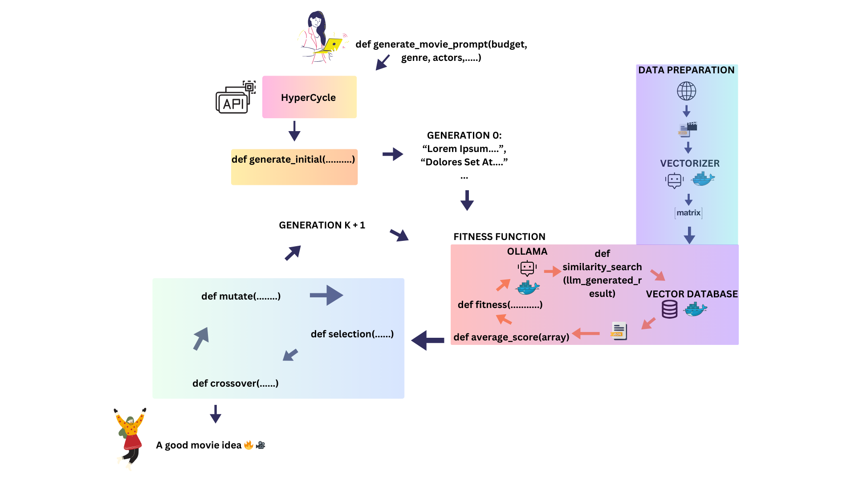
Design Process
Notes:
- Key Technologies: Briefly mention the technologies, tools, or methodologies you used.
Ollama, Hypercycle, Weaviate, different genetic algo methods
- Architecture Highlights: Describe any notable aspects of your solution’s architecture or design.

Slide 7

Sample Output
How about a movie called Terror at Sea? The movie follows a group of people on a luxury cruise ship who are thrown into chaos when a group > > > of terrorists take over the boat. The film will be a thrilling and suspenseful adventure as the passengers and crew try to survive and escape > > > the terrorists while also trying to piece together their motivations and plan their counter-attack. Along the way, there will be unexpected > > > twists and turns, shocking discoveries, and intense action sequences that keep the audience on the edge of their seats." SCORE: 81
"Title: Interceptor The story revolves around a highly skilled agent who works for a top-secret government agency. The agent is tasked with intercepting a terrorist cell that is planning to attack a major city. To achieve this, the agent will have to go undercover and infiltrate the group, using all sorts of techniques to gather intelligence and stay hidden. As the plot progresses, the agent will be alerted by their colleagues of a potential threat from an unexpected source - a random person on a tugboat who seems to have some sort of advanced knowledge about the terrorist group's plans. The agent will need to follow this lead and investigate the tugboat captain to gather more information. The movie could involve a lot of suspenseful moments as the agent races against time to stop the terrorists before they cause any damage. It could also feature some unexpected twists and turns as the story unfolds, with the potential for a few surprises along the way." SCORE: 76
Notes:
Explain the output of the program

Slide 8


Future Development
Optimising crossover and mutation algorithms
Tune parameters of GA
Distributive computing on Hypercycle
Make Dockerfile --> ease of use
Extensive documentation
Get more contributors
Generalization
Integrate to Openmesh
Openmesh
HyperCycle
Notes:
- Application Scenarios: Mention one or two potential real-world applications or use cases for your solution.
- producers or writers could come up with many creative ideas for their next movie e.g. Marvel
- Summarize: Concisely recap the key points of your presentation.
Future Impact: Briefly discuss the potential future impact or benefits of your solution.
- change the landscape of how movies are produced and released i.e. brainstorming new ideas for better movies
- Future Plans (if any): Mention any future developments, improvements, or aspirations for your project.

Slide 9
THANK YOU
Openmesh
HyperCycle
Notes:
We would like to thank Openmesh, Hypercycle and our fellow hackathon particpants and we wish all of you the best of luck for this challenge. Now moving onto the Q&A.

Slide 10
AI
Contact Us
tanay.sagrolikar@gmail.com
Openmesh
HyperCycle

Slide 11


Q&A
Openmesh
HyperCycle
Notes:
- How long would it take to vectorise each movie from the database to the GA?
Depends on the dataset but for ours it takes around 10mins
- Why does this work?
we measure the cosine similarity between the llm output and existing movies in vector space
- How did you decide upon the parameters and algorithms chosen for the selection, mutation, and crossover functions?
- Why did you choose this problem in particular?
We generalised this to help people in creative industries to brainstorm new ideas and give them an edge in their own endevours and use LLM to help instead of replacing them completely

