Slide 1
Conversion to SVG
Go to slide and mark everything with ctrl-a
Right-click and “save image as…” -> .emf
Go to https://convertio.co/de/emf-svg/
Upload .emf, convert, download .svg
Enjoy scalable graphics in docs ☺
Restrictions: 10 Minutes Conversion Time per Day ☹

Slide 2
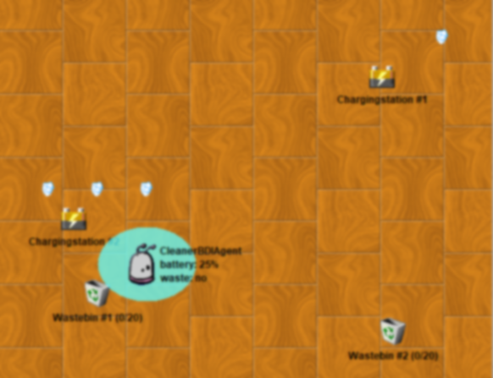
0
0.1
1
1
2
3
1
4
Patrol Plan 2
0.1
0

Slide 3
0
0.1
1
1
3
2
1
4
Patrol Plan 3
0.1
0

Slide 4
maintain condition becomes false
Maintain Battery Loaded
Perform Patrol
inhibits
Goal active
maintain condition becomes true
Goal idle
Patrol Plan 3
Load Battery
Patrol Plan 2
Patrol Plan 1
Maintain Battery Loaded
Perform Patrol
inhibits
Goal suspended
Goal active
Plan aborted
Patrol Plan 3
Load Battery
Patrol Plan 2
Patrol Plan 1

Slide 5
Goal Plan Tree Example
Eat pan-cakes
goal
Make pancake
plan
Pan- cake mix ready
Pan-cake flipped
…
sequential = AND
Get in- gredients off shelf
alternative = OR
Buy ingredi-ents
Throw pancake
alternative = OR
Flip with spatula

Slide 6
Simple Cleaner Agent
Need to recharge?
no
yes
Waste picked up?
Ch. station known?
no
yes
no
yes
Waste known?
Waste bin known?
Move randomly
Move to charg. station
no
yes
no
yes
Recharge
Move randomly
Move to waste
Move randomly
Move to waste bin
Pick up waste
Drop waste

