Slide 2
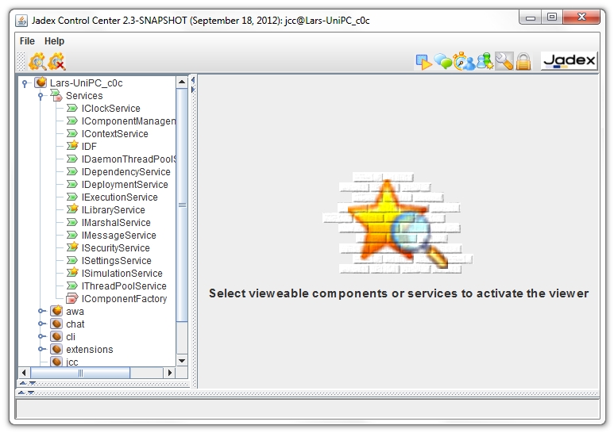
Tool Icon
Viewable
Components
and Services

Slide 3
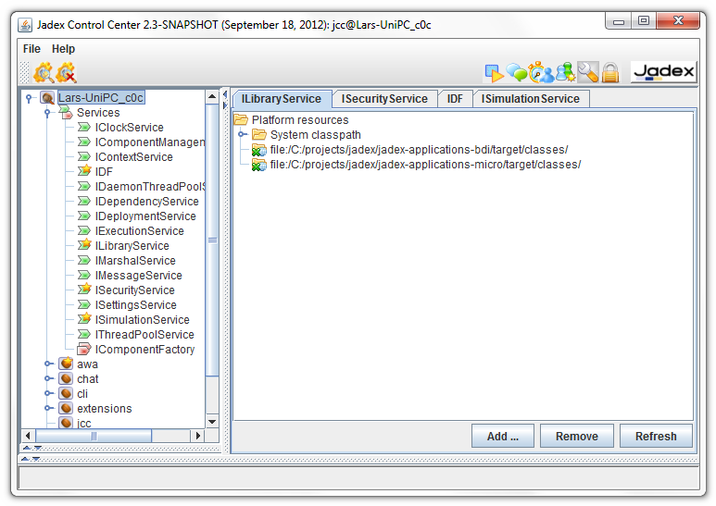
Tool Icon
Currently
Selected
Component
Viewable
Components
and Services
Custom Component or Service
User Interface

Slide 4
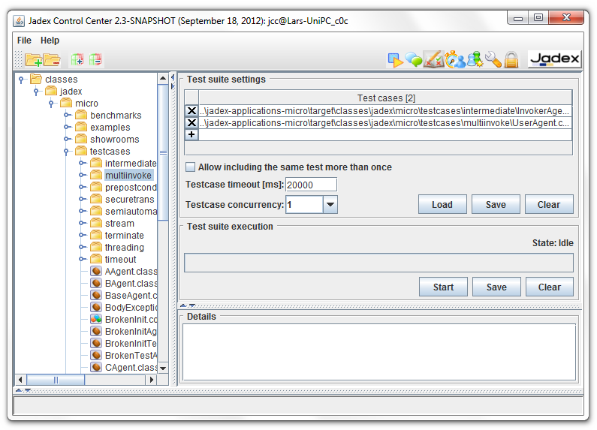
Add/Remove
Folders
Add / Remove Testcases
Tool Icon
Testsuite Handling
Testsuite Execution
Model
Tree
Report Area

Slide 5
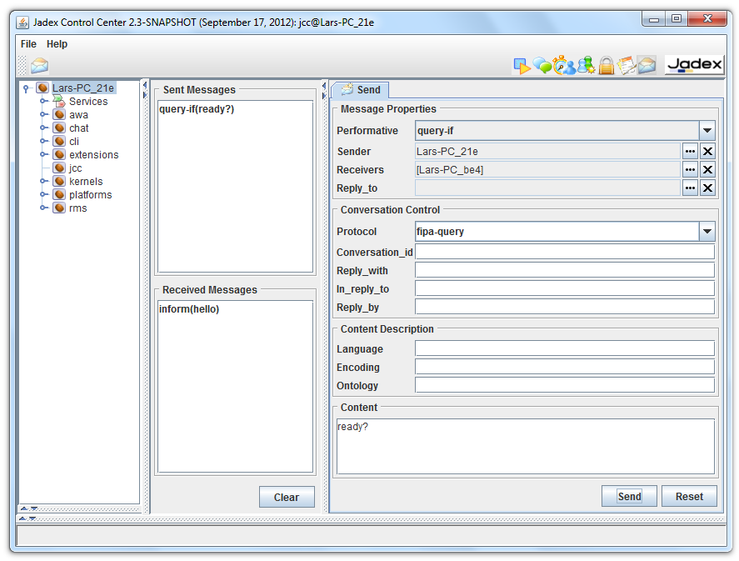
Messages
Sent to Other
Components
Message
Composition
Area
Messages
Received from
Other Components

Slide 6
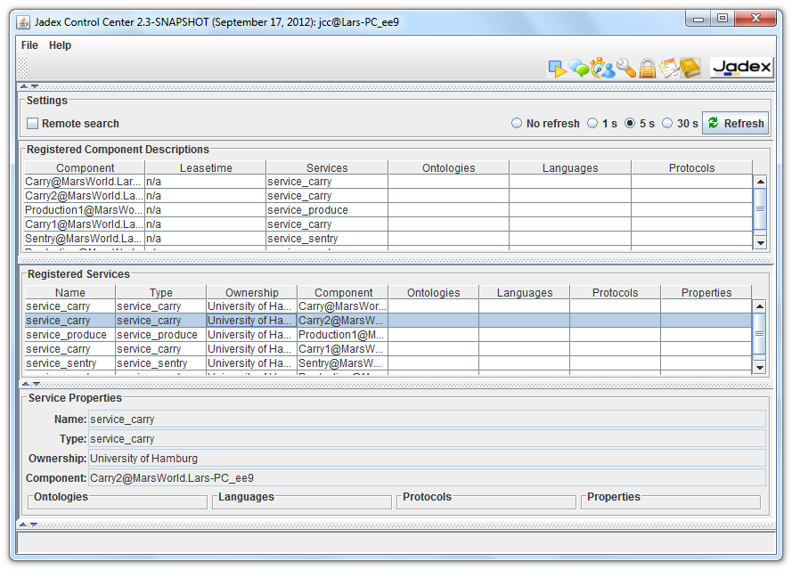
Tool Icon
Refresh Settings
Registered Component
Descriptions
Registered Service
Descriptions
Properties of a
Service Description

Slide 7
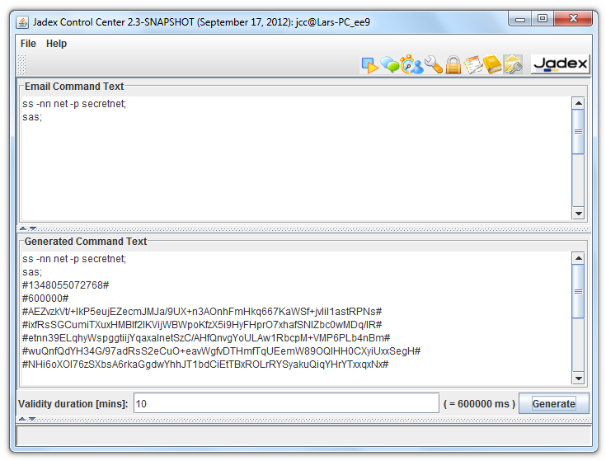
Area for CLI Input
Area for Generated
Signed Email CLI
Generate Options

Slide 8

Runs on
Platform A
2
Email
subject: command
receiver: rec@abc.com
content: <Signed Script>
Original Script
ss -nn net …
sas;
generate with
Cli Email Tool
Signed Script
manually
compose
1
3
Send via
Mail Program
(e.g. Thunderbird)
Mail Program
(e.g. Thunderbird)
cli email
Mailbox
Mailbox
receiveresult
emails
platforms listen
for new emails
platforms answer
with result emails
Platform 1
(CliEmailAgent)
Platform 2
(CliEmailAgent)
Platform n
(CliEmailAgent)
CliEmailAgent verifies and executes script on each platform and sends result email

Slide 9
2
Email
subject: command
receiver: rec@abc.com
content: <Signed Script>
Original Script
ss -nn net …
sas;
generate with
Cli Email Tool
Signed Script
manually
compose
1
3
Send via
Mail Program
(e.g. Thunderbird)
Mail Program
(e.g. Thunderbird)
cli email
Platform
Mailbox
Mailbox
Sender
Mailbox
receiveresult
emails
platforms listen
for new emails
platforms answer
with result emails
Platform 1
(CliEmailAgent)
Platform 2
(CliEmailAgent)
Platform n
(CliEmailAgent)
CliEmailAgent verifies and executes script on each platform and sends result email

Slide 10
Email
subject: command
sender: <sender>
receiver: <receiver>
content: <Signed Script>
Original Script
ss -nn net …
sas;
generate with
Cli Email Tool
Signed Script
manually
compose
1
2
Send via
3
CliEmailAgent verifies
and executes script
Mail Program
(e.g. Thunderbird)
Mail Program
(e.g. Thunderbird)
cli email
Platform
Mailbox
Mailbox
Platform 1
(CliEmailAgent)
cli email
result emails
Sender
Mailbox
Platform n
(CliEmailAgent)
result email
platforms answer
with result emails

