Slide 1



status ELDA: last activities
added quality flags
  qf handling throughout the code
  new, extended output file (in addition to the normal one)
  tested on hpb data
  feature requested by Doina, but not yet support for testing or response
document on class structure (preliminary)
more documentation within the code
Notes:
<Foliennummer>

Slide 2
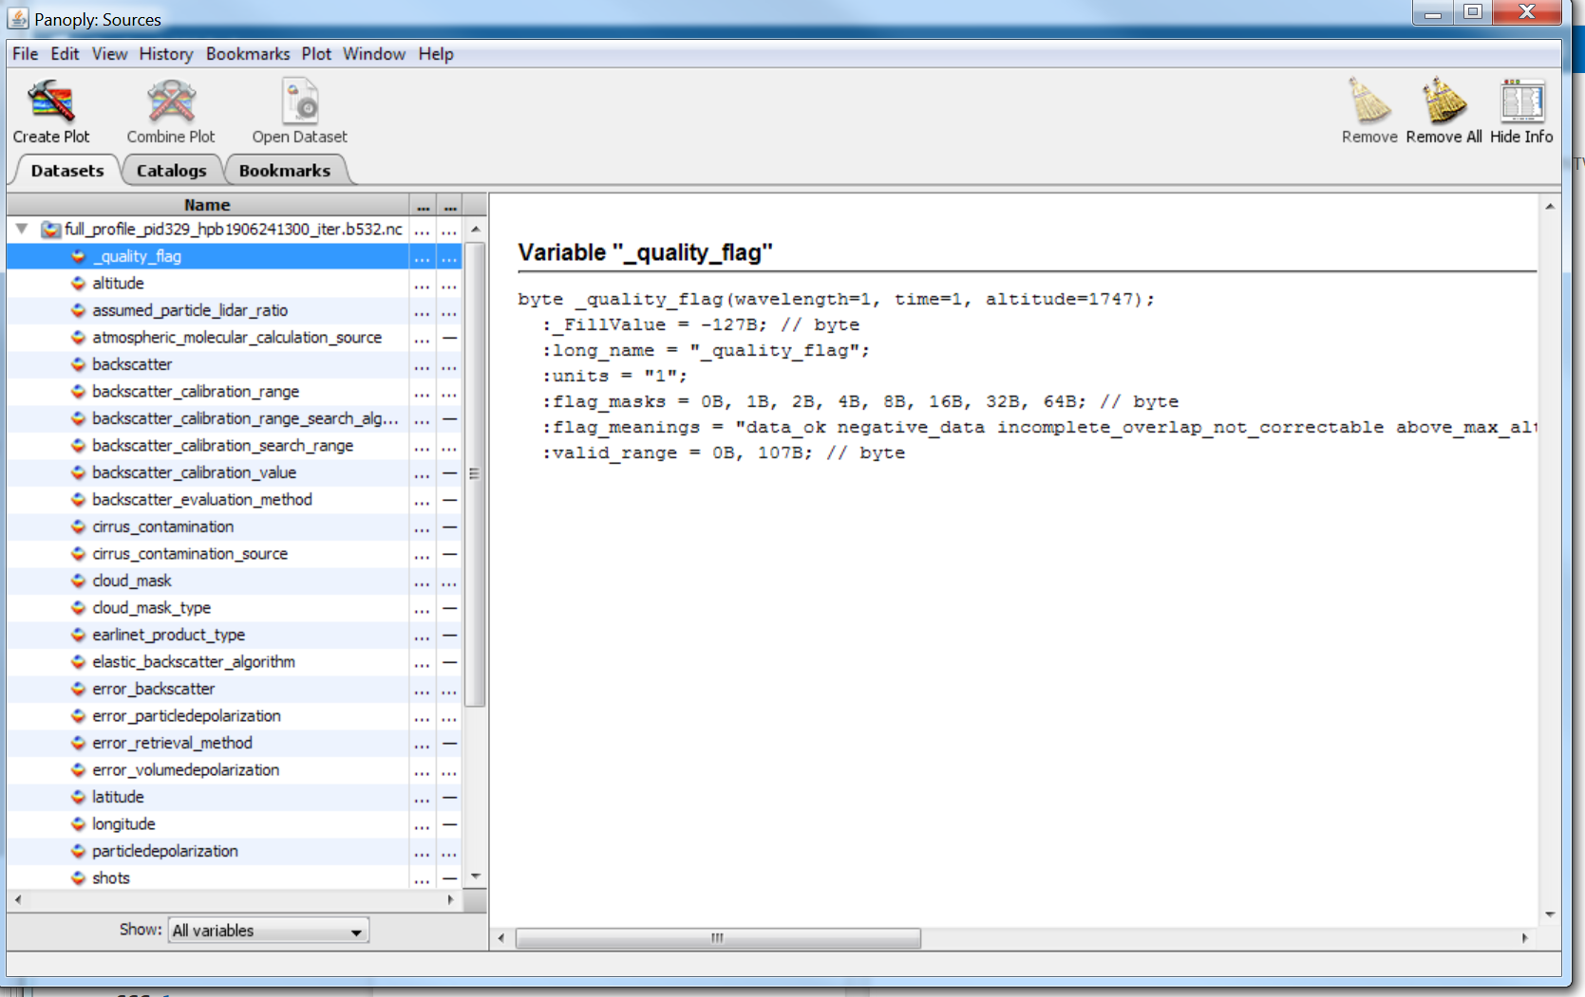
ELDA quality flags
(why data points might be missing)
ALL_OK = 0;
NEG_DATA = 1;
BELOW_OVL = 2;
ABOVE_MAX_ALT = 4;
HAS_CLOUD = 8;
ABOVE_KLETT_REF = 16;
INVALID_DEPOL = 32;
BELOW_MIN_BSCR = 64;
Notes:
<Foliennummer>

Slide 3
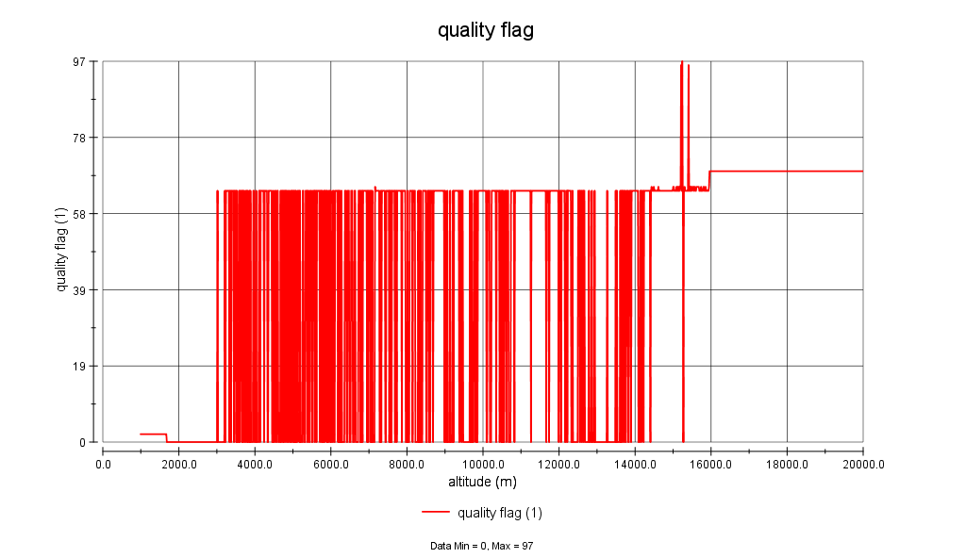
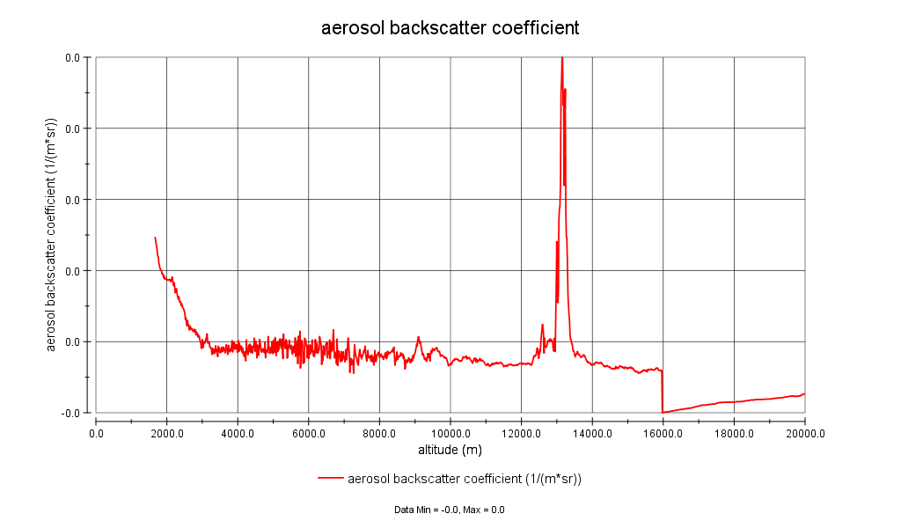
ELDA quality flags
(why data points might be missing)
qf profile
in extended file
full profile
(including ‘bad’ data points)
in extended file
Notes:
<Foliennummer>

Slide 4
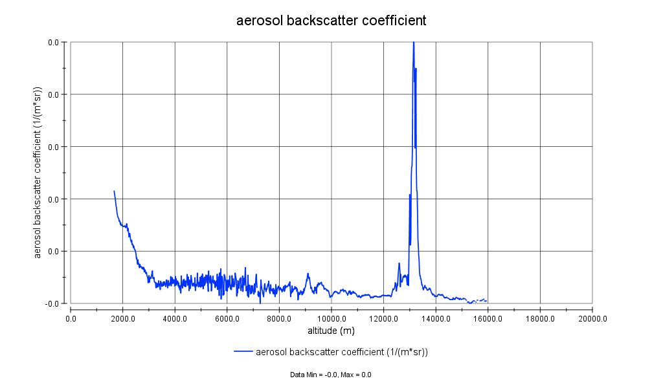
ELDA quality flags
(why data points might be missing)
qf profile
in extended file
full profile
(including ‘bad’ data points)
in extended file
screened profile
(only ‘good’ data points)
in standard file
Notes:
<Foliennummer>

Slide 5
status ELDA: next tasks
test quality flag output (bu!)
finish document on class structure
prepare procedure for implementation of new Rayleigh calibration code
Notes:
<Foliennummer>

Slide 6
status ELDAmwl
repository moved to Potenza
implemented functionality for
  check code formatting (pep8 & pycodestyle)
  testing (good coverage for all db related code)
  source code documentation (sphinx documentation generator)
general design for modularity is implemented (see examples)
current work:
  filling the skeleton with ‘real’ code -> design adjustments necessary
  code documentation whenever a class or procedure is changed
goal:
  retrieval of first ext, bsc, lr products before Easter
  with this milestone, the general structure should be ready for other developers to contribute
Notes:
<Foliennummer>

Slide 7

New / modified db tables
mwlproduct_product
→ requires new view in interface?
Notes:
<Foliennummer>

Slide 8
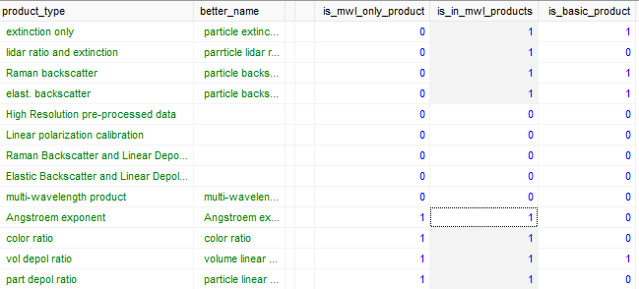
New / modified db tables
_product_types
→ requires no changes in other modules
Notes:
<Foliennummer>

Slide 9

New / modified db tables
Options of new products
ext_bsc_options
angstroem_exp_options (e.g. RBsc355 & RBsc532, Ext355 & Ext 532)
→ requires new view in interface ?
color_ratio_options (e.g. LR 355 & LR 532)
→ requires new view in interface ?
Notes:
<Foliennummer>

Slide 10
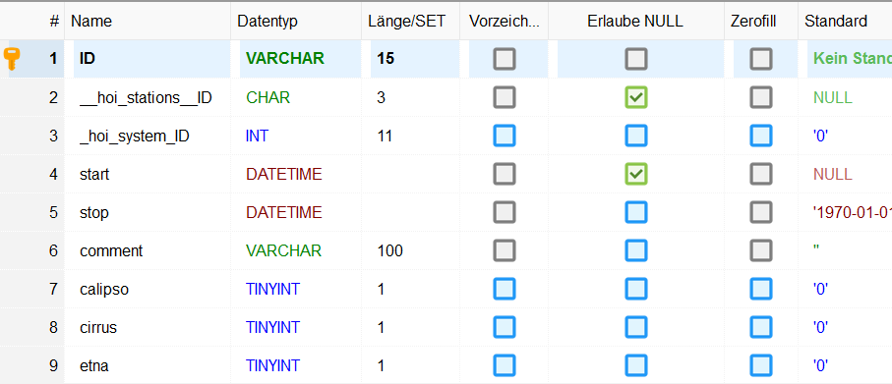
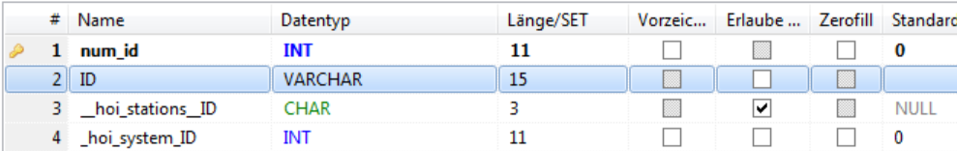
New / modified db tables
measurements
→ should not require changes in other modules, but needs to be tested !!!
(but we already plan to clean up the db structure)
Notes:
<Foliennummer>

Slide 11

New / modified db tables
tables with method definitions
→ requires no changes in other modules
Notes:
<Foliennummer>

Slide 12
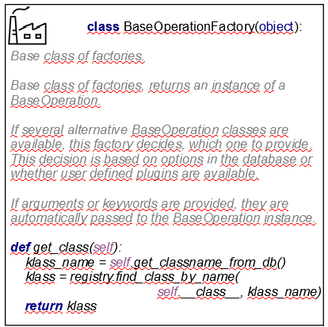
Modular design
base classes
Notes:
<Foliennummer>

Slide 13
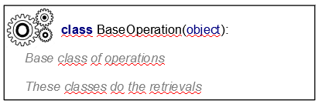
Modular design
base classes
Notes:
<Foliennummer>

Slide 14
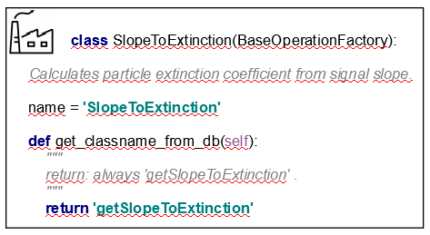
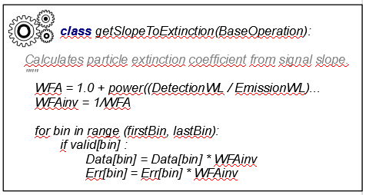
Modular design
Example: if there is only 1 method
Notes:
<Foliennummer>

Slide 15
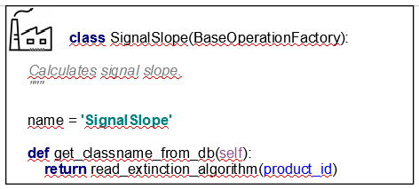
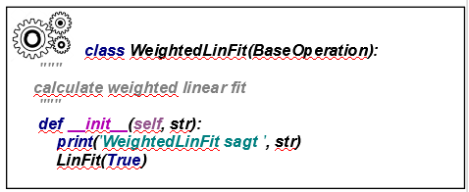
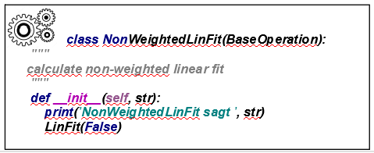
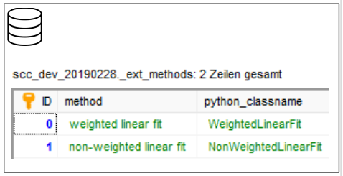
Modular design
Example: add a new method (Extinction)
Notes:
<Foliennummer>

Slide 16
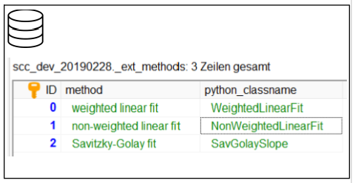
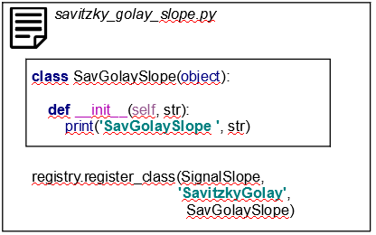
Modular design
Example: add a new method (Extinction)
Notes:
<Foliennummer>

Slide 17
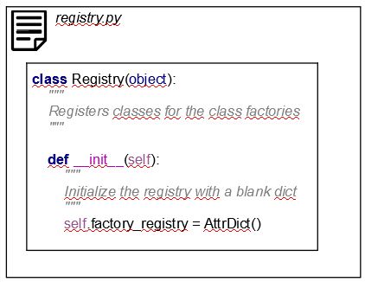
Modular design
registry
Notes:
<Foliennummer>

Slide 18
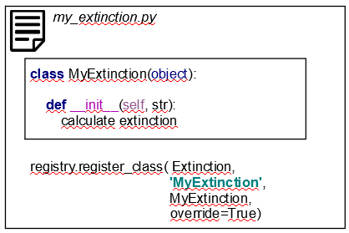
Modular design
Example: replace a method
Notes:
<Foliennummer>

Slide 19
global data storage class
(under development)
DataStorage
_data:{}
elpp_signals:{}
header: Header
cloud_mask: xarray.DataArray
prod_id_str_0:{}
prod_id_str_n:{}
channel_id_str_0: Signals
channel_id_str_n: Signals
Notes:
<Foliennummer>

Slide 20
Interaction with other modules
Some new views in user interface
Add new column id in db table measurements
  Clean-up db structure ?
ELPP provides pre-processed signals as before
ELDAmwl shall provide NetCDF files as before
  Plus mwl file (hierarchic NC4 file) as discussed in spring 2019
Notes:
<Foliennummer>

