Slide 1



Modified / new views for ELDAmwl
New view for mwl product
New view for VLDR product
New view(s) for “derived” products

Slide 2

New view for mwl product
Table mwlproduct_product
Hint: pre-processed files are created for the individual products as before
Limits: * only one mwl product per hoi_configuration
* no explicit single products beside mwl product in the same hoi_configuration to prevent parallel runs of ELDA and ELDAmwl
(of course implicit single products are needed)
Other tables: products
system_product
smooth_options
preproc_options

Slide 3
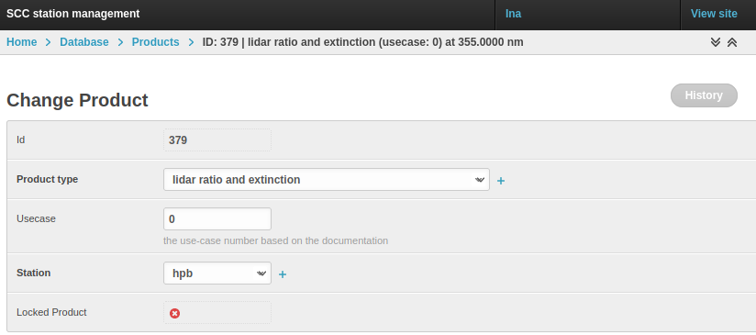
New view for mwl product
link to column
Products.ID
New option
in menu
Multi-wavelengths product
No usecase required

Slide 4
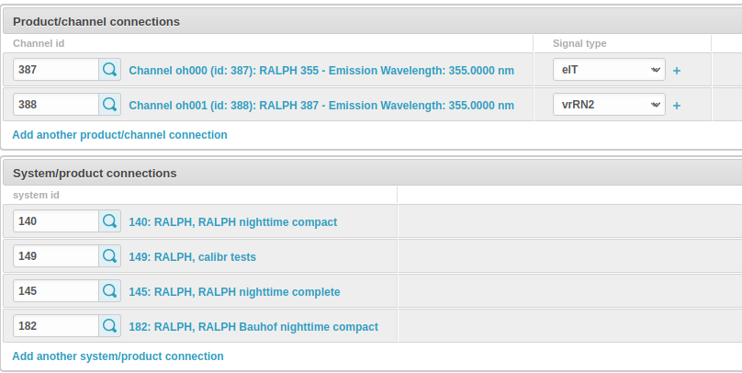
New view for mwl product
No channel attribution
required
System-product connection
as for other products

Slide 5
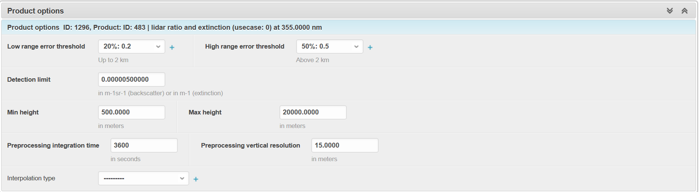
New view for mwl product
Fill table preproc_options
This block is not needed
The info is taken from individual products

Slide 6
New view for mwl product
Fill table mwlproduct_product
Selection of existing products
link to column _Product_ID
link to column
create_with_hr
link to column
create_with_lr
mwl-product / product connections
calculate with
high resolution
calculate with
low resolution
377: Extinction only (usecase 0) at 355 nm
378: Raman backscatter (usecase 0) at 355 nm
379: lidar ratio (usecase 0) at 355 nm
329: volume depolarization ratio...
Add another connection
Selectable are all product types with
_product_types.is_in_mwl_products = True
Tests: * only one product per wavelength and type
* each product has at least 1 “calc with ..”

Slide 7
New view for mwl product
Fill table smooth_options
smooth options
automatic smoothing
fixed smoothing
if fixed smoothing for mwl product,
-> smooth params of individual products are ignored
time and altitude resolutions for fixed smoothing
 | low altitude range (below tz) |  | high-altitude range (above tz) |  | transition zone (tz)
 | time [s] | altitude [m] | time [s] | altitude [m] | from [m] | to [m]
high-res product | 1800 | 150 | 1800 | 300 | 2000 | 3000
low-res product | 3600 | 300 | 7200 | 900
link to table smooth_options

Slide 8
New view for mwl product
Fill table smooth_options
smooth options
automatic smoothing
fixed smoothing
if automatic smoothing for mwl product,
-> table below is deactivated
time and altitude resolutions for fixed smoothing
 | low altitude range (below tz) |  | high-altitude range (above tz) |  | transition zone (tz)
 | time [s] | altitude [m] | time [s] | altitude [m] | from [m] | to [m]
high-res product | 1800 | 150 | 1800 | 300 | 2000 | 3000
low-res product | 3600 | 300 | 7200 | 900

Slide 9
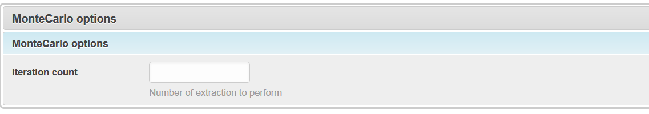
New view for mwl product
Monte Carlo options not needed
These info is taken from individual products

Slide 10
View for VLDR product
Product type of VLDR is 15
View is same as for product types 7 and 8, but without section “depolarization backscatter options”
Related table is vldr_options (instead of depol_bsc_options)

Slide 11
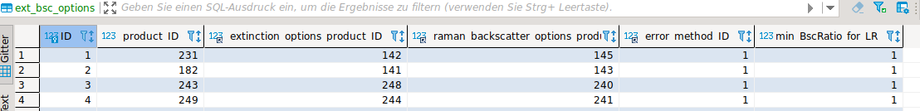
Views for “derived” products
Table ext_bsc_options
Table angstroem_exp_options
Table color_ratio_options
Table pldr_options
Hint: pre-processed files are created for the individual products as before

Slide 12
Views for “derived” products
New “derived” products:
All product types with
_product_types.is_basic_product = False
and
_product_types.is_in_mwl_products = True
Particle lidar ratio
No usecase required

Slide 13
Views for “derived” products
No channel attribution
required
System-product connection
as for other products

Slide 14
Views for “derived” products
This block is not needed
(except for lidar ratio as long as ELDA is still active)
The info is taken from individual products

Slide 15
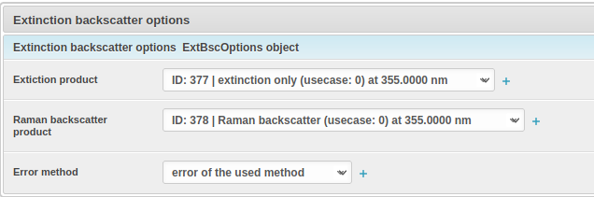

Fill table ext_bsc_options
Selection of existing
extinction products (_product_types.ID = 1)
bsc products (_product_types.ID = 0)
link to column
_extinction_options_product_ID
Lidar ratio options
link to column
_error_method_ID
lidar ratio
lidar ratio
link to column
min_BscRatio_for_LR
link to column
_raman_backscatter_options_product_ID

Slide 16
Fill table angstroem_exp_options
Selection of existing products:
Both must have the same product type
Product type must be basic
link to column
_lambda1_product_ID
Angström exponent options
Angström exponent options
Product at short wavelength
Product at long wavelength
link to column
_error_method_ID
Angström
exponent
lidar ratio
link to column
min_BscRatio_for_AE
link to column
_lambda2_product_ID

Slide 17
Fill table color_ratio_options
Selection of existing products:
Both must have the same product type
Product type must be basic
link to column
_nominator_product_ID
Color ratio options
Color ratio options
Nominator product
Denominator product
link to column
_error_method_ID
Color ratio
lidar ratio
link to column
min_BscRatio_for_CR
link to column
_denominator_product_ID

Slide 18
Fill table pldr_options
Selection of existing
vldr products (_product_types.ID = 15)
bsc products (_product_types.ID = 0 or 3)
link to column
_vldr_product_ID
PLDR options
PLDR options
VLDR product
VLDR (usecase 0) at 355 nm
backscatter product
link to column
_error_method_ID
lidar ratio
lidar ratio
link to column
min_BscRatio_for_PLDR
link to column
_bsc_options_product_ID

Slide 19

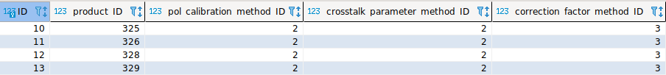
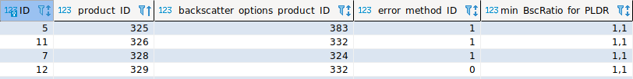
Polarization related db tables
What we have
products
polarization_options
depol_bsc_options

Slide 20
Polarization related db tables
Add new products
products
Raman bsc & depol
Elast bsc & depol
insert
n+1 | 0 | 15
n+2 | NULL? | 16
n+3 | NULL? | 16
VLDR
PLDR
PLDR

Slide 21
Polarization related db tables
new tables vldr_options, pldr options
vldr_options
ID | product_ID | Err_method_ID
inc | n+1 | 0
polarization_options (insert new VLDR)
inc | n+1 | 2 | 2 | 3
pldr_options
ID | product_ID | vldr_product_ID | bsc_product_ID | error_method_ID | min_BscRatio_for_pldr
inc | n+2 | n+1 | 324 | 0 | 1.01
inc | n+3 | n+1 | 332 | 0 | 1.01

