Slide 1
CSS Media Queries
By Christopher Smith

Slide 2
So What are Media Queries (in relation to CSS)?
Introduced in CSS2
CSS Media Queries are ways that you can adaptively build a website for different sizes (such as if you have an iphone screen or a browser screen)
This is especially helpful to change up things like a horizontal menu to become a vertical menu when there isn’t room for the menu
In addition, this is a way that sites can be compatible with specific devices (such as TV’s or Braile devices

Slide 3
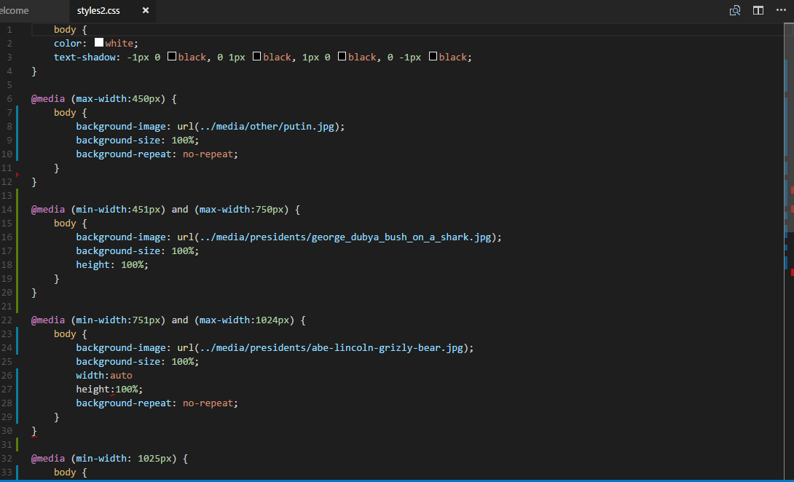
So I know what it is. Now how do I use it?

Slide 4
What are some uses of @media queries?
Some
Example site…

