Slide 1
CSS Media Queries
By Christopher Smith

Slide 2
So What are Media Queries (in relation to CSS)?
Introduced in CSS2
The @media rule is used to define different style rules for different mediatypes/devices
CSS Media Queries are ways that you can adaptively build a website for different sizes (such as if you have an iphone screen or a browser screen)
This is especially helpful to change up things like a horizontal menu to become a vertical menu when there isn’t room for the menu

Slide 3
What can @media Queries be used for?
In addition, @media Queries are used for
Printers
Speech readers
Television Internet screens (starting to be phased out)
Braile Devices (Ditto)
All screens for responsive web pages

Slide 4
What are some uses of @media queries?
Some of the biggest uses are to create responsive web pages based upon the size of screens (to change the look of your site)
This is something that is used by many different sites (such as Disney or any major web site)
Example site…

Slide 5
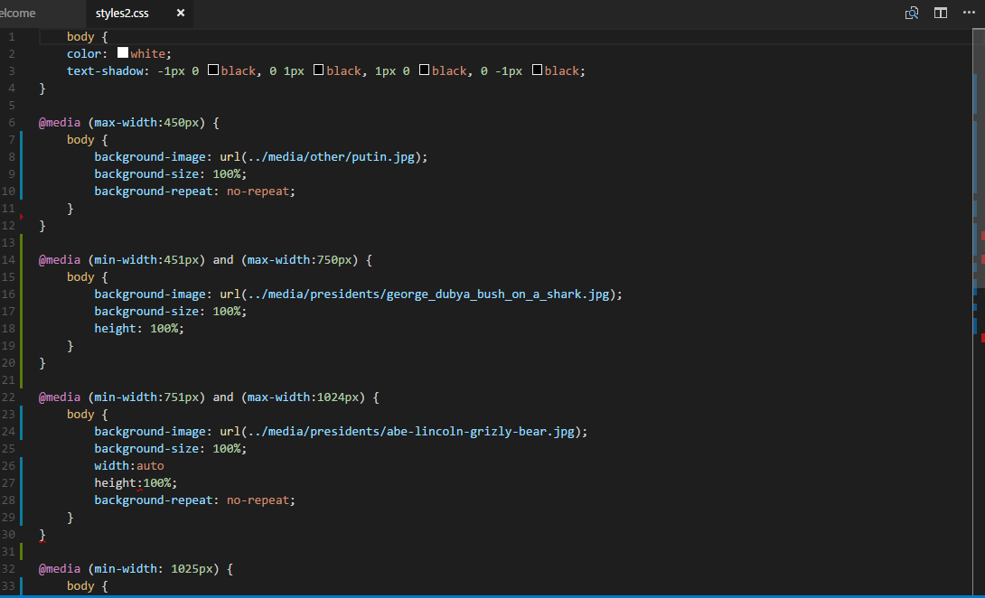
So I know what it is. Now how do I use it?

Slide 6
Questions?

Slide 7
