Slide 1

OPERATIONAL INTELLIGENCE PLATFORM
Turnaround
Operational Intelligence for Fleet and Corridor Logistics
Real-time fleet visibility, dwell monitoring, and cost intelligence for commercial trucking corridors across East Africa.
Presenter: [YOUR NAME]
Date: [DATE]
Demo: [DEMO_URL]
Notes:
Introduce yourself and the project. Turnaround is an operational intelligence platform for commercial fleet and corridor logistics across East Africa. It turns raw GPS telemetry into real-time fleet visibility, dwell monitoring, SLA analysis and cost intelligence. Replace the presenter name, date and demo URL placeholders before presenting.

Slide 2
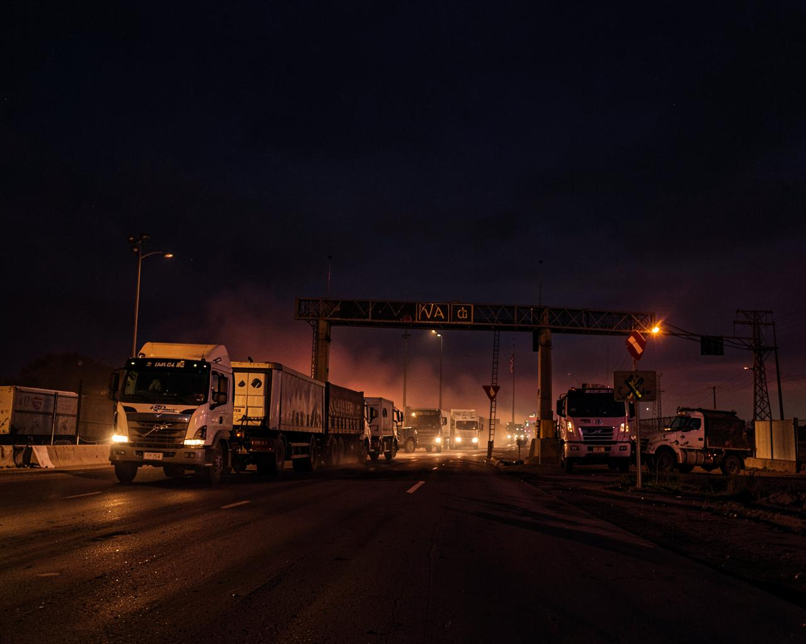
THE PROBLEM
Delay is invisible until it is expensive
Trucks wait at ports, depots, customs yards, weighbridges and customer sites
Dispatchers run on phone calls, spreadsheets and disconnected trackers
Delays surface late — after SLAs are already breached
No clear link between operational delay and financial loss
Vehicles, containers, drivers and trips live in separate systems
Core problem Logistics teams need one operational view that connects movement, delay, cost and action.
Notes:
Commercial carriers lose time and money because they cannot easily see where delays happen or how much those delays cost. Trucks wait at ports, container depots, customs yards, weighbridges and customer facilities. Dispatchers often rely on phone calls, spreadsheets and disconnected tracking tools. Delays are discovered late, after SLAs have already been affected. Fleet managers lack a clear link between operational delay and financial loss, and containers, vehicles, drivers and trips are often managed in separate systems. Core problem: logistics teams need one operational view that connects movement, delay, cost and action.

Slide 3
THE SOLUTION
One platform from telemetry to decision
Live corridor tracking
Telemetry ingestion
Geofence monitoring
Dwell detection
Vehicles and routes on one map
Location, speed, heading, time
Facilities and corridor zones
Arrival, dwell and departure states
SLA and delay analysis
Operating-cost impact
Dispatch and containers
Fleet and driver view
Actual versus expected dwell
Excess minutes priced as loss
Trips, cargo equipment, seals
Assets, drivers, availability
Outcome Identify bottlenecks earlier, respond faster, and reduce unrecovered idle costs.
Notes:
Turnaround is a fleet operational intelligence platform that turns GPS telemetry into practical decisions. It combines live vehicle and corridor tracking, telemetry ingestion, geofence monitoring, dwell-time detection, SLA and delay analysis, operating-cost calculations, container and trip dispatch management, and fleet, driver and asset visibility. Outcome: teams identify operational bottlenecks earlier, respond faster, and reduce unrecovered idle costs.

Slide 4
HOW IT WORKS
GPS signal to business intelligence
01
02
03
04
GPS Device
Telemetry Ingestion
Geofence Detection
Dwell Lifecycle
Location, speed, heading
Normalized event stream
Facility and corridor match
Arrival, dwell, departure
05
06
07
08
SLA Comparison
Financial Impact
Dispatcher Action
Improved Turnaround
Actual vs expected dwell
Excess minutes priced
Escalate, reroute, notify
Less idle, better SLA
Telemetry in — priced, actionable delay out
Notes:
A tracker sends location, speed, heading and timestamp data. Turnaround matches the coordinates against configured facilities and corridors. The system detects arrival, dwell and departure states. Actual dwell is compared with expected service levels. Excess time is converted into an estimated operating cost. Dispatchers and fleet managers then take action from the dashboard, which improves turnaround time.

Slide 5
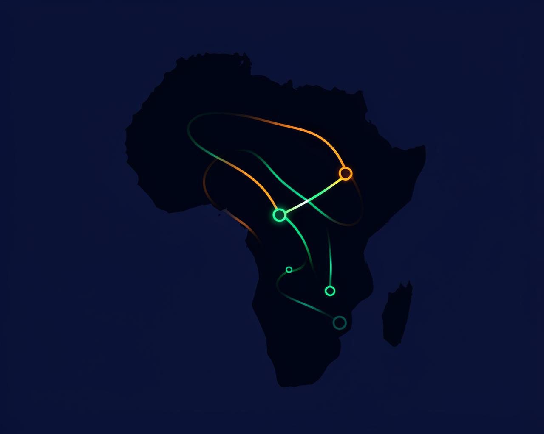
PRODUCT EXPERIENCE
Live corridor tracker
TOP 10 FLEET TRACKER
KDE 421X
Moving • 78 km/h
KDE 421X • 78 km/h
KCX 118M
Dwell 3h 12m
KBZ 902L • en route
KBZ 902L
Moving • 61 km/h
KDA 774T
Idle at ICD
KCX 118M • dwelling
KCB 330P
Moving • 54 km/h
KDE 421X — expanded
Driver: [name] Co-driver: [name]
Availability: On trip
GPS: Connected • 12s ago
Route: Mombasa Port → Nairobi ICD
Notes:
Product experience. The Live Corridor Tracker gives map-based visibility across logistics corridors, with vehicle markers showing status, speed and location, a Top 10 fleet tracker side panel, expandable vehicle details for driver, co-driver, availability and GPS connection, and trip route visualization between origin and destination. Fleet and asset management provides category-aware asset registration with separate workflows for trucks, tankers, trailers, chassis, ships and containers, a container registry and container assignment, driver and co-driver assignment for powered vehicles only, and telematics and tracker details per asset.

Slide 6
PRODUCT EXPERIENCE
Fleet and asset management
Trucks
Tankers
Trailers
Powered • driver + co-driver
Powered • driver + co-driver
Towed equipment
Chassis
Ships
Containers
Towed equipment
Vessel asset record
Cargo equipment • no driver
Category-aware registration
Container registry and assignment
Telematics and tracker details per asset
Notes:
Fleet and asset management: category-aware asset registration with separate workflows for trucks, tankers, trailers, chassis, ships and containers. A container registry supports container assignment. Driver and co-driver assignment applies to powered vehicles only. Telematics and tracker details are kept per asset. This slide sets up the key product distinction explained later: containers are cargo equipment, not drivable vehicles.

Slide 7
OPERATIONAL INTELLIGENCE
From movement data to money
Detects excessive dwell time and recurring facility bottlenecks
Tracks active and completed dwell events
Calculates excess delay minutes and estimated idle cost
Highlights demurrage risk
Supports historical facility benchmarking
Gives dispatchers actionable operational context
FINANCIAL LOSS FORMULA
Loss = max(0, Actual Dwell − Expected Dwell)
× (Hourly Operating Cost ÷ 60)
Excess minutes of dwell, priced at the vehicle's hourly operating cost.
DWELL-COST ANALYSIS (illustrative)
Facility
Excess
Est. cost
[Facility A]
[--] min
[--]
[Facility B]
[--] min
[--]
[Facility C]
[--] min
[--]
Notes:
Turnaround translates movement data into operational and financial insight. It detects excessive dwell time, identifies recurring facility bottlenecks, tracks active and completed dwell events, calculates excess delay minutes, estimates idle operating cost, highlights demurrage risk, supports historical facility benchmarking, and provides actionable operational context for dispatchers. The financial loss formula is: Financial Loss equals the maximum of zero and actual dwell minus expected dwell, multiplied by hourly operating cost divided by sixty. Note that the dashboard figures shown are illustrative placeholders, not measured results.

Slide 8
DATA MODEL
How vehicles, containers and delay connect
Vehicle
Geofence
Powered • driver + co-driver
Facility / corridor zone
Container
Trip
Dwell Event
Financial
Impact
Cargo equipment • no driver
Vehicle + container + route
Arrival → dwell → depart
Excess × cost
GPS Device
SLA
Telemetry source
Expected dwell
Containers attach to trips as cargo — never as drivable, driver-assigned units.
Notes:
This diagram shows how the core entities relate. A vehicle carries a GPS device that emits telemetry. Telemetry is matched against geofences, which produce dwell events on a trip. A trip links a powered vehicle, an assigned container, an origin and a destination facility. Dwell events compared against SLA produce financial impact. Containers attach to trips as cargo equipment; they never carry drivers.

Slide 9
DISPATCH WORKFLOW
Container assignment, done correctly
1
Select powered vehicle
NEW TRIP DISPATCH
2
Select origin and destination facilities
Vehicle
KDE 421X — Truck (powered)
Origin
Mombasa Port
3
Assign available registered container
Destination
Nairobi ICD
4
Capture customs seal information
Container
TRLU 1234567 — available
5
Record cargo type and payload weight
Seal / cargo
[seal no.] • [cargo] • [tonnes]
6
Schedule departure and ETA
Design decision Containers are cargo equipment — not vehicles, and never driver-assigned.
7
Check overlapping vehicle assignments
Notes:
Turnaround keeps the dispatch workflow aligned with how logistics operations actually work: select a powered vehicle for the trip, select origin and destination facilities, assign an available registered container, capture customs seal information, record cargo type and payload weight, schedule departure and estimated arrival, check overlapping vehicle assignments before dispatch, and preserve a clear link between vehicle, container, route and trip. Important design decision: containers are treated as cargo equipment, not as vehicles or driver-assigned units.

Slide 10
ARCHITECTURE
System and technology stack
GPS trackers → API
Async services → PostgreSQL
Managed cloud deployment
FRONTEND
BACKEND
PLATFORM SERVICES
React 19
TypeScript
Vite
Tailwind CSS
React Query
React Hook Form + Zod
MapLibre GL
Python
FastAPI
SQLAlchemy async ORM
PostgreSQL
Alembic migrations
Geofencing engine
Dwell engine
Supabase auth + database
Firebase Cloud Messaging
Render (backend deploy)
Vercel (frontend deploy)
Telemetry flows from trackers into FastAPI services, through the geofence and dwell engines, into PostgreSQL, and out to the React dashboard.
Notes:
Architecture and technology. Frontend: React 19, TypeScript, Vite, Tailwind CSS, React Query, React Hook Form with Zod, and MapLibre GL. Backend: Python, FastAPI, SQLAlchemy async ORM, PostgreSQL, Alembic migrations, and the geofencing and dwell engines. Platform services: Supabase authentication and database infrastructure, Firebase Cloud Messaging for notifications, Render for backend deployment, and Vercel for frontend deployment.

Slide 11
SECURITY
Multi-tenant by design
Company-level data isolation through tenant identifiers
JWT and Supabase authentication support
Role-based access control
Server-side handling of sensitive service credentials
Vehicle, trip, GPS, container and location data scoped per company
ROLES
Administrator
scoped permissions
Fleet manager
scoped permissions
Dispatcher
scoped permissions
Analyst
scoped permissions
Supervisor
scoped permissions
Operational user
scoped permissions
Notes:
Turnaround is designed as a multi-tenant operational platform. It provides company-level data isolation through tenant identifiers, JWT and Supabase authentication support, and role-based access control with separate permissions for administrators, fleet managers, dispatchers, analysts, supervisors and operational users. Sensitive service credentials are handled server-side, and vehicle, trip, GPS, container and location data is scoped to the correct company.

Slide 12

REGIONAL IMPACT
Built for East African corridors
KEY OPERATING CONTEXTS
Mombasa Port and Kilindini Terminal
Nairobi Inland Container Depot
Athi River and Gilgil weighbridges
Malaba and Busia One-Stop Border Posts
Namanga and other cross-border routes
Corridors linking Kenya, Uganda, Tanzania and Rwanda
POTENTIAL IMPACT
Reduce avoidable idle time
Improve SLA compliance
Earlier delay visibility for dispatchers
Better container and vehicle coordination
More accurate carrier reporting
Notes:
Turnaround is designed for the realities of East African commercial logistics corridors. Key operating contexts include Mombasa Port and Kilindini Terminal, the Nairobi Inland Container Depot, the Athi River and Gilgil weighbridges, the Malaba and Busia One-Stop Border Posts, Namanga and other cross-border routes, and long-haul corridors connecting Kenya, Uganda, Tanzania, Rwanda and the wider region. Potential impact: reduce avoidable vehicle idle time, improve SLA compliance, give dispatchers earlier visibility into delays, improve container and vehicle coordination, and support more accurate customer and carrier reporting. These are design goals, not measured results.

Slide 13
KEY LEARNINGS
What building Turnaround taught us
Operational software must model real-world resources accurately
A container should never be treated like a drivable vehicle
01
02
GPS data gains value when tied to geofences, trips, dwell and cost
Role-based workflows are essential in multi-user logistics systems
03
04
Dashboards need both high-level metrics and drill-down detail
Identifier consistency across devices, vehicles and containers is critical
05
06
Notes:
Key learnings. Operational software must model real-world resources accurately; a container should not be treated like a drivable vehicle. GPS data becomes far more useful when connected to geofences, trips, dwell states and cost models. Clear role-based workflows are essential in multi-user logistics systems. Good operational dashboards need both high-level metrics and drill-down details. Data quality and identifier consistency are critical when connecting GPS devices, vehicles, drivers and containers.

Slide 14
CHALLENGES FACED
Hard problems in the build
Multi-category assets
Event synchronization
GPS noise
Assignment integrity
One platform for trucks, tankers, trailers, chassis, ships and containers
Aligning GPS events with vehicle and trip records
Preventing false geofence transitions
Reliable vehicle and container assignment workflows
Information density
Live and responsive
Events to money
Complex data without overwhelming dispatchers
Real-time updates with a fast interface
Turning operational events into financial consequences
Notes:
Challenges faced: designing one asset platform for multiple asset categories, synchronizing GPS events with vehicle and trip records, preventing false geofence transitions caused by GPS noise, building reliable vehicle and container assignment workflows, presenting complex operational data without overwhelming dispatchers, supporting live updates while keeping the interface responsive, and converting operational events into understandable financial consequences.

Slide 15
FUTURE ROADMAP
Where Turnaround goes next
CONNECTIVITY
INTELLIGENCE
OPERATIONS
Traccar, Teltonika, Samsara, Cartrack integrations
Automated provider webhook mapping by IMEI
Offline telemetry buffering for weak-signal corridors
Predictive arrival and delay forecasting
Carrier benchmarking and customer-facing reports
Automated demurrage claim workflows
Mobile driver app for trip updates and proof of delivery
Granular container lifecycle tracking
Yard-position tracking
Planned direction — not yet shipped.
Notes:
Future roadmap: direct integrations with Traccar, Teltonika, Samsara and Cartrack; automated provider webhook mapping by tracker IMEI; offline telemetry buffering for poor-connectivity corridors; predictive arrival and delay forecasting; carrier benchmarking and customer-facing reports; automated demurrage claim workflows; a mobile driver application for trip updates and proof of delivery; and more granular container lifecycle and yard-position tracking. Present these as planned direction, not shipped features.

Slide 16
DEMO FLOW
Ten steps, one story
1
Sign in and open the operations dashboard
2
Open the Carrier Assets page
3
Contrast a powered vehicle with a container asset
4
Open the Trip Dispatch workflow
5
Select vehicle, route, facility and container
6
Open the Corridor Tracker map
7
Show the Top 10 fleet sidebar
8
Expand a vehicle: driver, co-driver, availability, GPS
9
Show a vehicle marker and live telemetry
10
Explain dwell data becoming cost intelligence
Demo: [DEMO_URL] Video: [DEMO_VIDEO_URL] Deck: [PITCH_DECK_URL]
Notes:
Live demo sequence: 1. Sign in and open the operations dashboard. 2. Open the Carrier Assets page. 3. Show the difference between a powered vehicle and a container asset. 4. Open the Trip Dispatch workflow. 5. Select a vehicle, route, facility and available container. 6. Open the Corridor Tracker map. 7. Show the Top 10 fleet sidebar. 8. Expand a vehicle to show driver, co-driver, availability and GPS status. 9. Show a vehicle marker and live telemetry details. 10. Explain how dwell data becomes cost and delay intelligence. Fill in the demo and video URLs before presenting.

Slide 17
TURNAROUND
Make every delay visible.
Make every minute actionable.
Turnaround gives commercial carriers the operational intelligence to improve fleet utilization, reduce dwell-related costs, and move freight more predictably.
GitHub: https://github.com/acunetix2/Turnaround.git
Demo: [DEMO_URL] Video: [DEMO_VIDEO_URL]
Deck: [PITCH_DECK_URL] Contact: [YOUR EMAIL]
Notes:
Close with the call to action: make every delay visible, make every minute actionable. Turnaround gives commercial carriers the operational intelligence they need to improve fleet utilization, reduce dwell-related costs, and move freight more predictably. Share the GitHub repository, demo link, video and contact email — replace all placeholders before presenting. Invite questions.

