Slide 1
Predicting Readmission of Diabetic Patients
Chao Sang
Ph.D. Candidate
University of Pittsburgh

Slide 2
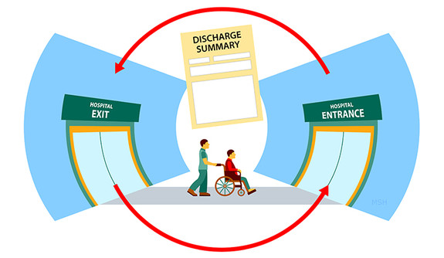
Hospital Readmission:
Patient who had been discharged from a hospital is admitted again within a specified time interval
Indicator of hospital quality
Increasing cost of care
Source: https://news.yale.edu/2015/01/15/

Slide 3
Objectives
Central questions:
What factors are the strongest predictors for hospital readmission in diabetic patients?
Can we accurately predict the hospital readmission?
Objectives:
Build predictive models to predict readmission
Identify the important factors

Slide 4
Problem-solving workflow
Data Collection
Data Preprocessing
EDA
Feature Engineering
Modeling
Production
UCI Diabetes 130-US hospitals

Slide 5
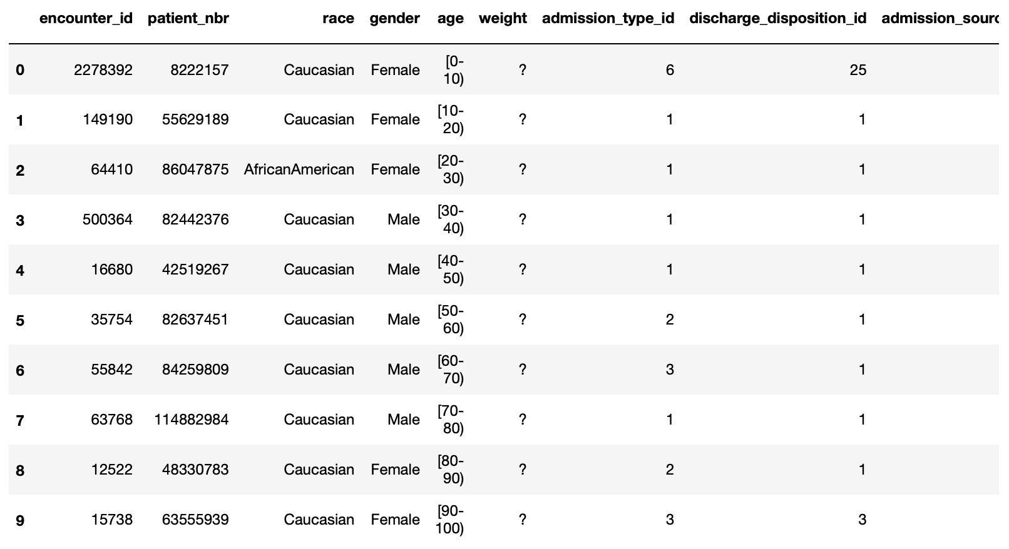
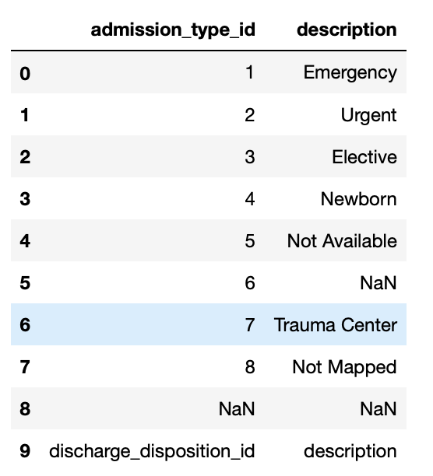
Exploratory Data Analysis (EDA)
101766 observations
50 features (13 numerical, 37 categorical)
Patient characteristics, conditions, test and 23 medications.
Hospital outcomes
Details of three features
Helpful for feature engineering

Slide 6
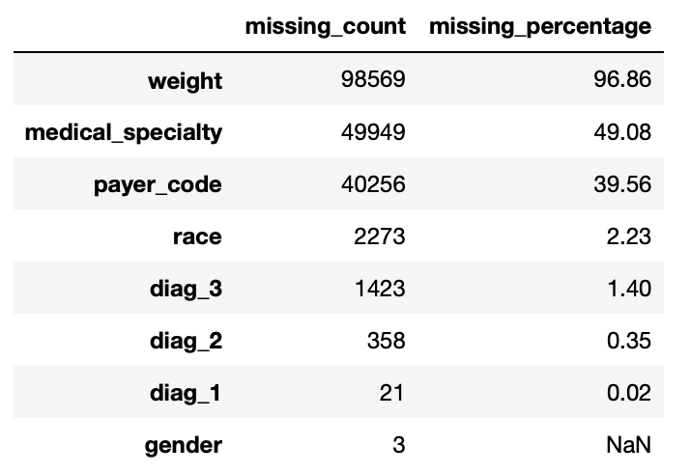
EDA
Missing values
Redundant features
Dropped:
'examide’
'citoglipton’
'encounter_id‘
These three features have the same information for all rows
Dropped
features
Dropped rows

Slide 7
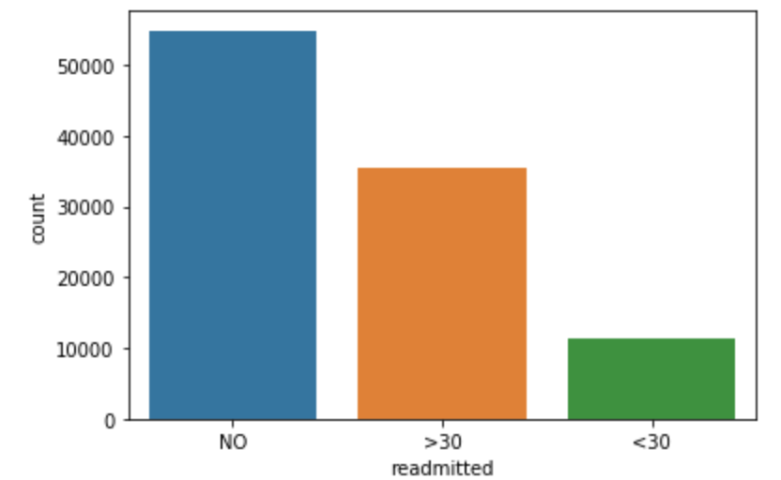
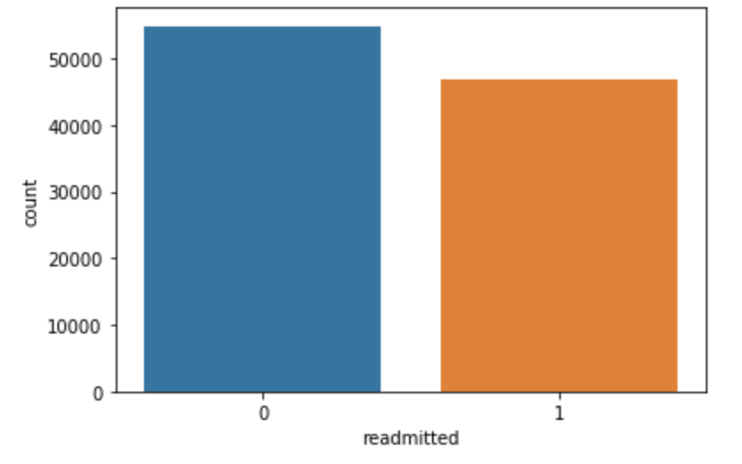
EDA – Predicted Variable
There were three categories in the predicted variable:
Not readmitted
Readmitted within 30 days
Readmitted after 30 days
Objective: Binary prediction (Readmitted or not)
‘<30’ and ‘>30’ days were grouped together

Slide 8
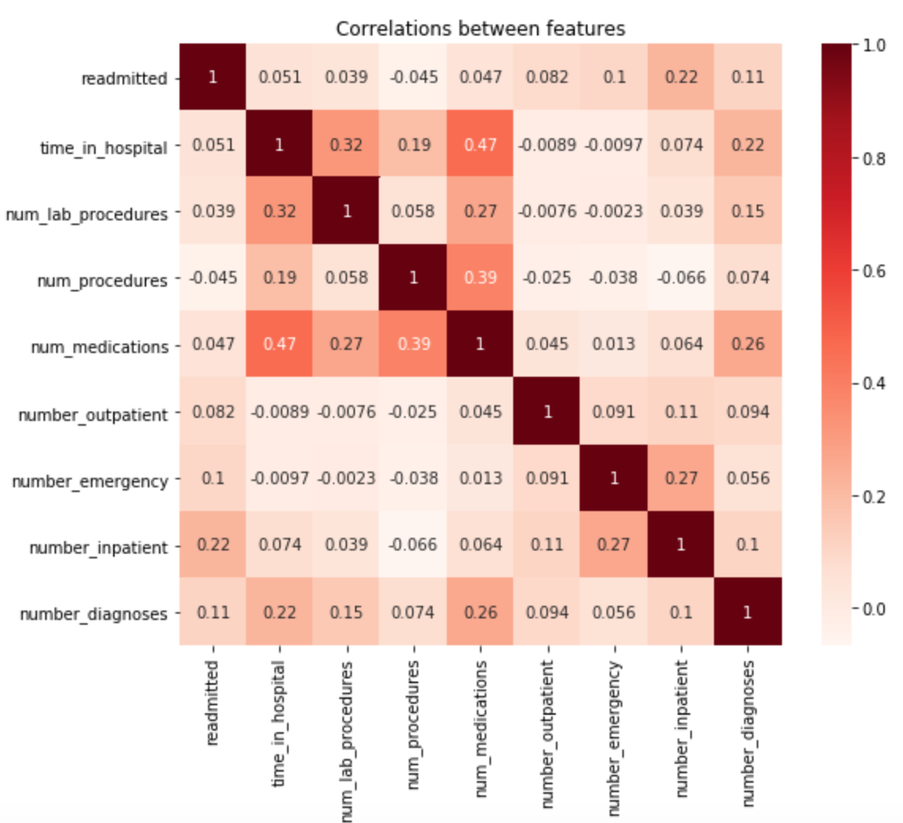
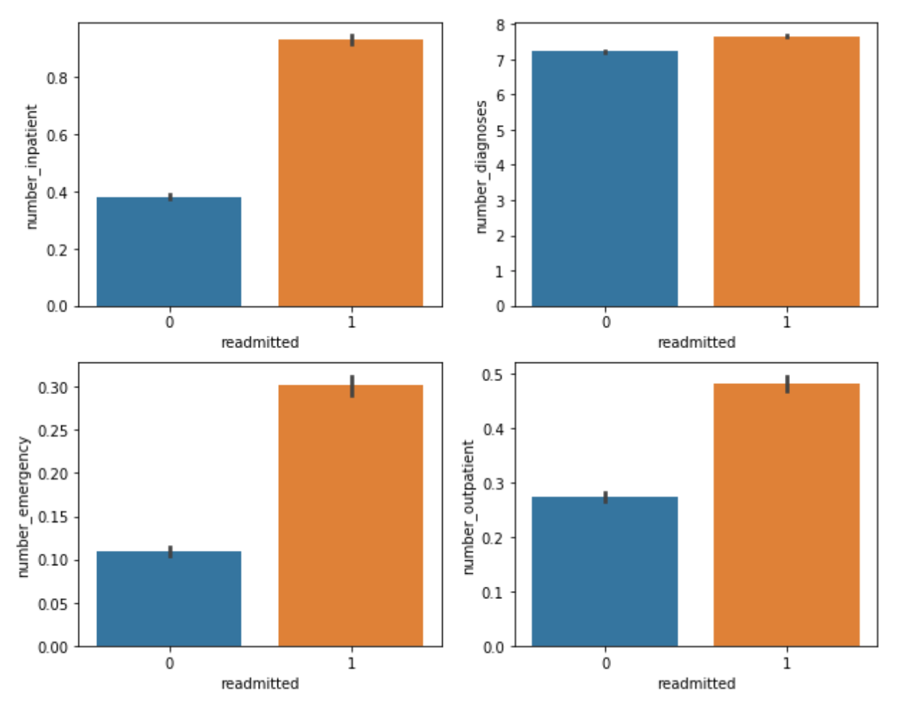
EDA – Numerical Features
Highest correlations with ‘readmitted’

Slide 9
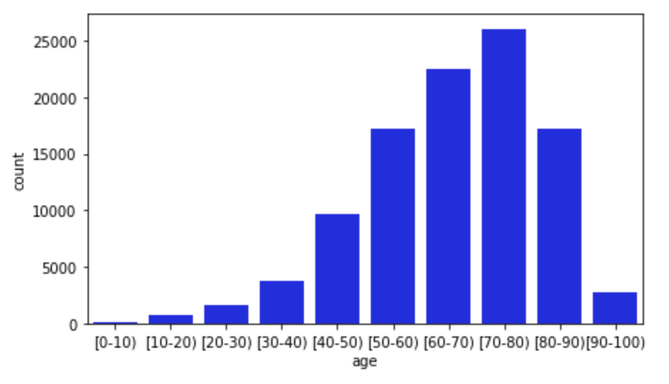
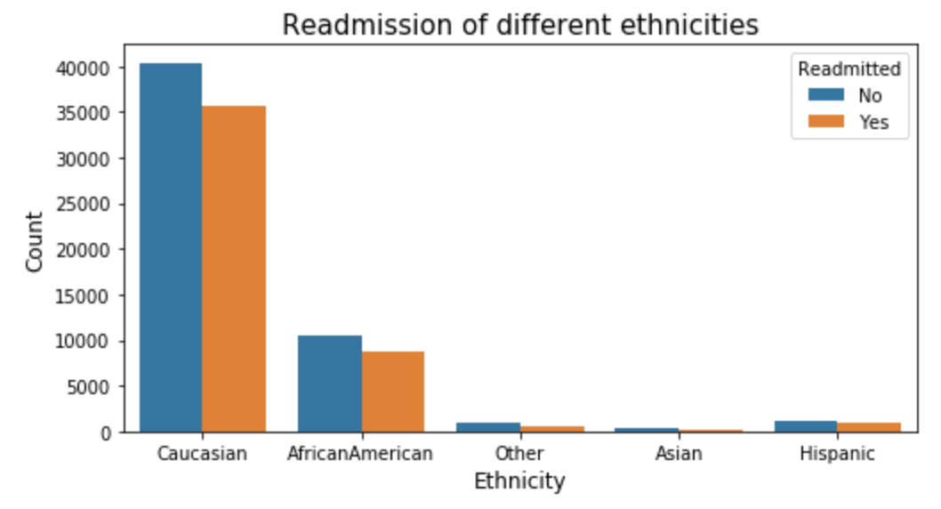
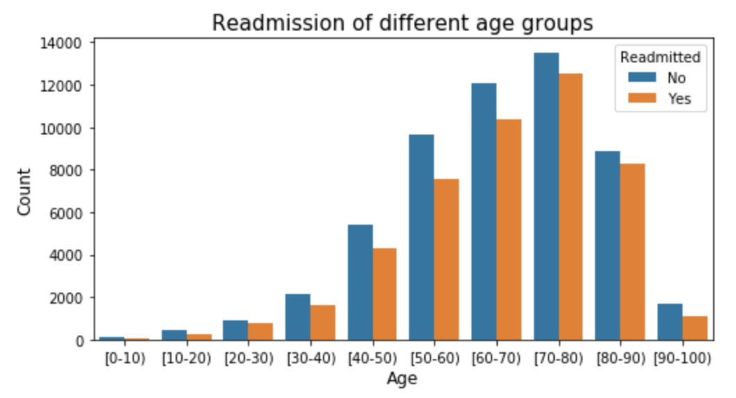
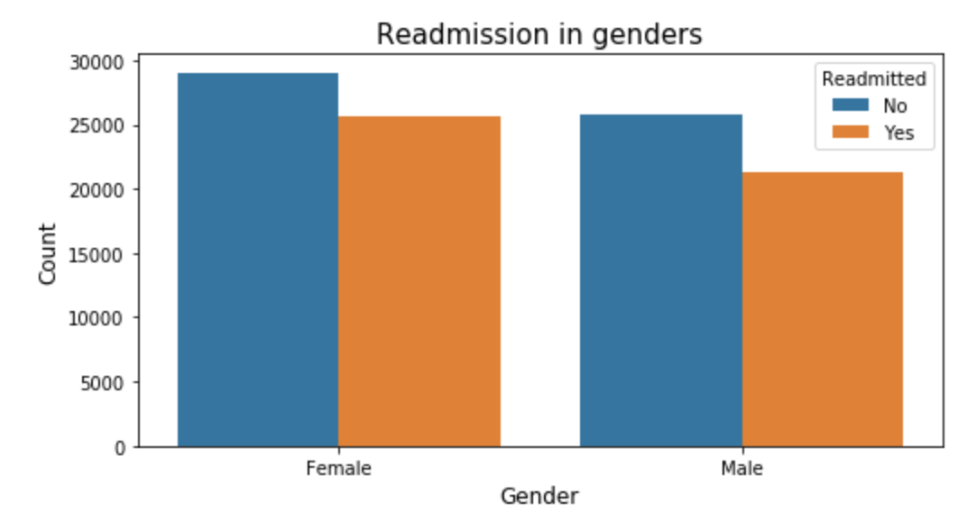
EDA – Categorical Features
Age
Ethnicity vs. Readmission
Age vs. Readmission
Gender vs. Readmission

Slide 10
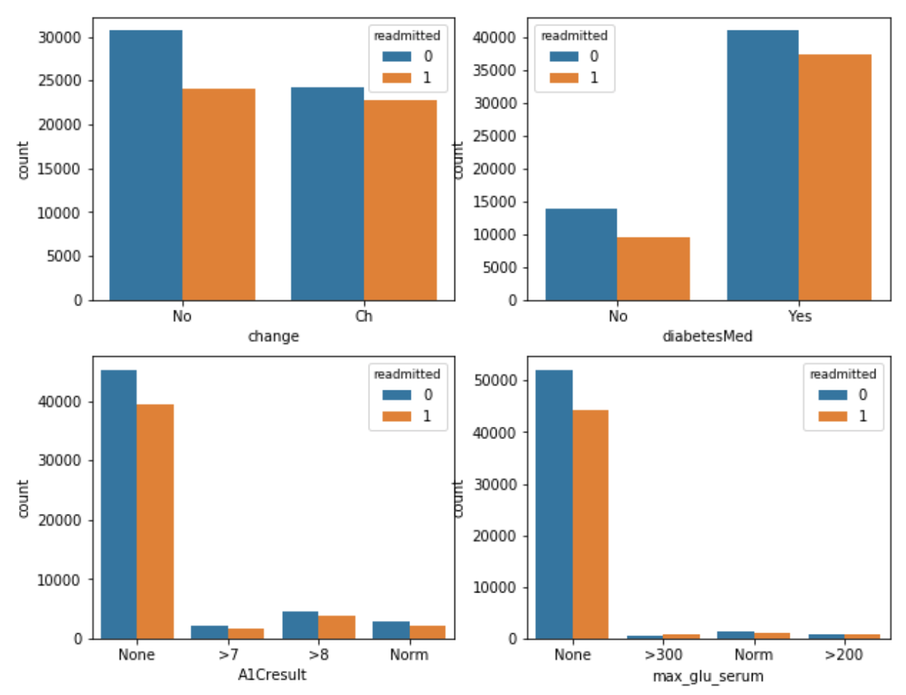
EDA – Categorical Features
Diabetes Med vs. Readmission
Med change vs. Readmission
A1Cresultvs. Readmission
Max_glu vs. Readmission
Patients with high glucose serum have higher change to be readmitted

Slide 11
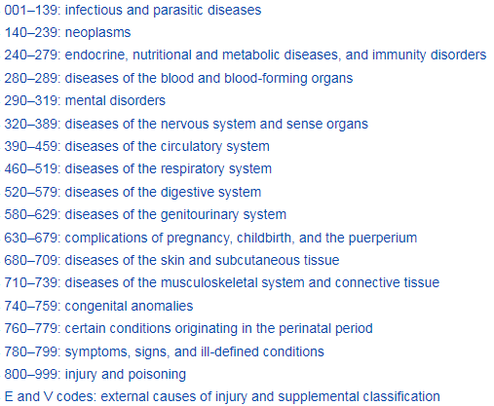
Feature Engineering
Diagnoses: ‘diag_1’, ‘diag_2’, ‘diag_3’
Represented by ICD9 code
Each has over 700 unique values
Encoded into 18 categories
23 Medications
Each has 4 categories
Combined into 2: take or not
No
Steady
Up
Down
0
1

Slide 12
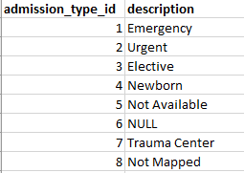
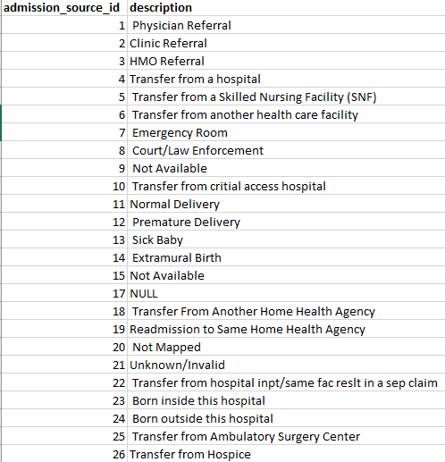
Feature Engineering
Admission_type_id:
8 categories initially
Combined into two categories
Admission_source_id:
26 categories initially
Combined into three categories
Emergency, referral, other
Emergency
Other

Slide 13
Feature Engineering
Age
Given in 10-year range
Replaced by middle value of each range
Discharge_disposition_id
I have run models using combined discharge categories (discharged to home or other)
However, the models gave us higher accuracy if they were not combined
Number of total hospital visits - created
number_visits = number_outpatient
+ number_inpatient
+ number_emergency

Slide 14
Data Preparation and Evaluation Metrics
Evaluation metrics
Accuracy
Recall
Precision
ROC-AUC
Data preparation
Standard Scaling numerical features
Dummy encoding categorical features
Split training and testing sets (80/20)

Slide 15
Training models
Logistic Regression
Easy to interpret, fast to run
K-Nearest Means
Easy to interpret, fast to run
Random Forest
Ensemble (Bagging),
Good performance
XGBoost
Ensemble (Boosting)
Good performance
Train set
Test set
Hyperparameter Tuning: Grid search
Logistic Regression
KNN
Random Forest
XGBoost
Evaluation & comparison
10 – fold
cross validation

Slide 16
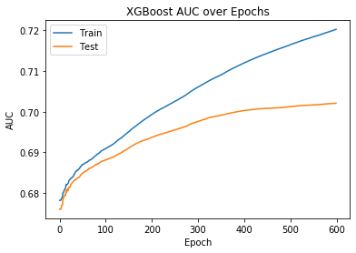
Early Stopping for XGBoost
Training stopped if the auc score was not improved in 10 epochs.

Slide 17
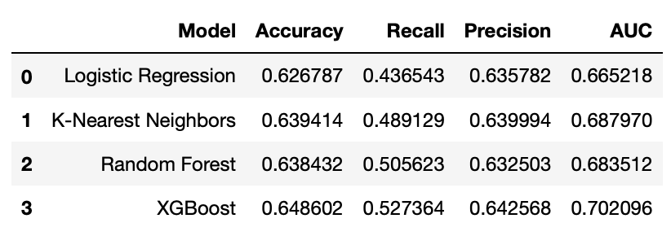
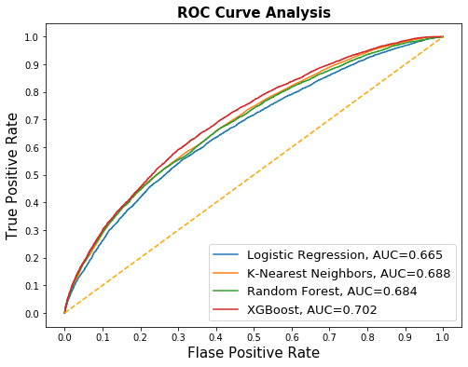
Evaluation
Winner: XGBoost
Accuracy: 64.9%
KNN also has decent performance and easy to run. However, it can not give feature importance

Slide 18
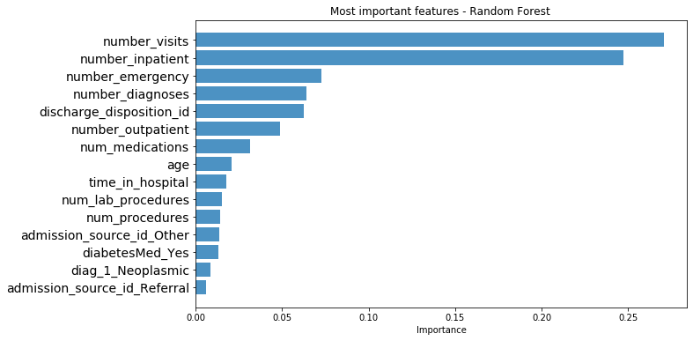
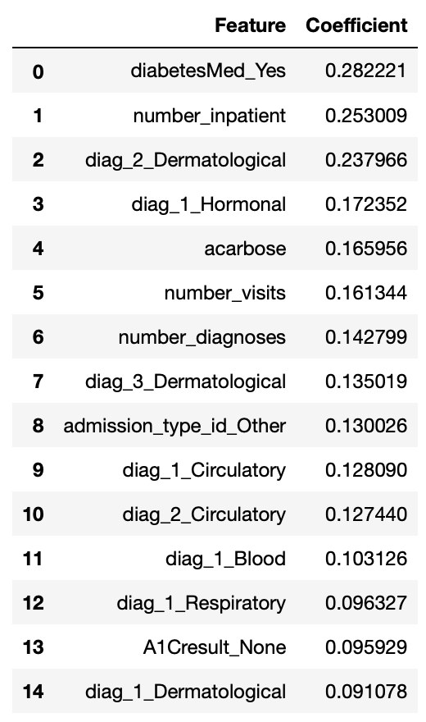
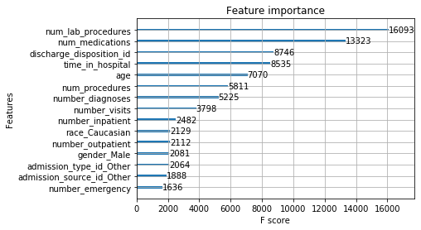
Feature Importance
Logistic Regression
Random Forest
XGBoost

Slide 19
Summary
XGBoost gives us the best prediction (higher accuracy, recall, precision, AUC)
Accuracy: 64.9%
Simple model like KNN also shows decent performance. However, it can not provide feature importance information
The most important features are:
Numerical features: Number of medications, number of visits, number of inpatient, number of emergency, number of lab procedure, time in hospital, age
Categorical features: Discharge disposition
The above features mentioned should be given extra attention

Slide 20
Future work
Fine tuning hyperparameters
Predicted classes can be balanced by resampling
Feature engineering can be improved in several ways
Group into more categories instead of 2 or 3
Different models can be tried on this data set
Neural networks usually gives higher accuracy. However, it lacks interpretability
Find a better threshold to label the prediction
Decrease threshold (from 0.5) can increase the sensitivity

