Slide 1
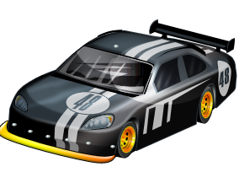

Doodle Drive
Team 6
Peachanok Lertkajornkitti
|
|
|
Alexander Curtis
Jun Pan
Edward Kidarsa

Slide 2
Outline
Project overview
Project-specific success criteria
Block diagram
Component selection rationale
Packaging design
Schematic and theory of operation
PCB layout
Software design/development status
Project completion timeline
Questions / discussion

Slide 3
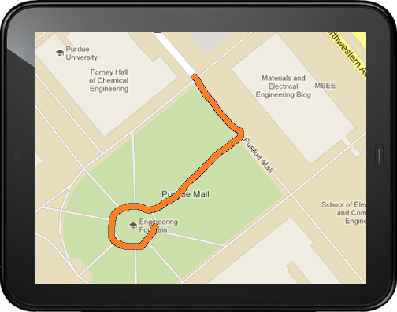
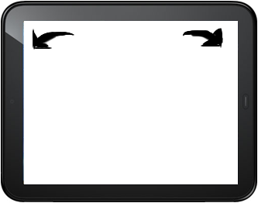
Project Overview
Android application as controller
Robot vehicle with microcontroller
Path will be drawn in Android application and the vehicle will follow that path
Outdoor mode with GPS, Google Maps, Compass
Indoor mode with tilt control

Slide 4
Project-specific success criteria
1. An ability to send and receive encoded data to an Android Device via Bluetooth
2. An ability to make a turn without stopping
3. An ability to navigate to a designated GPS coordinate with some approximation (GPS uncertainty of about ~5m)
4. An ability to monitor the battery power level
5.An ability to detect obstacles 0.5m away in a ~120 degree field of vision and alert user (vibrate)

Slide 5
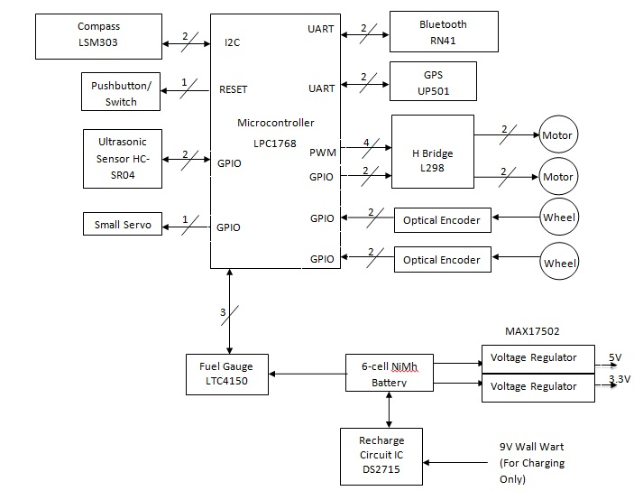
Block Diagram
PWM

Slide 6
Component selection rationale
MICROCONTROLLER
BLUETOOTH
POSITIONING:
GPS
COMPASS
POWER:
FUEL GAUGE
BATTERY RE-CHARGE CHIP

Slide 7
MICROCONTROLLER RATIONALE
NXP LPC1768
mBed prototyping environment and compiler
Quick and efficient prototyping with mbed SDK
Ease of use
Good amount of sample code/libraries exist
Enough ports for necessary peripherals
3x UART, 2x I2C, 6x PWM channels
Input capture pins with timer
Notes:
Quick prototyping with mbed SDK
Easy to move from module to custom PCB

Slide 8
POSITIONING/Communication Components RATIONALE
GPS: UP-501
Most cost effective according to comparison study (Sparkfun)
Low power consumption ~80mW
Configurable update rate (up to 10 Hz)
High accuracy ~2.5m
BLUETOOTH: RN-41
Class 1 device (range up to 100m as opposed to Class 2, 10m)
LEDs indicating the status of the connection
Compass: LSM303DLM
Cheapest 3-axis compass with tilt compensation

Slide 9
POWER components RATIONALE
FUEL GAUGE: LTC4150
Compatible with six NiMH cell configuration
Low feature and simple interfacing
Interrupt counting or input capture
BATTERY RE-CHARGE CHIP:
Compatible with six NiMH cell configuration
Switch mode charging for high efficiency and low heat dissipation
Accurate charge termination (dT/dt method) for safety

Slide 10
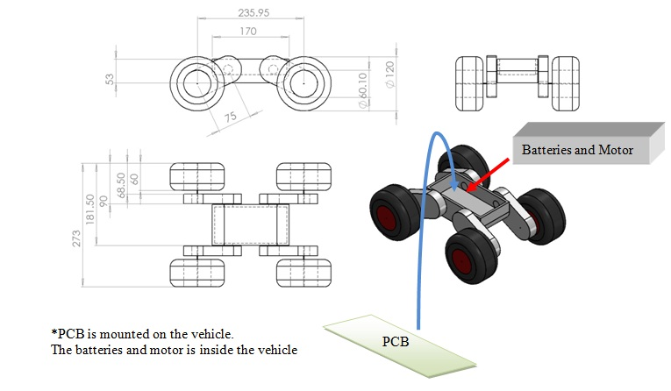
PACKAGING DESIGN
Durable rugged body and wheels
Large enough to fit components on the PCB
Mounted PCB
Portable
Minimal mechanical components

Slide 11
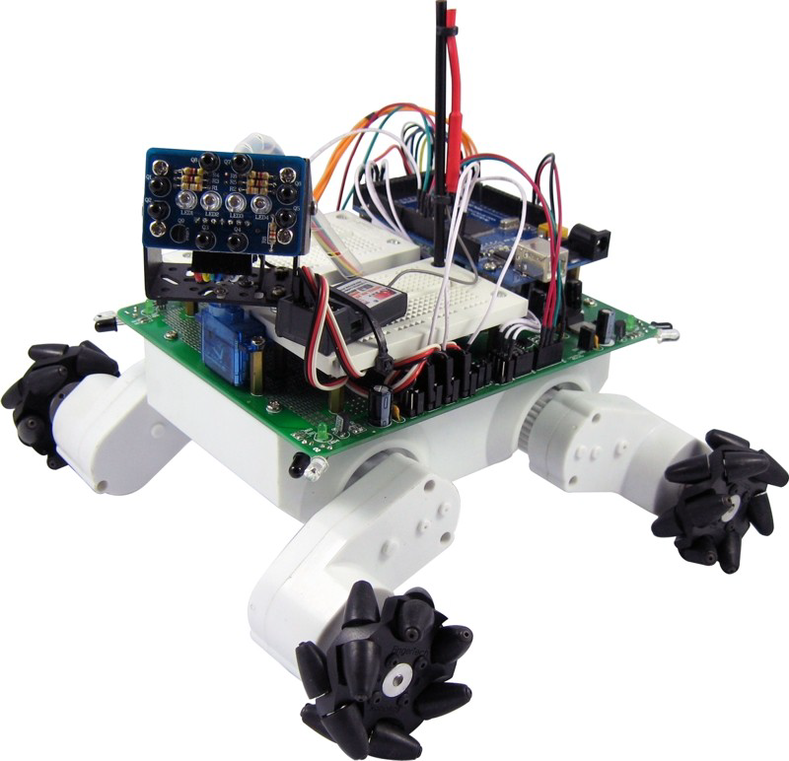
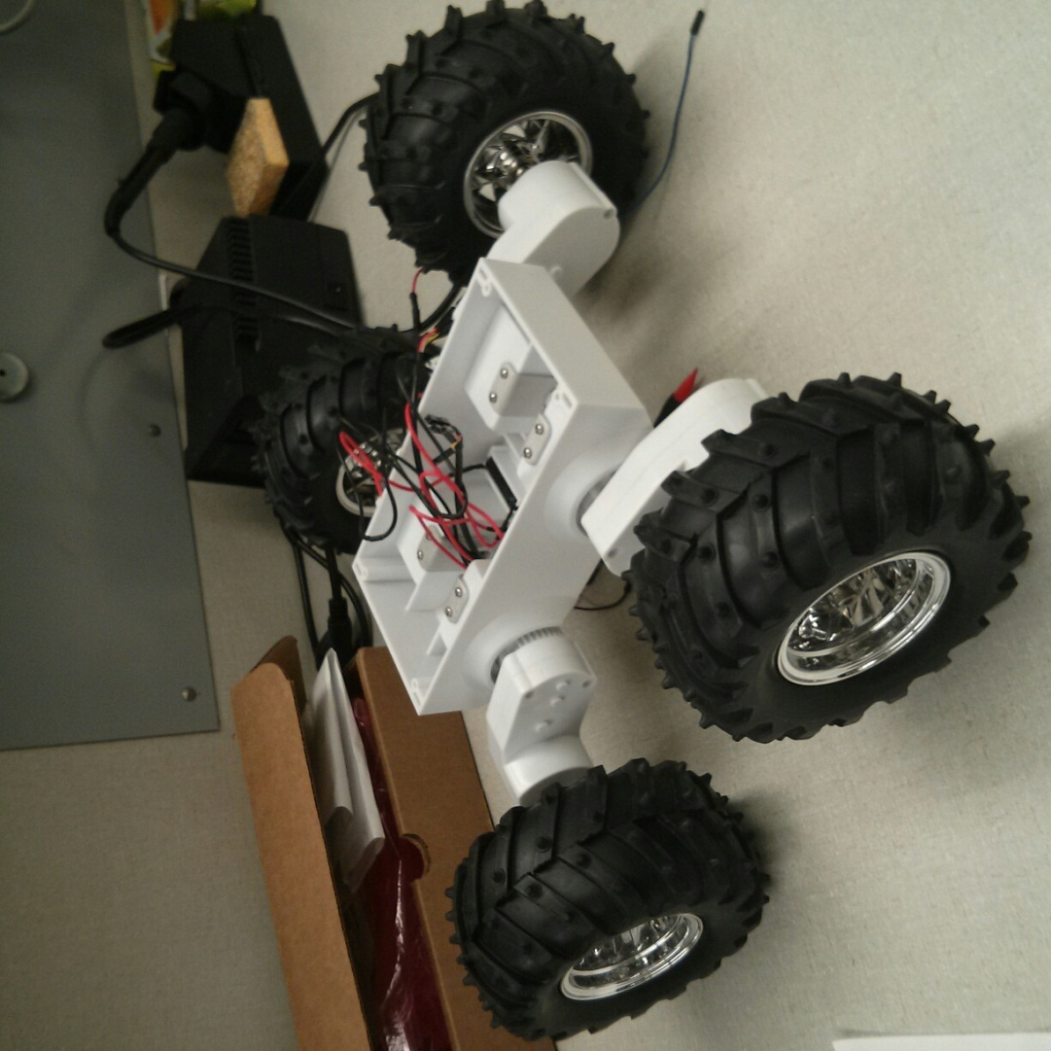
PACKAGING DESIGN

Slide 12
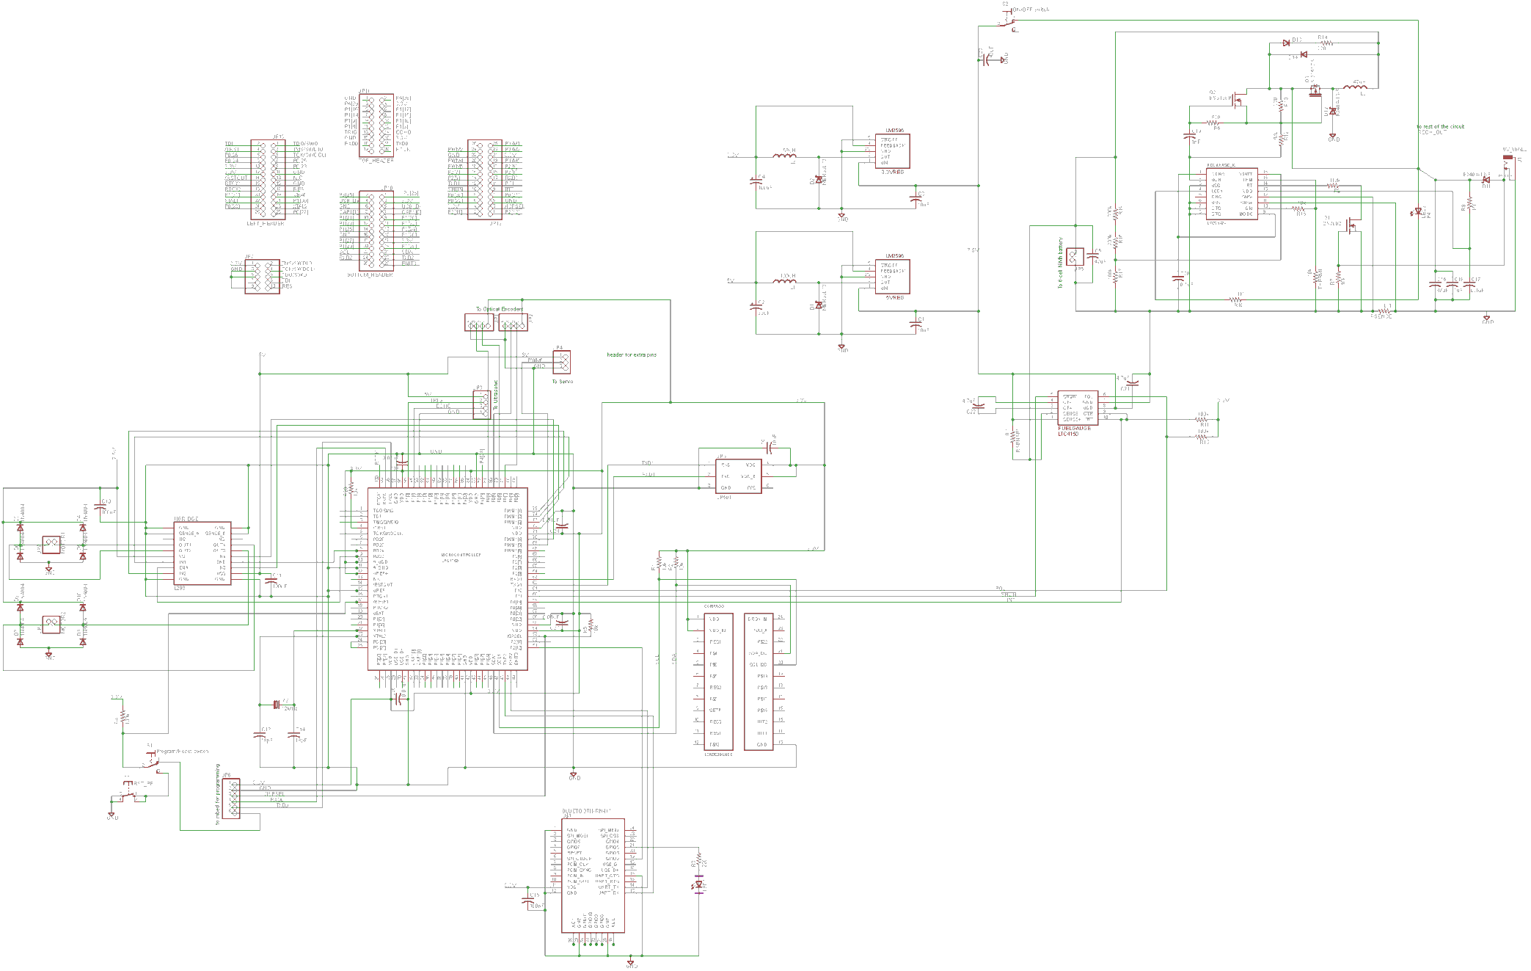
Notes:
Here’s an overview of our schematic – it’s essentially split into components that have to do with actual operation (bottom left) and power components (top right). I’ll be covering the microcontroller first and then the logic components surrounding it and then finish off with the power components

Slide 13
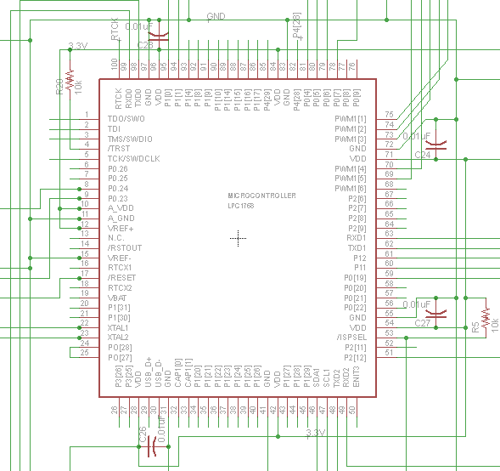
MicroController
1: Compass (I2C)
2: Bluetooth (UART)
3: GPS (UART)
4: H-Bridge (PWM, GPIO)
5: Ultrasonic (GPIO)
6: Optical Encoders (Input Capture, GPIO)
7: Crystal Oscillator
8: Fuel Gauge (GPIO)
9: Servo (PWM)
5
6
4
9
3
8
7
1
2
Notes:
Limited # of UART ports – 4 Total, 1 is used for Mbed testing, 1 overlaps with I2C, and that leaves 2 leftover – one for GPS, one for Compass
Only 2 I2C ports total, which is plenty, but they are right next to eachother. Bluetooth modules mainly only work with I2C
Spaced things out as best as possible.
Input capture for

Slide 14
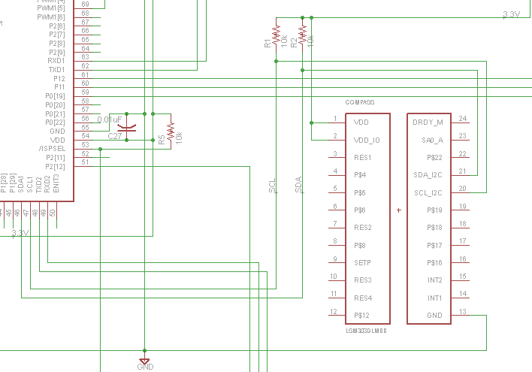
COMPASS
Notes:
Here’s the compass – the symbol looks a little odd but it’s this way because we’re actually using a breakout board for it (you can see this better on the PCB) because the IC itself is incredibly small. The breakout board has a bypass capacitors on it already. All that’s connected is the two pullup I2C resistors. There are a lot of unused pins, mainly because this device is more feature heavy than we need and actually has an accelerometer too.

Slide 15
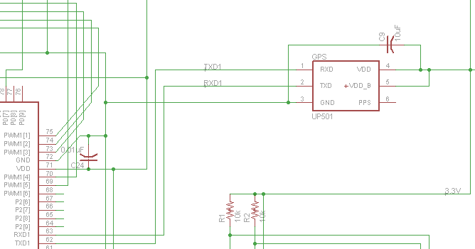
GPS

Slide 16
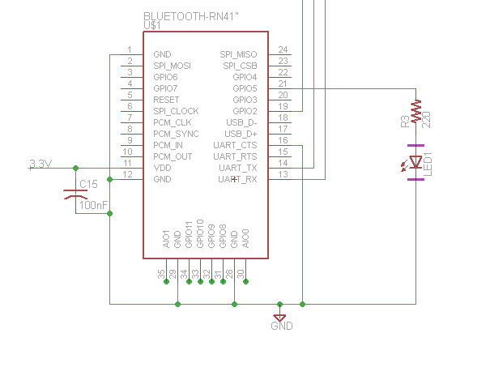
BLUETOOTH

Slide 17
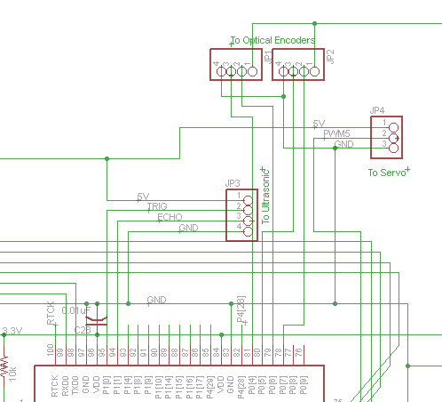
Ultrasonic / Encoder / Servo

Slide 18
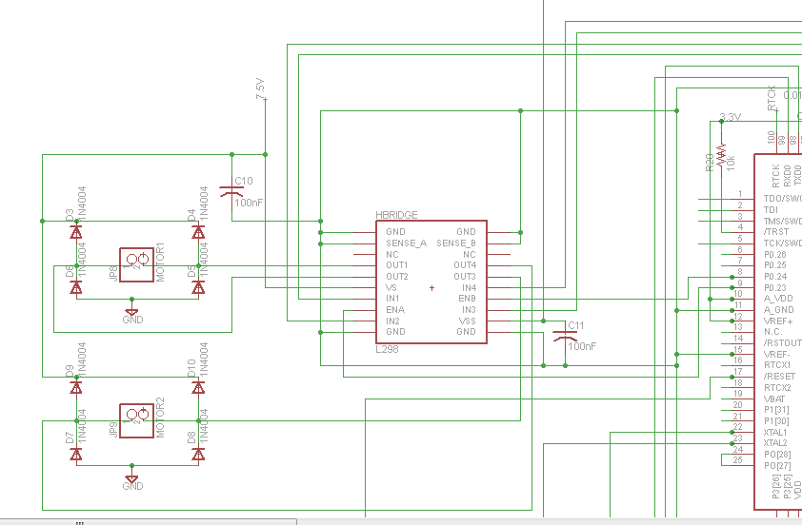
H-BridgE
Notes:
Hbridge. We currently have two 100nF capacitors for bypass (as specified by datasheet). For each motor, it takes in one gpio (enable) and two pwm channels (for controlling operation). We could connect sense resistors at SENSE_A and SENSE_B and have a pin monitoring the voltage at those so we know the current they’re using, but we aren’t doing that right now. You can see to the left two headers for each motor, as well as four flyback diodes that are used for protection (not internal to L298)

Slide 19
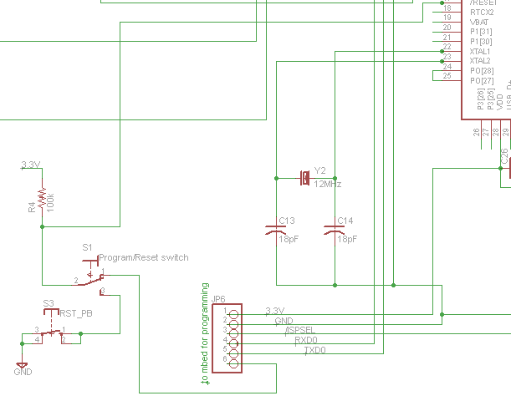
Reset / ProgramminG Switch
Notes:
This is the bottom left. The first thing to note is the programming header. This actually interfaces with the mBed prototype board which converts this serial to USB so it can interact with a computer. ISPSEL is used to put it into programming mode. Pin 6 on this header you’ll see is connected to a switch. When this switch is in the upward position (as it is is shown) it is connected to the microcontroller reset pin. This allows our application to automatically put the micro into reset mode once we have the pins connected to the header. On the other hand, when the program switch is down, it is just connected to a push button so we can reset the micro.

Slide 20
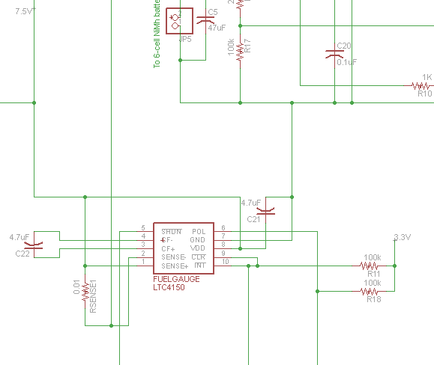
FUEL GAUGE
Notes:
This is our fuel gauge. This is actually a bit different than the schematic you have. The two resistors are pull up resistors for !INT and POL since they are both open drain outputs. INT will assert low whenever it detects a unit of charge so the microcontroller will be keeping track of this. Simultaneously, POL will be read – showing the polarity of the charge (charging or discharging). The sense resistor was chosen to not have a voltage drop exceeding 50mV and we will at most have 25mV drop. Finally, the C22 filter capacitor averages noise

Slide 21
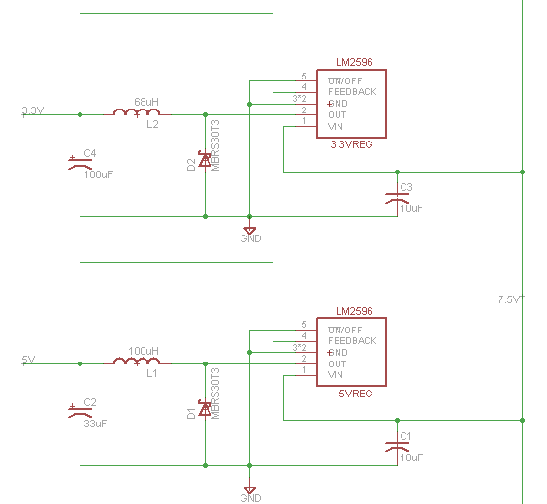
VOLTAGE REGULATORS
Notes:
As you’ve seen a lot of components that use 3.3V and then a few that use 5V, we have two step down regulators – they are switch mode for higher efficiency since we’re running off battery - these are pretty standard circuits and the data sheet was followed. The input capacitor is low ESR, and the output capacitor is electrolytic. We used TI’s bench simulation software to pick ideal values.

Slide 22
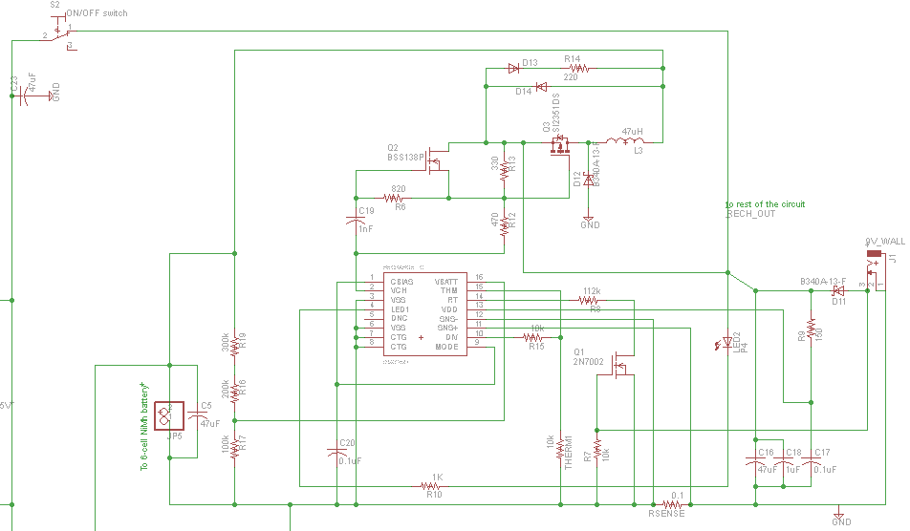
RECHARGE CIRCUIT
Notes:
Finally, this is the recharge circuit. The IC at the middle of this is the Maxim DS2715. This facilitates charging of the battery pack and is set up to run in switched mode. It has various modes – precharge, fast charge, top off, etc. – that are controlled and entered based on various conditions. The most important is fast charge, which has a charging current of ~1A set by the sense resistor. This mode is terminated by the thermal resistor (THERM1) placed physically next to the battery pack. It will sense the temperature and, when the battery is done charging and converted excess energy into heat, will discontinue the charging. The LED displays the mode of charging. There is also a backup termination mode based on timeout (this is set by the resistor on RT) and ours is currently set to ~160 minutes The Vch pin essentially toggles on and off depending on the sense resistor which will effect the operation of the mosfets – a lot of that circuit is used to improve switching times whereas the power MOSFET Q3 is the main control (Vch controls switching operation).

Slide 23
PCB LAYOUT: DESIGN CONSIDERATIONS
GPS far away from everything
Especially active circuits such as regulators
Bluetooth away from power supply
No traces / ground plane / vias allowed under antenna
Antenna end protrude 5mm beyond any enclosure
Traces
0.016 in used for most traces
Power and Ground traces used 0.040 when possible, some pins were too small
Routing
45 degrees routings were used as much as possible
T intersections were used to avoid acute angles

Slide 24
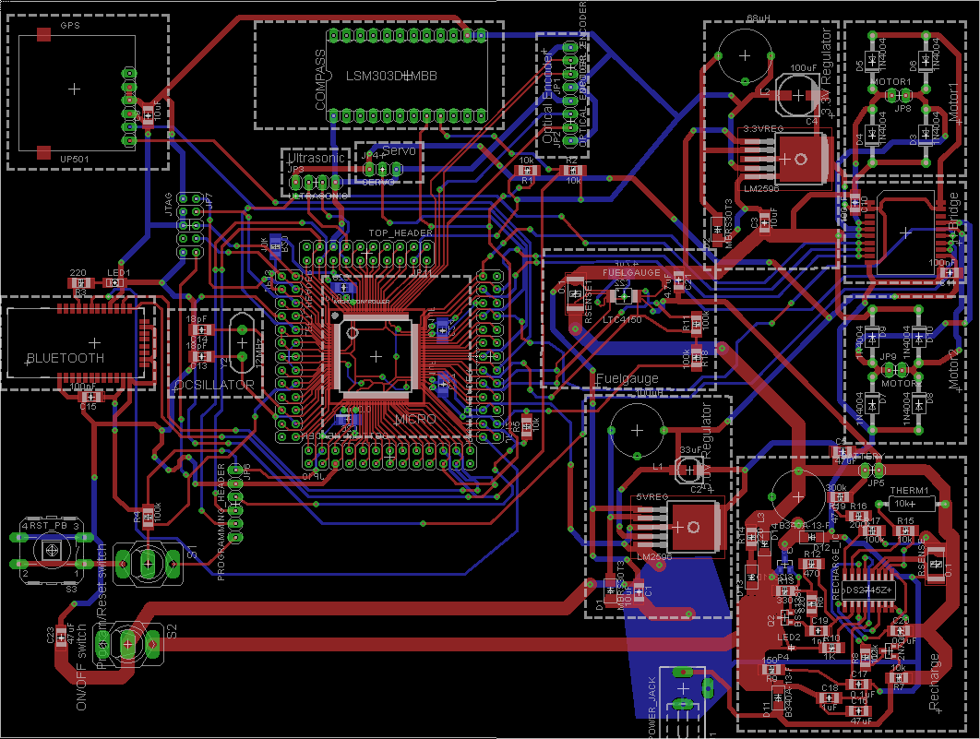
PCB LAYOUT – 7.3 x 5.5 in

Slide 25
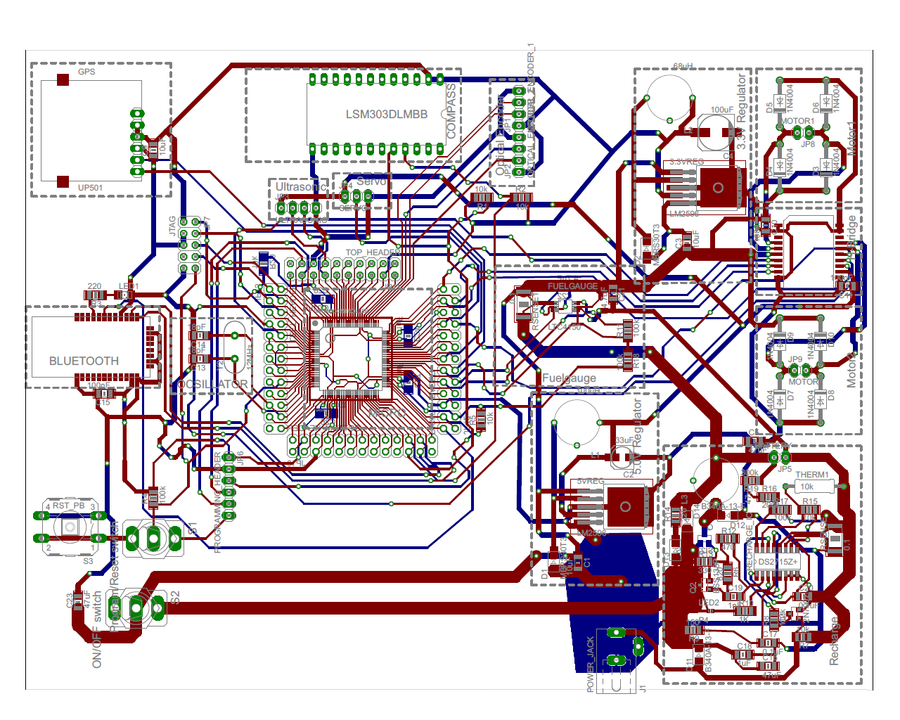

Slide 26
PCB LAYOUT: Micro
Center of PCB to be accessible to everything else
Headers on all sides for access to pins ( debugging etc )
Bypass capacitors placed next to micro before headers
External oscillator used
Located near the microcontroller after header
Routing
GPS and H-Bridge was on either ends of the board, thus had long connecting traces
Traces
Due to the small size of the pins, only 0.01 in traces were able to be used
JTAG header is connected to Micro

Slide 27
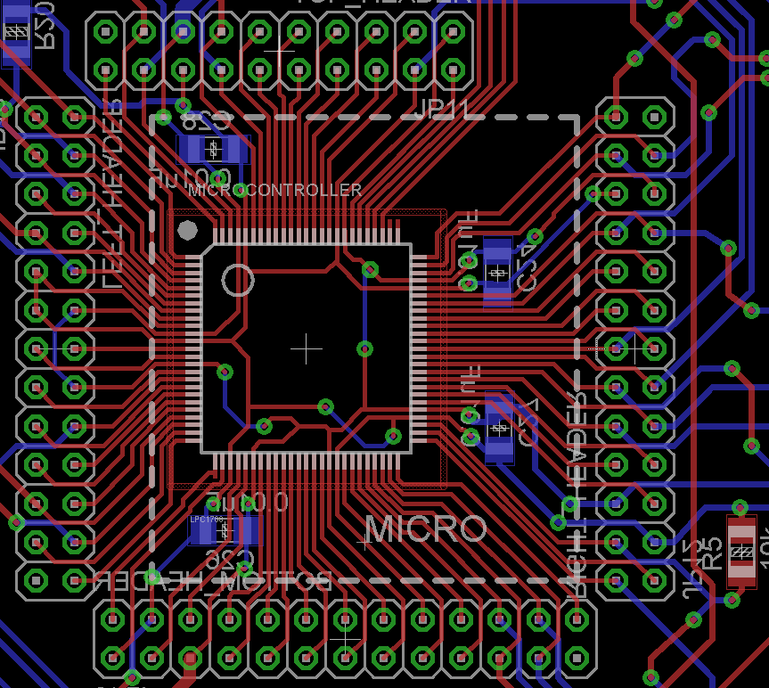
PCB LAYOUT: Micro

Slide 28
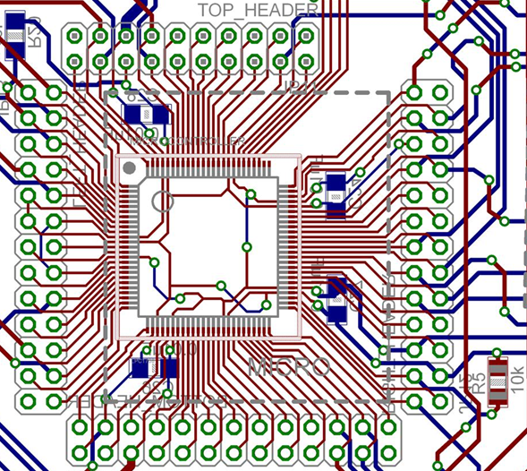
PCB LAYOUT: Micro

Slide 29
PCB LAYOUT: POwer
Power Circuit:
2 Motors, H-Bridge, Battery Recharge Circuit, 2 Voltage Regulators
Power circuit located near edge of PCB away from transmission peripherals
Placed near each other
Power circuits may have current feedback / current spikes need wider traces than the rest of the circuit

Slide 30
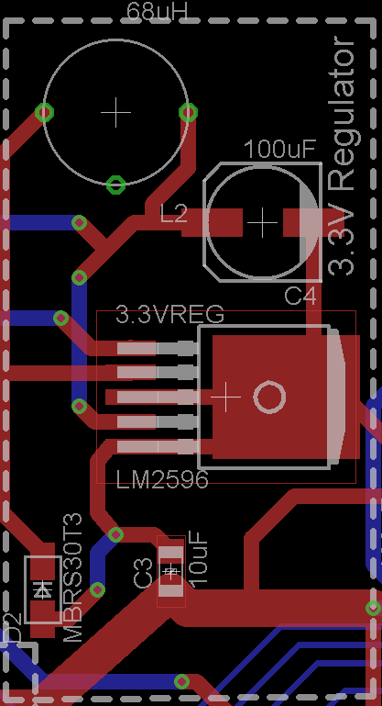
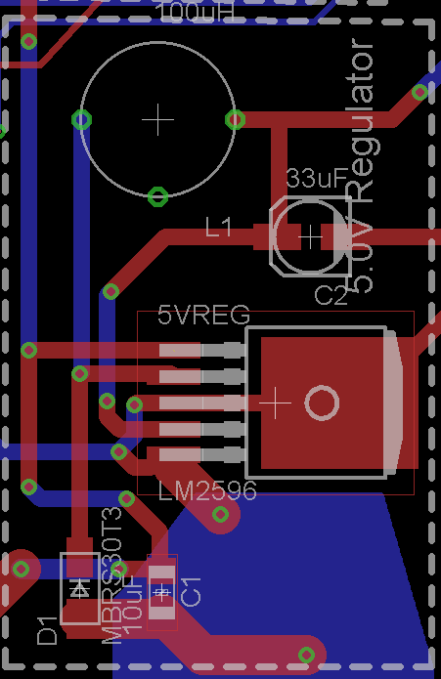
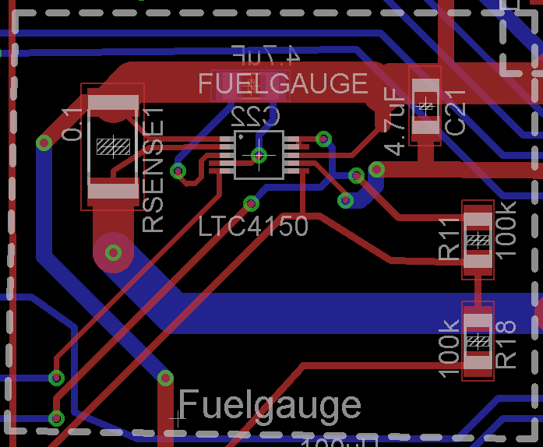
PCB LAYOUT: VOLTAGE REGULATORS
+ FUEL GAUGE
Notes:
the PC board copper area connected to this pin should be kept to a minimum.
Open core inductors may cause interference / noise / stray inductance
Large Copper Area / airflow might be needed if current load > 2A

Slide 31
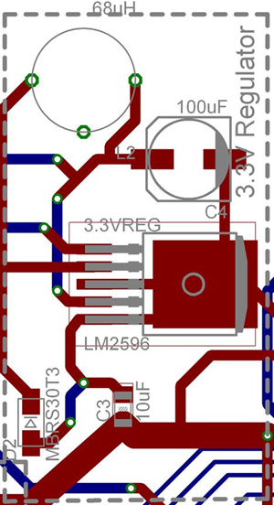
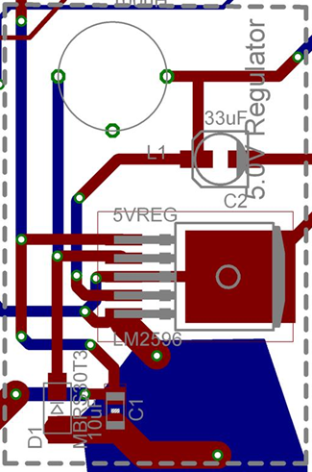
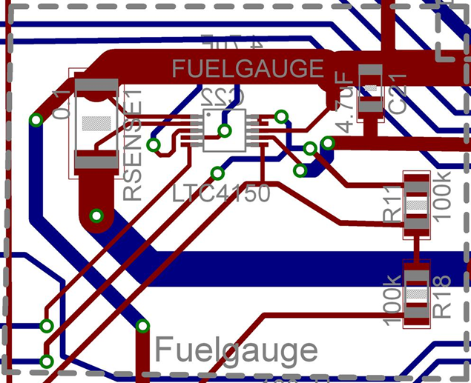
PCB LAYOUT: VOLTAGE REGULATORS
+ FUEL GAUGE
Notes:
the PC board copper area connected to this pin should be kept to a minimum.
Open core inductors may cause interference / noise / stray inductance
Large Copper Area / airflow might be needed if current load > 2A

Slide 32
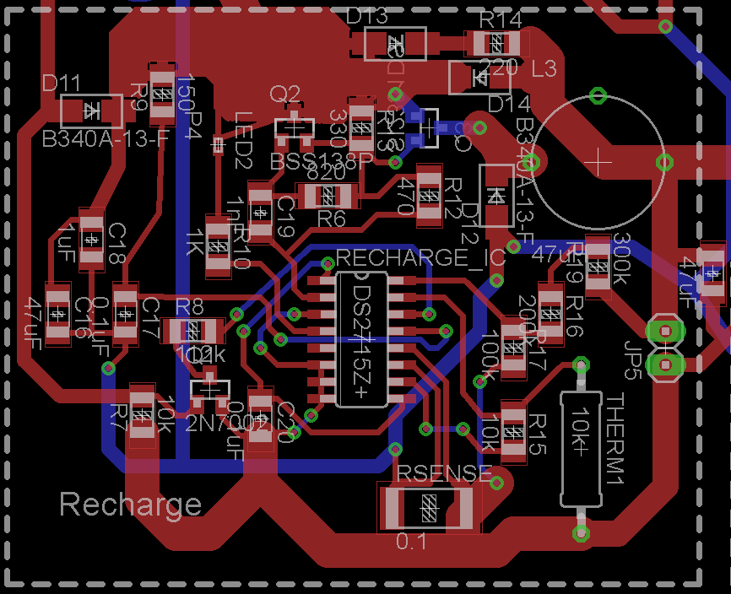
PCB LAYOUT: CHARGING CHIP
PIN HEADER TO BATTERY

Slide 33
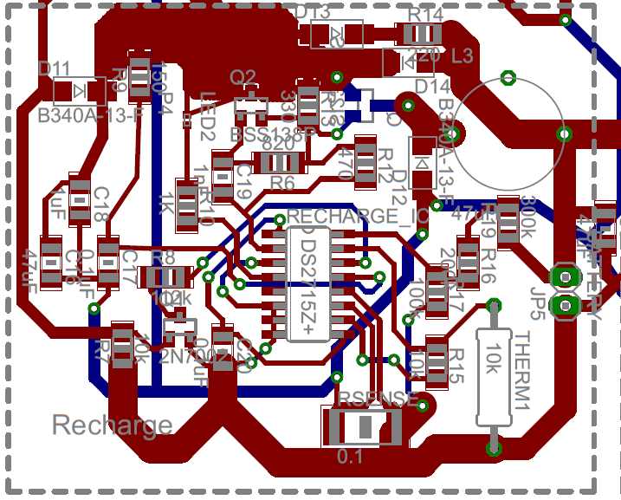
PCB LAYOUT: CHARGING CHIP
PIN HEADER TO BATTERY

Slide 34
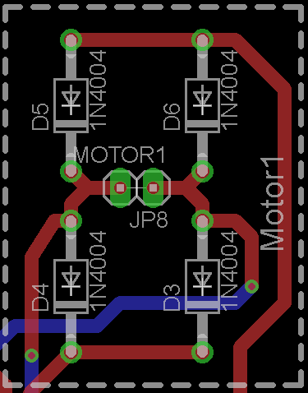
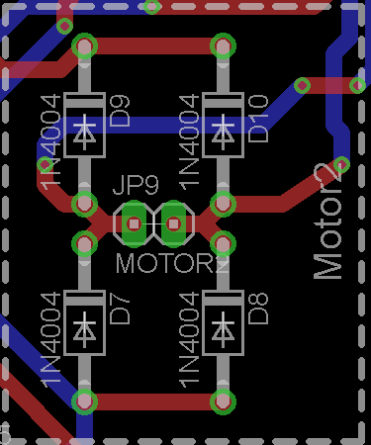
PCB LAYOUT: MOTORS
Notes:
Limited # of UART ports – 4 Total, 1 is used for Mbed testing, 1 overlaps with I2C, and that leaves 2 leftover – one for GPS, one for Compass
Only 2 I2C ports total, which is plenty, but they are right next to eachother. Bluetooth modules mainly only work with I2C
Spaced things out as best as possible.
Input capture for

Slide 35
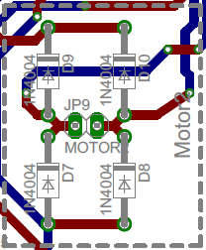
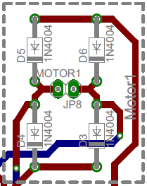
PCB LAYOUT: MOTORS
Notes:
Limited # of UART ports – 4 Total, 1 is used for Mbed testing, 1 overlaps with I2C, and that leaves 2 leftover – one for GPS, one for Compass
Only 2 I2C ports total, which is plenty, but they are right next to eachother. Bluetooth modules mainly only work with I2C
Spaced things out as best as possible.
Input capture for

Slide 36
PCB LAYOUT: PERIPHERALS

Slide 37
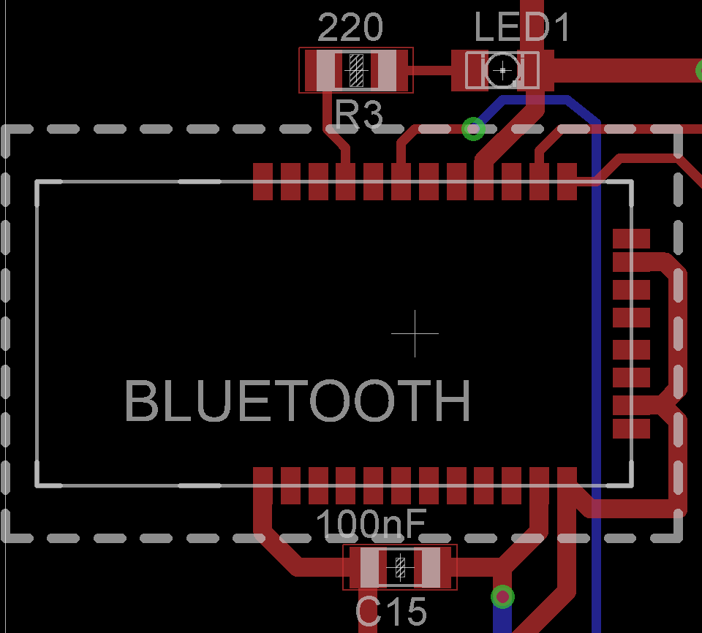
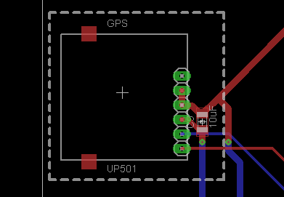
PCB LAYOUT: GPS + BLUETOOTH
Notes:
Limited # of UART ports – 4 Total, 1 is used for Mbed testing, 1 overlaps with I2C, and that leaves 2 leftover – one for GPS, one for Compass
Only 2 I2C ports total, which is plenty, but they are right next to eachother. Bluetooth modules mainly only work with I2C
Spaced things out as best as possible.
Input capture for

Slide 38
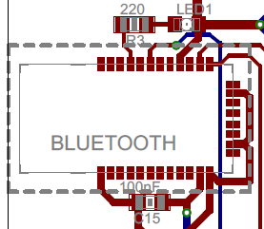
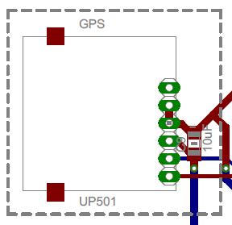
PCB LAYOUT: GPS + BLUETOOTH
Notes:
Limited # of UART ports – 4 Total, 1 is used for Mbed testing, 1 overlaps with I2C, and that leaves 2 leftover – one for GPS, one for Compass
Only 2 I2C ports total, which is plenty, but they are right next to eachother. Bluetooth modules mainly only work with I2C
Spaced things out as best as possible.
Input capture for

Slide 39
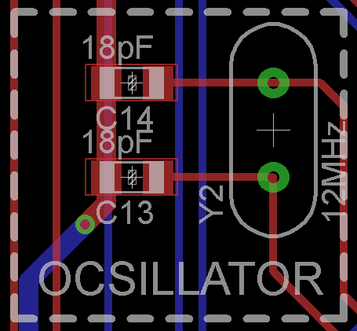
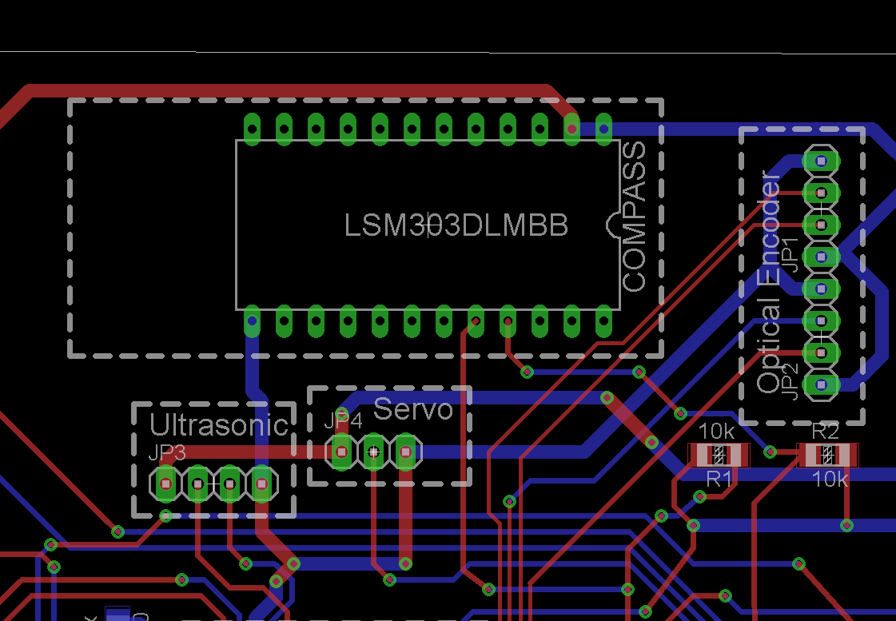
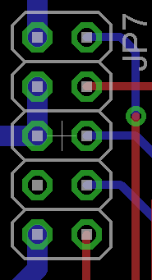
PCB LAYOUT: Compass + Servo + JTAG +
ULTRASONIC SENSOR+ OPTICAL ENCODER + OSCILLATOR
JTAG PROGRAMMING PINS
Notes:
Limited # of UART ports – 4 Total, 1 is used for Mbed testing, 1 overlaps with I2C, and that leaves 2 leftover – one for GPS, one for Compass
Only 2 I2C ports total, which is plenty, but they are right next to eachother. Bluetooth modules mainly only work with I2C
Spaced things out as best as possible.
Input capture for

Slide 40
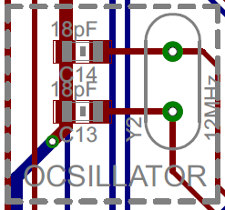
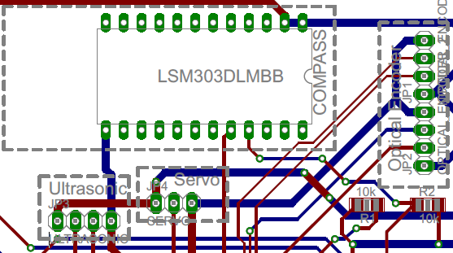
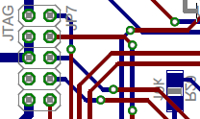
PCB LAYOUT: Compass + Servo + JTAG +
ULTRASONIC SENSOR+ OPTICAL ENCODER + OSCILLATOR
JTAG PROGRAMMING PINS
Notes:
Limited # of UART ports – 4 Total, 1 is used for Mbed testing, 1 overlaps with I2C, and that leaves 2 leftover – one for GPS, one for Compass
Only 2 I2C ports total, which is plenty, but they are right next to eachother. Bluetooth modules mainly only work with I2C
Spaced things out as best as possible.
Input capture for

Slide 41
Software Preliminary Design
Microcontroller
Done testing:
Ultrasonic sensors, H Bridge, Servo, Bluetooth
Need to test:
Compass (I2C)
GPS (UART)
Fuel Gauge (I/O)

Slide 42
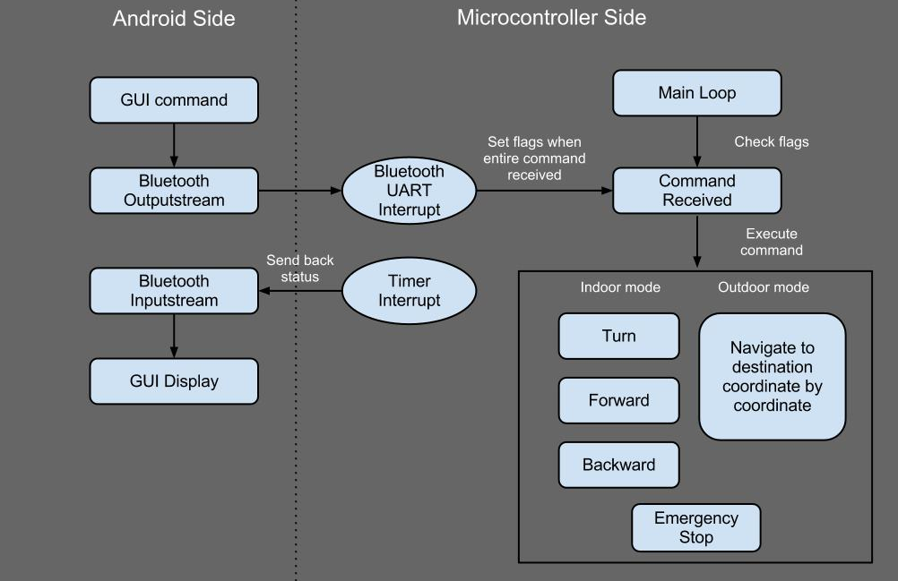
Software Preliminary Design
Notes:
Basic state diagram of our software design
Timer interrupt to report status of the GPS location, heading, battery statu, etc periodically.

Slide 43
Software Preliminary Design
Android application
Google Maps API
Battery status bar
Toggle switch between Indoor/Outdoor modes
Progress:
Android output angles when tilting (for Indoor Mode)
Google Maps displays on screen with ability to draw lines/polygons on screen
Battery status bar
Bluetooth interface

Slide 44
PROJECT TIMELINE
Week | Test all components | Finalize PCB | Test and Debug Micro code | Test & Debug Android code | Test each parts on PCB | Finish packaging | PSSC & Final Presentation
8
9
10
11
12
13
14
15
16

Slide 45
THANK YOU!
Questions / Discussions

