Slide 1
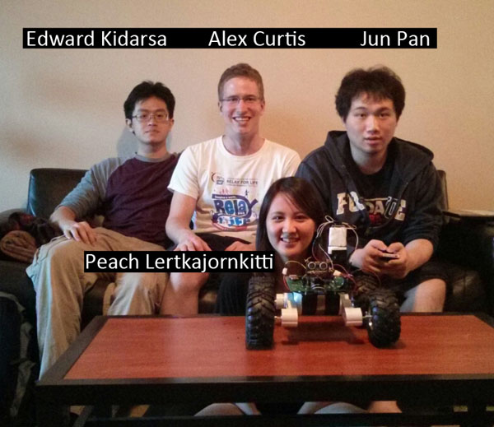
ECE 477 Final Presentation Team 6 − Spring 2013

Slide 2
Outline
Project overview
Block diagram
Design challenges
Individual contributions
Project demonstration
Questions / discussion

Slide 3
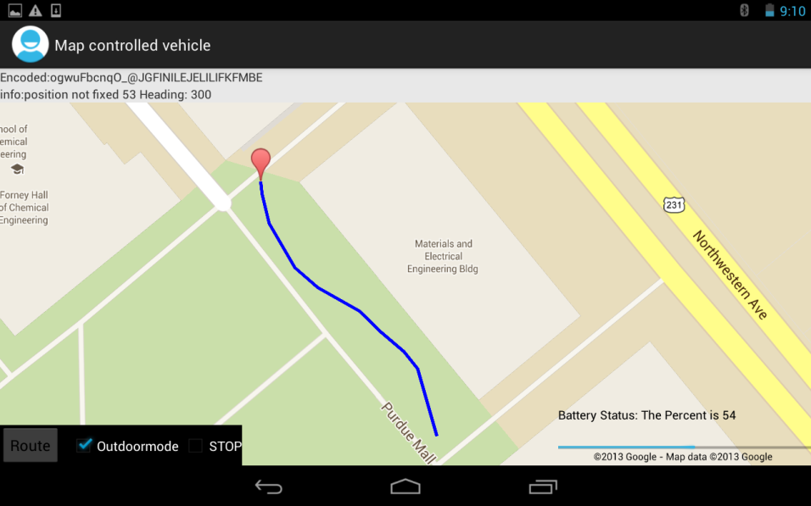
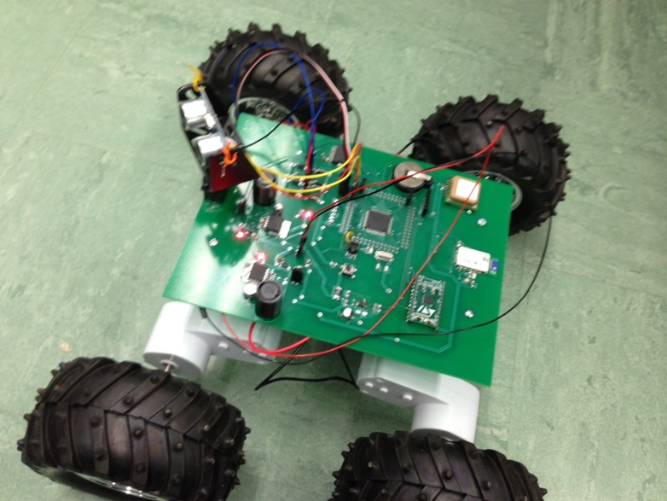
Project Overview
Android application as controller
Robot vehicle with microcontroller
Path is drawn in Android application and the vehicle will follow that path
Outdoor mode with GPS, Google Maps, Compass
Indoor mode with tilt control

Slide 4
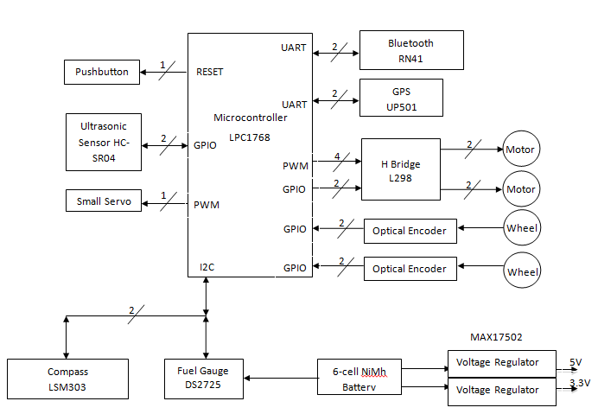
Block Diagram

Slide 5
Design Challenges
Compass interference
Mu metal, transorbs, choke, physical separation
Printed circuit board very convoluted
Redesign, remove unnecessary components (recharge circuit)
GPS, compass, and Bluetooth potential interference
Space out as much as possible on PCB
Programs would randomly stop
Identified as an Mbed problem with the online compiler, fixed with LPCXpresso

Slide 6
Individual Contributions
Team Leader – Alexander Curtis
Team Member 2 – Edward Kidarsa
Team Member 3 – Peachanok Lertkajornkitti
Team Member 4 – Jun Pan

Slide 7
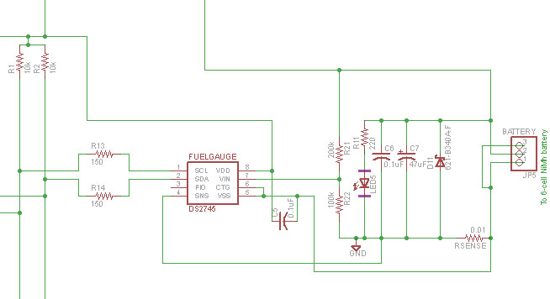
Team Leader – Alexander Curtis
Schematic
Initial creation and revisions
Microcontroller code
Fuel gauge algorithm
Ultrasonic sensor & servo interrupts
Testing components
GPS, fuel gauge, motor control
Proposing short term goals, organization

Slide 8
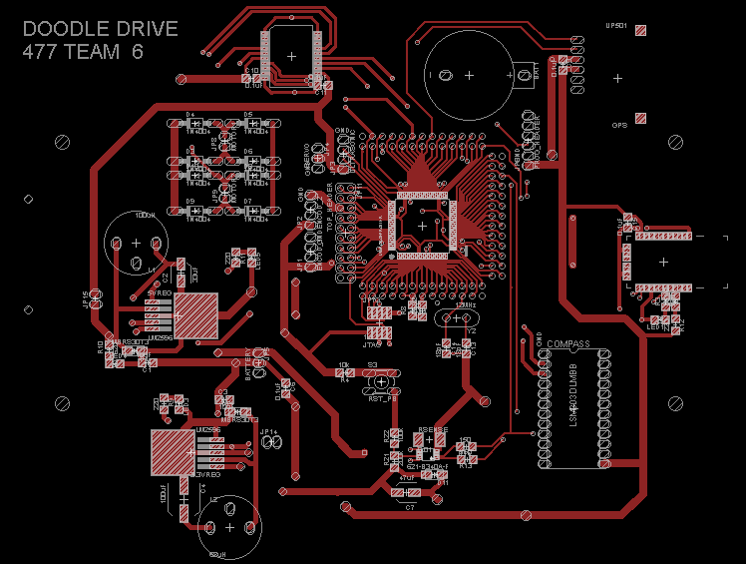
Member 2 – Edward Kidarsa
Created the printed circuit board
Multiple iterations as project progressed
Compass module (LSM303DLM)
Tilt compensation
Magnetometer and accelerometer values together
Interference issue
Outdoor mode algorithm
GPS and compass working together

Slide 9
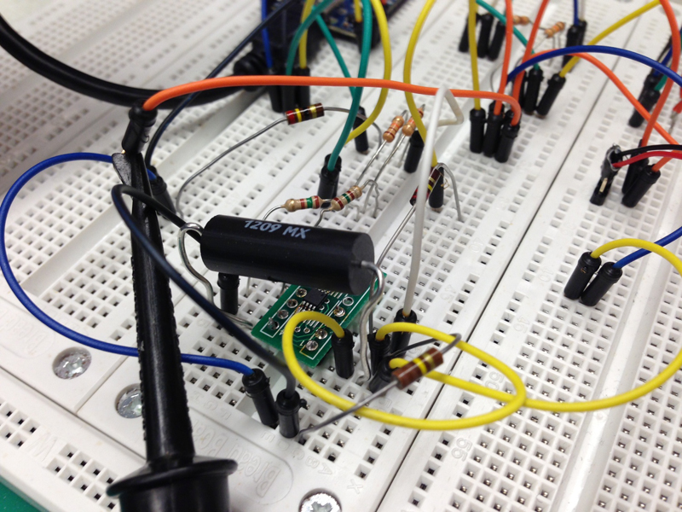
Member 3 – Peachanok Lertkajornkitti
Android programming
Battery progress bar
Fuel gauge
Battery percentage
Accelerometer
Debugging, testing
Power circuitry, compass
Documentation
User manual, senior design report

Slide 10
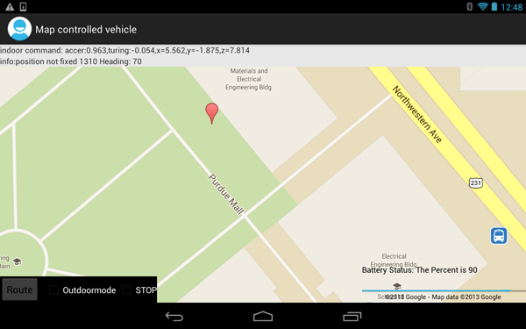
Member 4 – Jun Pan
Android programming
Bluetooth communication
Google maps, android map API
Microcontroller programming
Software framework
GPS parsing
Indoor & outdoor mode
Soldering
100 pin microcontroller many times
Power circuitry, most IC’s

Slide 11
Project Demonstration
The ability to send and receive encoded data to an from an Android device via Bluetooth.
The ability to control acceleration and direction of vehicle through Android device accelerometer.
The ability to navigate to a designated GPS coordinate with ~5m approximation.
The ability to monitor battery power.
The ability to detect obstacles and prevent forward movement until the obstacle is gone.

Slide 12
Questions / Discussion

