Slide 1

MAKING THE DIFFERENCE

Slide 2


Who We Are?
We are one of the fastest growing PEER TO PEER Companies in the online Network Marketing Industry today.
Our Mission
To provide residual Income for each and every member
One World, One Mission, One Team!

Slide 3

OUR TEAM PLAN
To build the largest and strongest Team Network in the World by training and educating our Team members from all over the world on to follow some simple steps and earn residual income over a consistent period of time.

Slide 4
How Do You Earn?
5% BONUSES ON DIRECT REFERAL
SPILL OVERS
SIX (6) PACKAGE OPTIONS
MULTIPLE REGISTRATIONS

Slide 5
At level 1 you donate 0.03BTC in total paying to ADMIN, your REFERRAL and whom you are assigned
To pay.
If you refer 10 persons at that level, you get 0.015 * 10 = 0.15BTC If you refer 100 persons to the system you get 0.015 *100 = 1.5BTC (5% ON ALL DIRECT REFERRALS)
When you get to your payout level on level 1, you get 0.0255 * 4 = 0.102 BTC
YOU THEN DECIDE TO RECYCLE AGAIN OR UPGRADE TO A HIGHER LEVEL.
* MULTIPLE REGISTRATIONS IS ALLOWED

Slide 6
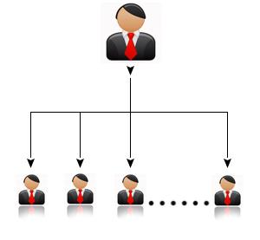


₁
5% BONUSES ON DIRECT REFERALS
No limit to number of referrals only gets better….
You get 5% on every referral you make
You get a leadership bonus of 1% extra when you get 100 referrals
Bonus is paid on referral every-time they upgrade or re-register with multiple accounts.

Slide 7
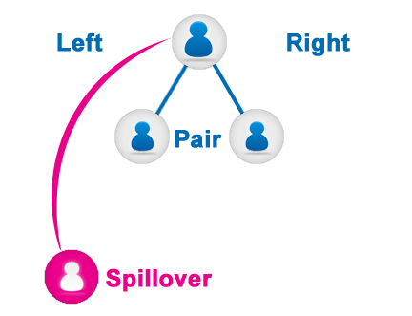
₂
SPILL OVERS
Once placement of first two is made, all other referrals spill over to down-lines randomly filling empty legs
So just register and you could earn without necessarily referring your own down-lines.

Slide 8
_{3&4}
SIX (6) PACKAGES
Members are allowed to register in multiple levels at once and maintain multiple accounts in each levels. This results in multiple streams of income and eventual RESIDUAL INCOME.

Slide 9

How Do You Get Started?
You have two very simple choices!

Slide 10

Immediately get back to the person who referred you to the website
or sent this presentation to you and ask the sign up process
Alternatively, you can visit www.alliedteam.net and Click on “Join Now” which will take you through three simple steps to have you start earning money within minutes!
It’s as simple as that.

Slide 11
MAKING THE DIFFERENCE
WWW.ALLIEDTEAM.NET

