Slide 1
실습

Slide 2
SupportVectorMachine
Chapter 01

Slide 3
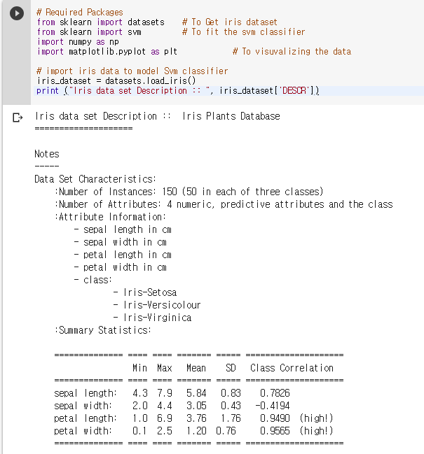
패키지 로드 & 데이터 읽기
# Required Packages
from sklearn import datasets
from sklearn import svm
import numpy as np
import matplotlib.pyplot as plt
# import iris data to model Svm classifier
iris_dataset = datasets.load_iris()
print ("Iris data set Description :: ", iris_dataset['DESCR'])
출처: http://dataaspirant.com/2017/01/25/svm-classifier-implemenation-python-scikit-learn/

Slide 4
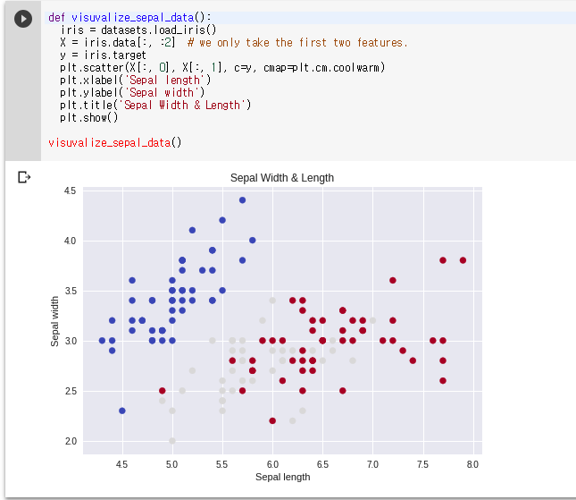
Data Visualize
def visuvalize_sepal_data():
iris = datasets.load_iris()
X = iris.data[:, :2]
y = iris.target
plt.scatter(X[:, 0], X[:, 1], c=y, cmap=plt.cm.coolwarm)
plt.xlabel('Sepal length')
plt.ylabel('Sepal width')
plt.title('Sepal Width & Length')
plt.show()
visuvalize_sepal_data()

Slide 5
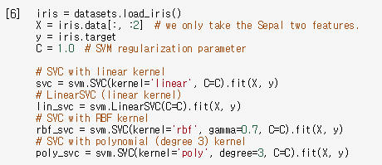
Modeling Different kernel Svm
iris = datasets.load_iris()
X = iris.data[:, :2] # we only take the Sepal two features.
y = iris.target
C = 1.0 # SVM regularization parameter
# SVC with linear kernel
svc = svm.SVC(kernel='linear', C=C).fit(X, y)
# LinearSVC (linear kernel)
lin_svc = svm.LinearSVC(C=C).fit(X, y)
# SVC with RBF kernel
rbf_svc = svm.SVC(kernel='rbf', gamma=0.7, C=C).fit(X, y)
# SVC with polynomial (degree 3) kernel
poly_svc = svm.SVC(kernel='poly', degree=3, C=C).fit(X, y)

Slide 6
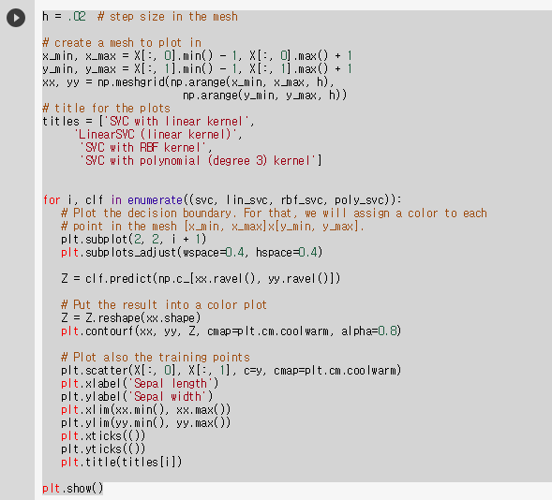
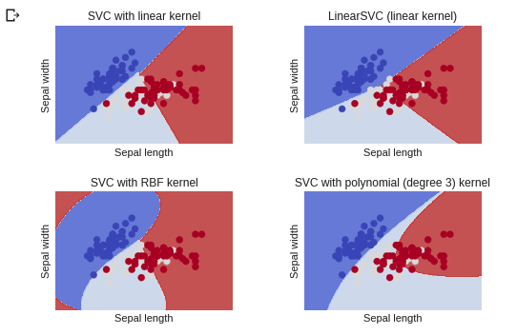
Modeling Different kernel Svm

Slide 7
Modeling Different kernel Svm
h = .02 # step size in the mesh
# create a mesh to plot in
x_min, x_max = X[:, 0].min() - 1, X[:, 0].max() + 1
y_min, y_max = X[:, 1].min() - 1, X[:, 1].max() + 1
xx, yy = np.meshgrid(np.arange(x_min, x_max, h),
np.arange(y_min, y_max, h))
# title for the plots
titles = ['SVC with linear kernel', 'LinearSVC (linear kernel)', 'SVC with RBF kernel', 'SVC with polynomial (degree 3) kernel']
for i, clf in enumerate((svc, lin_svc, rbf_svc, poly_svc)):
# Plot the decision boundary. For that, we will assign a color to each
# point in the mesh [x_min, x_max]x[y_min, y_max].
plt.subplot(2, 2, i + 1)
plt.subplots_adjust(wspace=0.4, hspace=0.4)
Z = clf.predict(np.c_[xx.ravel(), yy.ravel()])
# Put the result into a color plot
Z = Z.reshape(xx.shape)
plt.contourf(xx, yy, Z, cmap=plt.cm.coolwarm, alpha=0.8)
# Plot also the training points
plt.scatter(X[:, 0], X[:, 1], c=y, cmap=plt.cm.coolwarm)
plt.xlabel('Sepal length')
plt.ylabel('Sepal width')
plt.xlim(xx.min(), xx.max())
plt.ylim(yy.min(), yy.max())
plt.xticks(())
plt.yticks(())
plt.title(titles[i])
plt.show()

Slide 8
토론
Scikit learn 홈페이지를 이용하여 SVM의 여러 parameter들을 변경해 보고 결과를 확인해보세요.
첨부된 코드에 나와있는 parameter들을 제외하고 SVM에는 어떤 parameter들이 있었나요?
Scikit learn에서 제공하는 SVM의 여러 함수들에 대해서 알아보세요.

Slide 9
MultiLayerPerceptron
Chapter 02

Slide 10
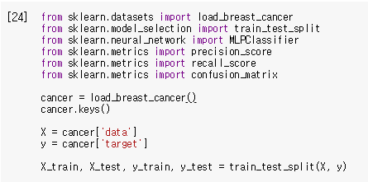
패키지 로드 & 데이터 읽기
from sklearn.datasets import load_breast_cancer
from sklearn.model_selection import train_test_split
from sklearn.neural_network import MLPClassifier
from sklearn.metrics import precision_score
from sklearn.metrics import recall_score
from sklearn.metrics import confusion_matrix
cancer = load_breast_cancer()
cancer.keys()
X = cancer['data']
y = cancer['target']
X_train, X_test, y_train, y_test = train_test_split(X, y)
출처: http://dataaspirant.com/2017/01/25/svm-classifier-implemenation-python-scikit-learn/

Slide 11
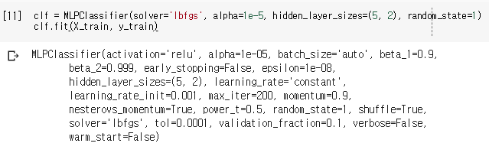
MLP 모델 준비
clf = MLPClassifier(solver='lbfgs', alpha=1e-5, hidden_layer_sizes=(5, 2), random_state=1)
clf.fit(X_train, y_train)

Slide 12
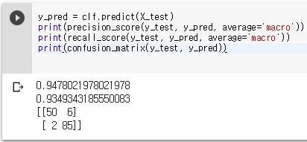
Metric
y_pred = clf.predict(X_test)
print(precision_score(y_test, y_pred, average='macro'))
print(recall_score(y_test, y_pred, average='macro'))
print(confusion_matrix(y_test, y_pred))

Slide 13
해보기
SVM에서 돌렸던 iris dataset을 이용해서 MLP를 학습시켜 보세요.

Slide 14
CNN - MNIST
Chapter 03

Slide 15
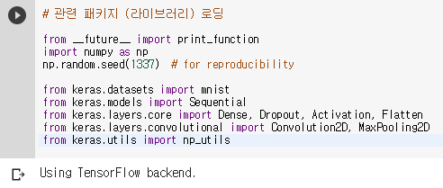
패키지 로드
# 관련 패키지 (라이브러리) 로딩
from __future__ import print_function import numpy as np np.random.seed(1337) # for reproducibility from keras.datasets import mnist from keras.models import Sequential from keras.layers.core import Dense, Dropout, Activation, Flatten from keras.layers.convolutional import Convolution2D, MaxPooling2D from keras.utils import np_utils
출처: http://m.blog.daum.net/goodgodgd/22

Slide 16
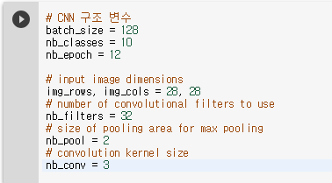
CNN parameter setting
# CNN 구조 변수 batch_size = 128 nb_classes = 10 nb_epoch = 12 # input image dimensions img_rows, img_cols = 28, 28 # number of convolutional filters to use nb_filters = 32 # size of pooling area for max pooling nb_pool = 2 # convolution kernel size nb_conv = 3

Slide 17
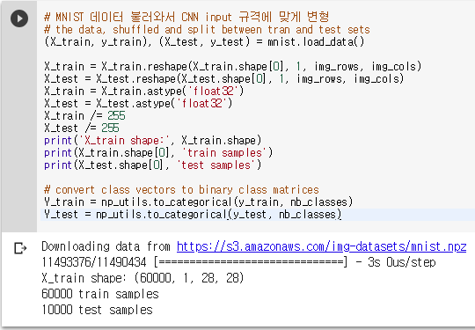
데이터 preprocessing

Slide 18
데이터 preprocessing code
# MNIST 데이터 불러와서 CNN input 규격에 맞게 변형 # the data, shuffled and split between tran and test sets (X_train, y_train), (X_test, y_test) = mnist.load_data() X_train = X_train.reshape(X_train.shape[0], 1, img_rows, img_cols) X_test = X_test.reshape(X_test.shape[0], 1, img_rows, img_cols) X_train = X_train.astype('float32') X_test = X_test.astype('float32') X_train /= 255 X_test /= 255 print('X_train shape:', X_train.shape) print(X_train.shape[0], 'train samples') print(X_test.shape[0], 'test samples') # convert class vectors to binary class matrices Y_train = np_utils.to_categorical(y_train, nb_classes) Y_test = np_utils.to_categorical(y_test, nb_classes)

Slide 19
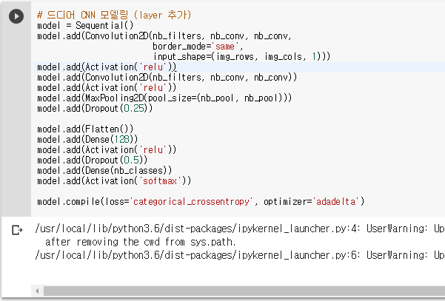
CNN 모델

Slide 20
CNN 모델 code
# 드디어 CNN 모델링 (layer 추가)
model = Sequential()
model.add(Convolution2D(nb_filters, nb_conv, nb_conv,
border_mode='same',
input_shape=(img_rows, img_cols, 1)))
model.add(Activation('relu'))
model.add(Convolution2D(nb_filters, nb_conv, nb_conv))
model.add(Activation('relu'))
model.add(MaxPooling2D(pool_size=(nb_pool, nb_pool)))
model.add(Dropout(0.25))
model.add(Flatten())
model.add(Dense(128))
model.add(Activation('relu'))
model.add(Dropout(0.5))
model.add(Dense(nb_classes))
model.add(Activation('softmax'))
model.compile(loss='categorical_crossentropy', optimizer='adadelta')

Slide 21
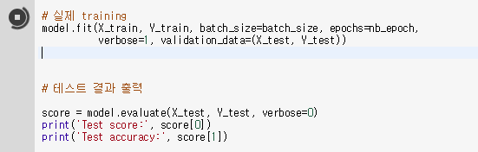
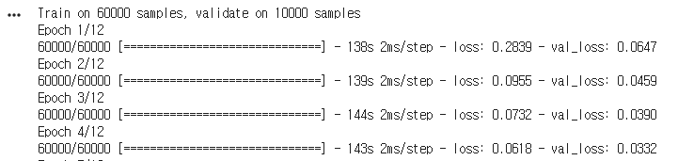
Training & Test
# 실제 training
model.fit(X_train, Y_train, batch_size=batch_size, epochs=nb_epoch,
verbose=1, validation_data=(X_test, Y_test))
# 테스트 결과 출력
score = model.evaluate(X_test, Y_test, verbose=0)
print('Test score:', score[0])
print('Test accuracy:', score[1])

Slide 22
CNN - CIFAR-10
Chapter 04

Slide 23
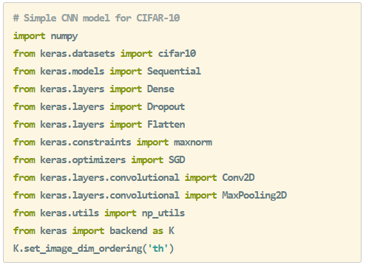
패키지 로드 & 데이터 읽기
# Simple CNN model for CIFAR-10
import numpy
from keras.datasets import cifar10
from keras.models import Sequential
from keras.layers import Dense
from keras.layers import Dropout
from keras.layers import Flatten
from keras.constraints import maxnorm
from keras.optimizers import SGD
from keras.layers.convolutional import Conv2D
from keras.layers.convolutional import MaxPooling2D
from keras.utils import np_utils
from keras import backend as K

Slide 24
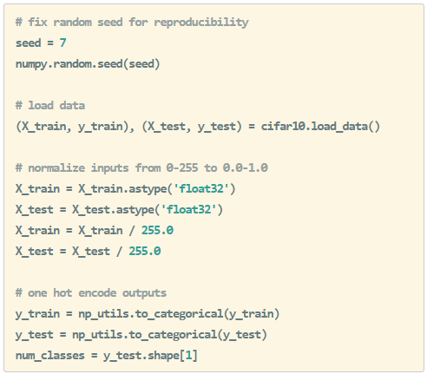
패키지 로드 & 데이터 읽기
# fix random seed for reproducibility
seed = 7
numpy.random.seed(seed)
# load data
(X_train, y_train), (X_test, y_test) = cifar10.load_data()
# normalize inputs from 0-255 to 0.0-1.0
X_train = X_train.astype('float32')
X_test = X_test.astype('float32')
X_train = X_train / 255.0
X_test = X_test / 255.0
# one hot encode outputs
y_train = np_utils.to_categorical(y_train)
y_test = np_utils.to_categorical(y_test)
num_classes = y_test.shape[1]

Slide 25
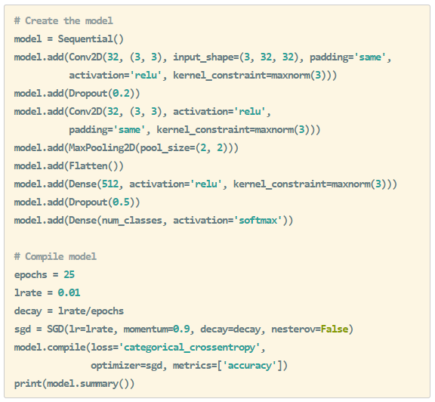
CNN for CIFAR-10
# Create the model
model = Sequential()
model.add(Conv2D(32, (3, 3), input_shape=(32, 32, 3), padding='same',
activation='relu', kernel_constraint=maxnorm(3)))
model.add(Dropout(0.2))
model.add(Conv2D(32, (3, 3), activation='relu',
padding='same', kernel_constraint=maxnorm(3)))
model.add(MaxPooling2D(pool_size=(2, 2)))
model.add(Flatten())
model.add(Dense(512, activation='relu', kernel_constraint=maxnorm(3)))
model.add(Dropout(0.5))
model.add(Dense(num_classes, activation='softmax'))
# Compile model
epochs = 25
lrate = 0.01
decay = lrate/epochs
sgd = SGD(lr=lrate, momentum=0.9, decay=decay, nesterov=False)
model.compile(loss='categorical_crossentropy',
optimizer=sgd, metrics=['accuracy'])
print(model.summary())

Slide 26
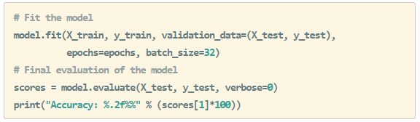
CNN for CIFAR-10 – Evaluation
model.fit(X_train, y_train, validation_data=(X_test, y_test), epochs=epochs, batch_size=32)
# Final evaluation of the model
scores = model.evaluate(X_test, y_test, verbose=0)
print("Accuracy: %.2f%%" % (scores[1]*100))

Slide 27
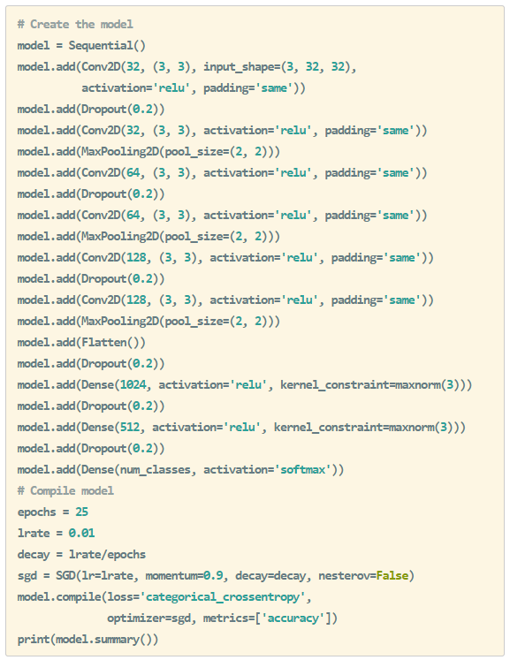
Larger CNN for CIFAR-10
# Create the model
model = Sequential()
model.add(Conv2D(32, (3, 3), input_shape=(32, 32, 3),
activation='relu', padding='same'))
model.add(Dropout(0.2))
model.add(Conv2D(32, (3, 3), activation='relu', padding='same'))
model.add(MaxPooling2D(pool_size=(2, 2)))
model.add(Conv2D(64, (3, 3), activation='relu', padding='same'))
model.add(Dropout(0.2))
model.add(Conv2D(64, (3, 3), activation='relu', padding='same'))
model.add(MaxPooling2D(pool_size=(2, 2)))
model.add(Conv2D(128, (3, 3), activation='relu', padding='same'))
model.add(Dropout(0.2))
model.add(Conv2D(128, (3, 3), activation='relu', padding='same'))
model.add(MaxPooling2D(pool_size=(2, 2)))
model.add(Flatten())
model.add(Dropout(0.2))
model.add(Dense(1024, activation='relu', kernel_constraint=maxnorm(3)))
model.add(Dropout(0.2))
model.add(Dense(512, activation='relu', kernel_constraint=maxnorm(3)))
model.add(Dropout(0.2))
model.add(Dense(num_classes, activation='softmax'))
# Compile model
epochs = 25
lrate = 0.01
decay = lrate/epochs
sgd = SGD(lr=lrate, momentum=0.9, decay=decay, nesterov=False)
model.compile(loss='categorical_crossentropy',
optimizer=sgd, metrics=['accuracy'])
print(model.summary())

Slide 28
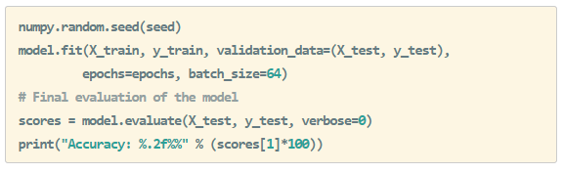
Larger CNN - Evaluation
numpy.random.seed(seed)
model.fit(X_train, y_train, validation_data=(X_test, y_test), epochs=epochs, batch_size=64)
# Final evaluation of the model
scores = model.evaluate(X_test, y_test, verbose=0)
print("Accuracy: %.2f%%" % (scores[1]*100))

Slide 29
토론
제공한 코드의 model 부분에서 activation 부분을 지운 후에 코드를 돌려보세요. 결과가 어떻게 나오나요?
Activation이 어떤 의미를 가지는지에 대해서 생각해 봅시다.
옆 사람과 Dropout의 비율을 달리하여 결과를 비교해보세요.
모델을 원하는 만큼 더 깊게 구성하여보고, 결과를 비교해보세요.

