Slide 1

Lab 2: Playing OpenAI Gym Games
Reinforcement Learning with TensorFlow&OpenAI Gym
Sung Kim <hunkim+ml@gmail.com>

Slide 2
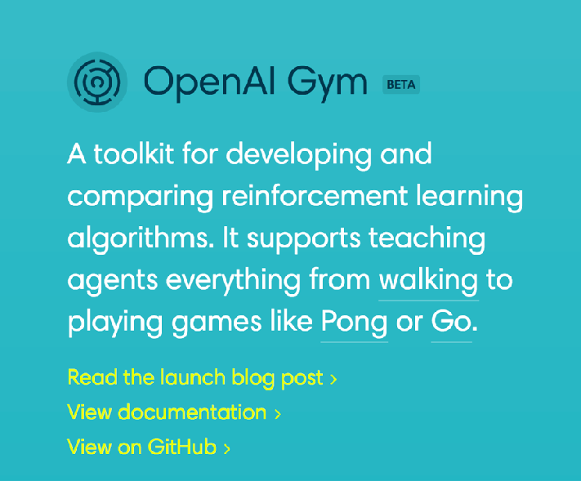
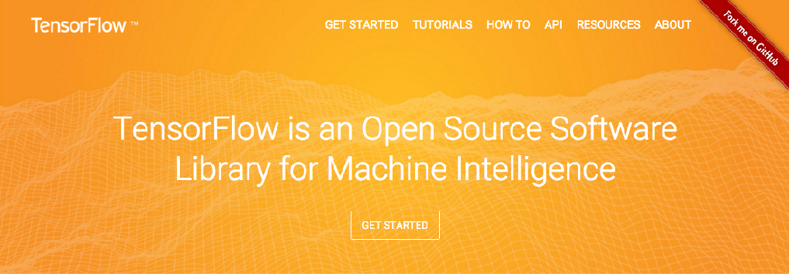
Installation

Slide 3
Basic installation steps
Python 3.x 64bit
TensorFlow
- pip install tensorflow (or pip install tensorflow-gpu)
OpenAI Gym
- pip install gym

Slide 4
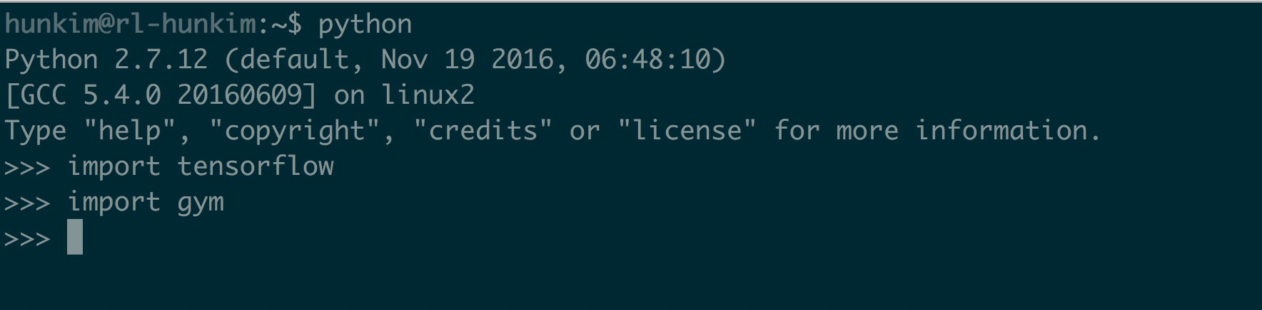
Basic installation - quick checking
Questions: https://www.facebook.com/groups/TensorFlowKR/

Slide 5
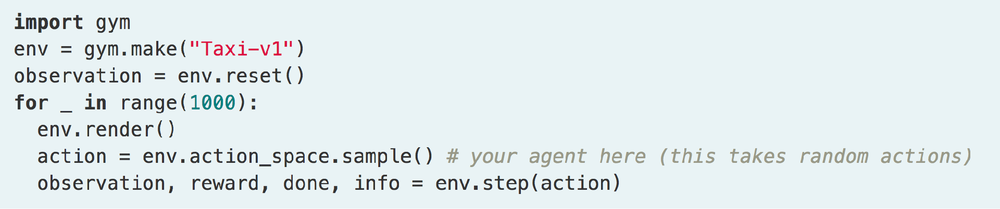
Basic OpenAI Gym Environment
(“FrozenLake-v0”)

Slide 6
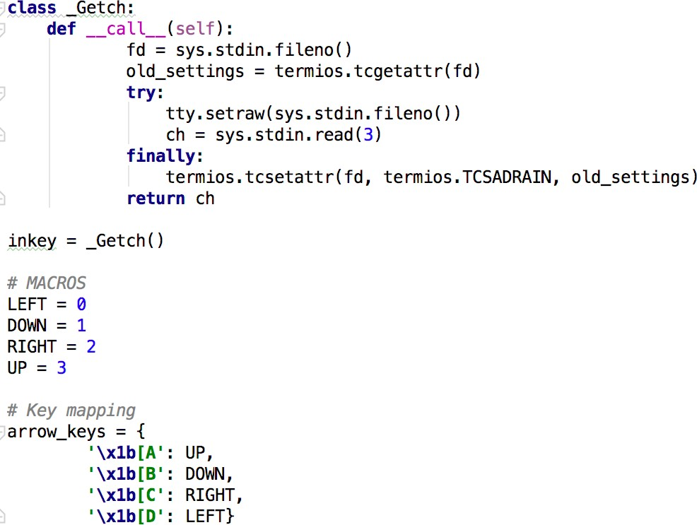
Python arrow keyin

Slide 7

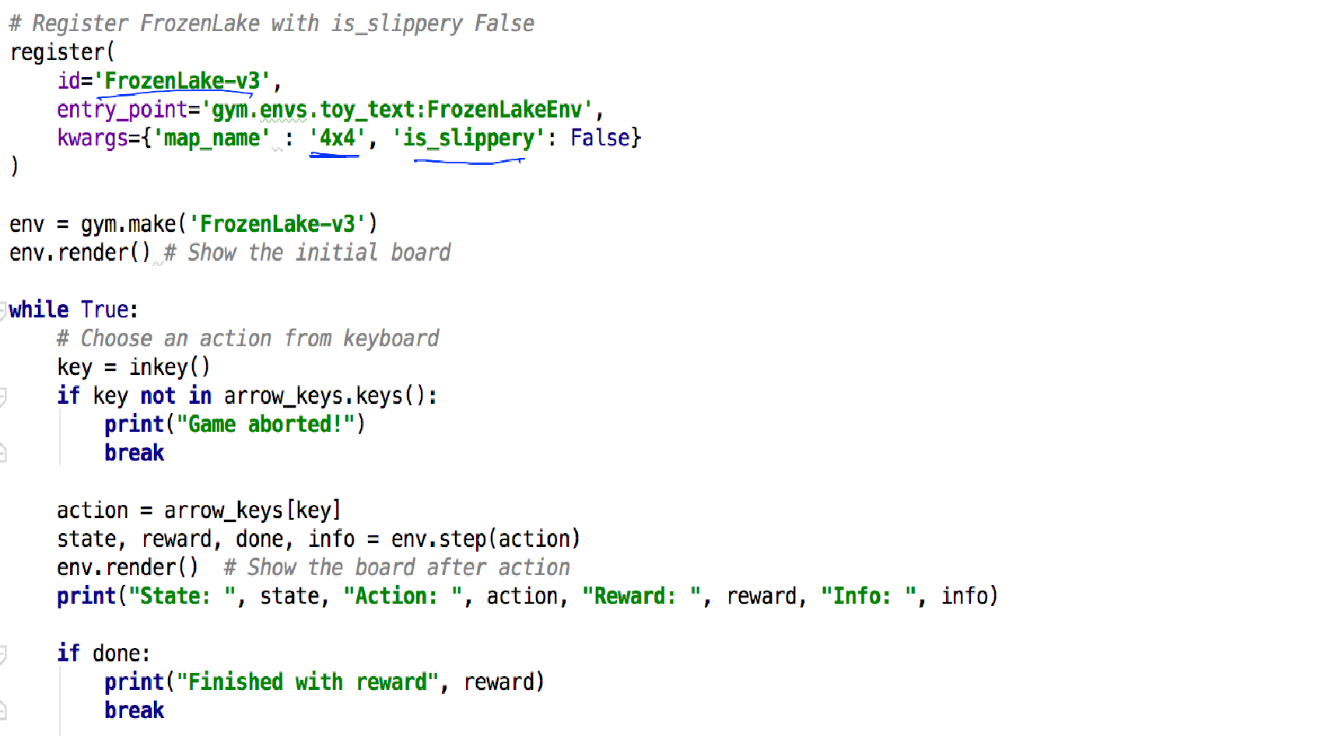
keyin and move

Slide 8
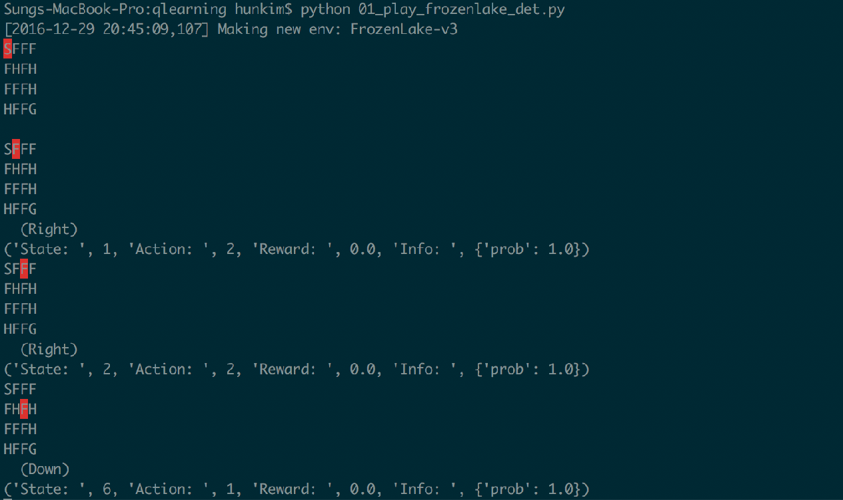
Game play
print("State: ", state, "Action: ", action, "Reward: ", reward, "Info: ", info)
* run in terminal. Keyin does not work in PyCharm!

Slide 9
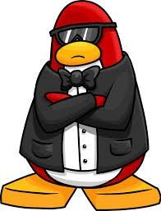
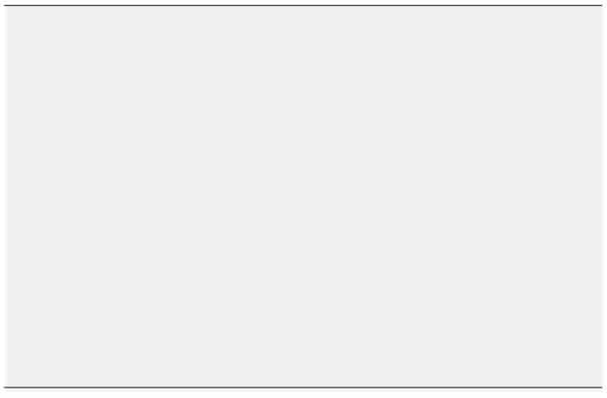



Frozen Lake World (OpenAI GYM)
S | F | F | F
F _{e} | v ^{H}= g | ym^{F}.m | ke^{H}
_{F} (' | roz_{F}en | La_{F}ke- | 3'_{H})
H | F | F | G
(1) env.step(action)
n
a
F
v
(2) state, reward, done, info
Agent
Environment

