Slide 1





Applied
Neurocognitive
Systems

Slide 2
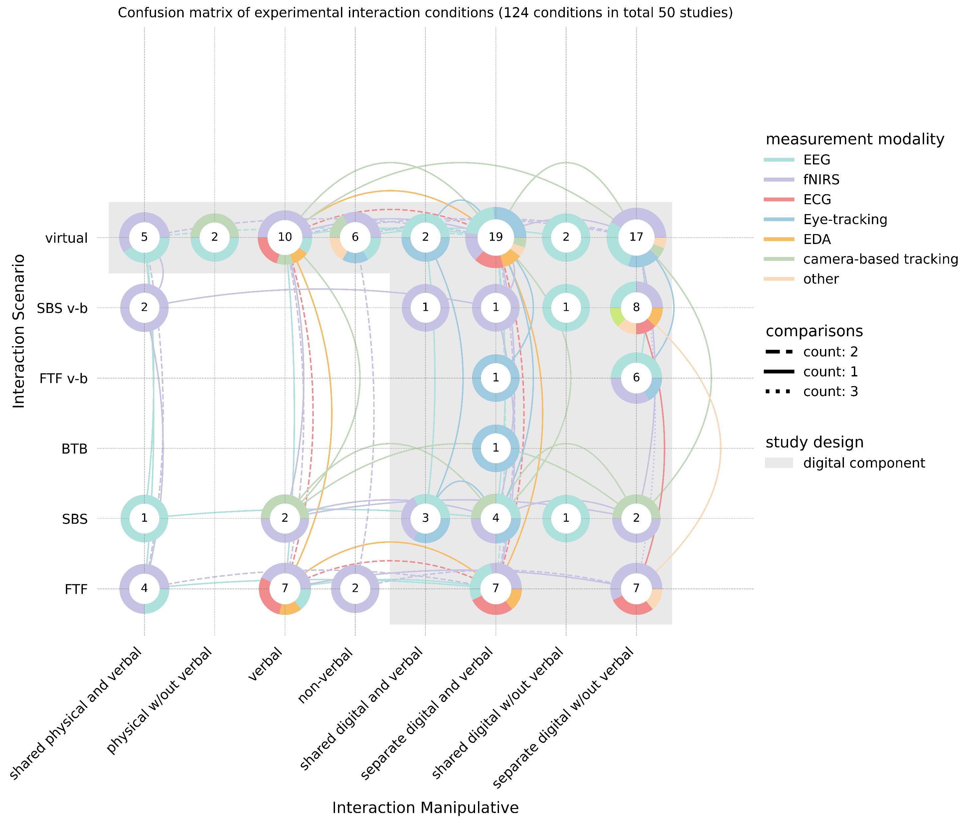
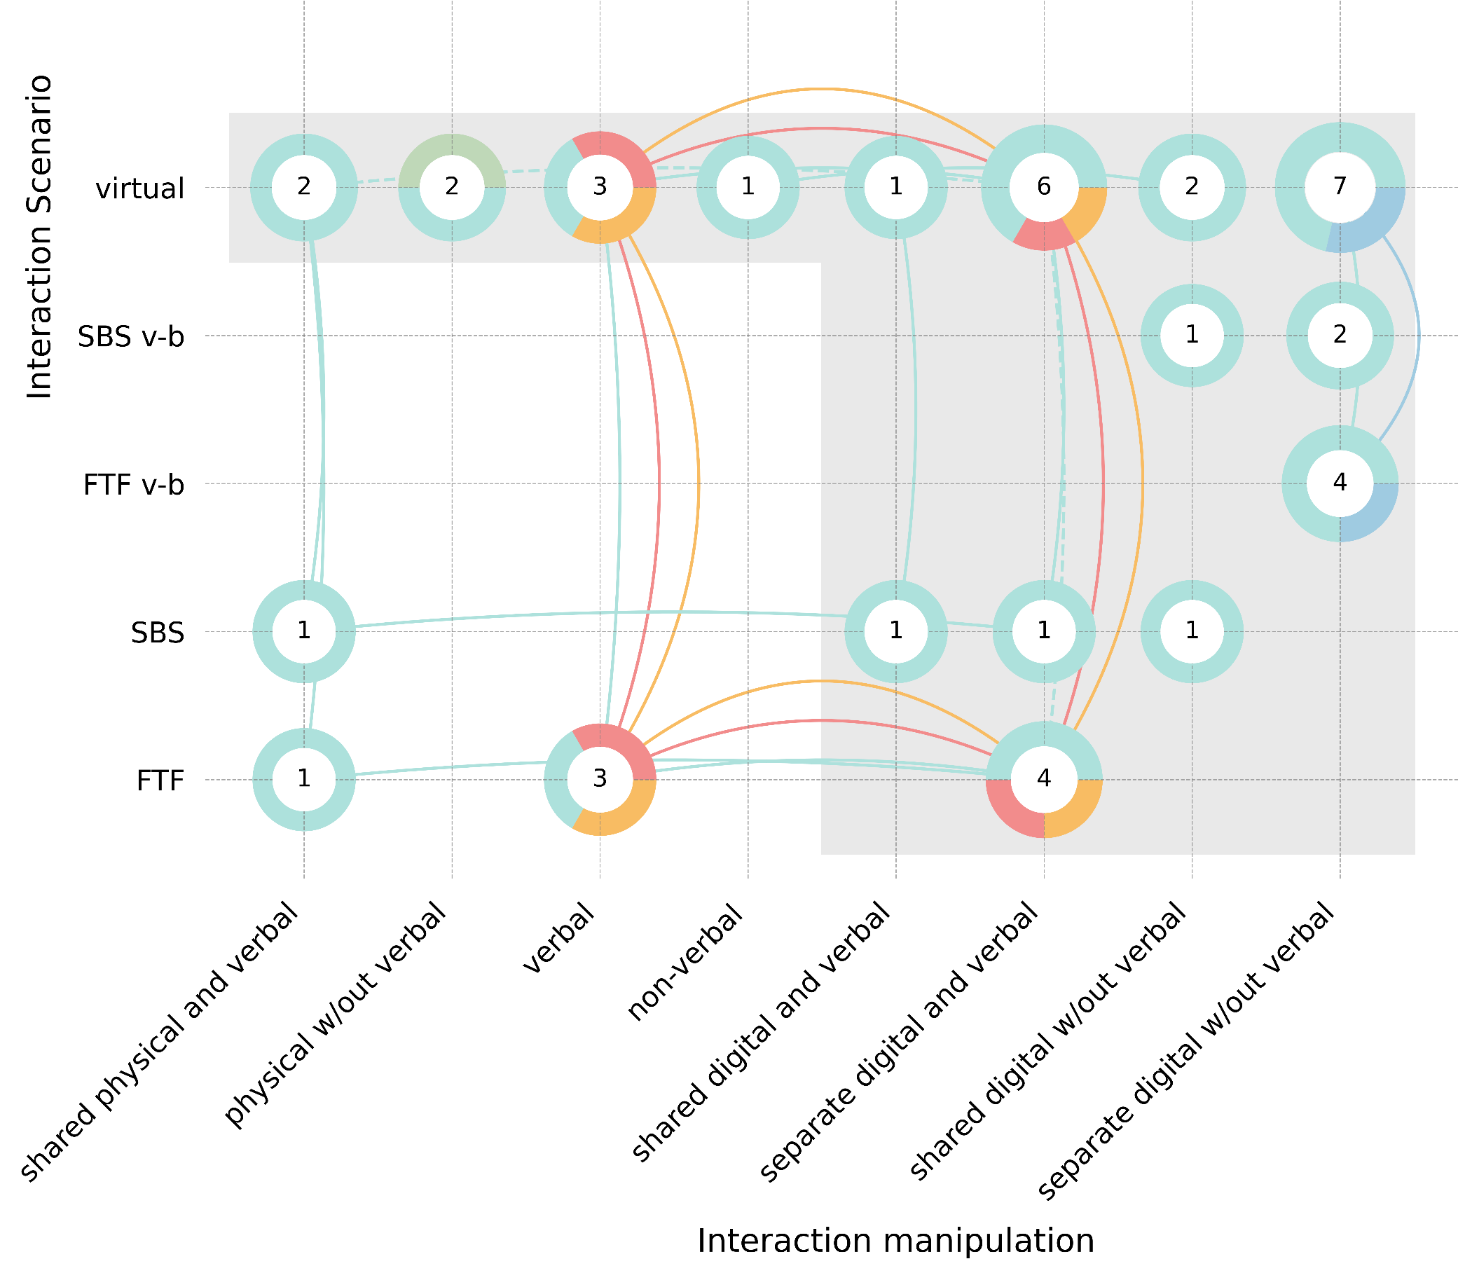
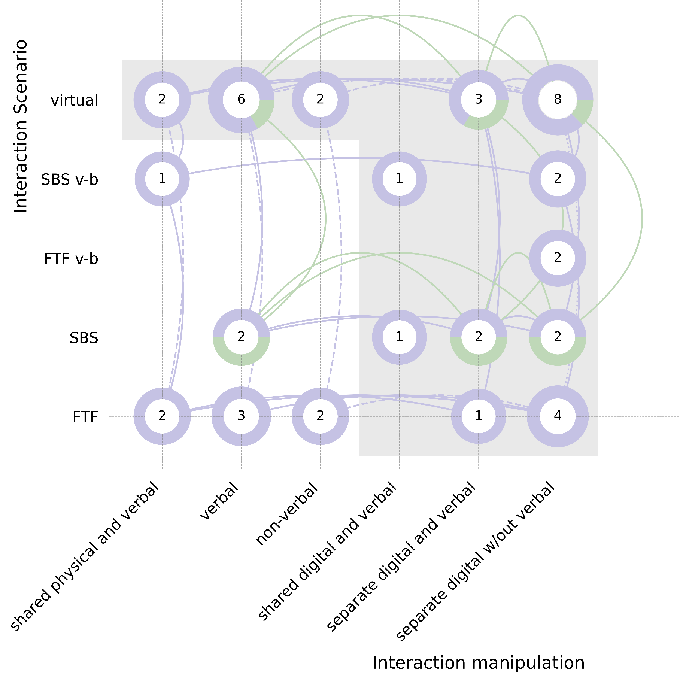
43 hyperscanning conditions of 19 studies
46 hyperscanning conditions of 15 studies

