Slide 1








Applied
Neurocognitive
Systems
Applied
Neurocognitive
Systems
Applied
Neurocognitive
Systems

Slide 2




Slide 3
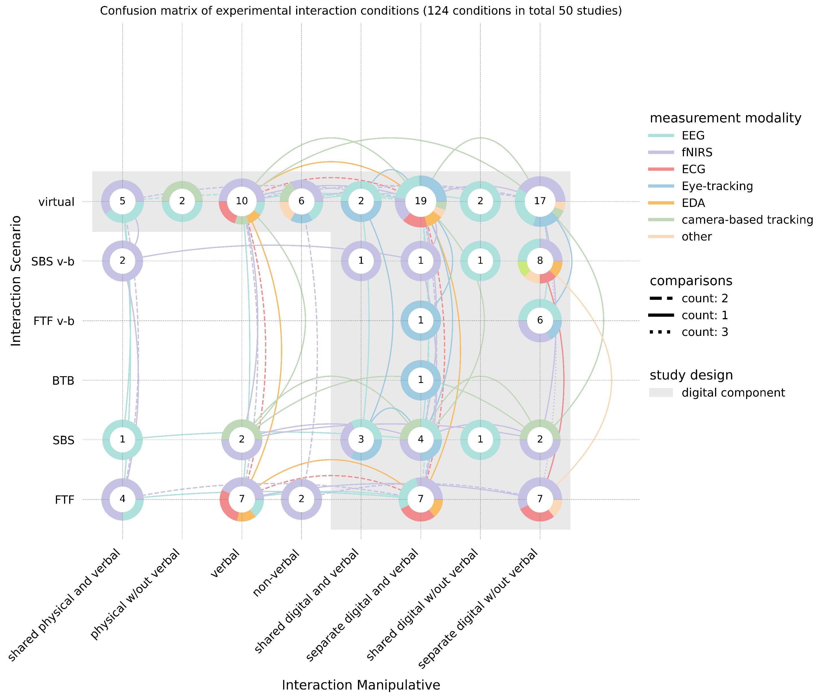
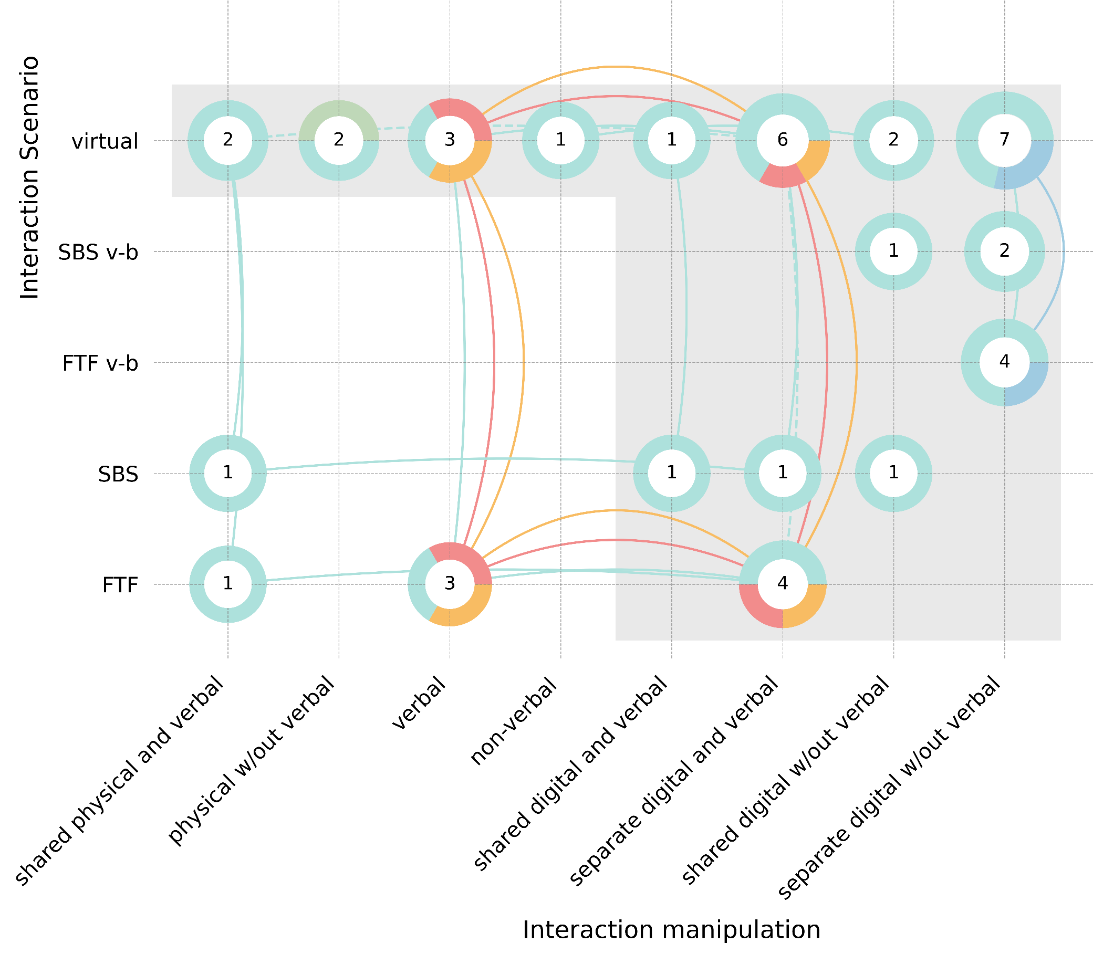
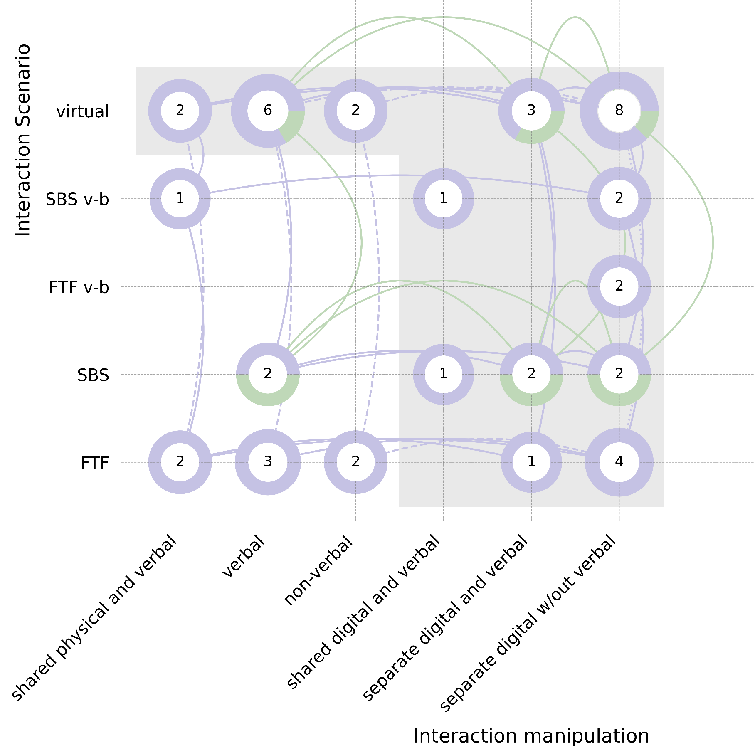
43 hyperscanning conditions of 19 studies
46 hyperscanning conditions of 15 studies

