Slide 1
Quantifying evaporation and tracing Central Texas surface waters with stable isotopes and conductivity
Alexander Van Plantinga¹, Lindsey Hunt¹, Destiny Winning², Elizabeth M. Stockert², Jessica R. Robertson², E. Brendan Roark³, Ethan L. Grossman¹
1. Department of Geology and Geophysics, Texas A&M University, College Station, TX 77843
2. Environmental Programs in Geosciences, Texas A&M University, College Station, TX 77843
3. Department of Geography, Texas A&M University, College Station, TX 77843

Slide 2
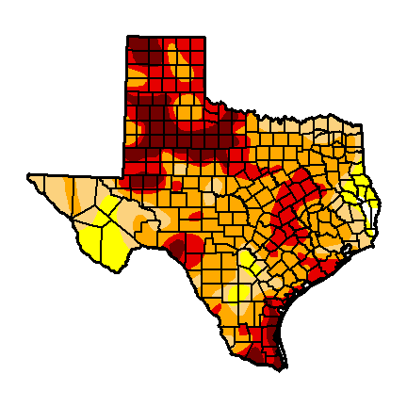
Background
-Problem
-Setting
Methods
Results
-Stable Isotopes
-Dissolved Ions
Discussion
-Stable Isotope Hydrology
-Brazos River Ions Sources
Texas Drought
Precipitation deficit,
July 9, 2013
(US Drought Monitor)
from John Nielsen-Gammon
Notes:
Currently, Texas drought is a major problem for state water management

Slide 3
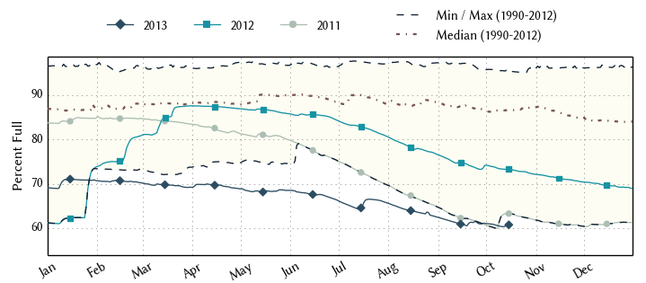
Brazos River Basin Reservoirs
Background
-Problem
-Setting
Methods
Results
-Stable Isotopes
-Dissolved Ions
Discussion
-Stable Isotope Hydrology
-Brazos River Ions Sources
From: Water Data for Texas (http://www.waterdatafortexas.org/reservoirs/basin/brazos)
Notes:
Brazos River is largest in Texas. From 2011 to today reservoir levels are decreasing

Slide 4
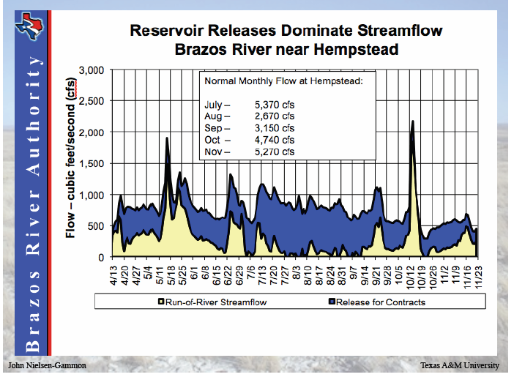
Background
-Problem
Methods
Results
-Stable Isotopes
-Dissolved Ions
Discussion
-Stable Isotope Hydrology
-Brazos River Ions Sources
Credit :
Notes:
In the Brazos watershed, reservoirs release water to meet contractual obligations (hydro-electricity, industrial demand), and the effect is most pronounced in the summer

Slide 5
Objectives
Characterize seasonal variations in the degree of evaporation of Brazos River (BR) waters
Compare BR and Navasota River (NR) watersheds by their stable isotope trends
Characterize seasonal variations in water sources in the BR

Slide 6
Lake Whitney
Setting
enlarged area
Bosque-Waco drainage
Lake Limestone
Brazos River
Little River
Navasota River
BCS
30 km
Sampling Location
gage
Alluvium Aquifer
Notes:
Revise graphic for PowePoint

Slide 8
Run of River Conceptual Model
Evaporation
College
Station
Whitney
Lake Whitney
Lake Waco
Brazos River
Outflow
Little River
Alluvial Aquifer
Local runoff
Notes:
Main processes influencing water in the central run of the Brazos River are dam-releases, surface-groundwater interaction, and evaporation

Slide 9
Methods
From January 2012 to July 2013 collect waters from sampling locations
Sample Lake Whitney at 5 m depth intervals with Niskin bottle at three locations (August 3, 2012)
Measure conductivity, temperature, and pH of waters in the field
Refrigerate water samples at 10˚C and filter using 0.45 µm glass fiber filters.
Measure δ¹⁸O and δD relative to VSMOW using a Picarro L2120i cavity ringdown spectrometer at the Stable Isotope Geoscience Facility at Texas A&M University
Report in delta notation: δ_{sample}= (R_{sample} - R_{standard}) / (R_{standard}) – 1000, where R is ¹⁸O/¹⁶O or D/H and the standard is Vienna Standard Mean Ocean Water (VSMOW).
Two working standards (JGULF, δ¹⁸O = 1.10‰ and δD = 7.4‰ and KONA, δ¹⁸O = -6.80‰ and δD = -48.0‰)
Precision was ± 0.08 and ± 0.4‰ for δ¹⁸O and δD respectively.

Slide 10
Water Stable Isotopes, General Trends
Arid vapor source
MWL
Humid vapor source
warmer, lower latitude or altitude, coastal
δD versus δ¹⁸O
Meteoric water line (MWL)
Evaporative trend
Ocean Water
more humid
Evaporative loss from rivers, reservoirs, lakes
δD ‰ VSMOW
cooler, higher latitude or altitude, inland
more arid
δ¹⁸O ‰ VSMOW
http://www.sahra.arizona.edu/programs/isotopes/oxygen.html

Slide 11
Brazos River δ¹⁸O vs. δD in 2012
Linear evaporation trend from Winter to Spring to Summer
Fall and Spring overlap with lower and higher extremes of Summer and Winter, respectively
Fall
Summer
Spring
Winter

Slide 12
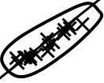
Lake Whitney and Brazos River δ¹⁸O vs. δD in 2012
The trend is both an evaporation and a mixing trend
Lake Whitney,
Aug 3, 2012

Slide 13
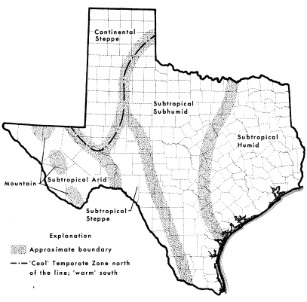
δ¹⁸O vs. δD for the Brazos River and Navasota River and for Lake Whitney
-4.6 ‰
Subtropical Subhumid
Subtropical Humid
BR
-5.3 ‰
NR
Larkin and Bomar (1983)
Continental Steppe
Sub-tropical humid
Sub-tropical humid
Larkin and Bomar (1983)

Slide 14
Notes:
August 2 and 6 .. Plot oxbow lake data

Slide 15
Run of River Conceptual Model
Evaporation
College
Station
Whitney
Lake Whitney
Lake Waco
Brazos River
Outflow
Local runoff
Little River
Alluvial Aquifer
Notes:
Main processes influencing water in the central run of the Brazos River are dam-releases, surface-groundwater interaction, and evaporation

Slide 16
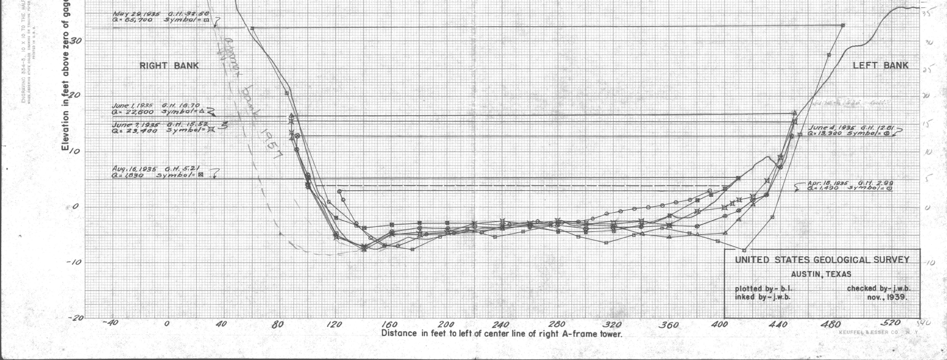
How much water can evaporate in the Brazos River itself? Use a simple mass-balance model:
Treat the river as a lake with uniform dimensions
Volume and residence time depends on discharge (USGS)
Use E-P data to estimate % Evaporation (TWDB)
Estimate the change in δ¹⁸O (fractionation, ε) from evaporation
L = 180 miles
A = 48.79*Q^{0.4996}
W = 137.05*Q^{0.1004}

Slide 17
How much water can evaporate in the Brazos River itself? Use a simple mass-balance model:
Treat the river as a lake with uniform dimensions
Volume and residence time depends on discharge (USGS)
Use E-P data to estimate % Evaporation (TWDB)
Estimate the change in δ¹⁸O (fractionation, ε) from evaporation
L = 180 miles
A = 48.79*Q^{0.4996}
W = 137.05*Q^{0.1004}

Slide 18
Month, 2012 | Avg. Daily Discharge (cfs) | E-P (ft/mo.) | Surface Area (acres) | Storage Vol. (acre-ft.) | Max Res Time (mo.) | Max % Evap. | Δδ¹⁸O ‰
June | 592 | 0.58 | 5676 | 25829 | 0.7 | 6.2 | 0.83
July | 844 | 0.56 | 5882 | 30840 | 0.6 | 3.9 | 0.52
August | 766 | 0.66 | 5824 | 29375 | 0.6 | 5.3 | 0.71
September | 1211 | 0.52 | 6099 | 36940 | 0.5 | 2.2 | 0.29
October | 661 | 0.37 | 5739 | 27292 | 0.7 | 3.6 | 0.48
November | 229 | 0.37 | 5160 | 16075 | 1.2 | 16.1 | 2.28
December | 264 | 0.21 | 5234 | 17252 | 1.1 | 7.5 | 1.01
Low Flow, High E-P | 140 | 0.88 | 4911 | 12570 | 1.5 | 50.9 | 9.30
Notes:
This table shows the input and output for our simple mass balance model. It shows how the interplay between discharge and E-P can determine percent evaporation and d18O enrichment. Max E-P was 10.52 in for Aug 1993.

Slide 19
Alluvium Aquifer water may have provided significant contributions to river flow during Fall 2012
2 ‰
Alluvium aquifer data from this study and from Chowdhury et al. (2010)
Notes:
August 2 and 6 .. Plot oxbow lake data

Slide 21
Summary and Conclusions
BR flow in JFM is dominated by runoff.
The BR watershed is more arid and has a lower average rain δ¹⁸O than the NR watershed.
LW contributions to BR flow in JAS increases conductivity, but other high δ¹⁸O waters dilute these.
BR probably received the greatest proportion of flow from the Alluvium Aquifer in OND in 2012.
Notes:
Remove abbreviations

Slide 22
Acknowledgements
The presenter would like to thank for their assistance (A-Z) Lauren Graniero, Chris Higgins, Chris Maupin, Gretchen Miller, Clyde Munster, John Nielsen-Gammon, Andy Roark, John Robbins, Brock Shenton, Jason West, Ralph Wurbs

Slide 23
References
Chowdhury, A., Osting, T., Furnans, J., Mathews, R. 2010. Groundwater-Surface Water Interaction in the Brazos River Basin: Evidence from Lake Connection History and Chemical and Isotopic Compositions. Texas Water Development Board, Report 375, August 2010.
Cronin, J., and Wilson, C. 1967. Ground Water in the Flood-Plain Alluvium of the Brazos River, Whitney Dam to Vicinity of Richmond, Texas. Texas Water Development Board, Report 41.
Larkin, T., Bomar, G. 1983. Climatic Atlas of Texas. Texas Department of Water Resources, LP-192.
Munster, C., Mathewson, C., Wrobleski, C. 1996. The Texas A&M University Brazos River Hydrogeologic Field Site. Environmental & Engineering Geoscience, vol. II, No. 4, pp. 517-530.
Rawson, J. 1967. Study and Interpretation of Chemical Quality of Surface Waters in the Brazos River Basins, Texas. Texas Water Development Board, Report 55.
Shah, S., Houston, N., Braun, C. 2007. Hydrogeologic Characterization of the Brazos River Alluvium Aquifer, Bozque County to Fort Bend County, Texas. USGS Scientific Investigations Map 2989.
Wurbs, R., Lee, C. 2009. Salinity Budge and WRAP Salinity Simulation Studies of the Brazos River/Reservoir System. Technical Report No. 352, Texas Water Resource Institute, Texas A&M University System.

Slide 24
Notes:
August 2 and 6 .. Plot oxbow lake data

Slide 25
δ¹⁸O vs. δD for the Brazos River and Navasota River and for Lake Whitney

Slide 26
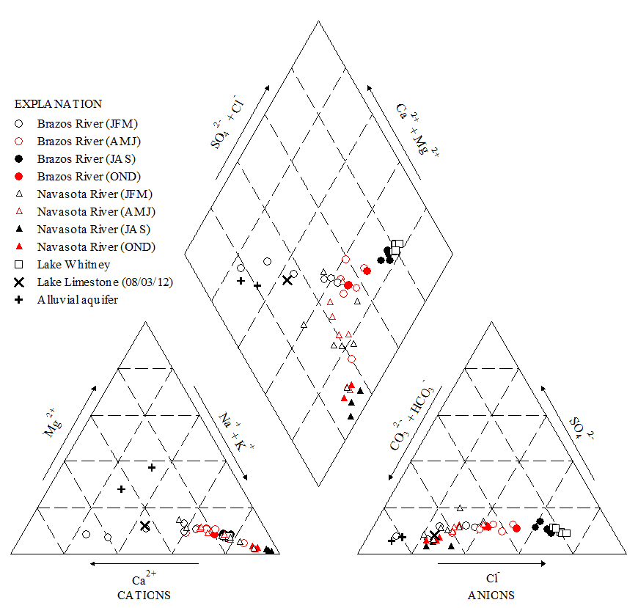

Slide 33
Background
Methods
Results
-Stable Isotopes
-Dissolved Ions
Discussion
-Stable Isotope Hydrology
-Brazos River Ions Sources

