Slide 1
Humidity Sensor April 2014

Slide 2
Outline
An Humidity introduction
TI Humidity solution
Humidity Sensing application
Humidity sensing competition
HDC1000/HDC1050
Package description
Roadmap
EVM Description
EVM GUI description
Summary

Slide 3
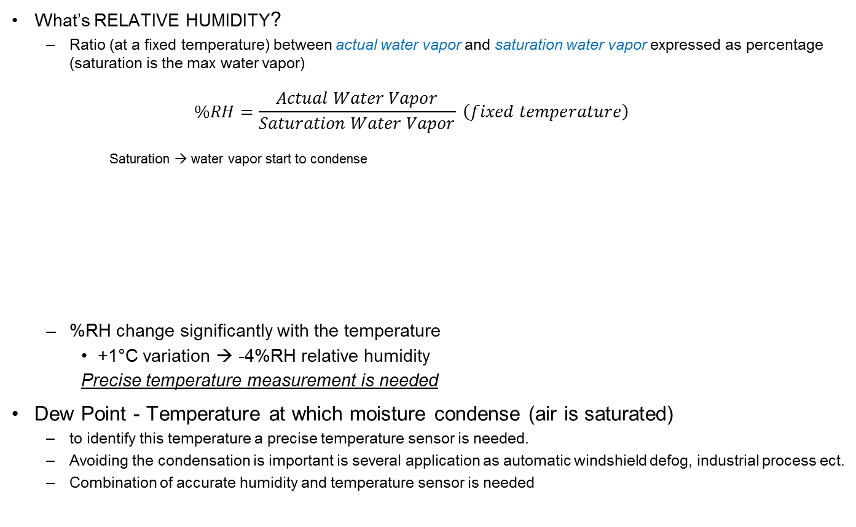
An Introduction to Humidity
What’s RELATIVE HUMIDITY?
Ratio (at a fixed temperature) between actual water vapor and saturation water vapor expressed as percentage (saturation is the max water vapor)
$$\%RH=\frac{Actual Water Vapor}{Saturation Water Vapor} \left(fixed temperature\right)$$
Saturation → water vapor start to condense
%RH change significantly with the temperature
+1°C variation → -4%RH relative humidity
Precise temperature measurement is needed
Dew Point - Temperature at which moisture condense (air is saturated)
to identify this temperature a precise temperature sensor is needed.
Avoiding the condensation is important is several application as automatic windshield defog, industrial process ect.
Combination of accurate humidity and temperature sensor is needed
Water Vapor
Water

Slide 4
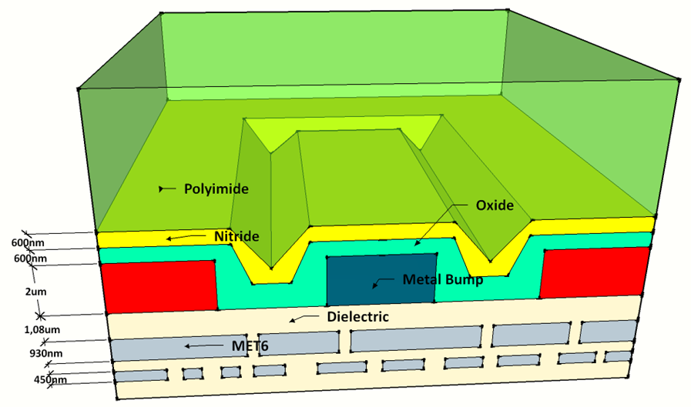
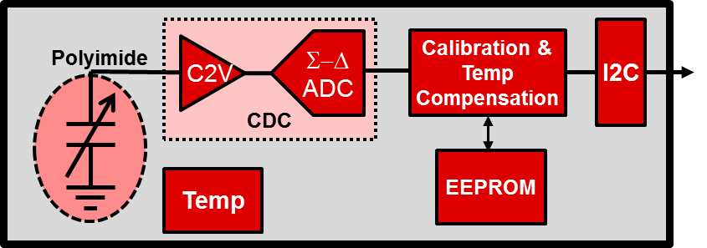
TI’s Humidity Sensing Solution
Polyimide
Working Principles
Fringe capacitance changes as water is absorbed/desorbed by polyimide
Metal
Metal
Implementation
Sensor is integrated using standard technology
(sensor cross-section)
Polyimide
Upper metal layer
Block diagram
Readout electronics converts cap value variation into RH value

Slide 5


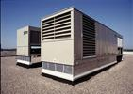
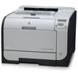

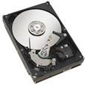
Humidity Sensing Applications
Automotive
HVAC, fog detection
White goods
Washer, microwave, dryer, dishwasher, refrigerator
HVAC
Building control
Printers
Modify print speed
Mobile devices
Remote weather station, sports/exercise, health, Humidifier
HDD
Adjust physical parameters to maximize performance (e.g., head height)

Slide 6
HDC Competition
Company | TI | COMP A | COMP B | COMP C | COMP D
Size (mm) | 1.59 x 2.04 3x3 | 3x3 | 2x2 | 3x3 | 2x2
Package | WCSP-8 / DFN-6 | DFN-6 | DFN-4 | DFN-6 | LGA-6
V_{DD} (V) | 2.7 ÷ 5.5 | 2.1 ÷ 3.6 | 1.62 ÷ 1.98 | 1.9 ÷ 3.6 | 1.71 ÷ 3.6
Resolution Max (%RH) | 14-bit | 12-bit | 12-bit | 12-bit | 16-bit
Isupply @ 1/s ( Hum+Temp 11bit resolution) (uA) | 1.1 | 6.5 | 4.8 | 1.1 | 2.0
Accuracy (%RH) | ±2 | ±3 // ±2 // ±1.8 | ±5 | ±4 // ±3 | ±3
Temp acc (degC) | ±0.5 | ±0.45 | ±0.5 | ±0.4 | ±1
Operating Range (%RH) | 0 – 100 | 0 – 100 | 0 – 100 | 0 – 100 | 0 – 100
Interface | I2C | SPI / I2C / PWM | I2C | I2C | I2C/SPI
Operating Range (degC) | -40 to +125 | -40 to +125 | -30 to +100 | -40 to +125 | -25 to +85
TI Values
Smallest Size with WCSP 2. Lowest Power 3. High accuracy

Slide 7
HDC1000/1050 Humidity & Temperature Sensor
Features
Benefits
Relative Humidity Range 0% to 100%
Humidity Accuracy ±2%
Typical Drift < 0.5%/yr
Supply Current (Measuring) 180uA
Avg Supply Current (@1sps) 1.1uA
Temperature Accuracy ±0.5ºC
Temperature Range (Operating) -20ºC to +85ºC
Temperature Range (Functional) -40ºC to +125ºC
Operating Voltage 3V to 5V
Package
8 pin WCSP HDC1000 (1.59mm x 2.04mm)
6 pin DFN HDC1050 (3mm x 3mm)
Completely integrated humidity and temperature IC provides guaranteed performance
Fully calibrated sensor enables quick time-to-market
Very low power consumption
Small package size supports compact designs
CDC
Calibration & Temp Compensation
I2C
Polyimide
C2V
Σ−Δ
ADC
Applications
HVAC
White goods (dryer, fridge, microwave, dishwasher)
Printers
Handheld Meters
Camera Defog
Smart Thermostats and Room Monitors
Medical Devices
Temp
EEPROM
HDC1000 Samples : now – RTM July
HDC1050 Samples: Q2’14– RTM November

Slide 8
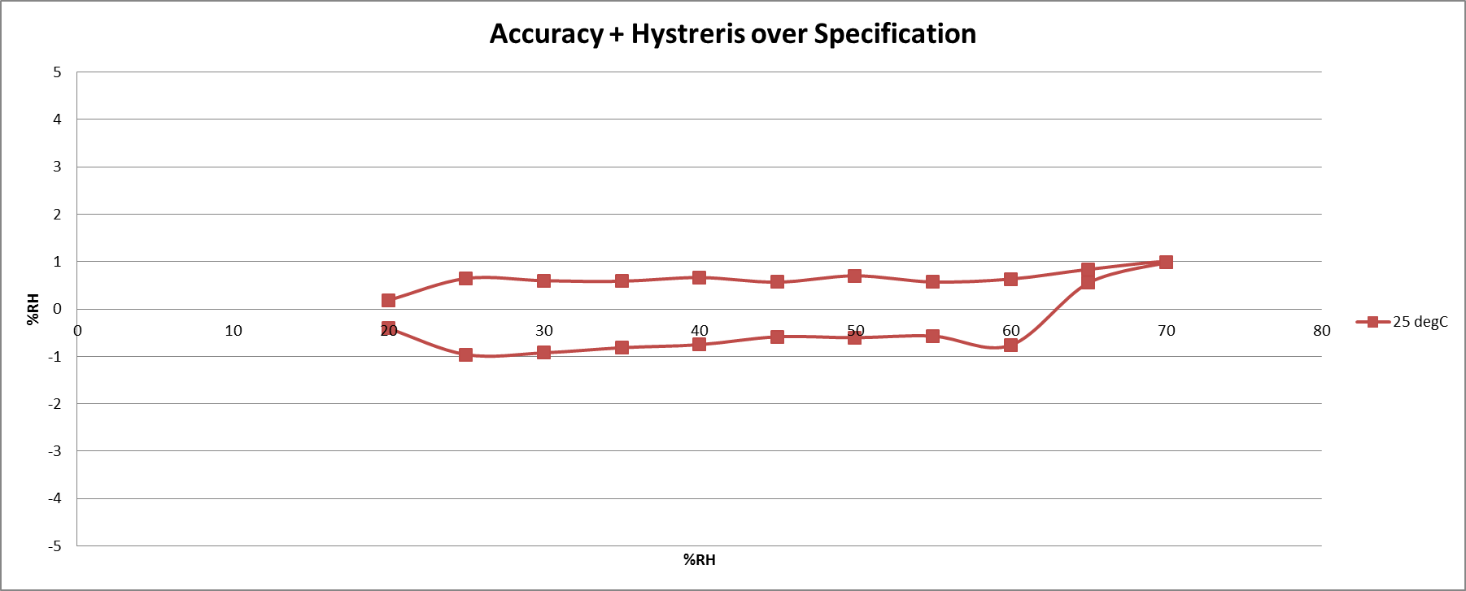
HDC1000 Humidity accuracy @ 25 °C
Limit
Spec
Limit
Spec
* Typical value

Slide 9
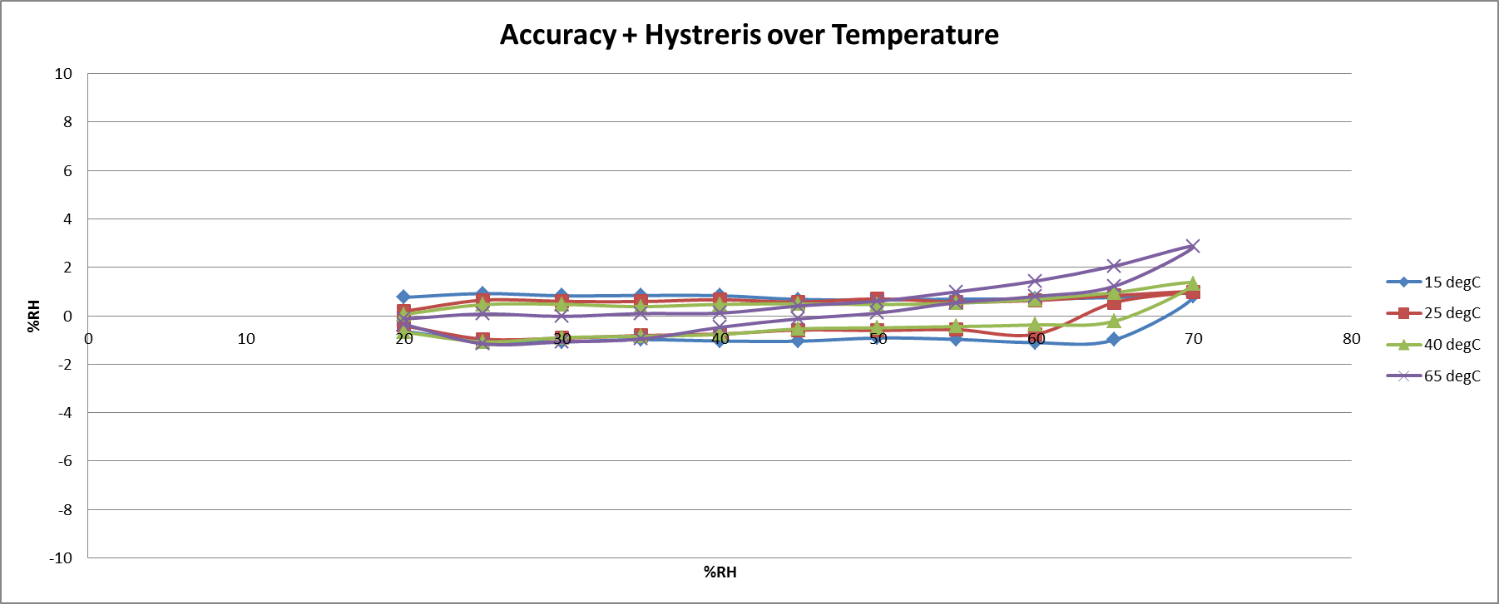
HDC1000 Humidity accuracy over temperate
Main competitor
performances
* Typical value

Slide 10
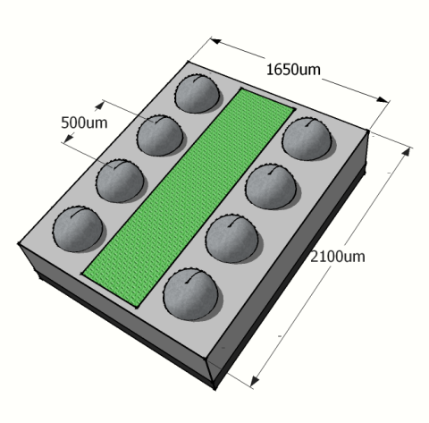
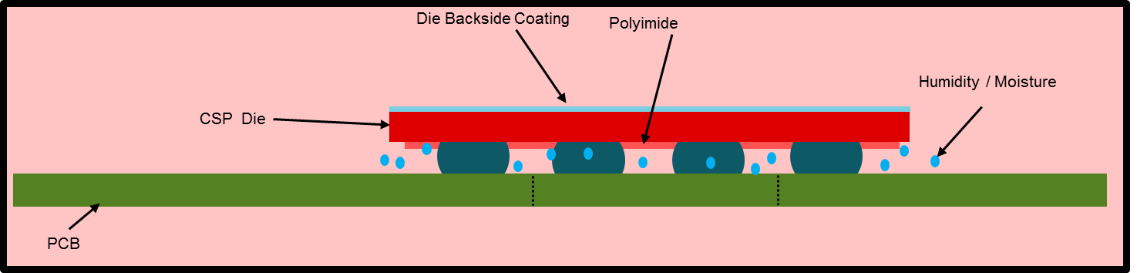
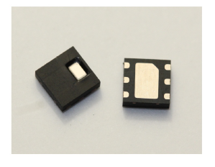
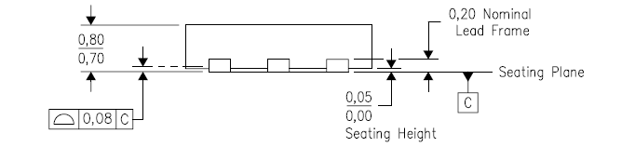
Packages Descriptions
HDC1000: 8-WCSP
3.00
3.00
HDC1050 – 6-DFN

Slide 11
Humidity Sensing Roadmap Sample Dates
HDD
Automotive
HDC1000-Q
2.7-5.5V
WCSP-8
Special
Application
HVAC
White Goods Printers
HDC1000
2.7-5.5V
WCSP-8
HDC2000
1.8V
WCSP 8
New 1.8-V core
High (+/-2%)
HDC1050
2.7-5.5V
DFN-6
HDC2050
1.8V
DFN-6
RH Accuracy
Down-spec
Down-Spec
Mobile Devices
Battery application
HDC1010
2.7-5.5V
WCSP-8
HDC2010
1.8V
WCSP-8
Low (+/-5%)
2014
2015
Legend
Sampling
Planned
Definition
Concept

Slide 12
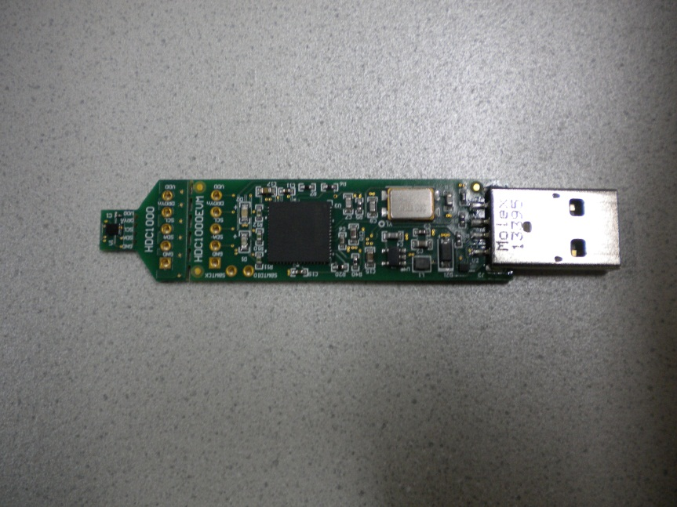
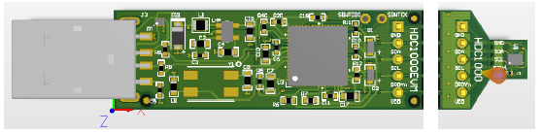
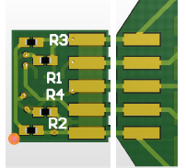
HDC1000 EVM
EVM HDC1000
EVM is pre-cut to enable the customer to separate the HDC1000 from the main board and better place the sensor using a simple 5 wires connection
1st Pre-cut
2nd Pre-cut

Slide 13
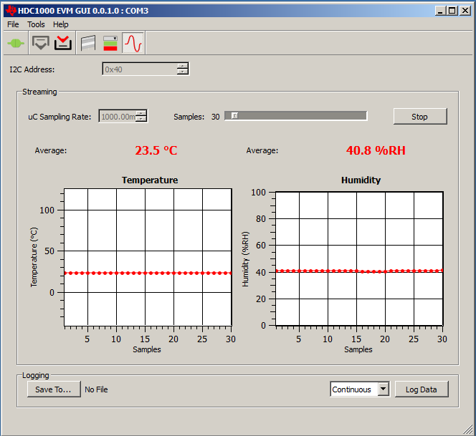
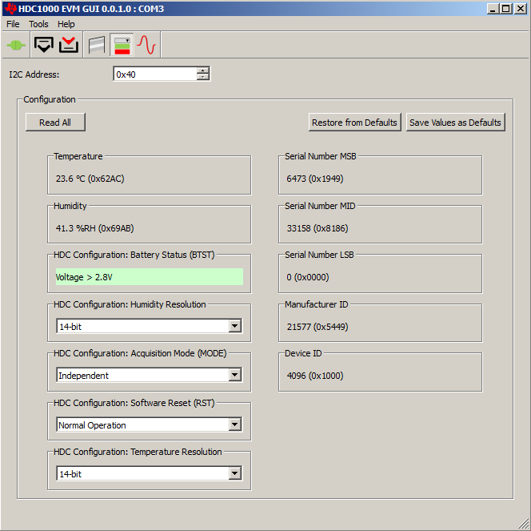
EVM GUI interface
µC Sampling Rate
Humidity and temperature
File data log
Devices Settings

Slide 14
Summary
Humidity Sensor is used in several application
Printer, Defog, HVAC, Dryer, Refrigerator, Weather Station, humidifier, etc.
HDC1000/HDC1050
High accuracy, extremely low power consumption and small footprint
HDC1000: RTM July 2014
HDC1050: RTM November 2014
EVM and GUI
HDC1000 available
HDC1050 available Q2’14

Slide 15
Thanks

