Slide 1
Project 4
Credit Risk
2024
Date:
$
DOLLARS
Group 2: Aaron, Karel, Mor, Whitney
Group two
12345678
12345678
12345
Authorized Signature

Slide 2
ABOUT
The Credit Risk Assessment Dataset provides a comprehensive collection of anonymized data designed for the analysis and prediction of credit risk. This dataset encompasses various attributes related to individuals' financial profiles, aiming to facilitate the development and evaluation of predictive models for assessing creditworthiness.
Containing a diverse range of features including demographic information, credit history, loan characteristics, and other relevant financial indicators, this dataset offers a rich resource for exploring patterns and relationships crucial for effective risk management in lending practices.
Notes:
https://www.kaggle.com/datasets/laotse/credit-risk-dataset?resource=download

Slide 3
PROJECT OVERVIEW
The objective of this project is to develop an automated credit score classification system using deep learning and machine learning techniques to predict creditworthiness accurately. We hope this project will help financial institutions make more informed lending decisions. Stakeholders can gain insights into factors influencing credit risk and develop robust models to enhance decision-making processes that ultimately contributes to a more effective risk management strategy and improved financial outcomes.

Slide 4
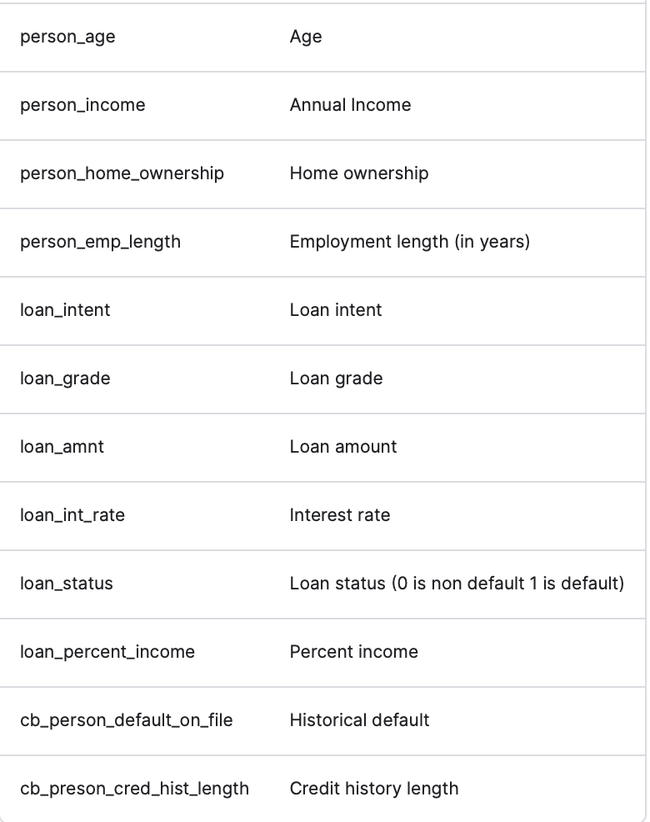
Data Card
Key Features:
Demographic Information: Age, gender, marital status, etc.
Financial History: Credit scores, past delinquencies, bankruptcy history, etc.
Loan Characteristics: Loan amount, term, interest rate, type of loan, etc.
Employment Details: Occupation, income level, employment history, etc.
Additional Attributes: Asset ownership, debt-to-income ratio, repayment behavior, etc.

Slide 5
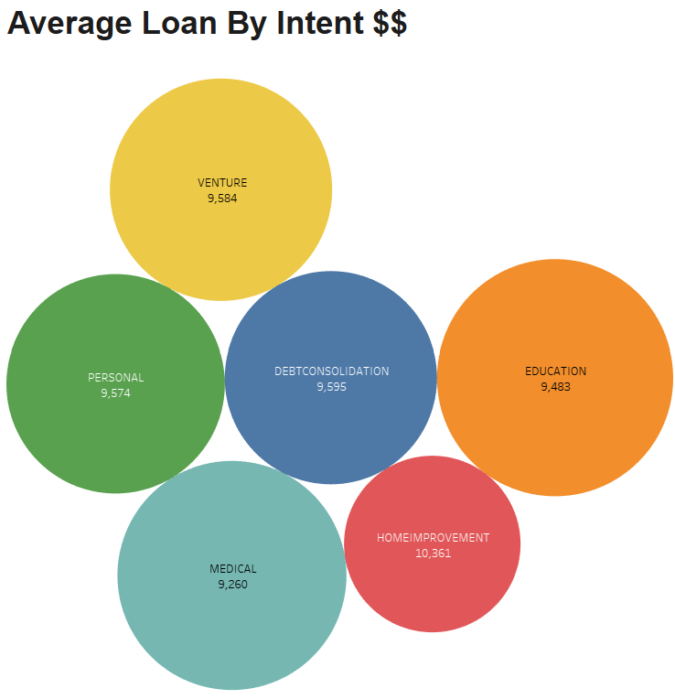
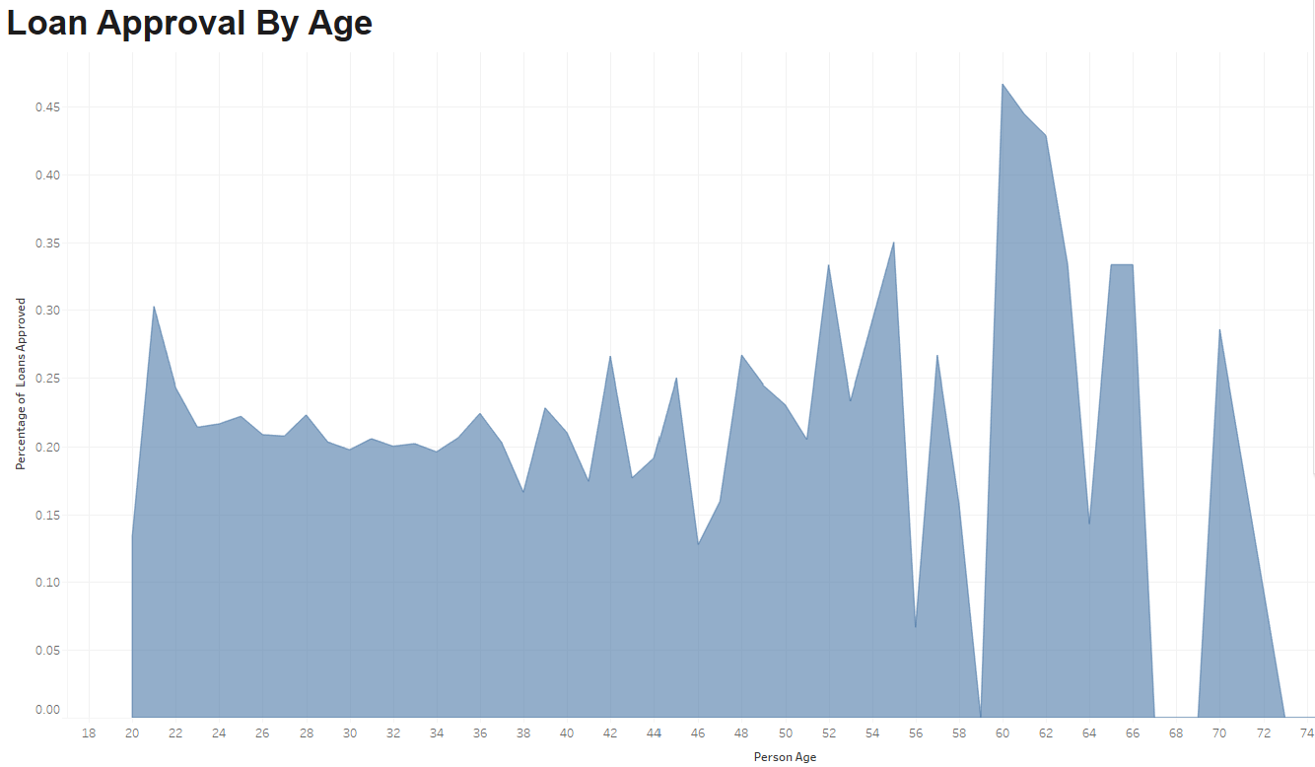
Tableau Visualizations

Slide 6
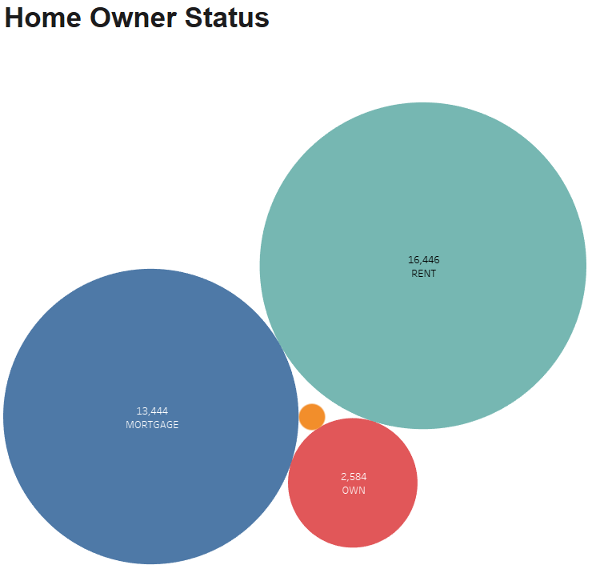
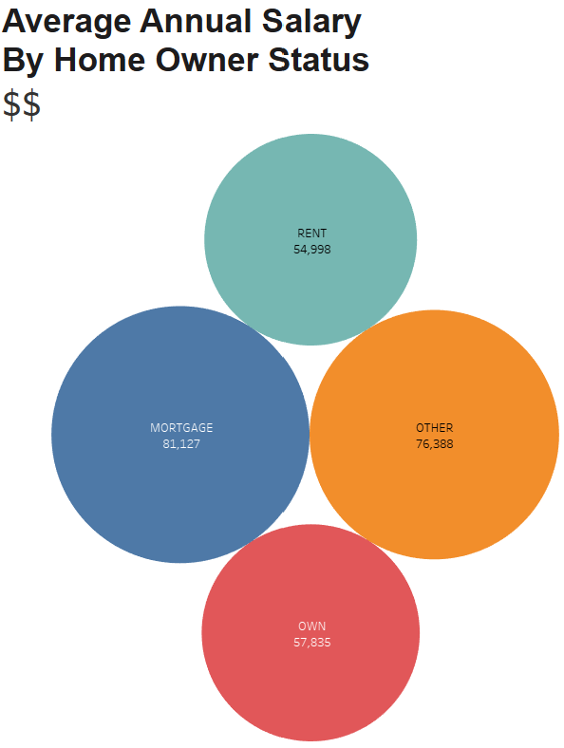

Slide 7
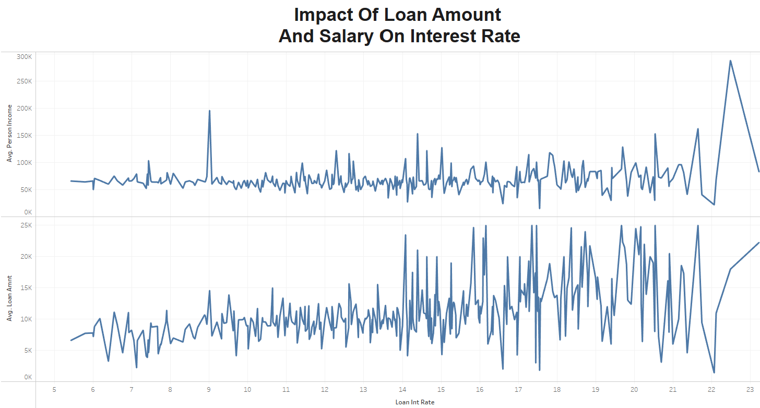

Slide 8
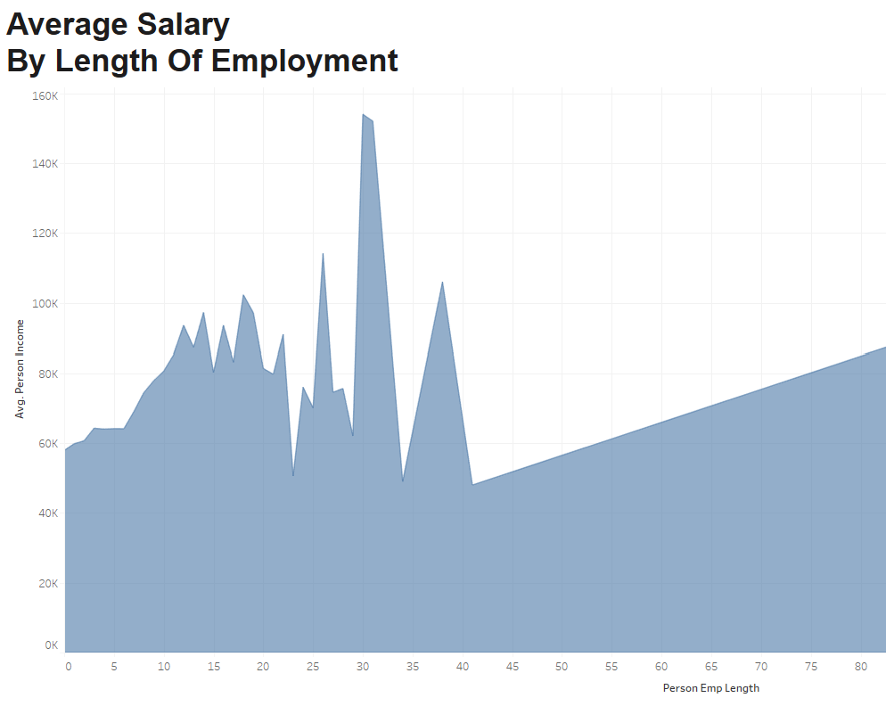

Slide 9
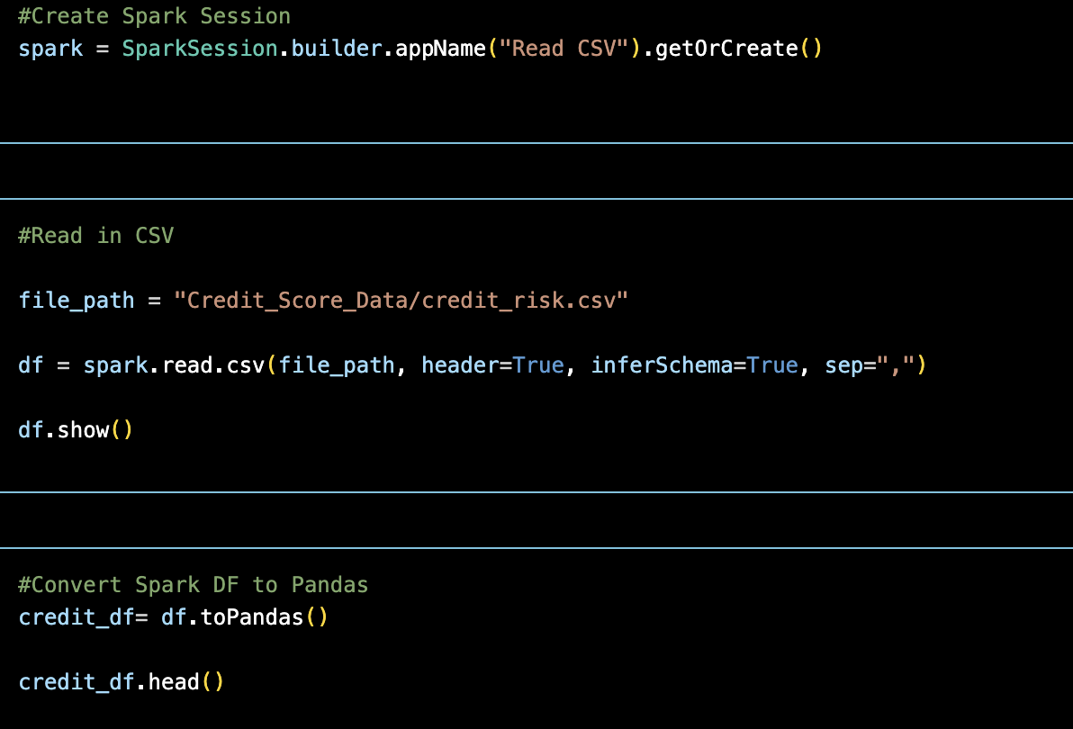
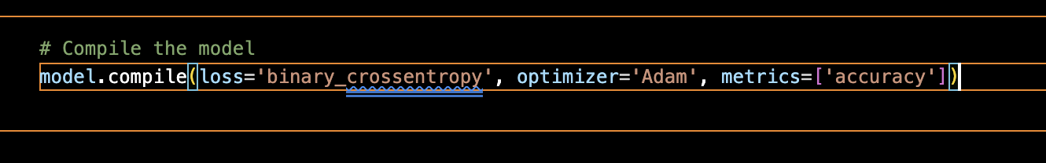

Slide 10
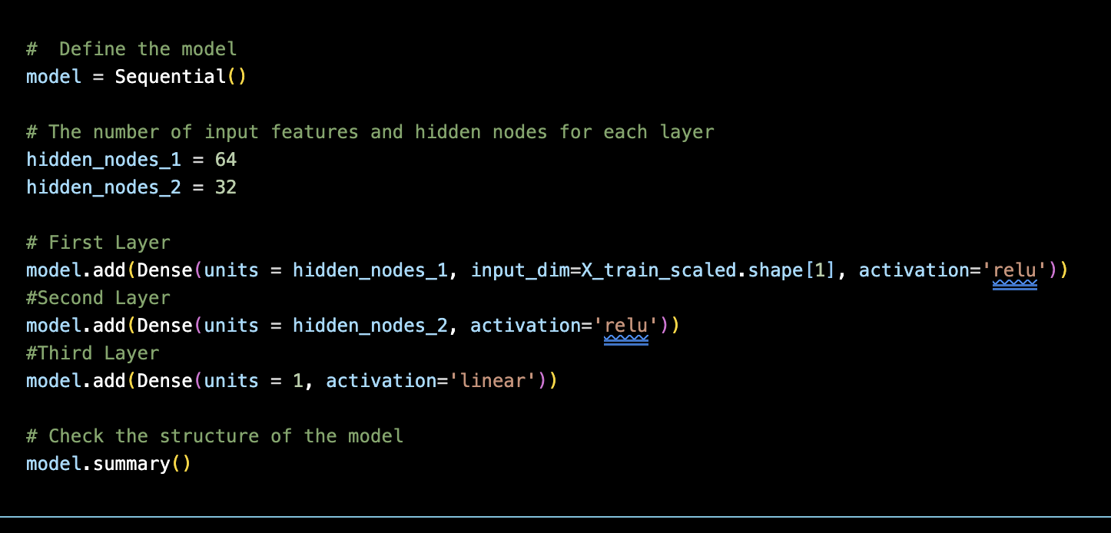

Slide 11
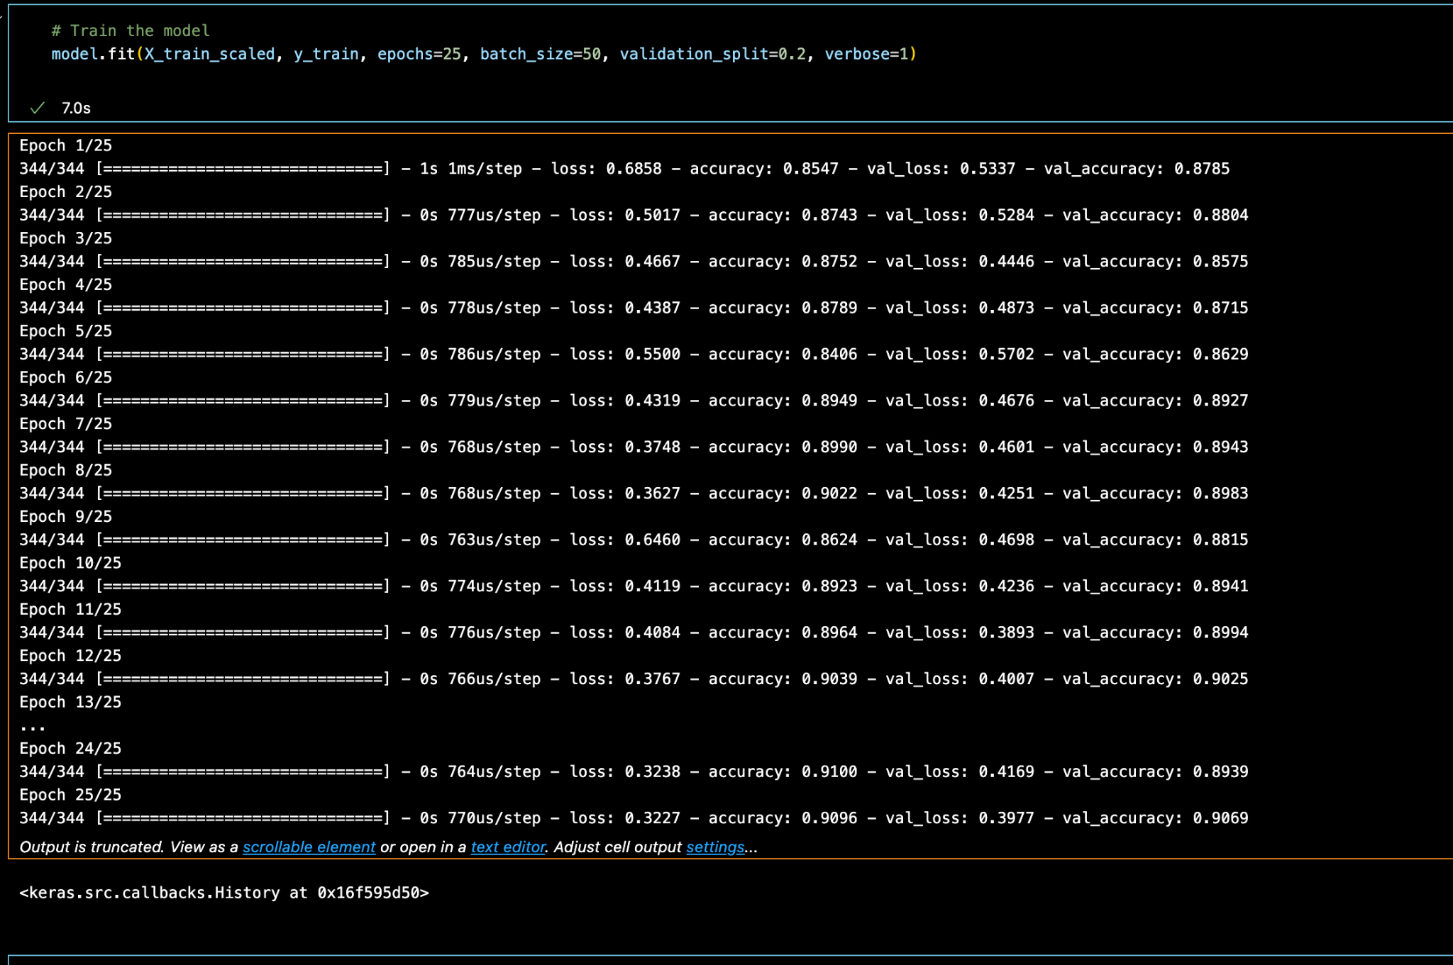

Slide 12
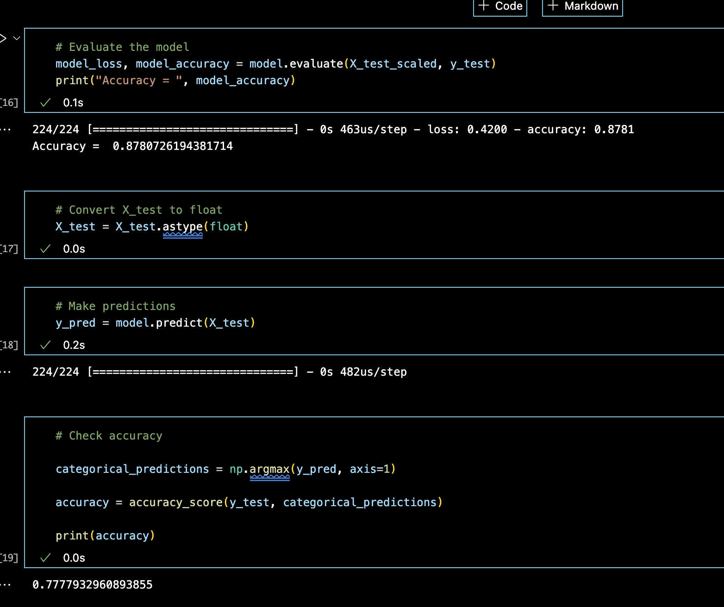

Slide 13
THANK YOU!

